Slide 1


REINFORCEMENT LEARNING · BCSE432E
RL-GAN Adaptive Image Inpainting
Damaged
RL-GAN output
A PPO agent that chooses the right repair strategy for every damaged image
PPO POLICY DECISION
Global Completion
chosen from 4 strategies in one step
Hariprasaadh K · Nithish Kumar CS
Faculty: Dr. Bharadwaja Kumar G
Notes:
Introduce the project: inpainting normally uses one fixed network for every hole. Our system keeps a strong frozen backbone and lets a PPO agent choose one of four specialised repair adapters for each image. Mention the course (BCSE432E) and the team.

Slide 2



MOTIVATION
One hole, many repair needs
Different damage calls for different repair strategies.
4
261-D
Thin scratches
strategy adapters
state per image
Seam continuity matters most
Large missing regions
Global structure must be rebuilt
1
235 ms
Textured surfaces
decision per image
per request, RTX 3050
High-frequency detail needs care
Notes:
Real damage varies: thin scratches, large missing regions, textured areas. A single fixed inpainting pass treats them all the same. We make the strategy a learned decision. Point to the four numbers: four adapters, 261-dimensional state, one decision per image, and about 235 ms per request on an RTX 3050.

Slide 3
ARCHITECTURE
Frozen
Trainable
RL controller
The inference pipeline
Damaged image
+ hole mask, 256×256
Coarse pass
Stage 1, gated conv + atrous
State builder
latent 256 + mask 4 + edge 1 = 261-D
PPO policy
action a ∈ {0, 1, 2, 3}
coarse composite
selects 1 of 4
Refine pass
Stage 2, contextual attention
Global
adapter 0
Local
adapter 1
Completed image
masked + refined × mask
Boundary
adapter 2
Texture
adapter 3
Tensors in [−1, 1] · mask 1 = hole
Notes:
Walk left to right on the top row, then the bottom row. The damaged image goes through the frozen coarse stage. Its bottleneck features plus mask statistics and a boundary-gradient value form the 261-dimensional state. The PPO policy outputs an action 0 to 3. In parallel the refine stage with contextual attention produces the refined image, the selected adapter edits it, and the result is composited back into the hole: completed = masked + refined * mask.

Slide 4



STATE
A 261-D view of the damage
256 latent features
4
1
Latent · 256
Mask stats · 4
Boundary value · 1
conv10_atrous bottleneck
96 channels
global average pool
2-layer head → 256
missing ratio
bounding-box ratio
regions count ÷ 10
centroid distance
Sobel magnitude
1-px ring outside hole
on coarse composite
scaled to [0, 1]
Notes:
The agent never sees raw pixels. The state is 256 latent values from the coarse bottleneck (96 channels, global average pooled, then a two-layer head), four mask statistics, and one boundary-gradient value computed on the coarse composite. It tells the agent how big the hole is, how fragmented, where it is, and how much structure crosses its border.

Slide 5




STRATEGIES
Four adapters, four specialities
Global
Local
Boundary
Texture
MECHANISM
MECHANISM
MECHANISM
MECHANISM
Plain residual pass
Input scaled by 1 + 0.5·mask
Blend on a dilate − erode ring
Laplacian high-pass + HF branch
TRAINING LOSS
TRAINING LOSS
TRAINING LOSS
TRAINING LOSS
L1 hole + L1 valid + VGG perceptual
6·L1 hole + SSIM-style term
Sobel gradient L1, ring weight 2.0
FFT magnitude + VGG perceptual
cost 0.00
cost 0.10
cost 0.15
cost 0.20
out = tanh( x + 0.5·tanh(Δ) ) FiLM-conditioned by a 64-D strategy embedding
Notes:
Each adapter is a small residual network on the 3-channel refined RGB output. It uses conv, instance norm and ELU with FiLM conditioning from a 64-dimensional strategy embedding, and finishes with tanh(x + 0.5*tanh(delta)). Global is the plain pass. Local scales the input by 1 + 0.5*mask. Boundary blends with a dilate-minus-erode ring. Texture adds a Laplacian high-pass term in the hole plus a small high-frequency branch. Costs 0, 0.10, 0.15, 0.20 are charged in the reward.

Slide 6



REINFORCEMENT LEARNING
A one-step contextual bandit
PPO agent
MlpPolicy
action a
Inpainting env
Gymnasium, frozen model
γ = 0
pure bandit
1 step
per episode
state s, reward r
Discrete(4)
action space
State
Action
Reward
261-D vector from the coarse pass: latent, mask stats and boundary gradient.
0 Global, 1 Local, 2 Boundary, 3 Texture. Exactly one adapter per image.
Measured gain over the coarse composite in PSNR, SSIM, LPIPS and discriminator score, minus action cost.
Notes:
Each image needs exactly one decision and its quality is known immediately, so every episode is one step with discount gamma equal to zero. The environment is a Gymnasium environment: reset samples an image and mask, runs the coarse pass and builds the state; step applies the chosen adapter, measures PSNR, SSIM, LPIPS and the discriminator score, computes the reward and draws the next sample. We train with Stable-Baselines3 PPO.

Slide 7
REINFORCEMENT LEARNING
Why a bandit, not a full MDP
MULTI-STEP MDP
CONTEXTUAL BANDIT · OURS
s₀
a0
s₁
a1
s₂
s
a
r
STOP
vs
one step, then the episode ends
Sequential edits with a STOP action
γ > 0, reward arrives late
Credit assignment across steps
One informed decision per image
Reward measured immediately
γ = 0: no credit assignment
Low-variance, fast PPO updates
The damage itself tells which adapter fits, so one informed choice is enough.
Notes:
We considered a sequential formulation: the agent applies edits step by step and emits a STOP action. That exists in the repo as env_multistep.py. For this problem the best adapter is determined by the damage itself and the quality is known immediately after one refine pass, so there is nothing to plan across steps. A contextual bandit with gamma zero removes credit assignment and gives low-variance PPO updates.

Slide 8
REWARD DESIGN
What the agent is paid for
R = α·ΔPSNR + β·ΔSSIM − γ·ΔLPIPS + δ·ΔD − λ·cost(a)
α
= 1.0
β
= 1.0
γ
= 0.5
δ
= 0.3
λ
= 0.1
ΔPSNR
ΔSSIM
ΔLPIPS
ΔDisc
Cost
÷ 10 dB, clip ±2
÷ 0.1, clip ±2
÷ 0.1, lower is better
PatchGAN confidence
0 / 0.10 / 0.15 / 0.20
Every delta is measured against the coarse composite. Total reward is clipped to ±10.
Notes:
The reward is the measured improvement of the adapter result versus the coarse composite. Each delta is normalised and clipped to plus or minus 2 so PSNR cannot dominate; the total is clipped to plus or minus 10. LPIPS is a distance so it is subtracted. The discriminator term uses a spectral-normalised PatchGAN. The cost term makes expensive adapters earn their place. Weights come from the config: 1, 1, 0.5, 0.3, 0.1.

Slide 9
REINFORCEMENT LEARNING
PPO: actor-critic with a clipped update
π(a | s)
ADVANTAGE
Actor
MLP 64 × 64
A = r − V(s)
γ = 0, so no bootstrapping
State
261-D
softmax over 4 adapters (schematic)
CLIPPED OBJECTIVE
min( ρ·A, clip(ρ, 1−ε, 1+ε)·A )
Critic
MLP 64 × 64
ρ = π_new / π_old, ε = 0.2
V(s)
TOTAL LOSS
expected reward
−L_clip + 0.5·L_V − 0.05·H(π)
entropy bonus keeps all 4 adapters in play
Notes:
Stable-Baselines3 PPO with the default MlpPolicy: two small MLPs on the 261-D state. The actor outputs a softmax over the four adapters. The critic predicts the expected reward V(s). Because gamma is zero, the advantage is simply reward minus V(s). The clipped objective keeps each policy update close to the previous policy, with the clip range at the SB3 default of 0.2. An entropy bonus of 0.05 keeps the agent exploring all four adapters; the value loss is weighted 0.5 and gradients are clipped at 0.5.

Slide 10


TRAINING
Two stages, backbone never updated
1
Adapter pretraining
2
PPO bandit training
COCO val2017, random stroke masks
Own loss for each adapter
Adam 1e-4, batch 4, 5 epochs
verify gate
Stable-Baselines3 PPO, γ = 0, seed 42
Backbone and adapters frozen
lr 3e-4, entropy coef 0.05
no strategy > 80%
ONE PPO ITERATION
Rollout
Advantage
Update
Log
128 one-step episodes
A = r − V(s)
4 epochs × batch 32
actions + reward terms
Notes:
Stage 1 pretrains the adapters on COCO val2017 resized to 256, with random irregular stroke masks generated on the fly; each adapter has its own loss. A verification gate checks that no single strategy wins more than 80 percent of images. Stage 2 freezes everything except the policy and trains PPO. Each PPO iteration collects 128 one-step episodes, computes advantages, then runs 4 epochs of minibatch updates of size 32. A callback logs the action distribution and every reward component to TensorBoard. Seed 42 throughout.

Slide 11
RESULTS
Adapters lift PSNR by up to 5.9 dB
+5.9 dB
peak gain, stage D on the meadow
+0.8 dB
Global adapter on lake and meadow
0.9946
best SSIM, sunset peaks
A to C: one feed-forward pass. D: adds 400 AdamW steps on the test image.
Notes:
PSNR in dB across three hand-masked scenes. The fixed Global adapter lifts the alpine lake and meadow by about 0.8 dB. On the meadow the PPO agent chose the Global adapter, giving +0.82 dB with no ground truth. Stage D shows the capacity of the adapter structure: 37 to 43 dB, up to +5.9 dB over the backbone, with SSIM up to 0.9946. Stage D uses the ground truth, so present it as the upper reach of the adapters.

Slide 12

WHY ADAPTIVE
Different images favour different adapters
Best per image
Global
2 images
Local
3 images
The right strategy depends on the image, so a learned selector has real work to do.
Notes:
Per-image PSNR for the four adapters on five verification images. The best adapter changes from image to image: Global wins two, Local wins three. No strategy takes more than 80 percent of images, which is exactly the condition a learned selector needs: the right choice depends on the image. This is the motivation for a state-conditioned PPO policy.

Slide 13













VISUAL RESULTS
From damaged input to completed image
Ground truth
Masked
A Backbone
C PPO-selected
D PPO + refine
Alpine lake
PPO: Boundary
34.45 dB
32.25 dB
37.23 dB
Lush meadow
PPO: Global
33.72 dB
34.54 dB
39.65 dB
Sunset peaks
PPO: Boundary
40.58 dB
36.80 dB
43.19 dB
Notes:
Three scenes, left to right: ground truth, masked input, backbone only (A), PPO-selected adapter (C), and PPO plus refinement (D). The PPO agent chose Boundary for the lake and sunset scenes and Global for the meadow. Stage D visibly tightens colour and texture inside the hole.

Slide 14
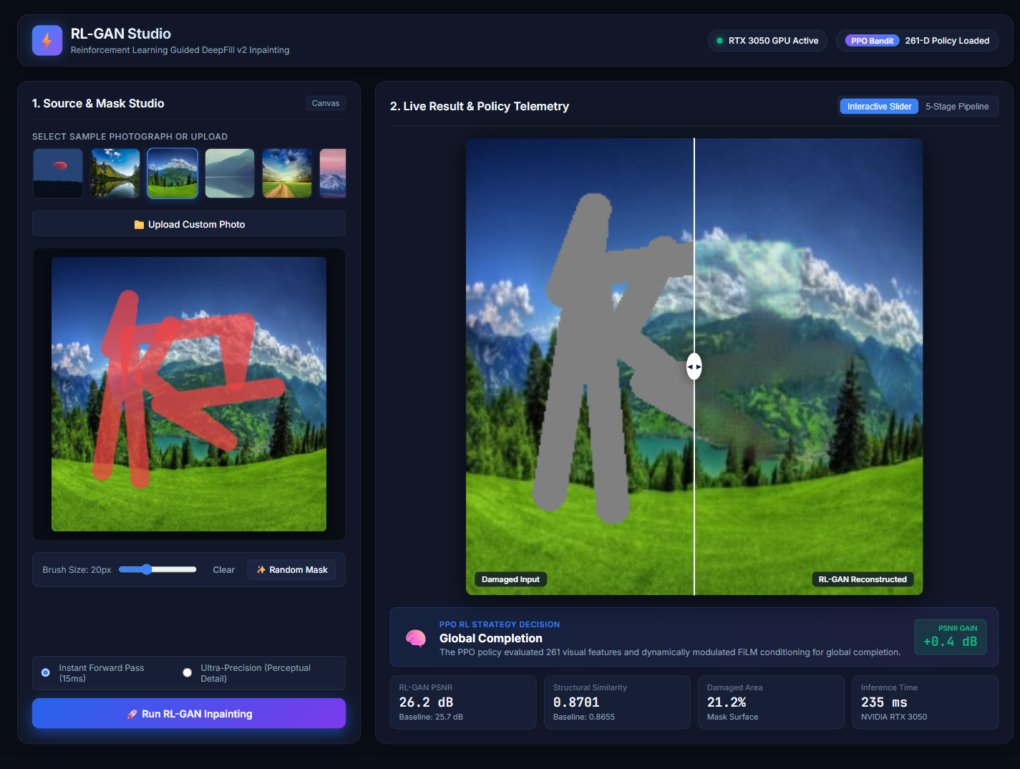

LIVE DEMO
RL-GAN Studio: draw, run, compare
Paint the hole
Brush canvas, random masks, or upload a photo.
See the decision
Strategy chosen by PPO and PSNR gain over baseline.
Compare instantly
Split slider and a 5-stage pipeline view.
Two modes
Instant ~235 ms, or Ultra-Precision with 60-step tuning.
Notes:
A browser studio served by app.py on port 7860. Draw a mask or load a preset, press Run. The server runs the coarse pass, builds the 261-D state, asks PPO for the action, computes a backbone baseline and the adapter result, and returns PSNR/SSIM with the decision. Instant mode takes about 235 ms warm on an RTX 3050; Ultra-Precision adds 60 AdamW steps on the chosen adapter and then restores the weights.

Slide 15



KEY TAKEAWAYS
Learn to choose the repair
Strong prior kept
Four specialists
Frozen Places2 DeepFill-v2 backbone.
Residual adapters with their own losses.
Cost-aware PPO
Interactive studio
One-step bandit over a 261-D state.
Mask, decide, compare in about 235 ms.
Thank you · Questions?
Hariprasaadh K · Nithish Kumar CS
Notes:
Close with the four takeaways and invite questions. Mention the repository has docs for architecture, training, evaluation and the studio, plus a 24-page report.

