Slide 1
EGPA
ENTERPRISE GOVERNANCE PLATFORM FOR AI
A real, working control plane — problem statement to governed, running agent, with enforced sign-off and a runtime kill-switch at every stage.
Product & Architecture Overview · August 2026

Slide 2
THE PROBLEM
Governance can't keep up with how fast teams want to build AI agents
1
2
3
Speed vs. review
No enforceable record
Two bad outcomes
Business units want to build agents fast, in whatever framework fits — central risk teams can't review that volume by hand.
A wiki page or a Slack approval thread leaves nothing that proves, after the fact, a control was actually satisfied.
Either governance becomes a bottleneck teams build around, or it stays paper-thin and doesn't survive an audit.
EGPA — Enterprise Governance Platform for AI
1

Slide 3
HOW WE ARRIVED AT EGPA
Problem discovery and validation
What follows is the reasoning that precedes the product — included so the decision is auditable, not just the outcome.
WHO WE'D TALK TO
ASSUMPTIONS TO TEST BEFORE CONFIRMING ANY SOLUTION
Enterprise Architecture & platform engineering — who own whatever gets built Risk, Compliance & Legal — who own what "acceptable" means Business-unit technology leads — who own the actual demand Existing GRC/ITSM platform owners, and a real sample of requesters
Existing GRC/ITSM genuinely can't absorb AI-specific risk without disproportionate custom work Request volume genuinely exceeds what manual review can sustain Business units will actually route through central intake, not build around it Risk can be meaningfully computed from a questionnaire, not just expert judgment
EGPA — Enterprise Governance Platform for AI
2

Slide 4
HOW WE ARRIVED AT EGPA
Three genuinely different options — not just technologies
A
B
C
Extend existing platforms
Buy an established product
Build a dedicated platform (EGPA)
Add an "AI use case" request type, a risk questionnaire, and an approval workflow to whatever GRC and ITSM tooling the org already runs.
Procure a commercial AI/model-risk-governance platform and configure it to the org's control requirements.
Purpose-built control plane, tailored to the org's own risk taxonomy, coupled directly to its own AI Gateway and execution substrate.
EGPA — Enterprise Governance Platform for AI
3

Slide 5
HOW WE ARRIVED AT EGPA
Options and trade-offs
THE PATH WE CHOSE
DIMENSION | EXTEND | BUY | BUILD (EGPA)
Implementation time | Fastest — reuses an existing engine | Medium — vendor config + integration | Slowest to first value, sequenced on our own terms
Cost profile | Lowest incremental — licensing sunk | Recurring license, per-seat/model | Upfront investment, no license, internal ownership
Integration complexity | Low, but AI runtime concepts aren't native | Medium-high — vendor didn't design for our Gateway | Low, by construction — built around our own stack
Flexibility | Constrained to the host platform | Configurable, but core logic is vendor-owned | Highest — shaped exactly to the org
Operational ownership | Existing GRC/ITSM team — no new team required | Vendor owns the product; we own configuration + risk mapping | New internal platform team — built and run by us, long-term
Regulatory control | General-purpose control language | Compliance-aware, but generic | Highest — maps to specific regulation (roadmap item)
Scalability | Not built for real-time runtime supervision | Bound to vendor's own AI roadmap | Purpose-built for kill-switch/streaming/audit
EGPA — Enterprise Governance Platform for AI
4

Slide 6
HOW WE ARRIVED AT EGPA
When build wins, and when it doesn't
BUILD EGPA WHEN
BUY OR EXTEND WHEN
Runtime enforcement is a hard requirement — a kill-switch that actually halts execution, live tool-call auditing The org already runs its own AI Gateway that governance needs to couple tightly to The risk taxonomy is specific enough that a generic product's ceiling is hit fast There's genuine, sustained capacity to build and maintain it
AI initiatives are early-stage or low-volume — a lightweight extension is enough There's no in-house AI Gateway yet — nothing for a build to attach to Speed to basic governance matters more than depth The org lacks sustained platform-engineering capacity to maintain a bespoke system
EGPA — Enterprise Governance Platform for AI
5

Slide 7
HOW WE ARRIVED AT EGPA
An incremental path, not a big-bang cutover
0
1
2
3
4
Current state
New use cases only
Retroactive governance
Bring validation in-house
Consolidate
Ad hoc AI use cases, informal approvals, no consistent audit trail
Route new work through EGPA alongside what exists — nothing force-migrated
High-risk existing use cases governed via preflight-check + reconciliation, no rebuild
Once trusted, validate new builds through EGPA's own execution engine
Retire legacy approval processes; integrate with GRC/ITSM for cross-reference
EGPA — Enterprise Governance Platform for AI
6

Slide 8
WHAT EGPA IS
Control Plane, not Data Plane
EGPA governs how AI agents get built and run — it doesn't sit in the live traffic path itself.
CONTROL PLANE — EGPA
DATA PLANE — AI GATEWAY
Risk templates & scoring Approval workflows & sign-off Model registry Architecture Decision Records Audit trail & kill-switch
Self-hosted LiteLLM Proxy Google Cloud Run Every live LLM call routes here Automatic multi-provider fallback One scoped virtual key, no raw provider keys
EGPA — Enterprise Governance Platform for AI
7

Slide 9
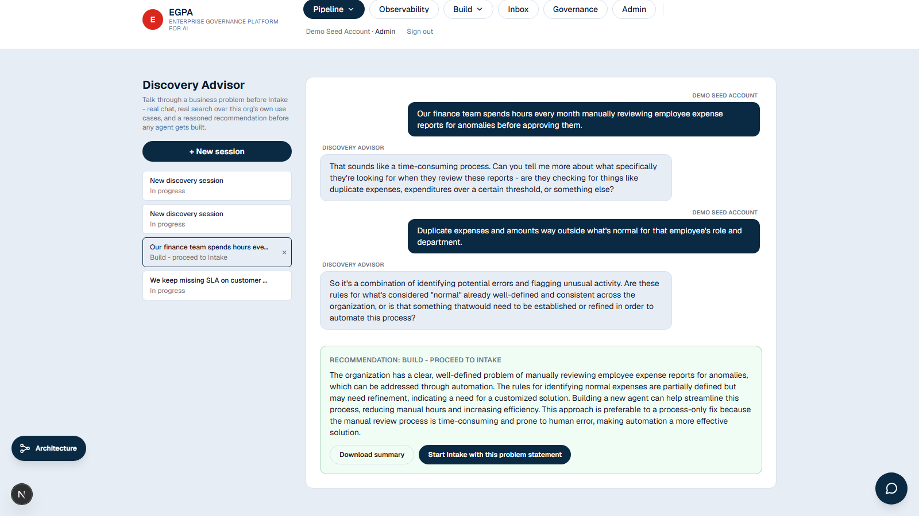
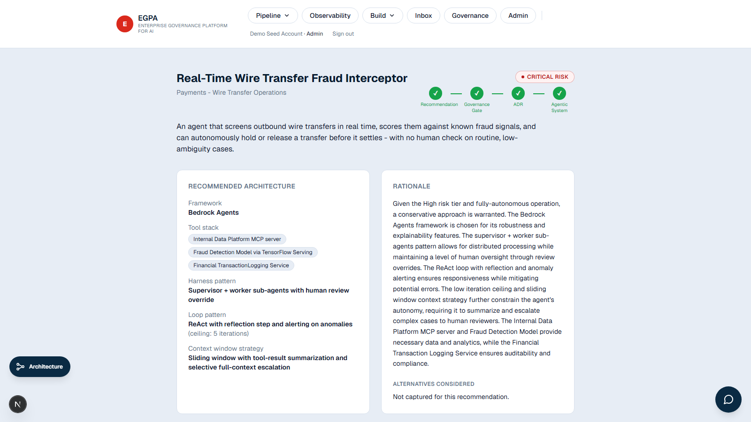
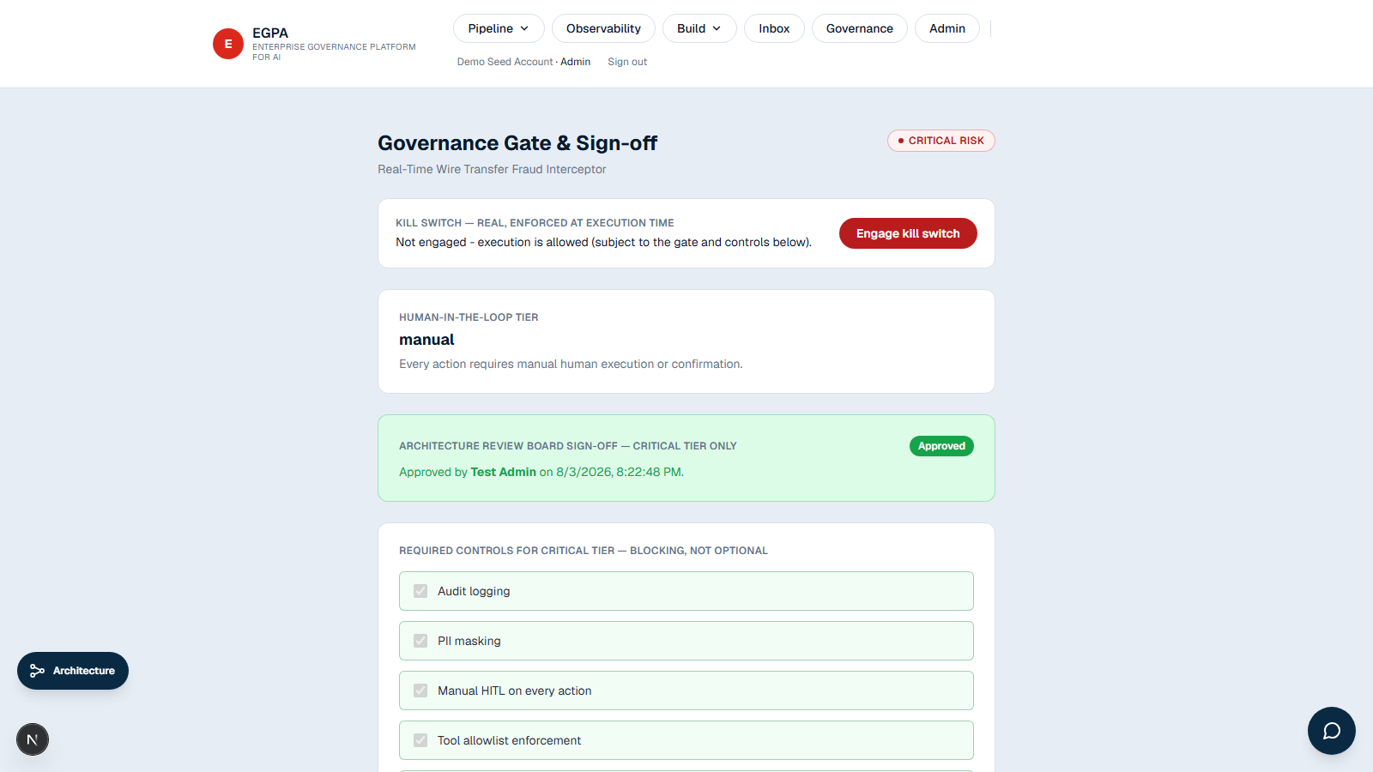
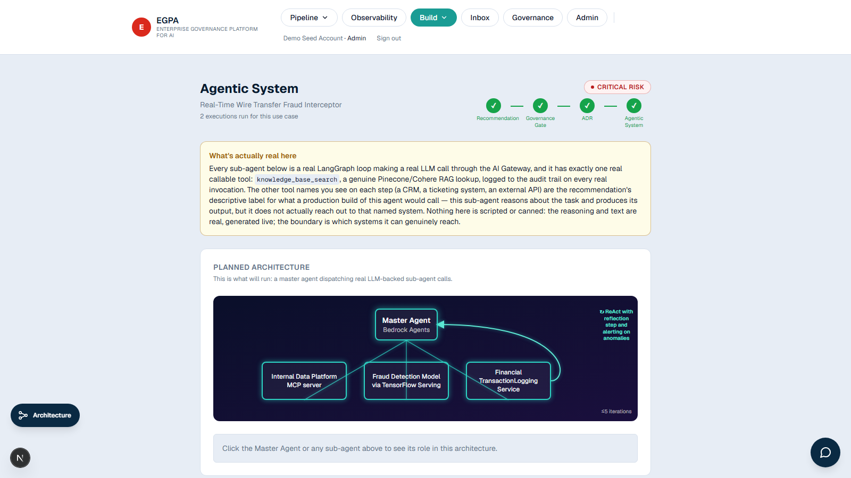
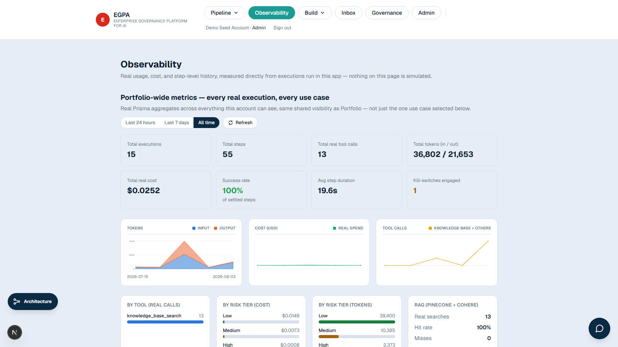
THE PIPELINE
Seven real stages, one enforced sequence
1
2
3
4
5
6
7
Discovery
Intake
Recommendation
Governance Gate
ADR
Agentic System
Observability
Real chat, questions the build-an-agent default
Risk & compliance profile, live risk-tier scoring
Real LLM architecture proposal + alternatives
Required controls + real ARB sign-off, kill-switch
Versioned decision record, auto-assembled
Real multi-agent run, streamed, real tool calls
Portfolio-wide real cost, usage, decision trail
HOW AN IDEA BECOMES A GOVERNED, RUNNING AGENT
1. Idea
2. Use Case
3. Governance Gates
4. Agentic Run
5. Observability
A real chat questions the build-an-agent default before anything else.
Intake creates the record; a real LLM call proposes the architecture.
Required controls + real sign-off enforced before anything can proceed.
A real multi-agent execution, streamed live, with genuine tool calls.
Portfolio-wide real cost, usage, and decision trail — nothing simulated.
EGPA — Enterprise Governance Platform for AI
8

Slide 10
GOVERNANCE & SECURITY
Enforced at runtime — not declared in a policy document
Kill-switch
Segregation of duties
Tamper-evident audit log
Server-enforced; actually blocks the next execution step.
An owner can never clear their own ARB sign-off.
SHA-256 hash chain — editing history breaks verification.
PII detection & redaction
Tool allowlist enforcement
Data retention enforcement
Runs against every real sub-agent step output.
Enforced server-side, not just documented as a plan.
Scheduled purge on each use case's declared window.
Preflight policy-check API
Declared-vs-actual reconciliation
Multi-tenancy + SSO
Real-time check for agents running outside this platform.
Flags any deviation from what was declared, after the fact.
Business-unit scoping, enforced server-side; Google OIDC.
EGPA — Enterprise Governance Platform for AI
9

Slide 11
Overall Platform Architecture
End-to-end view · Every layer real, deployed, and named — the full technology stack in one diagram
GOVERNANCE & IDENTITY — Auth.js v5 (credentials + Google OIDC SSO) · Real Organization / business-unit tenancy · 6 roles, server-enforced · Segregation of duties
DEPLOYMENT & RUNTIME — Vercel (Next.js app) · Google Cloud Run (AI Gateway container) · Neon Postgres (serverless) · Upstash Redis (rate limit, presence, SSE)
APPLICATION LAYER
AI GATEWAY & AGENTS
RAG & KNOWLEDGE
→ Next.js 16, React 19, TypeScript, Tailwind v4
→ One API route per pipeline stage
→ Prisma ORM -> Neon Postgres
→ Real-time SSE broadcast
→ Self-hosted LiteLLM Proxy (Cloud Run)
→ Anthropic -> Groq -> Gemini -> OpenRouter fallback
→ LangGraph + LangChain sub-agent execution
→ Token-by-token streaming
→ Pinecone vector index
→ Cohere embeddings
→ Namespace: governance docs
→ Namespace: in-app help docs
ACCESS CONTROL & AUDIT — Session-based RBAC · Scoped API keys (read/write) · SHA-256 hash-chained tamper-evident audit log
MONITORING & ALERTING — Real-time Observability dashboard · Slack notifications · Production error monitoring
10

Slide 12
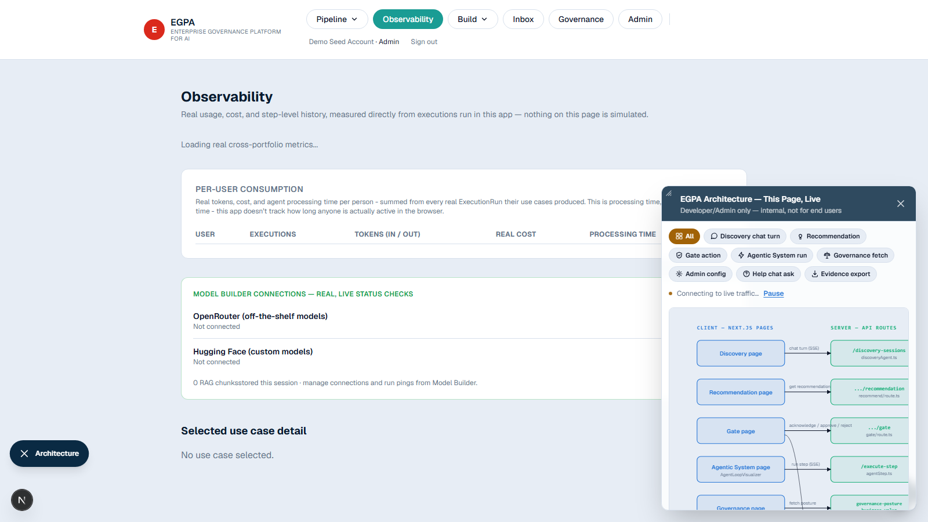
ARCHITECTURE
The real architecture diagram — straight from the app
Live and filterable by real request flow, visible to Developer/Admin roles — not a static export made for this deck.
EGPA — Enterprise Governance Platform for AI
11

Slide 13
ROLES & ACCESS
Six roles, one shared record
ROLE | PAGES | WHAT THEY GET
Requester | Intake, Portfolio | Turn an idea into a governed, documented use case
Steward / Architect | Recommendation, Guide | Validate architecture against real constraints
Governance Owner | Gate, ADR | Enforce controls; can halt a live execution
Developer | Agentic System, Observability | Run approved use cases; wire up webhooks
Review Board (ARB) | Gate (Critical tier) | The one sign-off nothing else can substitute for
Admin | Everything | Full access, every role's view
EGPA — Enterprise Governance Platform for AI
12

Slide 14
REAL BUSINESS VALUE
Not a projection — live numbers off this platform's own database
Tied directly to the outcome categories a real adoption case needs to justify itself against:
31.8 hr
100%
$399
9
7.5 hr
Reduced approval time
Improved reuse
Lower delivery cost
Reduced compliance exposure
Faster to production
avg. Intake -> Gate cleared
Discovery sessions that avoided a rebuild
real cost saved vs. declared baseline
incidents caught & logged to audit
avg. Intake -> first execution
16 real agent executions · 58 sub-agent steps (100% settled) · 13 real RAG searches (100% hit rate) — these figures grow with every real use case run through the platform, never reset or curated for presentation.
EGPA — Enterprise Governance Platform for AI
13

Slide 15
HONEST SCOPE
What's real, and what isn't
✓ GENUINELY REAL
○ DELIBERATELY OUT OF SCOPE
Real database, real auth (local + Google SSO) Real tool-calling agents, token-by-token streaming Real live multi-user sync, no refresh needed Real runtime governance — audit log, allowlist, kill-switch Real deployment: Vercel + Cloud Run + Neon + Redis
No real external system integrations — that's the org's own engineering work, informed by the ADR this platform produces. EGPA's own execution engine is a validation sandbox, not a production host — it validates the recommended pattern and governance behavior, not a live workload.
EGPA — Enterprise Governance Platform for AI
14

Slide 16
PHASED IMPLEMENTATION
No invented dates — sequenced by what deepens governance first
A single-team roadmap can't credibly commit to a quarter, so this is grouped by sequencing, not promised timing.
DELIVERED — MVP, LIVE TODAY
NEXT — DEEPENS GOVERNANCE
LATER & HARDENING
Full pipeline, Discovery through Observability
Real runtime governance: kill-switch, audit log, PII redaction
Real multi-tenancy, SSO, AI Gateway with fallback
Preflight-check + reconciliation APIs
Governance templates per regulatory regime
Configurable PII patterns per org/region
Regulatory citation mapping
Incident workflow tied to the kill-switch
Aggregate portfolio risk rollup
Intake & reference architecture templates
Vendor/model blast-radius reverse lookup
Configurable approval workflows per org
Broader test coverage, accessibility audit, SCIM, per-tenant branding
EGPA — Enterprise Governance Platform for AI
15

Slide 17
Governance as the fast path,
not the bottleneck
Risk assessment, sign-off, and audit — enforced, automatic parts of the same pipeline a team already uses to design their agent.
A real, running system — independently verifiable end to end.

