Slide 1


Music Fest

Slide 2

Music Fest
Welcome To Our
MUSIC FEST
Start Slide

Slide 3
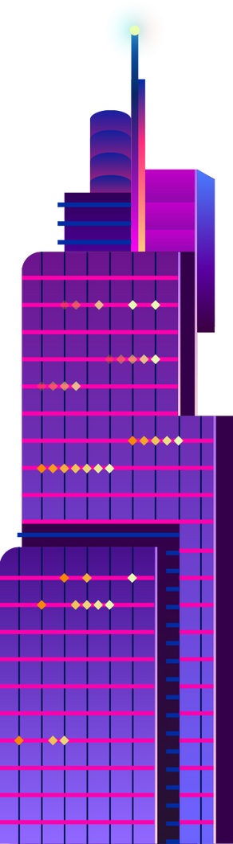
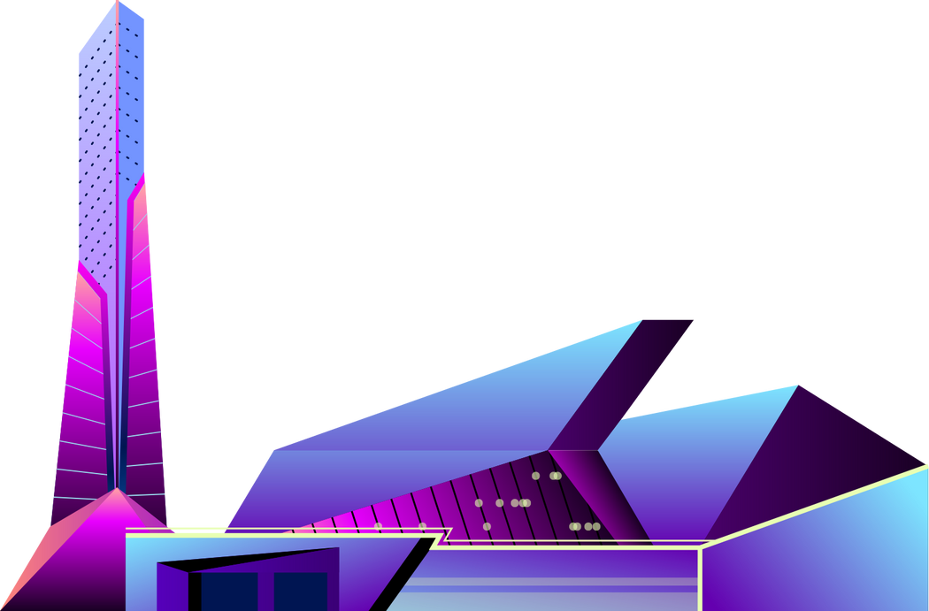
Music Fest
EVENT OVERVIEW
Mini music player with favorites using HTML, CSS, and JS.
This is a simple, lightweight music player built using HTML, CSS, and JavaScript. It features core audio playback functionality with a clean, centered UI and a floating favorites list on the top-right. Users can:
Play, pause, skip forward or backward through songs.
View current song details (cover + title).
Mark songs as favorites.
View and play songs directly from their favorites list.

Slide 4
Music Fest
PROBLEM STATEMENT
To design and develop a simple, browser-based music player that allows users to play songs, navigate between tracks, and manage a list of favorite songs — all without needing a backend or user login system. The player should be lightweight, responsive, and easy to use.
This project aims to design and implement a mini music player using HTML, CSS, and JavaScript, that provides essential audio playback features while maintaining a clean, simple user interface. The player will also allow users to add and access favorite tracks, offering a personalized yet local experience without any backend or database integration.

Slide 5

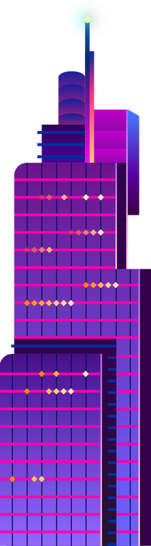

REQUIREMENTS
Music Fest
Software Requirements
HTML5 : Page structure
CSS3 : Styling and layout
JavaScripT : Player functionality & logic
Browser : Any modern browser (Chrome, Firefox,)
Text Editor : VS Code / Sublime Text / Notepad++
Hardware Requirements
Component Specification
Device : PC/Laptop/Mobile
RAM : Minimum 2GB
Storage : Few MBs(for songs/images)
Browser : Latest version (Chrome, Edge,ext)
Internet : Only required for hosting/upload

Slide 6
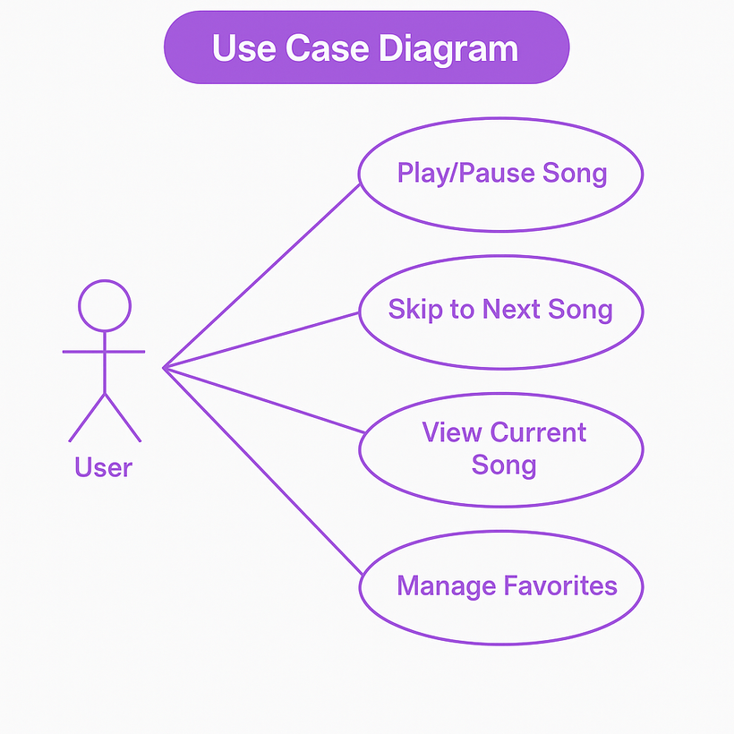
USE CASE DIAGRAM
Music Fest

Slide 7
Advantages and Disadvantages
Music Fest
Advantages
Simple and Ligthweigth
user-Friendly Interface
Favorites Feature -revisit Favorites song quickly
Offline Support
Customizable and Expandable
Disadvantages
No Real-Time Streaming
No User Authentication
Limited Storage
No Cloud Sync
Basic UI/UX-Application like Spotify or Apple Music.

Slide 8
Music Fest
SAFETY FIRST
1.Create Playlist:
Let user make their own mi=usic playlist
2.Upload Songs:
Allow users to add their own MP3 files
3.Online Music:
Add support to stream songs from the internet
4.Save Favorites Premanently:
Store favorite songs using local storage or database
5.user login:
Add login/singup so users can save their songs

Slide 9
CONCLUSION
Music Fest
The Mini Music Player with Favorites is a lightweight and user-friendly web application that demonstrates how core web technologies — HTML, CSS, and JavaScript — can be combined to create a functional and interactive media player. It allows users to play songs, navigate between tracks, and save their favorite music without the need for login or backend support.
This project showcases the fundamental principles of frontend development, such as DOM manipulation, event handling, and responsive design. Although simple, it lays a strong foundation for building more advanced music applications with features like playlist management, streaming support, and user authentication.

Slide 10
Music Fest
THANK YOU
For Your Attention
See You Next

