Slide 1


Carbon Emission Tracker For Your Daily Commutes.
From Team Titans

Slide 2

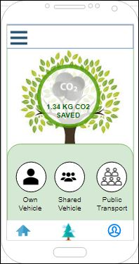
Home Page
The Home screen shows the total amount of Carbon saved by the user from the time of installation of the application.
There are 3 options available for the user to select the type of commute to be started.
  Own Vehicle
  Shared Vehicle
  Public Transport

Slide 3
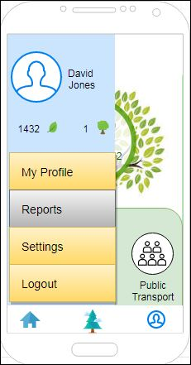
User Profile
The User Profile screen can be seen by clicking the hamburger icon on the top left.
This screen displays the User Name & display picture along with the leaves collected, trees made and also the below menu items.
  My Profile
  Reports
  Settings
  Logout

Slide 4
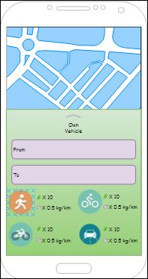
Own Vehicle
The Own Vehicle lay over appears on selecting the ‘Own Vehicle’ option from the home page.
The user can select the source, destination and type of commute.
This enables the application to calculate the carbon emissions based on the selected choice.

Slide 5
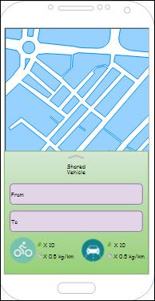
Shared Vehicle
The Shared Vehicle lay over appears on selecting the ‘Shared Vehicle’ option from the home page.
The user can select the source, destination, number of occupants and the type of commute.
This enables the application to calculate the carbon emissions based on the selected choice.

Slide 6
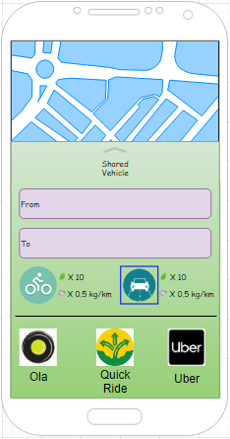
Shared Vehicle
Once the user selects an option from the shared vehicle lay over, the application shows the available, integrated vehicle pooling apps right under neath.
The user can choose an app of his choice for the commute and start the ride.

Slide 7
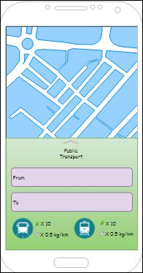
Public Transport
The Public Transport lay over appears on selecting the ‘Public Transport’ option from the home page.
The user can select the source, destination and type of commute.
The number of occupants for this type of commute is taken as an average value. i.e.., 50 for bus and 150 for train.
This enables the application to calculate the carbon emissions based on the selected choice.

Slide 8
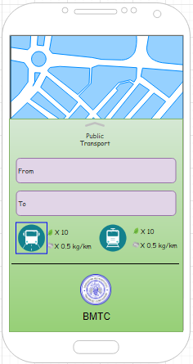
Public Transport
Once the user selects an option from the public transport lay over, the application shows the available public transport apps based on the user location.
This enables the user to check out the timings for the available public transport options through the route selected.
This example shows the apps available on selecting 'Bus' as a commute mode.

Slide 9
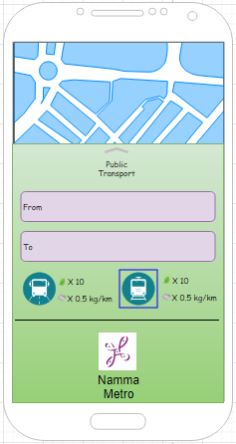
Public Transport
This example shows the apps available on selecting 'Train/Metro' as a commute mode.

Slide 10
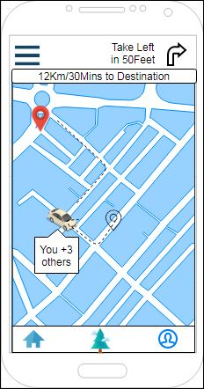
On Commute
The on-commute screen appears as the user completes selecting the type of commute.
The user can track the distance and time left to reach the destination along with the count of accompanying passengers..
This screen also displays the turn by turn navigation to the user..

Slide 11
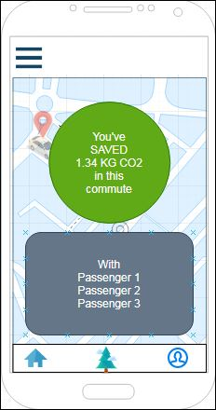
On Commute
Completion
The Commute Completion screen appears as the user reaches the destination.
The total amount of carbon saved during the commute is displayed on the screen along with the accompanying passenger list.

Slide 12
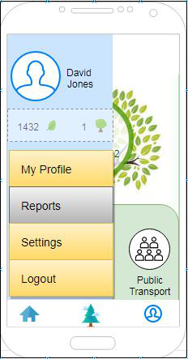
Create a Tree
To create a tree from the leaf points accumulated, the user needs to click on the leaf points from 'My Profile' section.
The user can select the 'Create a Tree' button to convert his leaf points to tree.
A tree can only be created with a minimum of 1000 leaf points.
For every tree created in the app a real tree/plant will be planted and taken care of.
This is in collaboration with the local NGOs, schools, universities and govt bodies.

Slide 13
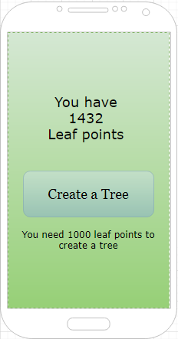
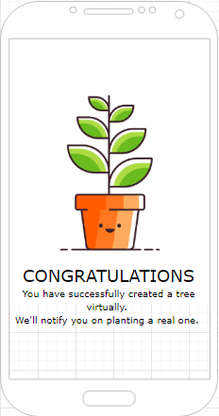
Create a Tree

Slide 14
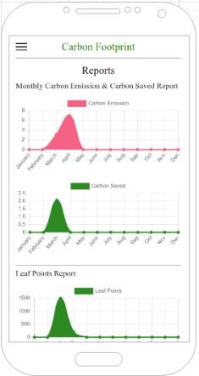
Reports
Users can access the reports from the Reports menu under User Profile screen.
User can view the weekly, monthly and yearly reports for carbon emissions, carbon savings and the leaf points collected.

Slide 15
Data Privacy
Users Profile captured in the application is secured in Rest and In-motion.
Data in Rest is secured using AES-256-GCM Encryption.
Data in motion is secured using SSL \ TLS .
Partner Services will be provided with minimal attributes from Users profile to facilitate collection of data towards carbon footprint.

Slide 16
Let’s start tracking our Carbon Footprints with
‘My Tanso’.

