Slide 1
REIMBREIMBURSEMENTREIMBURSEMENT PROCESS PROCESSURSEMENT PROCESS

Slide 2
REIMBURSEMENT PROCESS
EMPLOYEE REIMBURSEMENT MODULE

Slide 3
ABSTRACT
The expense claim an expense claim typically refers to a formal request for reimbursement of expenses incurred by an individual while conducting business on behalf of a company or organization
Expense claims are reimbursement requests filed by employees for out-of-pocket expenses incurred during business activities, covering travel, meals, accommodation, transportation, office supplies, and other necessary expenditures
This process is necessary in companies where employees don't have access to corporate funds. The employee incurs a cost on their personal credit card or through cash and then submits an expense claim form
The manager verifies the employee expense details then the admin verify the manager details,.

Slide 4
OBJECTIVE
The objective of the Automated Expense Reimbursement Project is to provide the State with a comprehensive solution for effectively managing the travel advance and expense reimbursement program
Here in this work employee, manager, and admin are the main contributors to maintaining company expense

Slide 5
INTRODUCTION
In the dynamic landscape of business operations, managing and streamlining expense reimbursement processes is a critical aspect of financial efficiency and employee satisfaction.
The Reimbursement Module, a fundamental component within our comprehensive system, is designed to simplify and expedite the reimbursement workflow, ensuring accuracy, transparency, and compliance with organizational policies
Employees can submit reimbursement requests seamlessly through a user-friendly interface. The module eliminates cumbersome paperwork, enabling a swift and paperless submission process.

Slide 6
EXISTING SYSTEM
In an existing system, it typically refers to the current setup, software, processes, or infrastructure already in place within an organization or a specific context.
reimbursement module or any other software component, it involves detailing the current software or process in place for managing reimbursements.
This includes its functionalities, user interface, integration capabilities, any limitations, and the overall effectiveness in meeting the organization's needs.

Slide 7
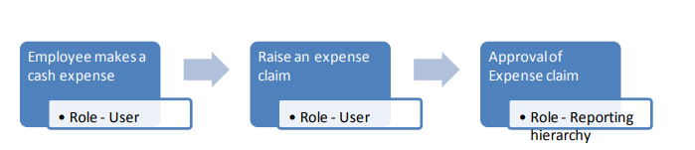
EXISTING SYSTEM

Slide 8
PROPOSED SYSTEM
The proposed system our Reimbursement Module is a cornerstone of our commitment to efficiency, accuracy, and employee well-being
Implement a system that allows employees to submit claims digitally, automatically routing them to the respective approvers based on predefined criteria or hierarchies
Allow administrators to define and customize expense categories easily, catering to specific organizational needs and policies.

Slide 9
Provide a dashboard or notification system that allows employees to track the status of their reimbursement requests in real time, reducing inquiries and enhancing transparency.
Build functionalities that automatically check submitted expenses for compliance with company policies and regulations before approval
Develop a mobile-friendly version or app that allows users to submit expenses on the go, capturing receipts via photo upload, if possible

Slide 10
Advantages
Time consuming
More secure
Effortless Submission

Slide 11
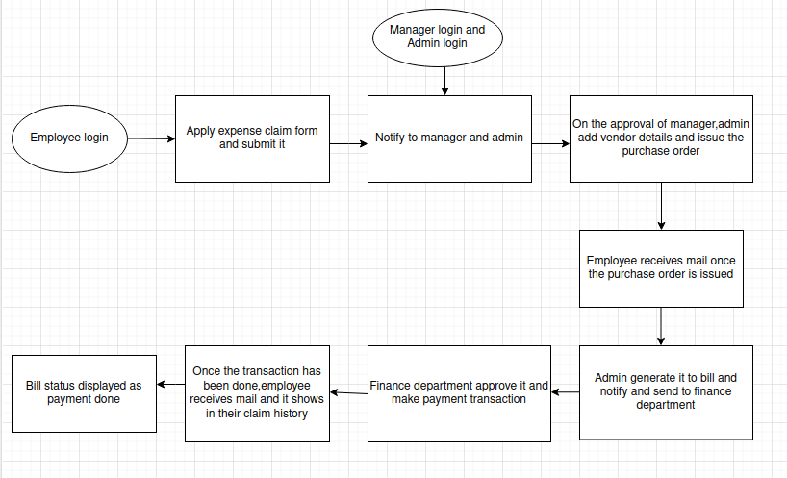
ARCHITECTURE DIAGRAM

Slide 12
MODULES
Employee
manager
Admin

Slide 13
SYSTEM REQUIREMENT
Hardware Requirements
Processors : Intel® Core™ i5 processor,8 GB of Ram
DRAMDisk space : 320 GB
Operating systems : Windows® 10, macOS*, and Linux*
Software Requirements
Server Side : Python 3.7.4(64-bit) or (32-bit)
Client Side : HTML, CSS, Bootstrap ,react ,node js
IDE : django
Back end : MySQL 5.
Server : Wampserver 2i

Slide 14
REFERENCES
https://www.zoho.com/in/expense/expense-management software/?campaignid=18945127139&adgroup=156530122035&keyword=expense%20management%20solutions&network=g&device=c&matchtype=p&placement=&adposition=&creative=681292034090&gclid=CjwKCAiA1 6sBhAoEiwArqlGPicC2LQHuMhgPvefawljZ9UJMfVVw3neqobTDlUquDYo1ZJIGYocahoClrwQAvD_BwE
https://www.digitalhrms.com/marketing-collateral/expense_&_reimbursement_module_presentation.pdf
https://techcommunity.microsoft.com/t5/valuesurveys/surveyspage/survey-event/SkIeRUWkBpdP39_UVxxWmBeLlBcc7UaXGbl0aLcdZH8vwoOgV7UYI5uGh6VsBVEfpxLXF1FJ1g18gqw5YTPjao_VbraJjUDjnQIJd3K3XRvvXqzKnwQhgqX9PVq2uNp4TcnSLVmLKmkj66Qf6vUWXanKQPehfhTuRowZy1CnHkBGXT5G0Zul0HTsGgjmJlKBHkJWxI9yYZ2jCaGU9fmd4k2q1ZWyaeVvUiZBWZFVKBekW48AoUW1blxslfiJrBWZGJ1JxZTyAxS2LAfnTdXN7Q..

Slide 15
Thank you

