Slide 1
BrewBean Inventory Analysis
Data Analyst / Computer Science and Engineering
Hari Prasath S
Inzovate Technologies Private Limited
Inventory performance • stock health • wastage • reorder analysis
BrewBean Inventory Analysis | Hari Prasath S | 1

Slide 2
Introduction
• This project analyzes BrewBean outlet-level inventory data to understand stock movement and inventory health.
• The analysis combines stock received, units sold, wastage, closing stock, reorder levels and supplier lead time.
• The project was selected to demonstrate practical data-analytics skills and convert raw inventory data into business insights.
• The final output supports faster identification of stock shortages, excess stock risk and wastage.
BrewBean Inventory Analysis | Hari Prasath S | 2

Slide 3
Problem Statement
RAW INVENTORY RECORDS
REORDER REQUIRED
WASTAGE
500 lines
132 lines
1,149 units
• Manual review of hundreds of outlet-product records makes stock exceptions difficult to identify.
• Some transactions show units sold above opening plus received stock, indicating utilization above 100% and requiring operational review.
• The business needs a structured way to monitor reorder requirements, wastage and closing stock.
BrewBean Inventory Analysis | Hari Prasath S | 3

Slide 4
Objectives
• Clean and validate the inventory dataset.
• Measure total stock received, units sold, wastage and closing stock.
• Identify products/outlets that require immediate replenishment.
• Compare inventory performance across outlets and product categories.
• Build KPI-driven analysis that can support inventory decisions.
• Present clear business recommendations from the data.
BrewBean Inventory Analysis | Hari Prasath S | 4

Slide 5
Dataset / Data Collection
RECORDS
OUTLETS
PRODUCTS
FIELDS
500
10
50
12
• Source: BrewBean Inventory workbook supplied for the project.
• Important columns: Inventory_ID, Outlet_ID, Product_ID, Opening_Stock, Received_Stock, Units_Sold, Closing_Stock, Wastage, Reorder_Level, Inventory_Status and Supplier_Lead_Time_Days.
• The workbook contains 10 outlets × 50 products = 500 outlet-product inventory lines.
• There is no date field in the inventory sheet, so a true monthly/date-wise trend was not calculated.
BrewBean Inventory Analysis | Hari Prasath S | 5

Slide 6
Tools & Technologies
EXCEL
Data storage, cleaning checks, formulas, pivot-style analysis and dashboard
PYTHON / PANDAS
Data validation, aggregation and analytical calculations
POWER BI
Dashboard and interactive business visualization approach
SQL
Can be used for structured inventory queries and operational reporting
BrewBean Inventory Analysis | Hari Prasath S | 6

Slide 7
Data Cleaning / Preprocessing
DUPLICATE IDS
BLANK CORE FIELDS
INVALID LEAD TIMES
REVIEW RECORDS
0
0
0
65
• No duplicate Inventory_ID or duplicate Outlet_ID + Product_ID combinations were found.
• Core stock, wastage, reorder-level and lead-time fields were complete and numeric.
• 64 records had units sold greater than opening + received stock and were flagged for review.
• 65 records produced negative calculated closing stock; adjusted closing stock was used for safe inventory totals.
• Remarks were retained as operational notes such as “Restock immediately”.
BrewBean Inventory Analysis | Hari Prasath S | 7

Slide 8
Analysis / Methodology
• Inventory Available = Opening Stock + Received Stock
• Stock Utilization = Units Sold ÷ Inventory Available × 100
• Wastage Rate = Wastage ÷ Inventory Available × 100
• Reorder Status was evaluated using the source inventory status and reorder level.
• Outlet and category aggregations were used to compare sales, wastage and closing stock.
• Exception records were separated for operational review instead of being silently removed.
BrewBean Inventory Analysis | Hari Prasath S | 8

Slide 9
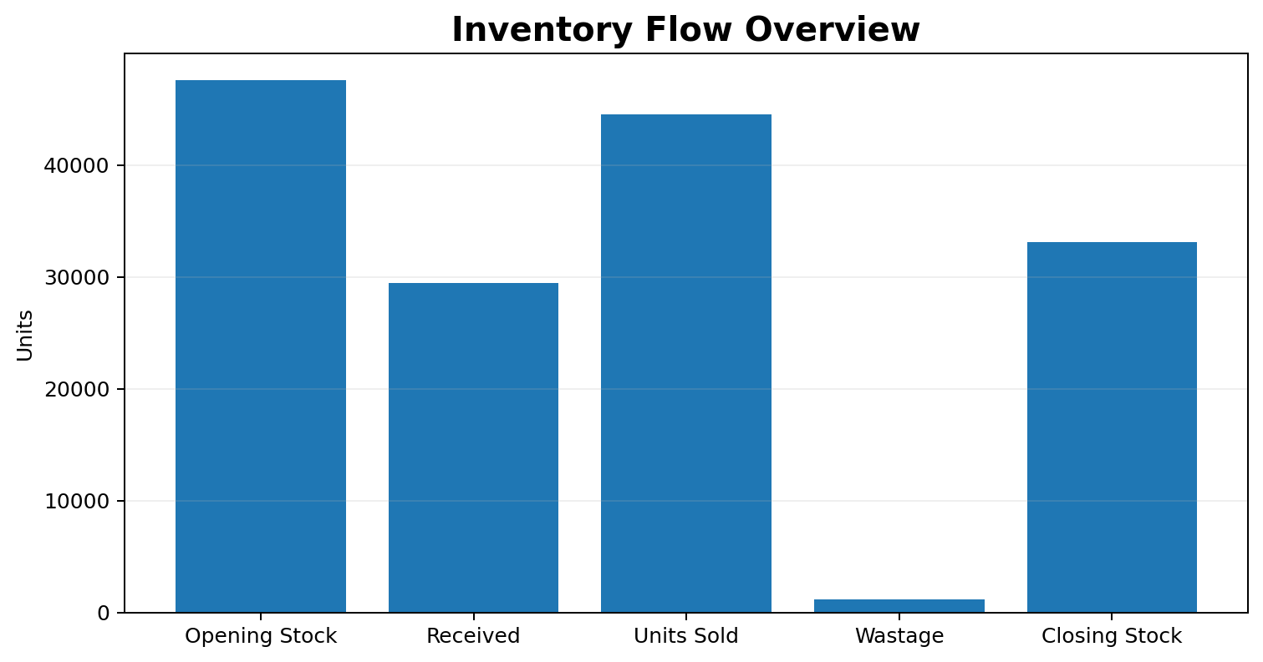
Dashboard / Output
Key KPIs from the cleaned inventory data
TOTAL UNITS SOLD
TOTAL WASTAGE
CLOSING STOCK
REORDER LINES
WASTAGE RATE
44,572
1,149
33,083
132
1.5%
• Inventory available: 77,113 units
• Overall utilization: 57.8%
• Reorder rate: 26.4% of inventory lines
• Dashboard focus: sales movement, wastage, closing stock and replenishment.
BrewBean Inventory Analysis | Hari Prasath S | 9

Slide 10
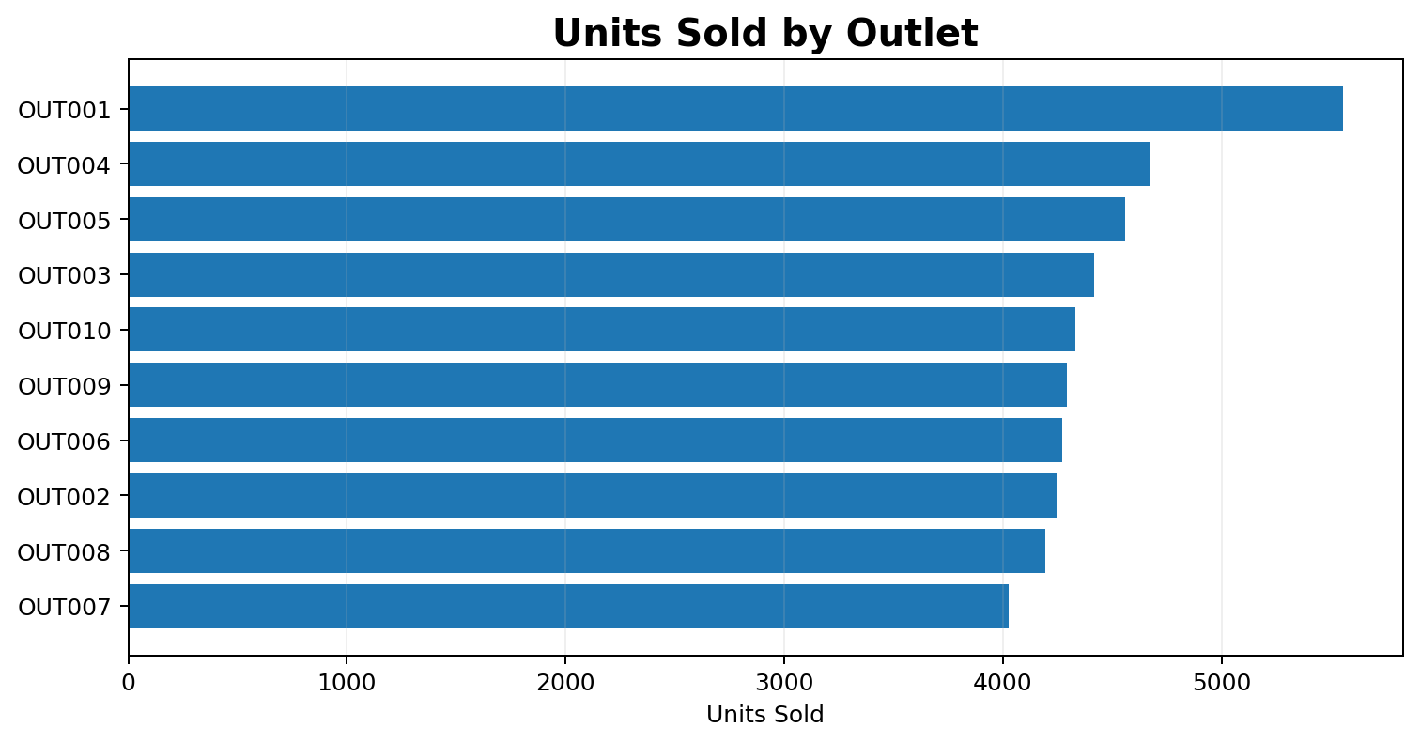
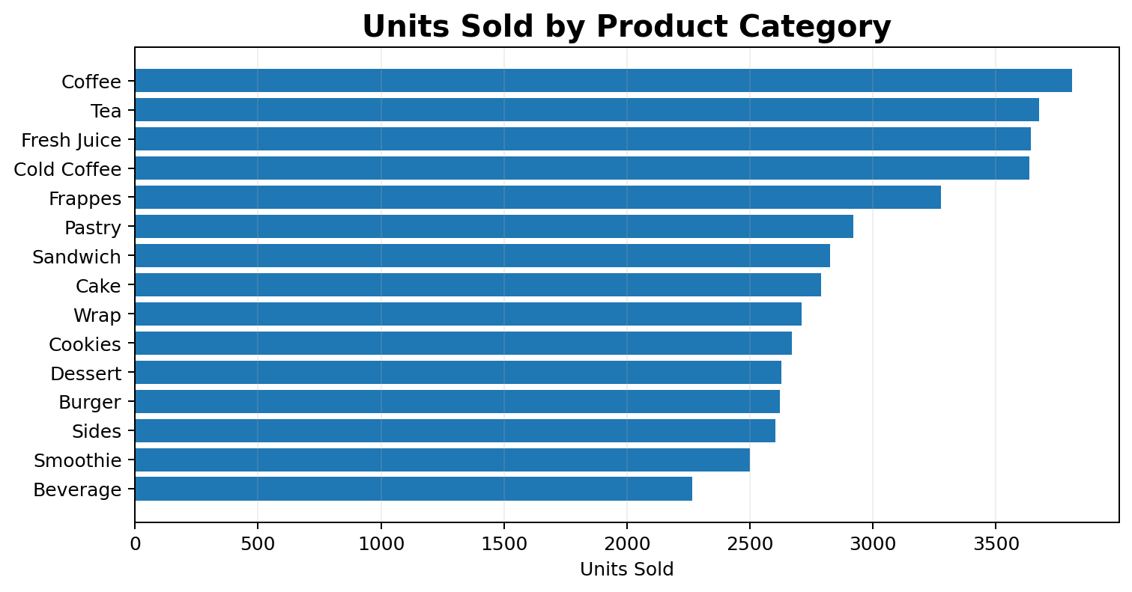
Analysis Results
Top outlet by units sold: OUT001 (5,554 units) | Top category: Coffee (3,809 units)
BrewBean Inventory Analysis | Hari Prasath S | 10

Slide 11
Key Insights
HIGHEST SALES OUTLET
HIGHEST WASTAGE OUTLET
HIGHEST CLOSING STOCK
OUT001
OUT010
OUT007
• OUT001 recorded the highest units sold at 5,554 units.
• OUT010 recorded the highest wastage at 124 units, making it a priority for wastage review.
• OUT007 holds the highest closing stock at 3,841 units; stock turnover should be monitored.
• 132 of 500 inventory lines (26.4%) are marked Reorder Required.
• Total wastage is 1,149 units, equal to approximately 1.5% of opening + received stock.
BrewBean Inventory Analysis | Hari Prasath S | 11

Slide 12
Recommendations
• Prioritize replenishment for the 132 reorder-required inventory lines.
• Investigate the 64 over-utilization records with outlet teams; confirm whether receipts were recorded late or incompletely.
• Review the 65 negative calculated closing-stock exceptions and reconcile missing stock movements.
• Monitor the outlets with higher wastage and identify causes such as over-ordering, storage issues or product handling.
• Use reorder levels and supplier lead time together to plan replenishment earlier.
• Add transaction dates and supplier names in future data collection to enable monthly trends, supplier performance and forecast analysis.
BrewBean Inventory Analysis | Hari Prasath S | 12

Slide 13
Conclusion
• The project transformed 500 inventory records into a structured view of sales movement, stock levels, wastage and reorder requirements.
• The analysis identified 44,572 units sold, 1,149 wastage units, 33,083 closing-stock units and 132 reorder-required lines.
• Data validation helped separate clean records from operational exceptions that need business review.
• The project strengthened practical skills in Excel-based data cleaning, KPI analysis, aggregation, dashboard thinking and business storytelling.
• The same approach can be extended with dated transactions for forecasting and advanced inventory optimization.
BrewBean Inventory Analysis | Hari Prasath S | 13

Slide 14
Thank You
Any Questions?
Hari Prasath S | Data Analyst / CSE | Inzovate Technologies Private Limited

