Slide 1
PERSONAL EXPENSE TRACKER TEAM ID: PNT2022TMID23073
Team Leader:
Subadhina.J
Team Members:
Miruthula.N
Poornimadevi.A
Suuky.M
Mentor:
Dr.S.Ponmalar

Slide 2
Problem Definition
Personal finance entails all the financial decisions and activities that a Finance app makes your life easier by helping you to manage your finances efficiently. A personal finance app will not only help you with budgeting and accounting but also give you helpful insights about money management.
Personal finance applications will ask users to add their expenses and based on their expenses wallet balance will be updated which will be visible to the user. Also, users can get an analysis of their expenditure in graphical forms. They have an option to set a limit for the amount to be used for that particular month if the limit is exceeded the user will be notified with an email alert

Slide 3
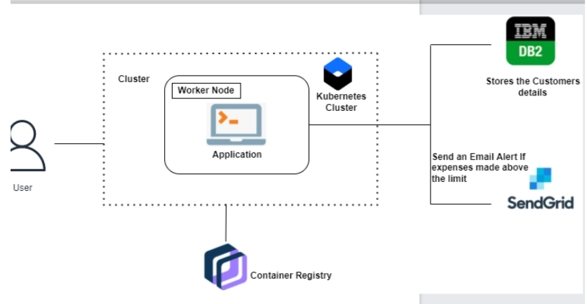
Technical Architecture

Slide 4
Paper-1
Author: Shahed Anzarus Sabab , Sadman Saumik Islam , Md. Jewel Rana , Monir Hossain
Title: eExpense : Smart Approach to Track Everyday Expense
Published Journal: 2018 4th International Conference on Electrical Engineering and Information & Communication Technology
Year of Published: 13-15 sept 2018
Objective: Users can save their expense by simply scanning the bills . This application extracts the textual information from the receipts and saves the amount and description for further processing. It also monitors user's income by tracking the received SMS's from the user's saving accounts. By calculating income and expense it produces the user's balance in monthly and yearly basis.
Technology used: Artificial Intelligence

Slide 5
Paper-2
Author: Shiva Mehra, Prabhat Parashar
Title: Daily Expense Tracker
Published Journal: International Journal of Research in Engineering and Science
Year of Published: Dec 2021
Objectives: Daily expense tracker allows the user to track the expense of the user daily creates the digital record and illustrate in the form of chart.
Technology Used: React JS(FE) , DOM(JavaScript object)[For the performance of the app],AI Powered engine(Voice implementation)

Slide 6
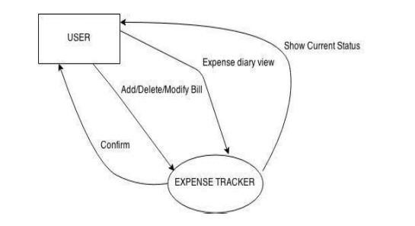
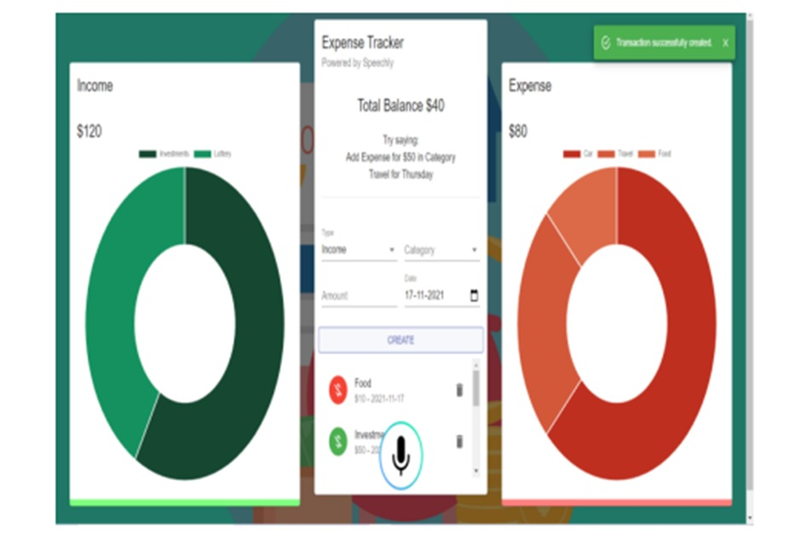

Slide 7
Paper-3
Author: S.Chandhini , D.Ranjeeth
Title: Online Income and Expense Tracker
Published Journal: International Research Journal of Engineering and Technology
Year of Published: Mar 2019
Objective: User can input amount of expense category wise . Also they can sort the expense weekly , monthly, yearly. User can view the expense in the graph format. User receive the mail regarding their expenses , savings and income weekly.
Language used: PHP

Slide 8
Paper-4
Author: Prof. Miriam Thomas, Dr. Mahalaxmi
Title: Expense tracker
Published Journal: International Journal of Advance Research and Science Communication and Technology
Year of Published: Sept-2020
Objectives: There are three logins such as admin , manager and staff. Admin can add , delete , edit manager. Manager can add the type of expense , verify expense and generate the report. Staff can add and edit the expense and perform calculations.
Technology: NetBeans IDE
Language used: PHP,HTML5,C,C++,MySQL

Slide 9
Paper-5
Author: M.Harish Kumar, D.Thenmullai ,G.P.Shree Harini
Title: Application for Tracking Personal Expense
Published Journal: International Journal of Advanced Research in Computer and Communication Engineering
Year of Published: Mar-2022
Objective: User have to input their expenses category wise daily which will give result in the format of graph , If it exceeds the certain limit fixed by the user ,it will send the alert message to the user.
Technology used: Android studio , OCR(Optical Character Recognition )

Slide 10
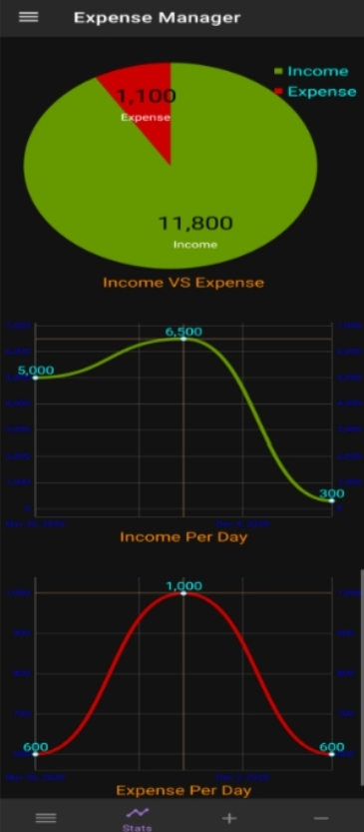

Slide 11
Paper-6
Author: Prapphulla S. Kheradhe , Raj S. Vilankar
Title: Expense Tracker
Published Journal: Iconic Research And Engineering Journals
Year of Published: May-2021
Objective: User have to input their expenses in the daily basis and when the limit exceeds ,it will give the warning and will give remainder if the user didn’t enter the daily expenses.
Language Used: Angular 8, SQL lite

Slide 12
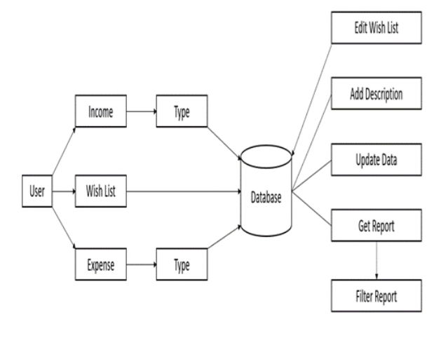

Slide 13
Paper-7
Author: Nidhi Jitendra Jadhav, Rutuja Vijay Chakor, Trupti Mahesh Gunjal
Title: Expense Tracker
Published Journal: International Research Journal of Modernization in Engineering Technology and Science
Year of Published: Mar-2022
Objective: The user can establish their own spending categories, such as food, clothing, rent, and bills, and then enter the amount spent as well as any notes. Include more information in the Additional information area to specify the expense. A pie chart of costs will be available to the user.

Slide 14
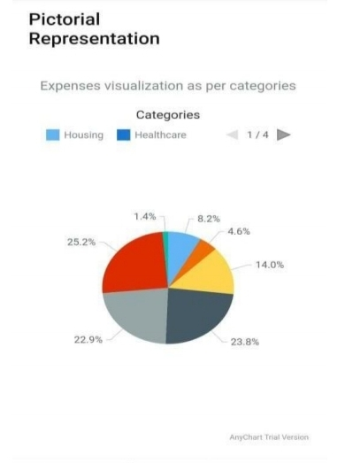

Slide 15
Paper-8
Author: Saumya Dubey, Pragya Dubey
Title: Student Expense Tracking Application
Published Journal: IJARIIE-ISSN(O)-2395-4396
Year of Published: Jul-2022
Objectives: This application creates an easier , faster and smooth tracking system between the money spent and the money earned on day to day basis for the students.
Technology used: Android studio , firebase

Slide 16
Paper-9
Author: Mr. Shekhar Singh, Aman Garg
Title: Expense Tracker
Published Journal: International Journal for Research in Applied Science & Engineering Technology
Year of Published: Mar-2021
Objective: This application asks the user to enter the income and their expenditure . This app will analyze the monthly and year wise income so , that user will come to know in which area the user is spending more.

Slide 17
Paper-10
Author: Tamia Ruvimbo Masendu, Aanajey Mani Tripath
Title: Daily Expense Tracker
Published Journal: International Journal of Research in Engineering, Science and Management
Year of Published: May-2022
Objective: This application helps the user to manage their daily expense in which the user gives an input If it exceeds the certain limit fixed by the user ,it will send the alert message to the user.
Technology Used: NetBeans IDE13
Language Used: MySQL

Slide 18
Critical Findings:
The application can be extended to include scanning of barcode on the price tag which decreases the effort of entering the data in the input fields.
A notification system can be enabled in case when the expenses crosses over the income generated by the user to warn him or her about the situation.

Slide 19
Thank You!

