Slide 1
Employee Data Analysis using Excel
STUDENT NAME: N.HARIPRASATH
REGISTER NO: 122200262(BF4576122E5120A96C945FDA792C6B01)
DEPARTMENT:BCOM CORPORATE SECRETARYSHIP
COLLEGE: s.s.govt arts college Tiruttani

Slide 2
PROJECT TITLE
Employee Performance Analysis using Excel

Slide 3


AGENDA
Problem Statement
Project Overview
End Users
Our Solution and Proposition
Dataset Description
Modelling Approach
Results and Discussion
Conclusion
3/21/2024 Annual Review

Slide 4

PROBLEM STATEMENT
As a result, we need a comprehensive employee performance analysis framework to:
Accurately measure and track employee performance metrics.
Identify correlations between performance and factors like training, engagement, and demographics.
Develop targeted interventions to enhance employee growth and productivity.
Inform data-driven decisions on talent management, promotions, and resource allocation“.

Slide 5

PROJECT OVERVIEW
Our organization seeks to develop a comprehensive employee performance analysis framework to drive data-informed decisions, improve productivity, and enhance talent development. This project aims to:
*Collect and integrate relevant employee data from various sources (HR systems, performance reviews, training records, etc.)
* Develop a performance metrics framework to measure employee productivity, quality, and growth
*Analyze key drivers of employee performance, including training, engagement, demographics, and more
* Identify areas for improvement and develop targeted interventions to enhance employee growth and productivity
* Create data visualizations to communicate insights to stakeholders and facilitate decision-making.
.

Slide 6


WHO ARE THE END USERS?
1.Employee
2. Manager
3.Industry
4.Employer

Slide 7

OUR SOLUTION AND ITS VALUE PROPOSITION
*Conditional formatting -missing
*Filter- remove
*Formula -performance level
*Pivot table-summary
*Graph -Data visualization

Slide 8
Dataset Description
Employee data set -download by KAGGLE
26 features -9 features taken
employee id ,numerical value , first name ,last name -text,
employee type -performance level

Slide 9

THE "WOW" IN OUR SOLUTION
=IFS(Z8>=5,"VERY HIGH",Z8>=4,"HIGH",Z8>=3,"MEDIUM",TRUE,"LOW")
3/21/2024 Annual Review
9

Slide 10
MODELLING
Data collection
*KAGGLE _ download
*EDUNET _ download
Features collection
*identify the feature in excel
Data cleaning
*missing value _ identifying excel
*missing value _ filter out by COLOUR
Performance level
*formula using _ high & low
Pivot table
*summarized & visualized
Result
*graph
10

Slide 11
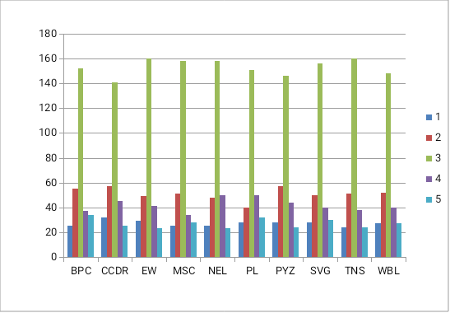
RESULTS
EMPLOYEE PERFORMANCE ANAYSIS
11

Slide 12
conclusion
THE EMPLOYEE PERFORMANCE ANALYSIS THE PROJECT HAS PROVIDED VALUABLE INSIGHTS INTO THE KEY DRIVERS OF EMPLOYEE PRODUCTIVITY, GROWTH ,
AND RETENTION WITH IN OUR ORGANISATION .BY LEVERAGING DATA ANALYTICS & VISUALISATION TECHNIQUES ,WE HAVE IDENTIFIED AREAS FOR IMOROVEMENT &
DEVELOPED TARGETED INTERVENTIONS TO ENHANCE EMPLOYEE PERFORMANCE.

