Slide 1


M.Tech Program
Advanced Industry Integrated Programs
Jointly offered by University and LTIMindTree
REVIEW III
IoT-ENABLED PREDICTIVE QUALITY MONITORING OF PERISHABLE FOOD ITEMS
HARIPRIYA S
(241262601005)
Knowledge partner | Implementation partner

Slide 2
IoT-Enabled Predictive Quality Monitoring of Perishable Food Items
Introduction
Perishable foods such as dairy, fruits, and meat spoil rapidly during storage and transport.
Existing monitoring methods rely on laboratory tests or simple IoT threshold alerts.
Spoilage gases increase before visible deterioration.
Lack of predictive monitoring results in food waste, safety concerns, and economic losses.
This project aims to integrate IoT sensing with machine learning for real-time freshness and shelf-life prediction.

Slide 3
IoT-Enabled Predictive Quality Monitoring of Perishable Food Items
Objective
Develop an end-to-end IoT system using ESP32 and sensors for real-time monitoring.
Capture and analyze the spoilage indicators: Volatile Organic Compounds(VOC), Ammonia(NH3), Carbon-Dioxide(CO2), ethanol, temperature, and humidity.
Design a machine learning model for predicting spoilage progression and estimating remaining shelf life.
Build a cloud-connected dashboard for live data visualization.
Demonstrate the system under controlled storage conditions for selected perishable items.

Slide 4
IoT-Enabled Predictive Quality Monitoring of Perishable Food Items
Problem Statement
Food spoilage is difficult to detect before it occurs, yet early detection is critical for safety and quality.
Laboratory methods are precise but slow and impractical for real-time monitoring.
Most IoT systems rely on simple thresholds, giving only reactive outputs.
Spoilage gases rise well before visible signs appear.
Key gaps:
  No real-time shelf-life prediction.
  Cold-chain failures often go unnoticed.
  Manual inspection is subjective and inconsistent.

Slide 5
IoT-Enabled Predictive Quality Monitoring of Perishable Food Items
Modules
Module 1: Data Acquisition.
Module 2: Data Preprocessing and EDA.
Module 3: Cloud Dashboard Setup and Integration.
Module 4: Machine Learning Model Development.
Module 5: Prediction and Alert System.

Slide 6
IoT-Enabled Predictive Quality Monitoring of Perishable Food Items
Methodology
Project workflow structured into sequential phases: data collection, preprocessing, modeling, and alert generation.
ESP32 transmits sensor data simultaneously to Render and ThingSpeak.
Render handles API hosting and redirects data to respective Azure ML endpoints based on user category selection.
Azure performs ML inference and returns predictions for spoilage stage and shelf life.
ThingSpeak visualizes live sensor readings and trends.
Dual-layer alerting: threshold-based (reactive) and ML-driven (proactive) via Render–Azure pipeline.

Slide 7
IoT-Enabled Predictive Quality Monitoring of Perishable Food Items
Approach , Algorithms & Tools
Approach
Hybrid strategy: Threshold-based alerts + ML predictions.
Edge-level alerts through ESP32, predictive modeling in cloud.
Algorithms
Random Forest Classifier- spoilage stage classification.
Regression model- estimation of remaining shelf life.
Tools & Platform
Hardware: ESP32, DHT22, MQ-135, MQ-137, MQ-3 sensors.
Cloud: Render(API hosting & ML routing), Azure(ML endpoints & alerts), ThingSpeak (dashboard visualization).
Software: Python (pandas, scikit-learn, matplotlib), Arduino IDE.

Slide 8
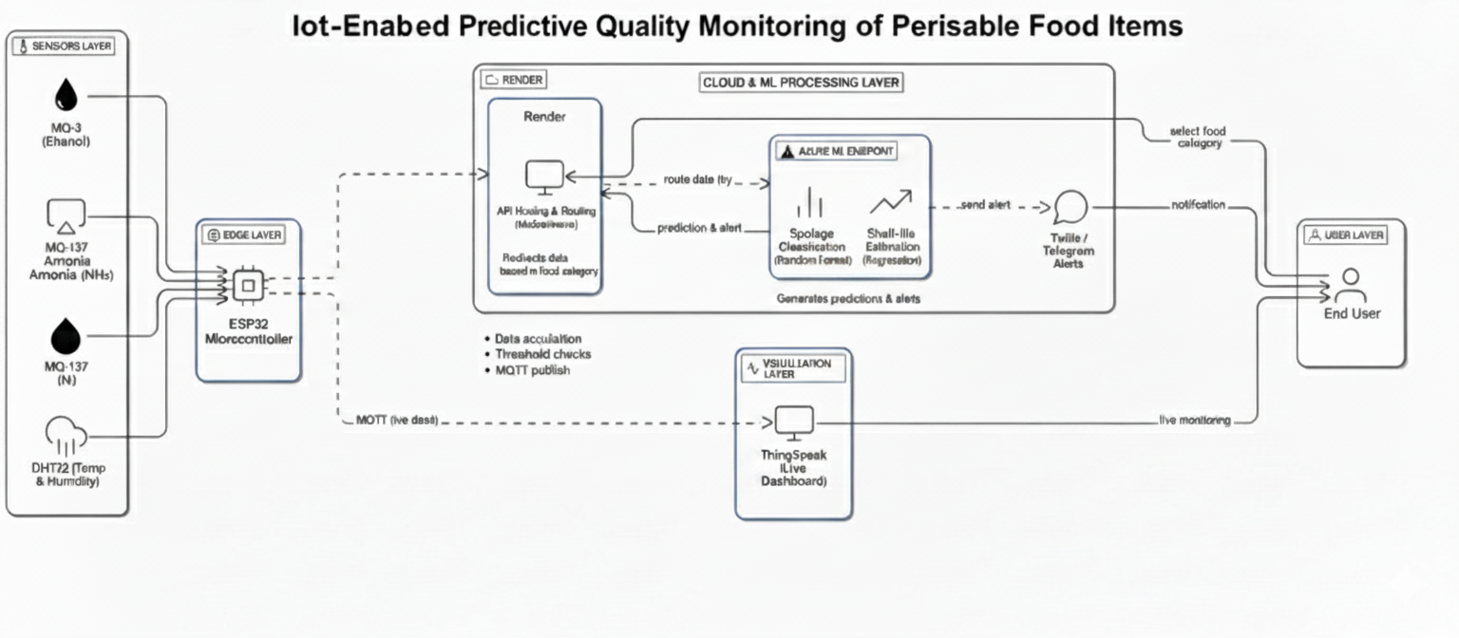
IoT-Enabled Predictive Quality Monitoring of Perishable Food Items
Pipeline structure

Slide 9
IoT-Enabled Predictive Quality Monitoring of Perishable Food Items
Findings
Testing was conducted on multiple category food items such as fruits, meat, and dairy, under controlled storage conditions.
Each category exhibited distinct gas emission patterns, validating the sensing module’s accuracy.
VOC and Alcohol (MQ135 & MQ3) levels rose during early freshness loss, while Ammonia (MQ137) dominated in later spoilage stages, especially for meat and dairy.
Temperature and humidity influenced the gas emission rate and overall spoilage progression.
The observed data confirmed that the system can detect early spoilage indicators before visible deterioration across categories.

Slide 10
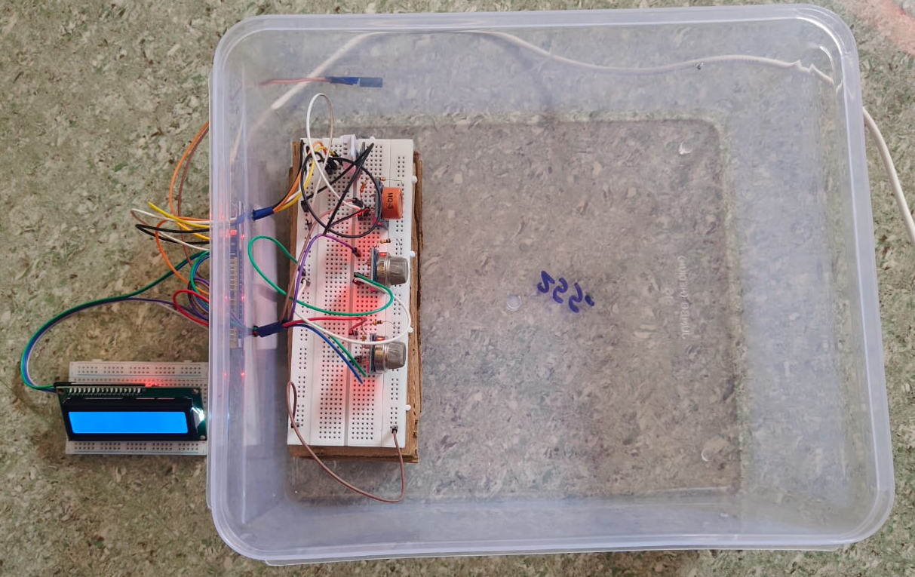
IoT-Enabled Predictive Quality Monitoring of Perishable Food Items
Findings
System setup for monitoring multiple-category food items under controlled conditions.

Slide 11
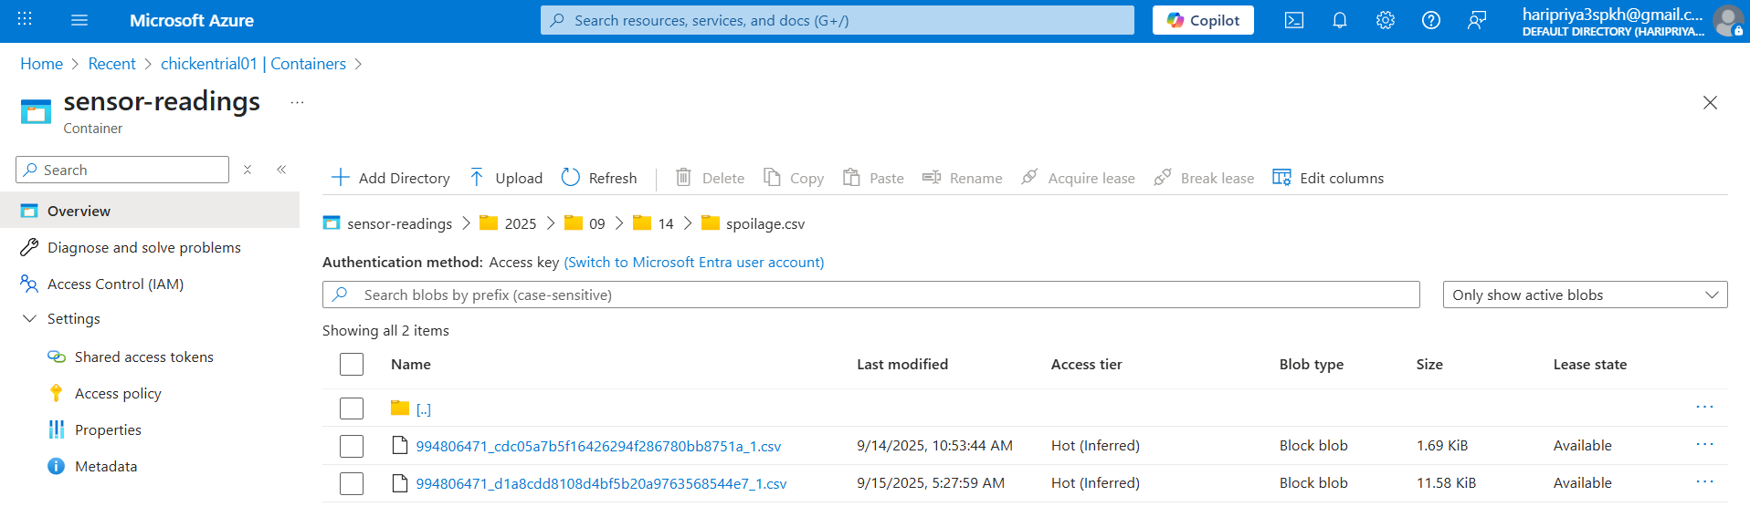
IoT-Enabled Predictive Quality Monitoring of Perishable Food Items
Findings
Cloud integration using Microsoft Azure platform.

Slide 12
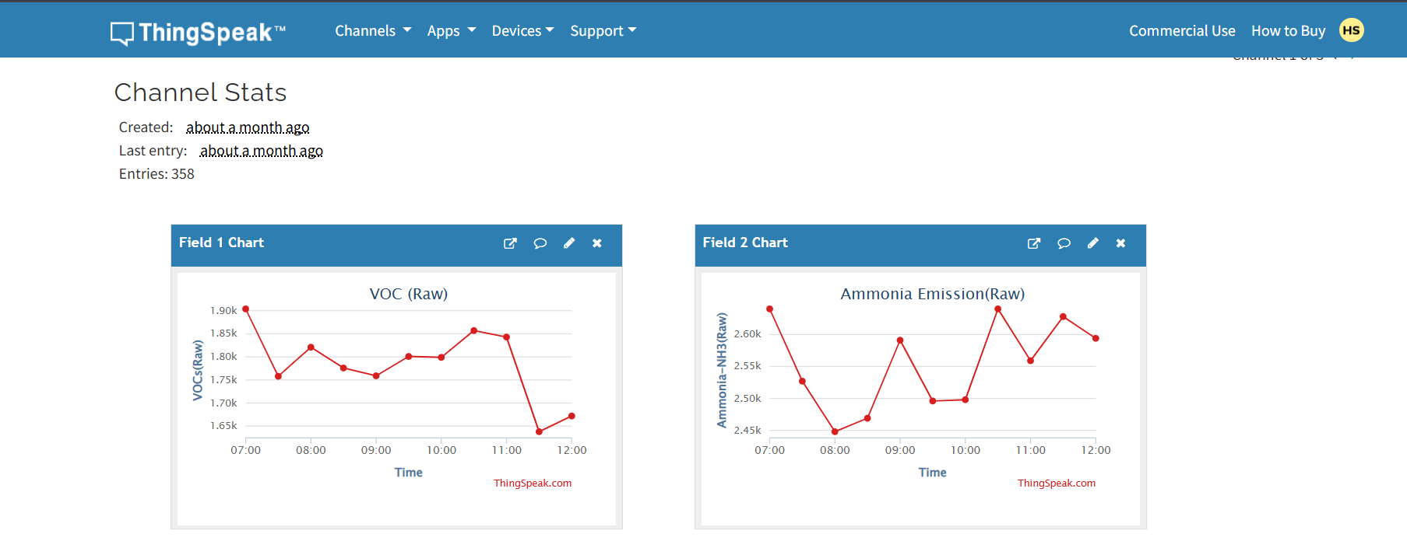
IoT-Enabled Predictive Quality Monitoring of Perishable Food Items
Findings
Real-time data visualization on ThingSpeak platform.

Slide 13
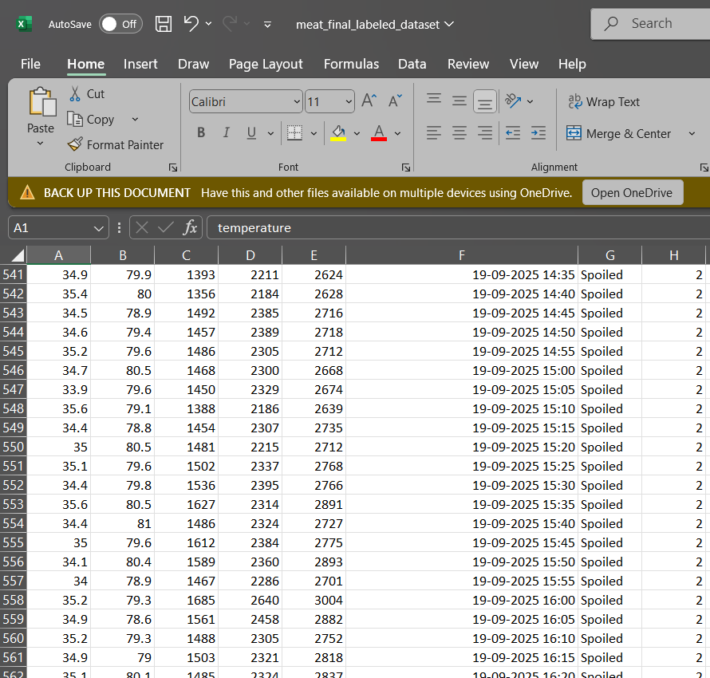
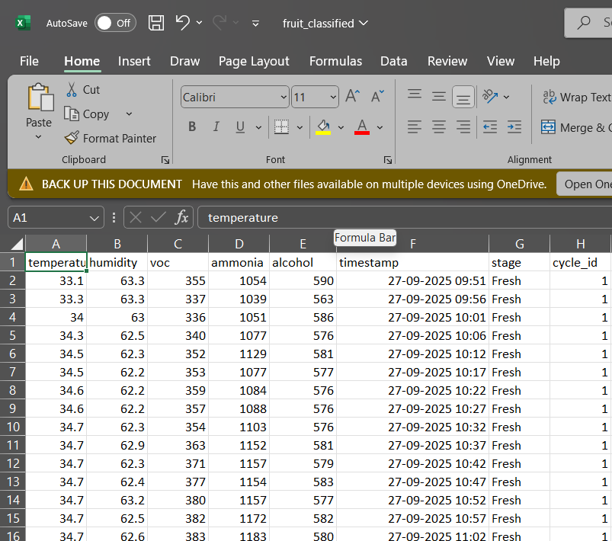
IoT-Enabled Predictive Quality Monitoring of Perishable Food Items
Findings
Real-time spoilage CSV data samples exported from ThingSpeak and Azure used for model training and validation.

Slide 14
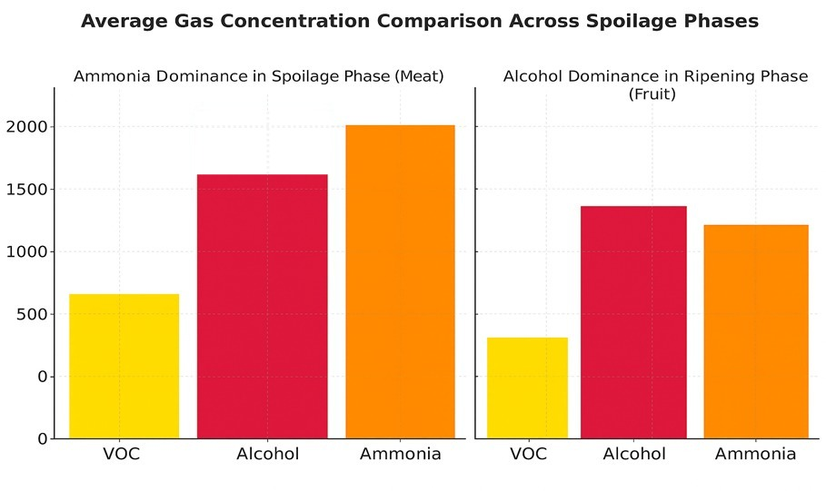
IoT-Enabled Predictive Quality Monitoring of Perishable Food Items
Findings

Slide 15
IoT-Enabled Predictive Quality Monitoring of Perishable Food Items
Results
The ESP32 successfully transmitted real-time sensor data to ThingSpeak for visualization and Render for cloud routing at fixed time intervals.
The Render web app enabled users to select the food category and redirected the incoming data to the respective Azure ML endpoint.
The Azure ML model accurately classified fruits, meat, and dairy samples based on gas concentration variations.
Telegram and Twilio alerts were automatically triggered upon spoilage prediction.
The integrated IoT–ML framework demonstrated reliable end-to-end operation from sensing to cloud prediction and alert generation.

Slide 16
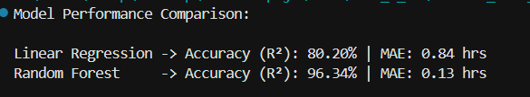
IoT-Enabled Predictive Quality Monitoring of Perishable Food Items
Results
Random Forest achieved 96.34% accuracy (R²) with a Mean Absolute Error of 0.13 hrs,
outperforming Linear Regression, which achieved 80.20% accuracy with 0.84 hrs MAE.
Hence, Random Forest was selected as the final model for Azure ML deployment.

Slide 17
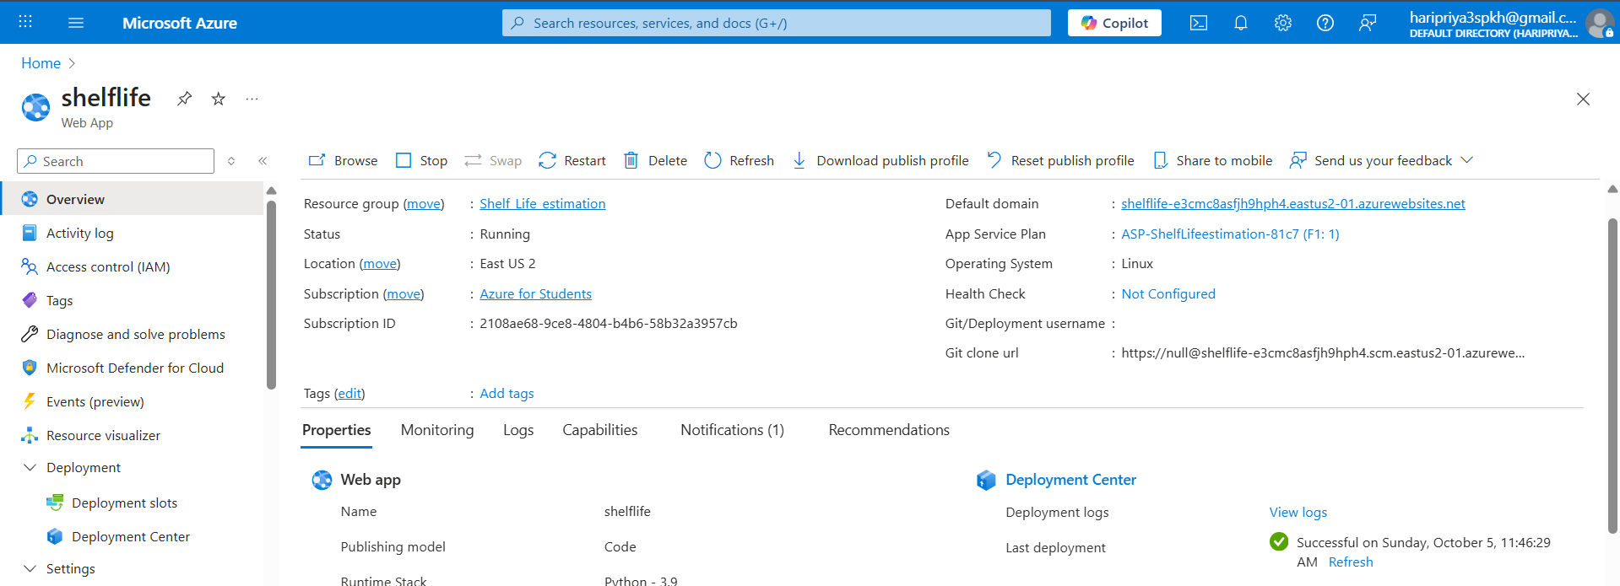
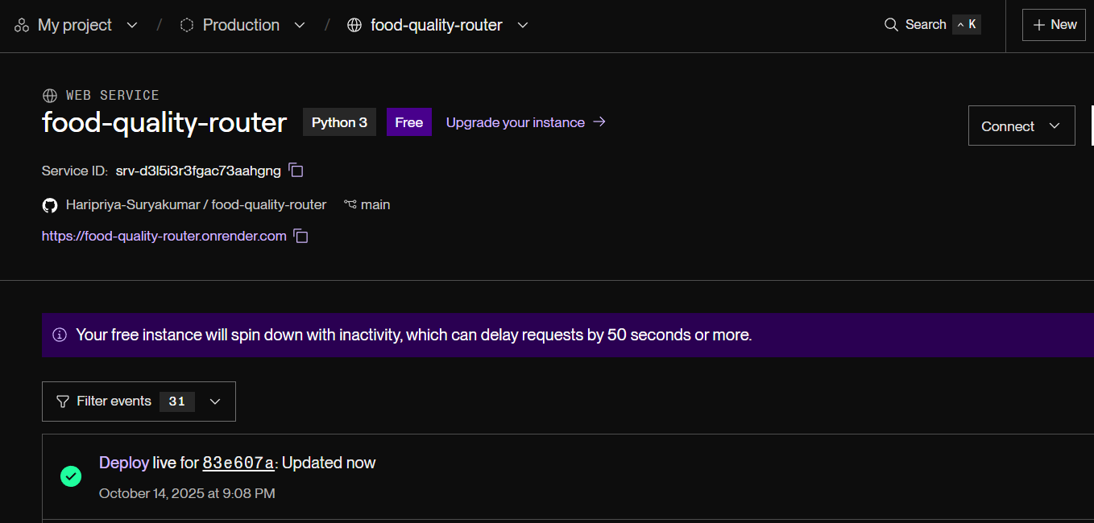
IoT-Enabled Predictive Quality Monitoring of Perishable Food Item
Results
Deployed Random Forest (RF) models on Azure Web Apps for real-time spoilage prediction.
Render Web App interface (endpoint routing)

Slide 18
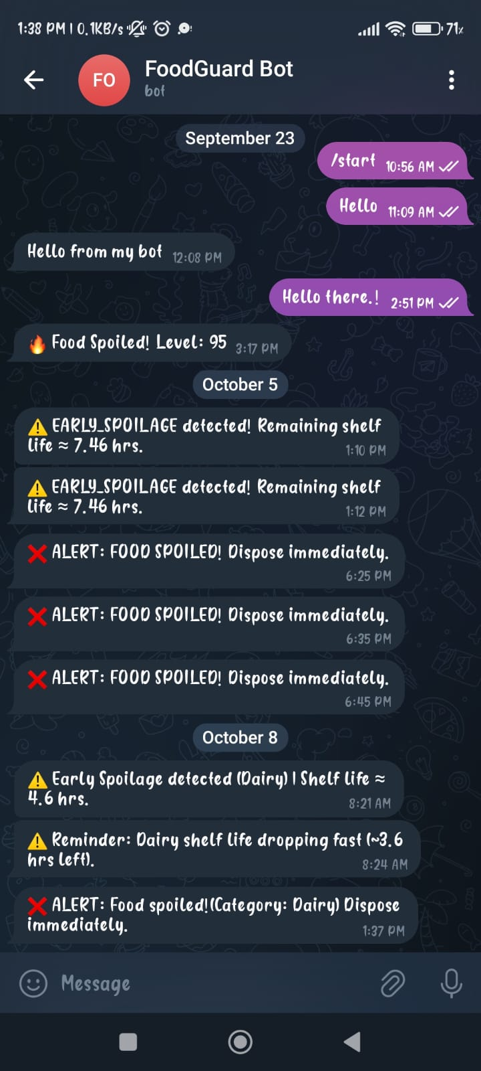
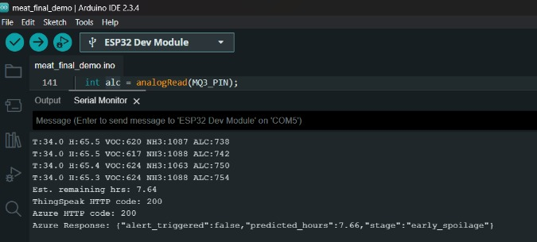
IoT-Enabled Predictive Quality Monitoring of Perishable Food Item
Results
Live data sent to ThingSpeak and Render, followed by Telegram alerts showing spoilage stage prediction (Meat Demo).

Slide 19
IoT-Enabled Predictive Quality Monitoring of Perishable Food Items
Conclusion
A real-time IoT-based spoilage monitoring system was successfully developed for multiple food categories including fruits, meat, and dairy.
The system used gas sensors and a Random Forest model deployed on Azure ML for accurate spoilage stage prediction.
Data was transmitted through ESP32 to ThingSpeak for visualization and Render for cloud routing and model access.
Automated alerts through Telegram Bot and Twilio SMS notified users instantly when spoilage was detected.
The IoT–ML framework demonstrated reliable end-to-end performance, proving its potential for real-time food quality management.

Slide 20
IoT-Enabled Predictive Quality Monitoring of Perishable Food Items
Reference
Z. W. Bhuiyan et al., “IoT-Based Meat Freshness Classification Using Deep Learning,” IEEE Internet of Things Journal, 2024.
J. Chong, A. E. Omer, S. Idziak, L. Wei, and G. Shaker, “Low-Cost Real-Time Non-Invasive Milk Quality Monitoring Using 60 GHz FMCW Radars,” Sensors, 2025.
Abass, Eruaga, Itua, and Bature, “Advancing Food Safety through IoT Real-Time Monitoring and Control,” International Journal of Smart Agriculture and Food Technology, 2024.
J. Retna Raj et al., “An IoT-Based Application for Real-Time Detection of Rotten Fruits,” Journal of Food Engineering and Technology, 2024.
C. Y. Song, Z. Wu, J. Gray, and Z. Meng, “An RFID-Powered Multi-Sensing Fusion Industrial IoT System for Food Quality Assessment and Sensing,” IEEE Access, 2024.
Seilov, Abildinov, Baydeldinov, and Nurzhaubayev, “Integration of Electronic Nose and Machine Learning for Monitoring Food Spoilage in Storage Systems,” Computers and Electronics in Agriculture, 2024.

Slide 21
IoT-Enabled Predictive Quality Monitoring of Perishable Food Items
Thank You.!

