Slide 1

Impact of Physical & Lifestyle factors on Sleep Health : Analysis
Name: Hari Priya Ramamoorthy
Date: 6th August 2024
Class: ALY 6000 – Introduction to Analytics

Slide 2
Dataset Overview
Source of the dataset: https://www.kaggle.com/datasets/henryshan/sleep-health-and-lifestyle
Dataset Description:
- This dataset, contains 373 rows and 13 columns, encompasses a broad spectrum of variables associated with sleep and daily routines of the working group people aged between 24 to 59 years.
- It provides information on aspects like gender, age, profession, duration of sleep, sleep quality, level of physical activity, stress levels, BMI classification, and the existence or non-existence of sleep disorders.
Why Studying this data is Important?
Adequate sleep is crucial for both mental and physical health, that influences conditions such as obesity, diabetes, and cardiovascular diseases.
Understanding sleep's impact on health can guide public and organizations health interventions and policies.

Slide 3
Key Questions
Pattern of sleep across different gender and different age groups?
How does physical activity affect sleep?
How does BMI affect sleep?
How does stress correlate with sleep?
Occupation affects sleep?

Slide 4
Glimpse of Data
Key Summary:
There are 4 Categorical and 5 Numerical variables
Age of the sample represents working group population aged between 27 to 59.
The sleeping hours of the sample population ranges between 4 to 9 hours with the mean of 7.30 hours.
The sample population’s time spent on physical activity ranges from 30 mins to 90 mins a day with the mean of 60 mins.
The mean Stress level rating of the sample is 5.39 and the max is 8.
Count of Categorical variables – 4
Count of Numerical variables – 5
Categorical Variables:
Gender – Male / Female
BMI category – Normal / Overweight / Obese
Sleep disorder – Insomnia / Sleep Apnea / None
Occupation
Summary of Numerical Variables:
Age Quality of sleep Physical activity Stress level Heart Rate
(in Years) (in hours) (in mins/day) (Rated 0-10) (bpm)
----------------------------------------------------------------------------------------------------------------------------------
Min. 27.00000 4.000000 30.00000 3.000000 65.00000
1st Qu. 35.00000 6.000000 45.00000 4.000000 68.00000
Median 43.00000 7.000000 60.00000 5.000000 70.00000
Mean 42.13941 7.308311 59.12869 5.391421 70.17158
3rd Qu. 50.00000 8.000000 75.00000 7.000000 72.00000
Max. 59.00000 9.000000 90.00000 8.000000 86.00000

Slide 5
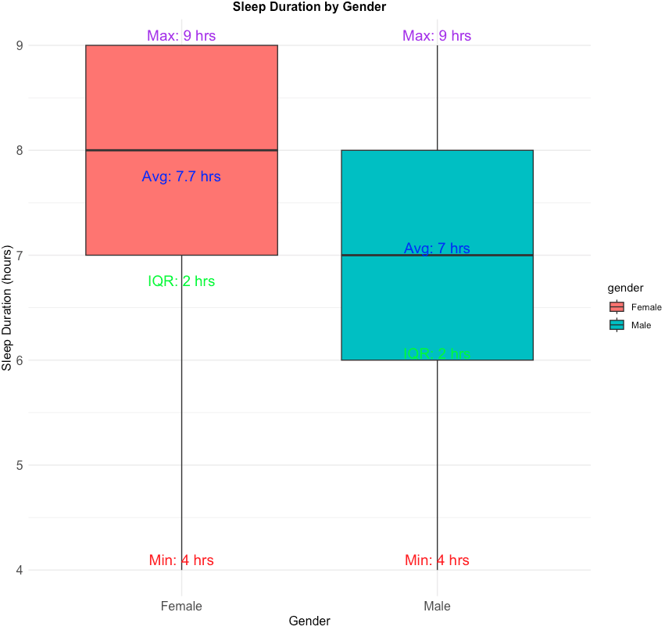
Gender-Wise Sleep Pattern
Key Points:
Females tend to sleep slightly longer than males on average.
Both genders have fairly symmetrical sleep distribution, as there are no visible outliers.
Notes:
The average sleep duration for females is 7.7 hours, while for males, it is 7 hours.
The Extreme values are not significantly different between genders hence they are symmetrical

Slide 6
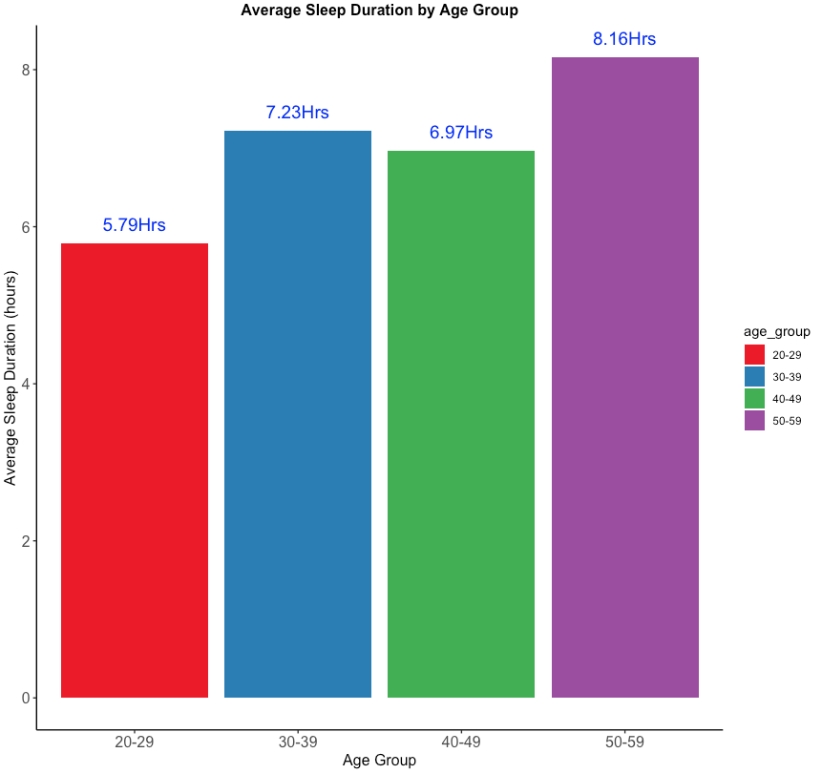
Age-Wise Sleep Pattern
Key Points:
Increasing trend of Sleep duration with Age.
The peak in the 50-59 age group reflect a greater emphasis on health and well-being.
Increase in sleep might be due to : more “routine” regular work schedule and people prioritizing health and sleep.
Notes:
Data Cleaning: Age is categorized into bins of 10 for better visualization
The youngest age group (20-29) has the shortest average sleep duration, while the oldest age group (50-59) has the longest average sleep duration.
The increase in average sleep duration from the 20-29 age group to the 30-39 age group may be due to changes in lifestyle, such as settling into more regular work schedules or prioritizing health and sleep more as responsibilities increase.
The peak in the 50-59 age group reflect a greater emphasis on health and well-being as people approach or enter retirement, allowing for more consistent and longer sleep patterns.

Slide 7
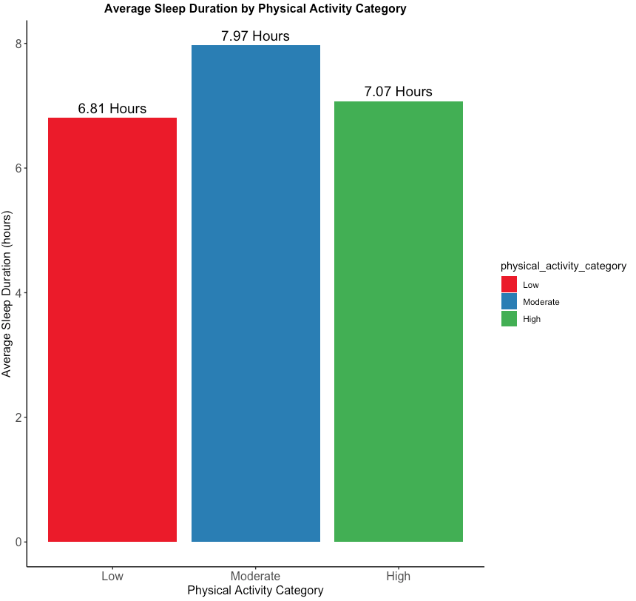
Physical activity affects sleep quality?
Key Points:
Sample population exhibit no sleep pattern based on physical activity
Both low and high physical activity population has a quality sleep of almost 7 hours a day.
Hence, no correlation of sleep quality on physical activity.
Notes:
Data cleaning : The physical activity was categorized as low,moderate,high using mean,Inter quartile range as threshold

Slide 8
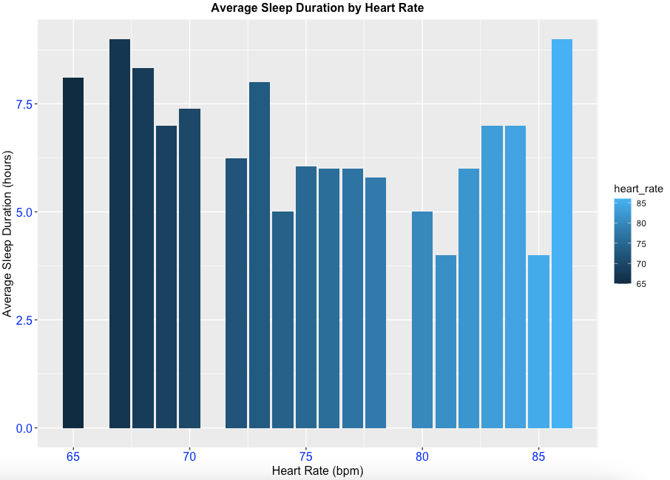
Heart Rate Vs Sleep Pattern
Key Points:
Heart rate does not affect the sleep cycle
No visible trend in chart
Notes:
Sample population does not show any trend in the heart rate and sleep duration.

Slide 9
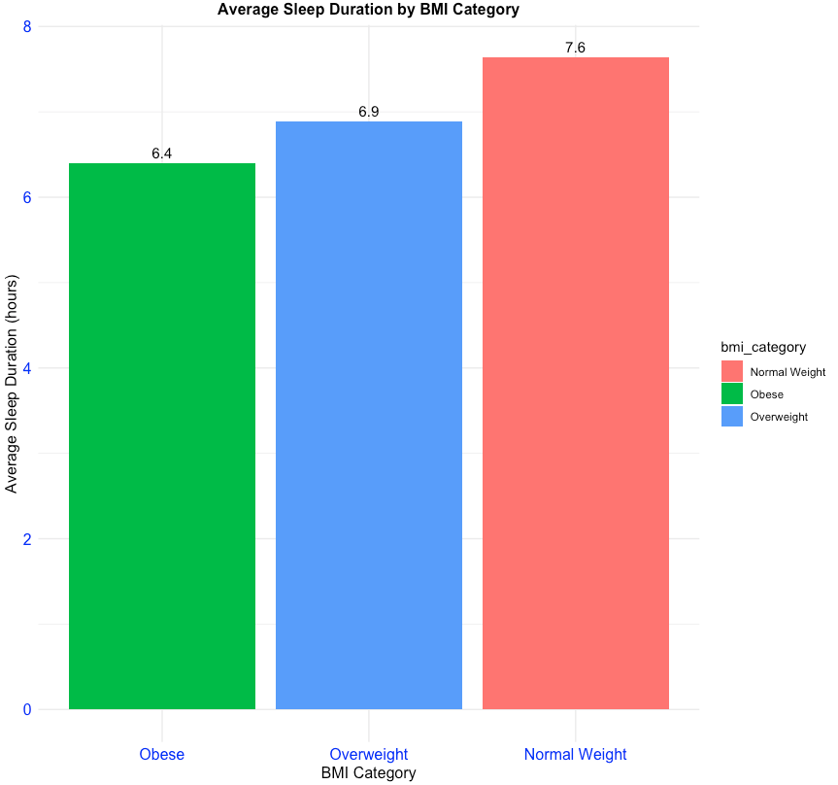
BMI Affects Sleep quality?
Key Points:
Obesity deteriorates body sleep cycles.
Chart shows, Normal BMI category population shows better sleep quality than overweight and obese BMI category.

Slide 10
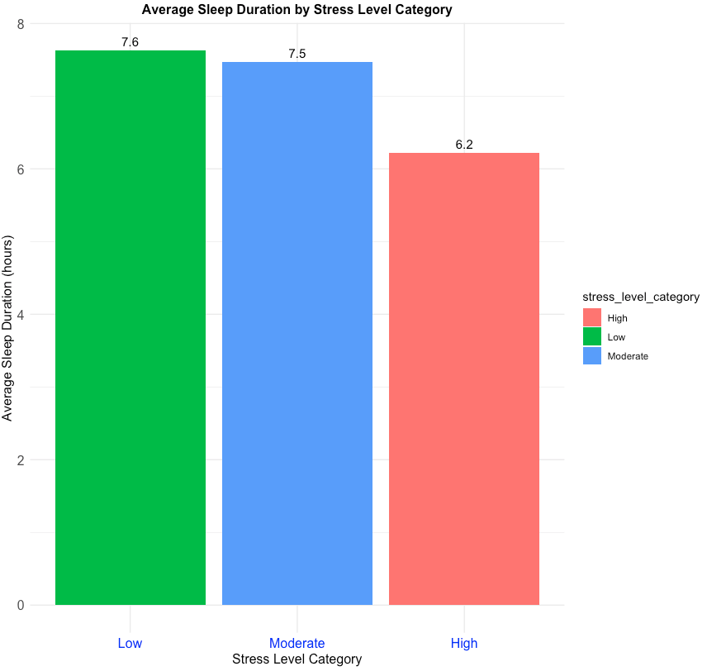
Stress Affects Sleep quality?
Key Points:
Stress affects sleep cycles.
High stress level sample population sleeps less than population with low stress

Slide 11
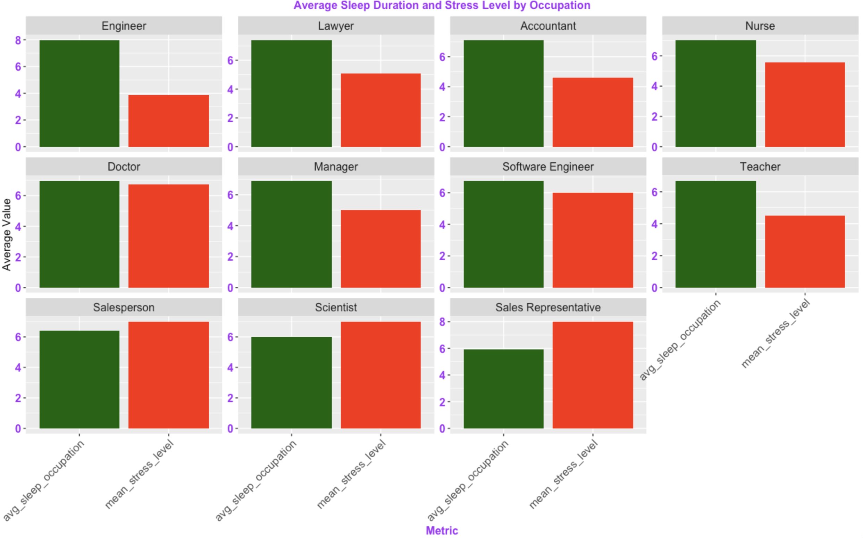
Occupation-Wise Stress & Sleep Pattern
Key Points:
Occupation affects sleep quality.
Target oriented jobs like Sales Representatives, scientists has more stress and less sleep.
Stable, routine jobs like Engineer, Accountants have less stress and good sleep pattern.
Notes:
The chart represents the sleep time (green), average stress(red) based on occupation. Charts are arranged on descending order of sleep quality.
Last row represents low sleep quality occupation while former rows has better sleep pattern.

Slide 12
Key Findings & Conclusion
Gender Differences: Females generally have a higher average sleep duration compared to males, suggesting potential differences in sleep needs or behaviors between genders.
Age Factor: The trend of increasing sleep duration with age highlights the importance of focusing on health and sleep as people age. This could be due to increased awareness and health issues requiring more rest.
Physical Activity and Heart Rate: The lack of correlation between physical activity and heart rate with sleep duration suggests that other factors might be more influential in determining sleep duration in this population.
Impact of Obesity: The negative effect of obesity on sleep cycles emphasizes the importance of maintaining a healthy BMI for better sleep health.
Occupational Stress Influence: Occupational stress significantly impacts sleep quality. Target-oriented jobs, such as sales representatives and scientists, are associated with higher stress and shorter sleep durations, whereas stable, routine jobs like engineers and accountants experience lower stress and better sleep patterns.

Slide 13
To improve Sleep Quality…
Maintain healthy BMI
Individuals need to maintain their stress levels despite their work load
Organizations should identify and tailor health and wellness programs addressing specific stressors and health issues related to different occupations to improve overall sleep health.

Slide 14
References
https://www.kaggle.com/datasets/henryshan/sleep-health-and-lifestyle/data
http://www.sthda.com/english/wiki/ggplot2-facet-split-a-plot-into-a-matrix-of-panels
https://stackoverflow.com/questions/68949512/ggplot2-bar-chart-with-two-bars-for-each-x-value-of-data-and-two-y-axis
https://stackoverflow.com/questions/68949512/ggplot2-bar-chart-with-two-bars-for-each-x-value-of-data-and-two-y-axis
https://www.geeksforgeeks.org/order-bars-in-ggplot2-bar-graph/
https://www.datacamp.com/cheat-sheet/ggplot2-cheat-sheet

