Slide 1




MASSACHUSETTS BAY TRANSPORTATION AUTHORITY (MBTA) On-time PREDICTION ACCURACY ANALYSIS
BY TEAM EPSILON
HARI PRIYA RAMAMOORTHY​
ISAAC NYINAKU​
SHILIN WANG​

Slide 2
OBJECTIVE
MBTA Business Problem Statement :
The MBTA operates many transport lines (Bus, Red, Green, Orange, & Blue lines) across the Massachusetts state.
The MBTA wants to improve their to improve MBTA On-Time prediction model to provide accurate predictions to improve operational efficiency and ridership.
Objective of the Analysis: Recommend significant factors to add in MBTA prediction model to improve it’s accuracy.
Datasets Used: MBTA Prediction Accuracy, Seasons, and Ridership Volume data from MBTA Opendata portal.
Methodology:
Data Manipulation & Integration in R
EDA & Hypothesis Testing in R
Linear Accuracy Prediction Model in R
Feature Selection – Lasso & Step-wise Regression in R

Slide 3
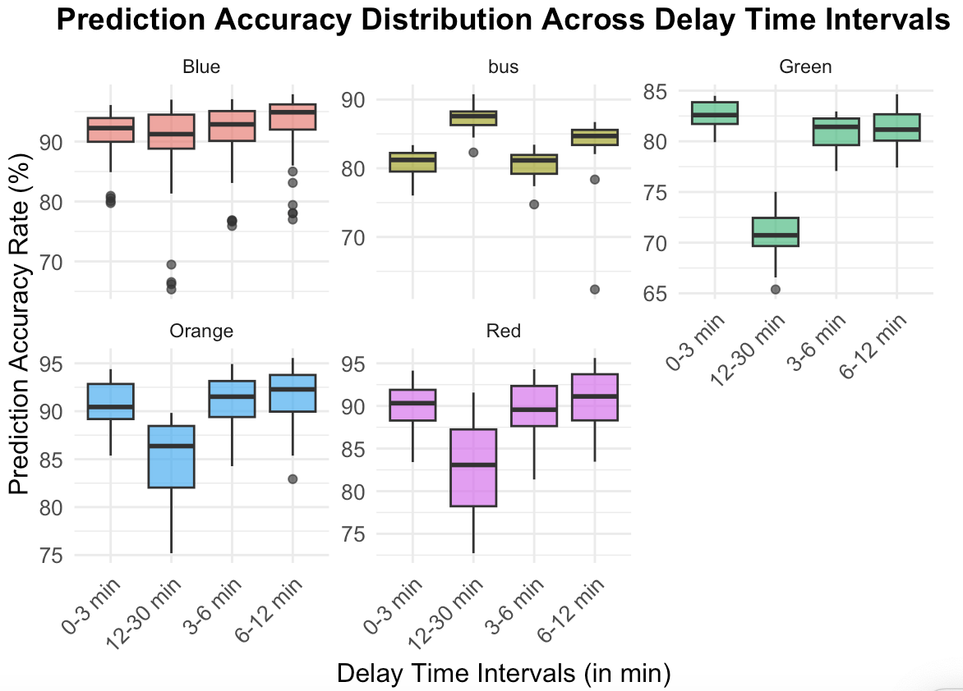
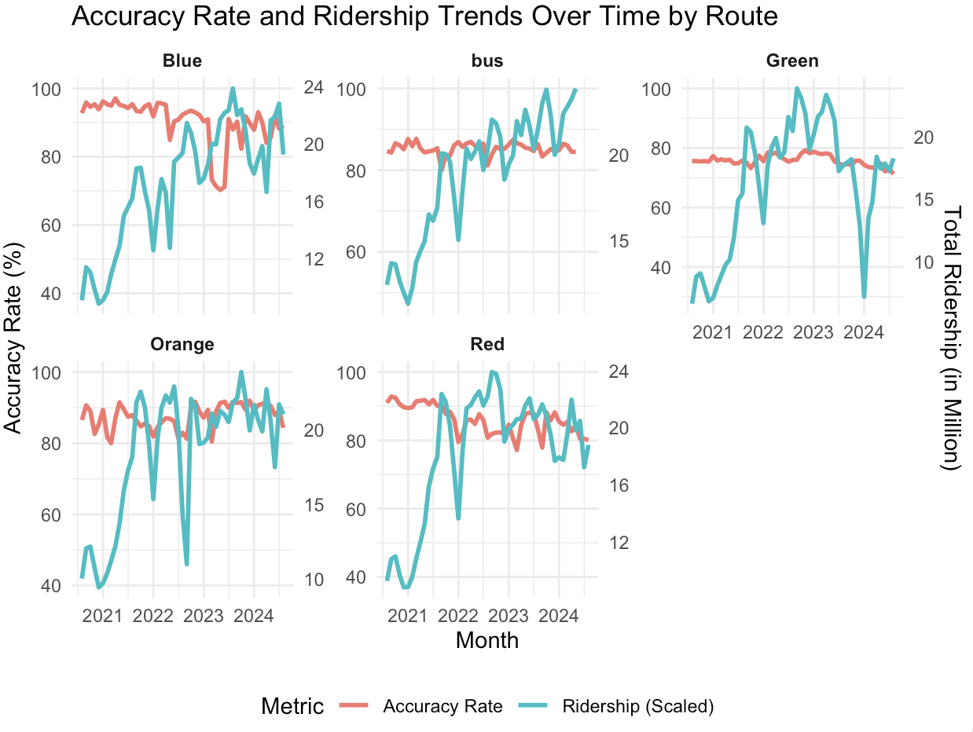
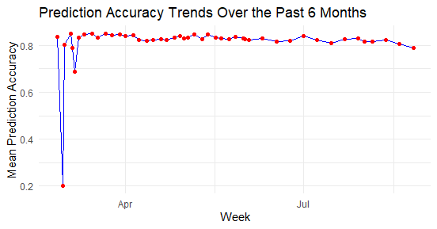
EDA & Hypothesis Testing
EDA Insight : Prediction accuracy varies across Route ​ Statistical Test : ANOVA Test
H0: No difference​ between routes H1: Significant difference in prediction accuracy across different transportation routes.​ Result: Prediction Accuracy varies across routes
EDA Insight : Ridership and Prediction Accuracy exhibits similar trend relationship . Statistical Test : Pearson’s Correlation Test between Accuracy rate and ridership volume.
H0: Correlation=0
H1: Correlation is not equal to 0
Result: Significant negative correlation of -0.298 exists.
EDA Insight : No variation in Prediction accuracy across past 6 Months Statistical Test : Chi-Square Independence Test on Accuracy Vs Time period
H0: Prediction accuracy is not independent of Time.​ H1: Prediction accuracy is independent of Time.​
Result: Prediction accuracy is independent of Time.​

Slide 4
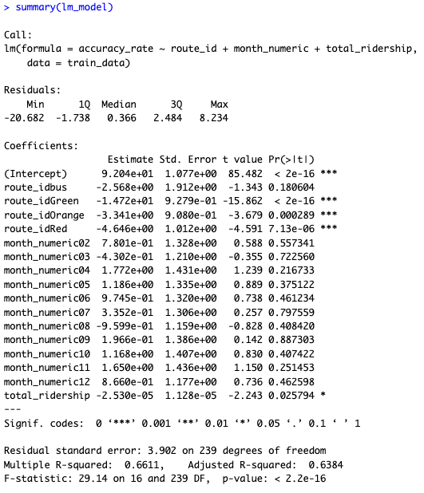
Linear model
Table-1 : Linear Model Summary
Linear regression model:
Y-Var: Accuracy
X-Var: Route, Ridership, and Month
Identified Significant Predictors: Route , Ridership
Identified Insignificant Predictor: Month
Adjusted R-Squared: 0.6384 = 64%

Slide 5
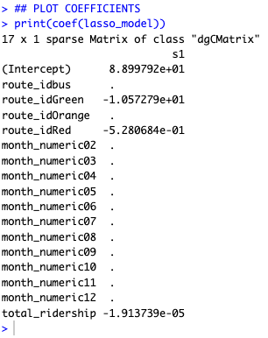
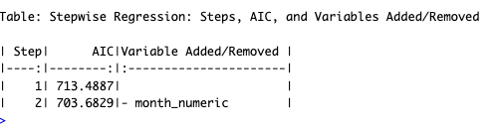
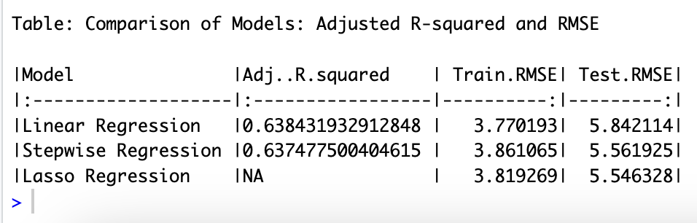
LASSO & STEPWISE : Feature Selection
Table-2 : LASSO Regularization : Shrink coefficients to 0.
Table-3: Step-wise Model: Optimal AIC
​LASSO & Stepwise Results (Table-2,3): month/seasonal pattern does not influence prediction accuracy.
Model Comparison (Table-4):
Linear regression Adj.R.Squared remains unchanged after removing “Month,” confirming its redundancy.
Table-4: Model Comparison

Slide 6
Recommendations & NEXT STEPS
Key Insights from Hypothesis and Feature Selection Tests:
Influential Factors: Route and ridership volume significantly influence MBTA's ETA, explaining ~64% of the variance.
Seasonality Impact: No discernible seasonal patterns affect the on-time prediction of transport lines.
Recommendations for MBTA Improvement:
Route-Specific Prediction Models: MBTA should have different On-Time prediction models across transport lines.
Ridership Volume as a Predictor: Incorporate ridership volume as a core variable in On-time prediction models to improve accuracy and reliability.
Further Research:
Traffic-Aware Prediction Algorithms: Explore models that factor in real-time traffic conditions for enhanced On-time predictions.

Slide 7
References
Bluman, A. G. (2014). Elementary statistics: A step by step approach (9th ed.). McGraw-Hill.
MBTA. (n.d.). MBTA Blue Book Open Data Portal. Retrieved from https://mbtahttps://mbta-massdot.opendata.arcgis.com/massdot.opendata.arcgis.com/
Massachusetts Bay Transportation Authority (MBTA). (n.d.). MBTA Rapid Transit and Bus Prediction Accuracy Data. Retrieved from https://mbta-massdot.opendata.arcgis.com/
Massachusetts Bay Transportation Authority (MBTA). (n.d.). MBTA Seasonality Data. Retrieved from https://mbta-massdot.opendata.arcgis.com/datasets/a2d15ddd86b34867a31cd4b8e0a83932_0/explore
Chen, M., Liu, X., Xia, J., & Chien, S. (2004). Predicting bus arrival time on the basis of global positioning system data. Journal of Transportation Research Board, 1885(1), 98-106. Retrieved from Researchgate

Slide 8

Q&A Thank You !!

