Slide 1
MARKETING CAMPAIGN
PERFORMANCE ANALYSIS
Excel Dashboard Project Presentation
Excel: Marketing Campaign Dataset • 3,000 records
1

Slide 2
1. Problem Statement
The dataset contains campaign-level information covering campaign type, marketing channel, location and device.
The main challenge is to understand which campaigns and marketing segments generate strong customer engagement and financial returns.
The analysis focuses on impressions, clicks, conversions, campaign spend, revenue, CTR, conversion rate and ROI.
The final dashboard should make campaign performance easy to compare and support data-driven marketing decisions.
2

Slide 3
2. Dataset Overview
Dataset Size
3,000 campaign records
15 columns
Time Period
01 Jan 2025 to 31 Dec 2025
Full year of campaign data
Dimensions
6 campaign types • 8 channels
10 locations • 3 devices
Campaign information: Campaign ID, Campaign Code, Campaign Date, Campaign Type
Targeting dimensions: Marketing Channel, Location, Device
Engagement metrics: Impressions, Clicks, CTR (%)
Conversion metrics: Conversions, Conversion Rate (%)
Financial metrics: Campaign Spend, Revenue, ROI (%)
3

Slide 4
3. Data Preprocessing
Data Quality
Checked missing values, duplicates and Campaign ID uniqueness.
Data Types
Converted Campaign Date to date format and verified numeric fields.
Validation
Checked Impressions ≥ Clicks ≥ Conversions and validated KPI formulas.
Standardized text categories for campaign type, channel, location and device.
Checked for invalid or negative values in engagement and financial fields.
Validated CTR = Clicks ÷ Impressions × 100.
Validated Conversion Rate = Conversions ÷ Clicks × 100.
Validated ROI = (Revenue − Campaign Spend) ÷ Campaign Spend × 100.
The cleaned_data sheet in the workbook was used for the final analysis.
4

Slide 5
4. Five Important KPIs
Overall values calculated directly from the Excel dataset
75.66M
Total Campaign Spend
2.17B
Total Revenue
1.63M
Total Conversions
8.06%
Overall CTR
2771.31%
Overall ROI
Total impressions: 151.60M
Total clicks: 12.22M
Overall conversion rate: 13.37%
These five KPIs summarize investment, revenue, customer action, engagement and return.
5

Slide 6
5. Dashboard Questions
Q1. How is the overall marketing campaign performing?
Q2. Which marketing channels generate the highest engagement and conversions?
Q3. Which campaign types generate the highest revenue and ROI?
Q4. How does campaign performance vary across different locations?
Q5. Which devices generate the highest customer engagement and conversions?
Q6. How does campaign performance change month by month?
6

Slide 7
Q1. How Is the Overall Campaign Performing?
151.60M
Impressions
12.22M
Clicks
1.63M
Conversions
13.37%
Conversion Rate
2771%
ROI
The campaign portfolio generated strong activity across the complete funnel.
Clicks represent an overall CTR of 8.06% from 151.60M impressions.
1.63M conversions were generated from 12.22M clicks.
The overall KPIs provide the baseline against which channels, campaign types, locations and devices can be compared.
Impressions: 151.60M
Clicks: 12.22M
Conversions: 1.63M
7

Slide 9
Q2. Which Marketing Channels Perform Best?
Email leads conversions with 240,213.
Email has the highest calculated CTR at 8.32%.
Email has the highest conversion volume in the workbook's Q2 table.
Channel comparison helps decide where to focus future marketing activity.
8

Slide 10
Q3. Which Campaign Types Generate the Highest Revenue & ROI?
Product Launch has the highest revenue: $384.6M.
Product Launch has the highest ROI: 2965.34%.
Lead Generation produces strong financial performance and should be monitored closely.
Campaign-type comparisons help with budget allocation and campaign planning.
9

Slide 11
Q4. How Does Campaign vary across different locations?
Salem has the highest revenue, followed closely by Delhi and Bengaluru.
Coimbatore, Madurai, Mumbai, and Kochi show comparatively lower revenue performance.
Campaign spend and conversions are much smaller than revenue across all locations, suggesting revenue is the dominant performance metric in the chart.
13

Slide 12
Q5. Which Devices Generate the Highest Engagement and conversations?
Desktop has the highest conversions: 572,077.
Desktop has the highest calculated CTR: 8.13%.
Desktop records the highest conversion rate among the three devices.
Device insights can guide responsive design, ad creative and landing-page optimization.
11

Slide 13
Q6. How Does Campaign Performance Change Month by Month?
Monthly analysis calculated from the Excel campaign dates
March records the highest monthly revenue: $221.7M.
March records the highest monthly conversions: 162,783.
Monthly trends can reveal seasonal patterns and periods requiring stronger campaign activity.
Use a date slicer in the final dashboard for month-level drill-down.
12

Slide 14
6. Slicers
For your Marketing Campaign Dashboard, I recommend these 6 slicers:
Campaign Date – filter campaigns by date/month.
Campaign Type – filter by campaign type.
Marketing Channel – filter Email, Social Media, Search, etc.
Location – compare campaign performance by location.
Device – filter Mobile, Desktop, Tablet.
Campaign Code – select a specific campaign.
Campaign Date | Campaign Type | Marketing Channel | Location | Device | Campaign Code

Slide 15
7. Recommended Dashboard Layout
Suggested Power BI page structure based on the Excel analysis
75.7M
Spend
2.17B
Revenue
1.63M
Conversions
8.06%
CTR
2771%
ROI
Channel Performance
Campaign Type
Location / Device
Monthly Revenue / Conversion Trend
Engagement and conversations
Revenue and ROI
Use drill-down and slicers to move from overall KPIs to channel, campaign type, location, device and individual campaign performance.
15

Slide 16
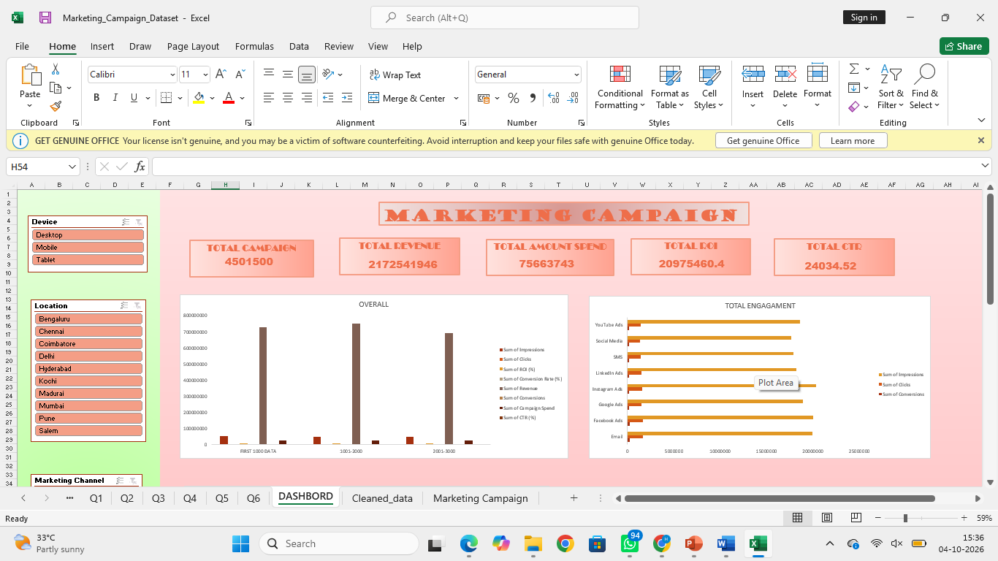

Slide 17
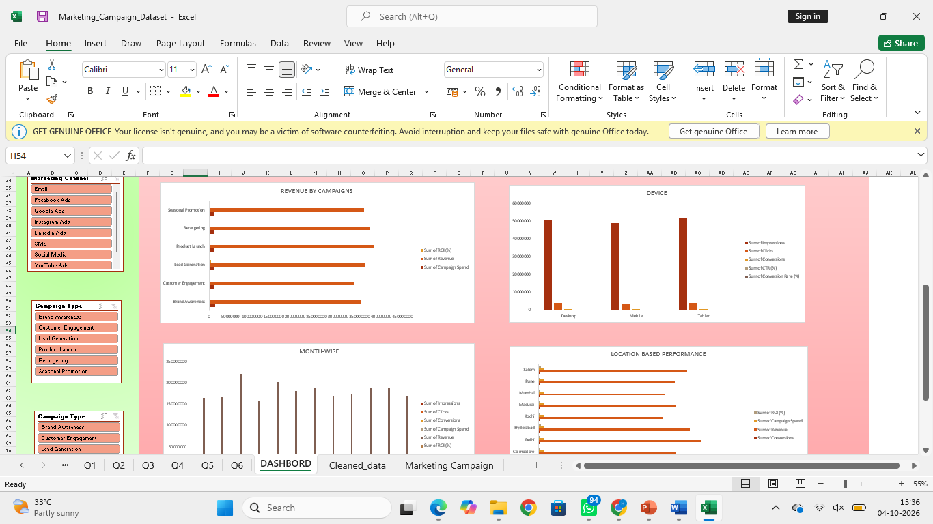

Slide 18
8. Conclusion
The workbook contains 3,000 campaign records covering the full year 2025.
Total revenue is $2.17B against $75.66M campaign spend.
The overall CTR is 8.06% and the overall conversion rate is 13.37%.
Product Launch leads campaign-type revenue, while Product Launch leads campaign-type ROI.
Hyderabad is the strongest location by calculated ROI, while Desktop leads device conversions.
The dashboard can convert these findings into actionable decisions on budget allocation, targeting and campaign optimization.
16

