Slide 1

Ticket Resolution, Satisfaction & Agent Performance | Data: 2016 - 2020 | 97,498 Tickets Analysed
IT Support Ticket Analysis &
Operation Dashboard
Presented By: Haripriya MC
09-08-2026

Slide 2

Introduction
This project analyses IT support ticket data collected over five years (2016–2020), covering ticket volumes, resolution times, satisfaction ratings, and agent performance across 50 IT agents. The goal is to build a clear, data-driven understanding of how the IT support function is operating — from basic data quality checks to deeper questions around agent efficiency, request categories, and customer satisfaction trends. The analysis is divided into objective questions, which establish foundational facts about the dataset, and subjective questions, which use those facts to answer practical business questions around training, tooling, and investment decisions. Ultimately, this study aims to provide actionable insights that help guide staffing, training, and technology investment decisions for the IT support team going forward.

Slide 3

Problem Statement
Modern IT support teams handle thousands of tickets every month, and even small inefficiencies can significantly affect employee productivity and satisfaction. This project analyses five years of IT support ticket data to understand ticket volume trends, agent performance, resolution times, and customer satisfaction. Before any deeper analysis, it is important to first establish what the raw data actually contains, how clean and complete it is, and what basic patterns exist across categories, agents, and time.
Project Objectives
01
Understand ticket distribution and trends over time
02
Evaluate agent performance and operational efficiency
03
Identify improvement areas for resolution time and satisfaction
04
Provide actionable insights to guide future IT investment decisions

Slide 4
Dataset Overview
What the data covers
97,498 tickets spanning 2016–2020
50 agents across all request categories
Key fields
Date, Request Category, Severity, Priority,
Resolution Time, Satisfaction Rate, agent demographics
Source
IT ticket log covering Hardware, Software, System and Login Access,
with Issue Type (IT Error / IT Request) — plus a separate
IT Agents sheet with age and tenure
Data cleaning
Removed duplicates, standardized Severity and Priority values,
corrected date formats and verified numeric fields
Why this data matters
It is the full operational record of the support function — the only way to separate genuine agent skill gaps from systemic process bottlenecks

Slide 5
Analytical Approach & Methodology
01
Data Cleaning
04
Trend & Correlation Analysis
Removed duplicates, corrected formatting inconsistencies, standardized categorical values (Severity, Priority), ensured correct data types for dates and numeric fields.
Analyzed temporal trends by year/quarter, age group vs satisfaction patterns, and severity vs resolution time correlation (r = -0.04).
02
Data Enrichment
05
Visualization & Dashboard
Linked ticket data with IT Agents sheet using VLOOKUP on Agent ID to retrieve full names, ages, and demographic details for agent-level analysis.
Created Dashboard covering all 13 Pivot Charts with interactive slicers for Year, Priority, Severity, Issue Type, and Request Category.
03
Descriptive Analysis
Evaluated ticket volumes, resolution times, satisfaction levels, and agent performance using pivot tables, COUNTIF, SUMIF, AVERAGE, and CORREL functions.

Slide 6
Key Performance Indicators
97,498
50
Total Tickets Analyzed
IT Agents
4.10
4.55
Avg Satisfaction Rate
Avg Resolution Days
2016–20
41.1
Data Time Span
Avg Agent Age

Slide 7
Objective Analysis
Yearly Ticket Volume Trend
Consistent upward trend across all five data points — no dips or reversals
Steady growth through the first four periods, roughly linear pace
Sharp acceleration in the final period, breaking from the earlier trend line
Momentum is building, suggesting the growth rate itself is increasing, not just the total

Slide 8
Objective Analysis
TICKET CATEGORY DISTRIBUTION
System issues dominate, accounting for 40% of the total — nearly double the next largest category
Login Access is the second-largest driver at 30%, together with System making up 70% of all issues
Software (20%) and Hardware (10%) are comparatively minor contributors
System + Login Access alone represent 7 out of 10 cases, suggesting these two areas should be the top priority for resolution or investigation

Slide 9
Objective Analysis
COUNT OF TICKET HANDLE BY EACH AGENT
Wide performance spread — the highest-performing agent handles noticeably more tickets than the lowest, with a smooth, gradual decline rather than sharp tiers
Most agents cluster in the middle, handling a fairly similar volume — the real outliers are at the two extremes
A long tail of lower-volume agents at the right suggests either newer team members, part-time capacity, or uneven ticket distribution
Top-heavy distribution: a small group of high performers likely accounts for a disproportionate share of total tickets resolved

Slide 10
Objective Analysis
ISSUE TYPE
IT Requests dominate the ticket volume, making up roughly three-quarters of all issues logged
IT Errors are a smaller share, around a quarter of the total
Requests outnumber errors by about 3:1, suggesting the team's workload leans more toward user-driven asks (access, provisioning, setup) than system/technical failures

Slide 11
Objective Analysis
COUNT OF SEVERITY OF TICKETS
Severity 2 overwhelmingly dominates, with 88,656 tickets — roughly 91% of all tickets (~97,498 total)
All other severities are minor by comparison: Severity 3 (4,836), Severity 4 (1,392), Severity 1 (2,258), and Severity 0 (356) combined make up less than 10% of volume

Slide 12
Subjective Analysis
INVESTMENT PRIORITY: TRAINING OVER HIRING OR SOFTWARE
No overload, no time-satisfaction link: Correlation between resolution time and satisfaction is ~0 (-0.004), and agent workload is fairly even (~1,850–2,050 tickets/agent) — so the problem isn't staffing capacity.
Performance gap is skill-based, not category-based: Satisfaction varies more across agents (3.04–4.60) than across ticket categories (~4.09–4.11), pointing to inconsistent agent knowledge/skill rather than process or category issues.
Recommendation: Prioritize training programs (addresses root cause) → secondary investment in ticket management software (improves routing/knowledge access) → hiring more agents is not justified by the data.

Slide 13
Subjective Analysis
AGENTS NEEDING TRAINING SUPPORT
14 agents fall below average on both satisfaction and resolution time — Alfonso Barraza stands out with the lowest satisfaction score (3.04)
6 agents (A. Trejo, Elena Velez, Lorena, Nurio Zepeda, Sandra Lujan, Guadalupe Villanueva) underperform on both metrics, signaling a systemic skills gap needing dual-track coaching

Slide 14
Subjective Analysis
TOOL EFFECTIVENESS HOLDING STEADY UNDER GROWING LOAD
Resolution time stayed flat across all categories (Hardware, Login Access, Software, System) from 2016–2020 despite rising ticket volume — no signs of tool strain
Satisfaction rate improved consistently in every category over the same period, showing current tools support a steadily improving customer experience

Slide 15
Subjective Analysis
STEADY QUARTERLY PERFORMANCE WITH GRADUAL IMPROVEMENT
Resolution time stayed consistent across quarters (4.52–4.58 days), with satisfaction rate trending upward each year within every quarter (e.g., Qtr1: 3.95 in 2016 → 4.14 in 2020)
No major seasonal spikes in resolution time despite year-over-year growth, though slightly higher volumes show mild upward pressure — suggesting room to optimize during peak periods

Slide 16
Subjective Analysis
TECH INVESTMENT COULD CUT RESOLUTION TIMES, LIFT SATISFACTION
Hardware, System, and Software requests show the longest resolution times (5.2–7.6 days) and the lowest satisfaction rates — the clearest targets for tech investment
34,348 of 97,498 tickets already resolve within 0–1 day, showing faster resolution is achievable and directly linked to higher satisfaction

Slide 17
Subjective Analysis
AGENT SENIORITY DRIVES FASTER, MORE SATISFYING RESOLUTIONS
Older/more experienced agent groups (53-58) show the lowest resolution times for Software and System requests, with the highest satisfaction rate (4.41) despite handling fewer tickets
Hardware and System requests remain the slowest category across every age group, pointing to task complexity rather than agent demographics as the root driver

Slide 18
Subjective Analysis
RISING TICKET VOLUME, RISING SATISFACTION YEAR-ON-YEAR
Ticket volume more than doubled from 13,051 (2016) to 29,088 (2020), yet satisfaction climbed in parallel from 3.98 to 4.16 — no sign of service strain
2020 marks the peak year for both volume and satisfaction, showing IT support scaled effectively despite the heaviest workload

Slide 19
Key Recommendations
01
Invest in Technology & Automation
Expected Impact:
Why: Hardware (7.6d) and System (6.6d) resolution times are excessive. Better routing software reduces these significantly.
Faster ticket resolution
Reduced agent workload
Improved satisfaction scores
02
Strengthen Agent Training Programs
Expected Impact:
Why: 14 agents show high resolution time + low satisfaction — a pattern indicating skill gaps, not headcount issues.
Close performance gaps without hiring
Consistent service quality
Higher team-wide satisfaction
03
Optimize Workforce Planning
Expected Impact:
Why: Ticket volumes grew 123% over 5 years with clear yearly peaks. Planning ahead prevents workload overload.
Better load distribution
Sustained satisfaction in peaks
Proactive resource allocation

Slide 20
Interactive Dashboard Overview
Count of ticket IDs by time.
Count of tickets by request category.
Satisfaction rate by time
Age group by satisfaction rate.
Distribution of tickets based on Resolution time
Agents Needs Training
Tool Effectiveness Vs IT Tickets
Employee Demographic Vs Avg Resolution Time
Ticket by severity rate.
Ticket by priority
Issue type
Average resolution time by request category, quarter-wise
Distribution of tickets based on satisfaction score.
Slicers
Dashboard Charts
Year
Priority
Severity
Issue Type
Request Category
How to Use the Dashboard
Filter by Year
Select a specific year to see how ticket volumes and satisfaction evolved over time.
Filter by Severity or Priority
Isolate high-severity or high-priority tickets to identify where resolution time is longest.
Filter by Category
Drill into Hardware, Software, System, or Login Access to compare category-specific performance.
Filter by Issue Type
Toggle between IT Error and IT Request to see the impact on resolution time and satisfaction.

Slide 21
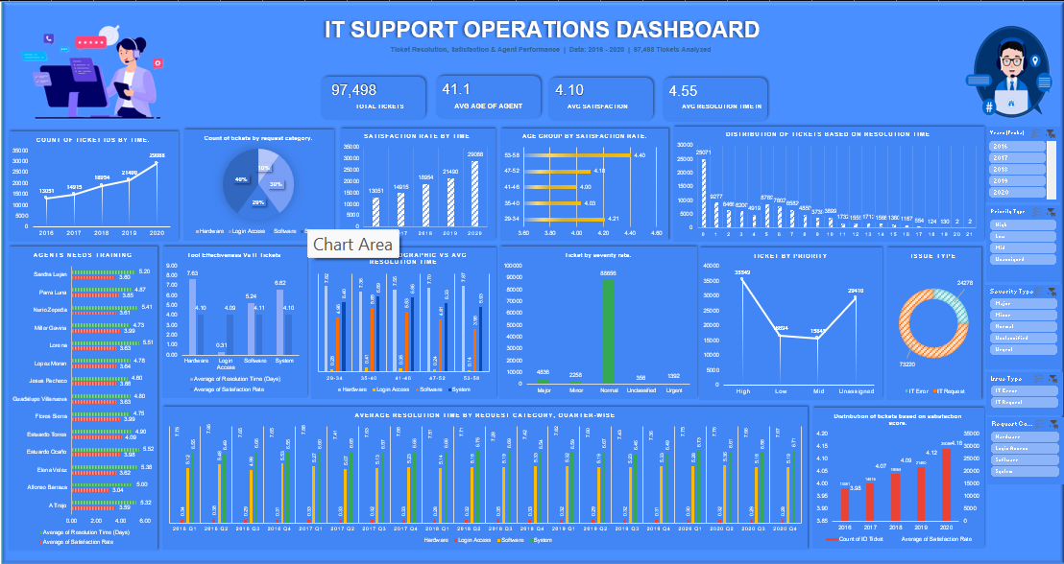

Slide 22
Conclusion & Summary
Key Findings
Final Recommendations
97,498 tickets analyzed across 5 years (2016–2020) with 50 agents
Ticket volume grew 123% — demand is accelerating
Satisfaction improved steadily: 3.98 → 4.16 despite higher volumes
Hardware requests: 7.63 days avg — highest resolution time by far
14 agents consistently underperform on satisfaction and resolution time
Severity-priority mismatches indicate software routing inefficiencies
Senior agents (53–58) achieve highest satisfaction (4.41)
80% of tickets rated 4–5 stars — solid overall service quality
Upgrade ticket management software with AI routing
Implement targeted training for the 8 underperforming agents
Use data-driven shift planning for peak periods
Monitor severity-to-priority alignment continuously
Leverage senior agents as mentors for complex categories
By leveraging data-driven insights and interactive dashboards, organizations can improve IT service efficiency, enhance satisfaction, and make smarter investment decisions.

