Slide 1


Python Introduction
Grow@TCS ILP
September 4, 2024

Slide 2
What is python
Definition: Python is a high-level, interpreted programming language known for its simplicity and readability.
History:
Created by Guido van Rossum.
First released in 1991.
Key Features:
Easy to learn and use.
Dynamically typed.
Extensive standard library.
Supports multiple programming paradigms (procedural, object-oriented, functional).

Slide 3
Why Learn Python
Popularity: Widely used in various fields such as web development, data analysis, artificial intelligence, scientific computing, and more.
Community: Large and active community, with extensive documentation and support.
Versatility: Can be used for small scripts to large-scale applications.
Career Opportunities: High demand for Python developers in the job market.

Slide 4
Python Syntax and Basics
Hello World Example :
print('welcome to python programming’)
Variables and Data Types:
Integer
count = 5
Float
average = 10.5
String
message ='Good morning’
Boolean
is_listening = True

Slide 5
Python Basics cont...
Basic Operations:
Arithmetic operations: + ,- ,*,/,%
Example
a=5
b=10
add= a + b

Slide 6
Control Structures
Conditional statements:
if age >=18:
print('major')
else:
print('minor’)
Looping statements
For loop:
for i in range(1,6):
print(i)

Slide 7
Functions
Function definition:
def greeting(name):
print('Hello ' + name + ' Welcome’)
def add(a,b):
return a+b
Calling a function
greeting('Sam’)
sum = add(5,7) print(sum)

Slide 8
Data Structures in Python
Lists
fruits = ['Apple’, 'Mango’, ‘Grapes’]
Dictionary
employee_alice = {'name':'Alice','age':45}
Tuples
point=(10,20)
Sets
natural_numbers ={1,2,3,4,5}

Slide 9




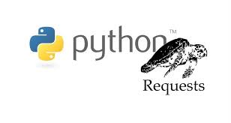
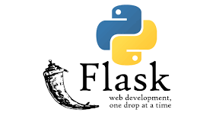
Libraries and Frameworks
Popular Libraries:
NumPy: Numerical computing.
Pandas: Data manipulation and analysis.
Matplotlib: Data visualization.
Requests: HTTP requests.
Popular Frameworks:
Django: Web development.
Flask: Micro web framework.

Slide 10
Getting started with Python
Installation
Download from the official website: python.org
Use the package managers like pip to install libraries
IDE and Text Editors:
PyCharm
VSCode
Jupyter Notebook
Sublime Text
Commands:
Running a script: - python script.py
Installing a package – pip install package_name

Slide 11
Conclusion
Python is a versatile and easy-to-learn programming language.
Widely used across various domains.
Strong community and extensive libraries.

Slide 12
DEMO

