Slide 1
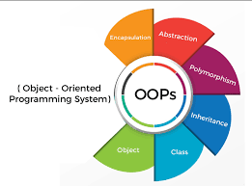

Object oriented programming in python
Grow@TCS ILP
September 15, 2024

Slide 2
What is Object-Oriented Programming (OOP)?
A programming paradigm based on the concept of "objects", which can contain data and code to manipulate that data.
Core Concepts: Encapsulation, Abstraction, Inheritance, and Polymorphism.

Slide 3
Why Use OOP?
Modularity: Code is organized into objects, making it easier to manage and understand.
Reusability: Objects and classes can be reused across different programs.
Scalability: Easier to manage and scale large software projects.
Maintainability: Enhances code maintainability through better organization and structure.

Slide 4
Basic Terminology - OOP
Class: A blueprint for creating objects (a particular data structure).
Object: An instance of a class.
Method: A function defined within a class.
Attribute: A variable bound to an instance of a class.

Slide 5
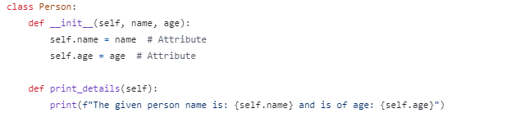
Creating a Class in Python
__init__ Method: The constructor method for initializing an object's attributes
Self Parameter: Refers to the instance of the class.

Slide 6
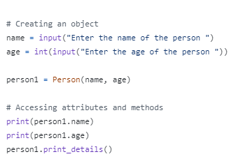
Creating an Object
Instantiation: Creating an instance of a class.
Accessing Methods and Attributes: Using the dot notation.

Slide 7
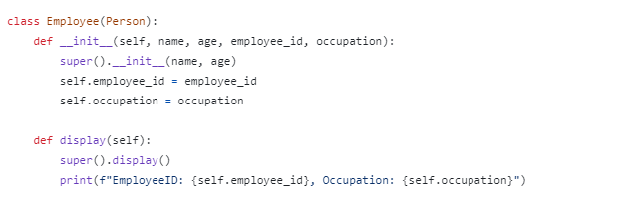
Inheritance
A mechanism for creating a new class using details of an existing class
super() Function: Calls the parent class's constructor.

Slide 8
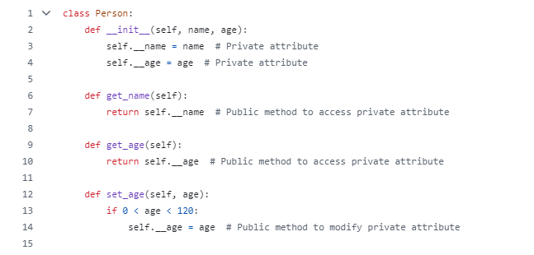
Enscapsulation
Definition: Bundling data with methods that operate on that data.
Private Attributes: Attributes that cannot be accessed directly from outside the class.

Slide 9
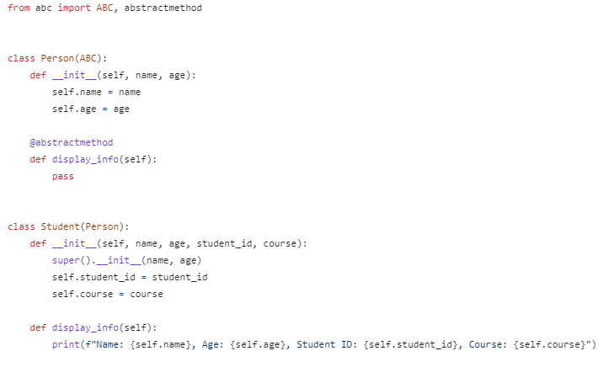
Abstraction - Hiding the complex implementation details and showing only the necessary features

Slide 10
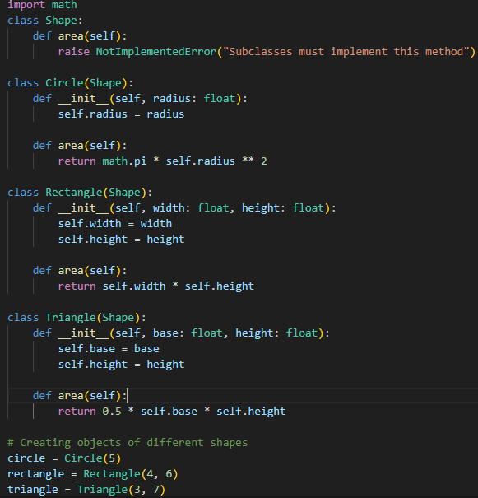
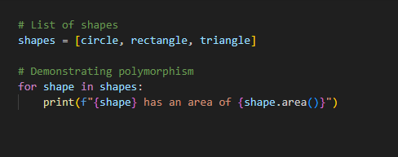
Polymorphism - the ability of one object to take on multiple forms

Slide 11
Real-World Applications - OOP
Software Development: Creating modular, reusable code
Game Development: Managing game entities and behaviors.
Data Science: Structuring data and operations in a clear, organized manner.
Web Development: Creating scalable and maintainable web applications.

Slide 12
Conclusion
OOP principles help create organized, reusable, and scalable code.

Slide 13
DEMO

