Slide 1


Python operators and Constructors
Grow@TCS ILP
September 8, 2024

Slide 2
Python operators and constructors
In Python, operators and constructs are essential components that allow you to perform various operations and control the flow of your programs
Operators are special symbols or keywords that perform operations on operands.
Python constructs are the fundamental building blocks of the language

Slide 3
Operators in python
Arithmetic Operators - Perform basic mathematical operations
Comparison (Relational) Operators - Compare values and return a Boolean result
Logical Operators: Combine conditional statements
Bitwise Operators: Perform operations on binary numbers
Assignment Operators: Assign values to variables
Identity Operators: Check if two values are located on the same part of the memory.
Membership Operators: Test for membership in a sequence (like strings, lists, or tuples).

Slide 4
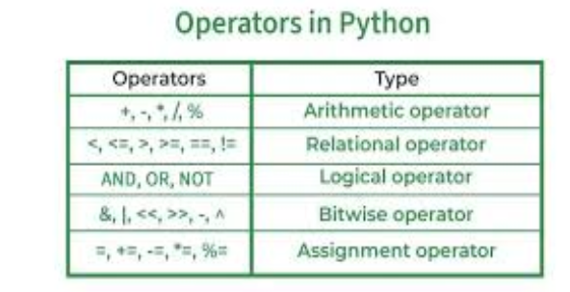
Operators in Python in python cont ....

Slide 5
Operators in python cont....
Identity Operators:
is: a is b
is not: a is not b
membership Operators
in: a in b
not in: a not in b

Slide 6
Functions
Function definition:
def greeting(name):
print('Hello ' + name + ' Welcome’)
def add(a,b):
return a+b
Calling a function
greeting('Sam’)
sum = add(5,7) print(sum)

Slide 7
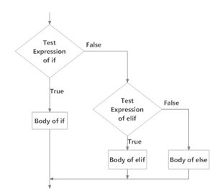
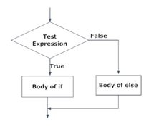
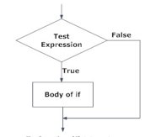
Python constructs – conditional statements
If .... elif - else statement
If statement
If .... else statement

Slide 8
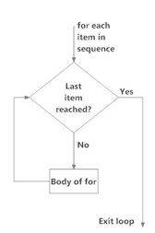
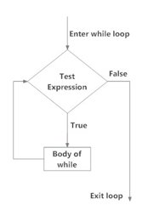
Python constructs- looping statements
For loop
While loop

Slide 9
Classes and objects in Python
class Employee:
def __init__(self, name, age):
self.name = name
self.age = age
def display_info(self):
print(f"Name: {self.name}, Age: {self.age}")
emp1 = Employee("John Doe", 30)
emp1.display_info()
emp1.display_info()

Slide 10
Modules and packages in python
Default modules in python:
Examples – math, json, random
User defined modules in python
Function defined in a python file could be called/used in another python file.

Slide 11
Exceptional handling in python
try:
result = 10 / 0
except ZeroDivisionError:
print("Cannot divide by zero")

Slide 12
DEMO

