Slide 1
Advanced Detection of Fraudulant claims Using Machine Learning

Slide 2
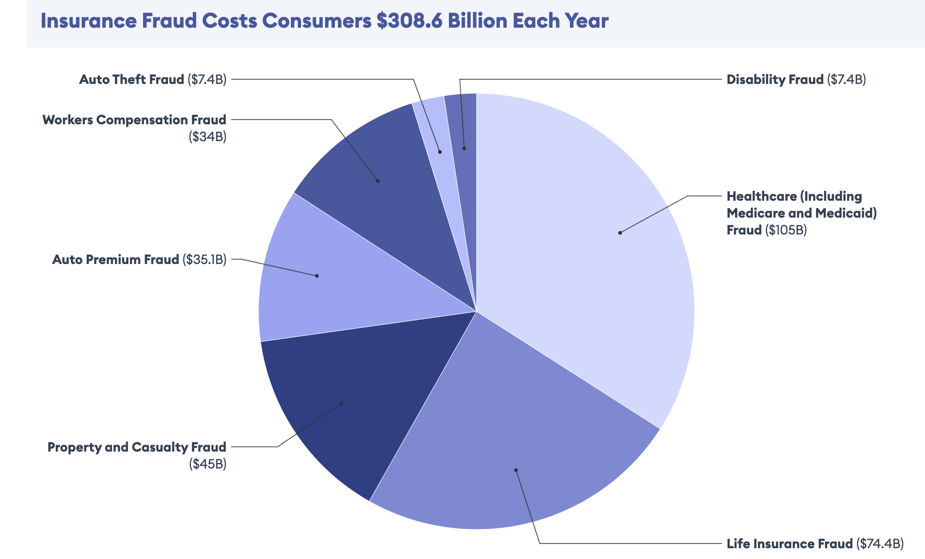
Project Overview
Objective
To develop a machine learning model that accurately detects fraudulent auto insurance claims, helping reduce financial losses and enhance the efficiency of the claims processing system.
Importance
Auto insurance fraud costs the industry billions of dollars annually.
Accurate detection of fraudulent claims is crucial for minimizing these losses and maintaining trust with policyholders.

Slide 3
Machine Learning Approach
Preprocessing
01
Utilize a dataset of auto insurance claims and preprocess it and Perform feature engineering
02
EDA
Conduct Exploratory Data Analysis (EDA) to understand the data and uncover patterns.
Feature Selection
04
ML techniques
03
Perform feature selection using Random Forest model.
Apply various machine learning techniques to build and evaluate a robust fraud detection model.

Slide 4
Dataset Overview
Dataset Description
Key Features
Data Challenges
The size of dataset is 40,000.
Dataset Link
39 features
Target variable: Fraud Reported (Yes/No).
Customer Information: Age, occupation, education level
Policy Details: Policy number, annual premium, deductible
Claim Details: Total claim amount, property, injury, vehicle
Imbalanced classes
Missing values and outliers
High dimensionality

Slide 5



Data Preprocessing
Initial Exploration –
Analyzed data distribution and types including identifying missing values.
Handling Missing Values -
Dropped column _c39 because it contained all null values.
Replaced missing values in authorities_contacted with the mode.
Data Transformation -
Calculated customer tenure (months as a customer) from policy_bind_date for better analysis.
Transformed fraud_reported from categorical (Y/N) to binary (1/0).

Slide 6
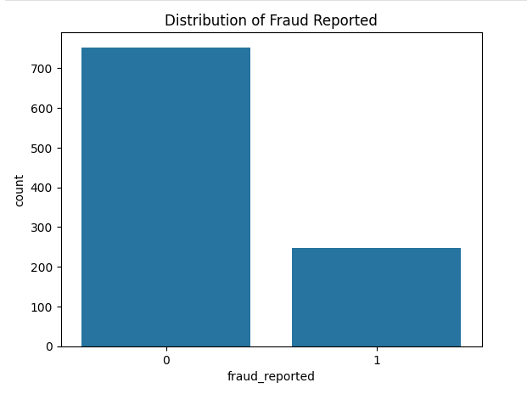
Distribution of Fraud Reported
01
Majority of claims are not fraudulent.
02
Imbalanced dataset with more non-fraud cases.
03
Important for model training considerations.

Slide 7
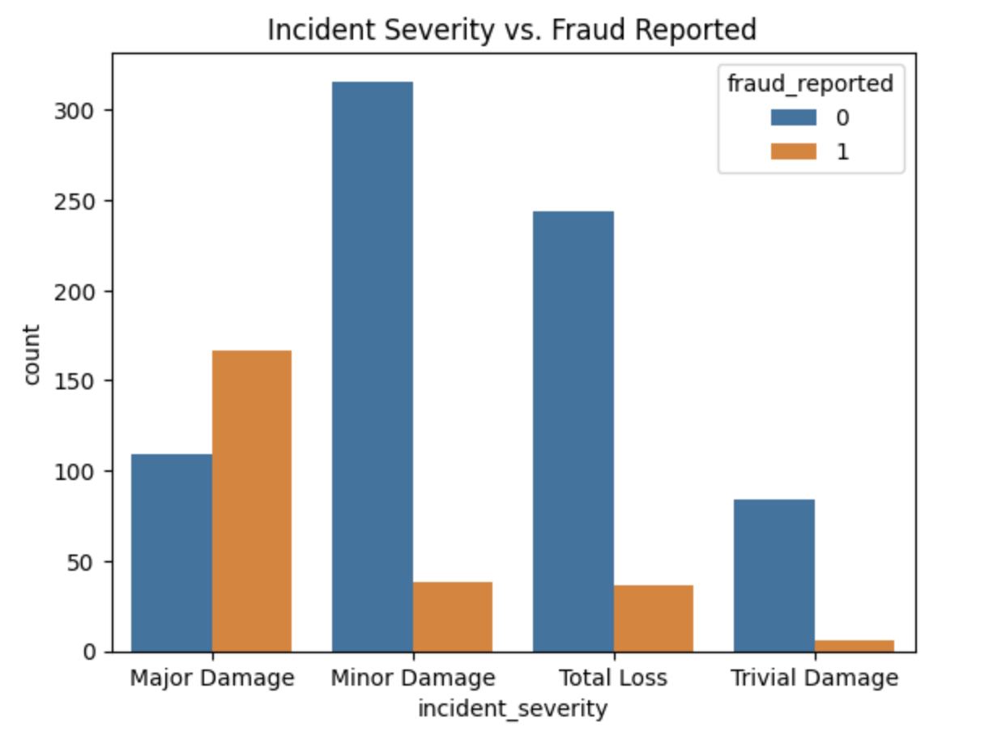
Incident Severity vs. Fraud Reported
01
Higher fraud in cases of major damage.
02
Minor damage incidents less likely to be fraudulent.
03
Clear pattern between severity and fraud.

Slide 8
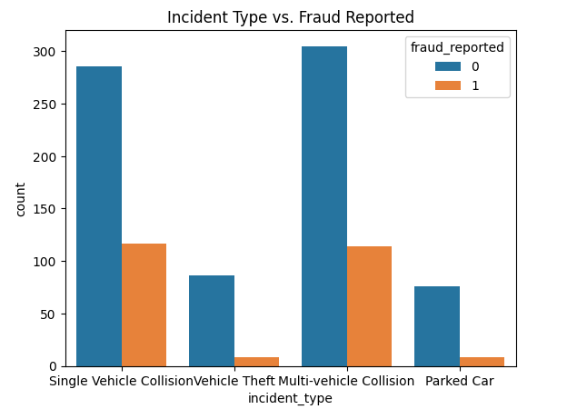
Incident Type vs. Fraud Reported
01
Multi-vehicle collisions have higher fraud.
02
Vehicle theft less associated with fraud.
03
Incident type affects fraud probability.

Slide 9
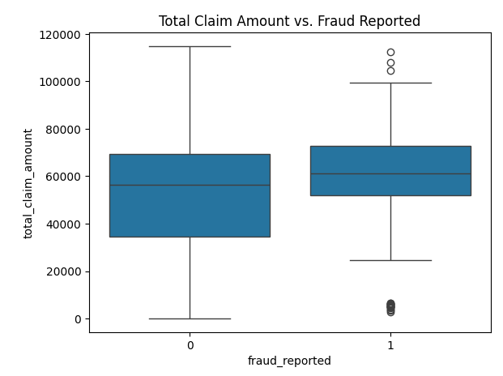
Total Claim Amount vs. Fraud Reported
01
Higher claims more associated with fraud.
02
Slightly lower median for fraudulent claims.
03
Presence of outliers in fraudulent claims.

Slide 10
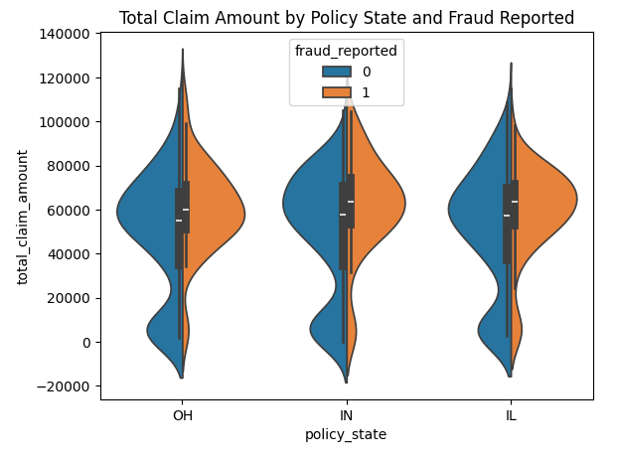
Total Claim Amount by Policy State and Fraud Reported
01
Fraudulent claims distributed across all states.
02
Some variance in claim amounts by state.
03
Ohio shows a broader range of fraudulent claim amounts.

Slide 11
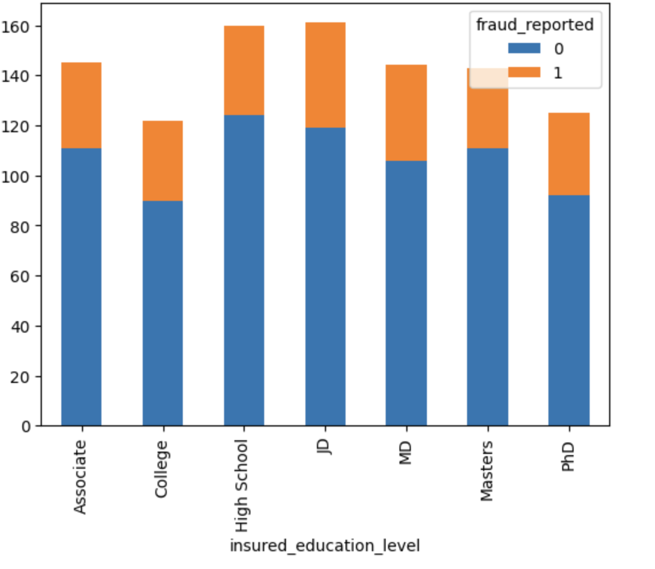
Education Level vs. Fraud Reported
01
Higher education levels show more fraud.
02
High School and College show less fraud.
03
Education might be a factor in fraud risk.

Slide 12
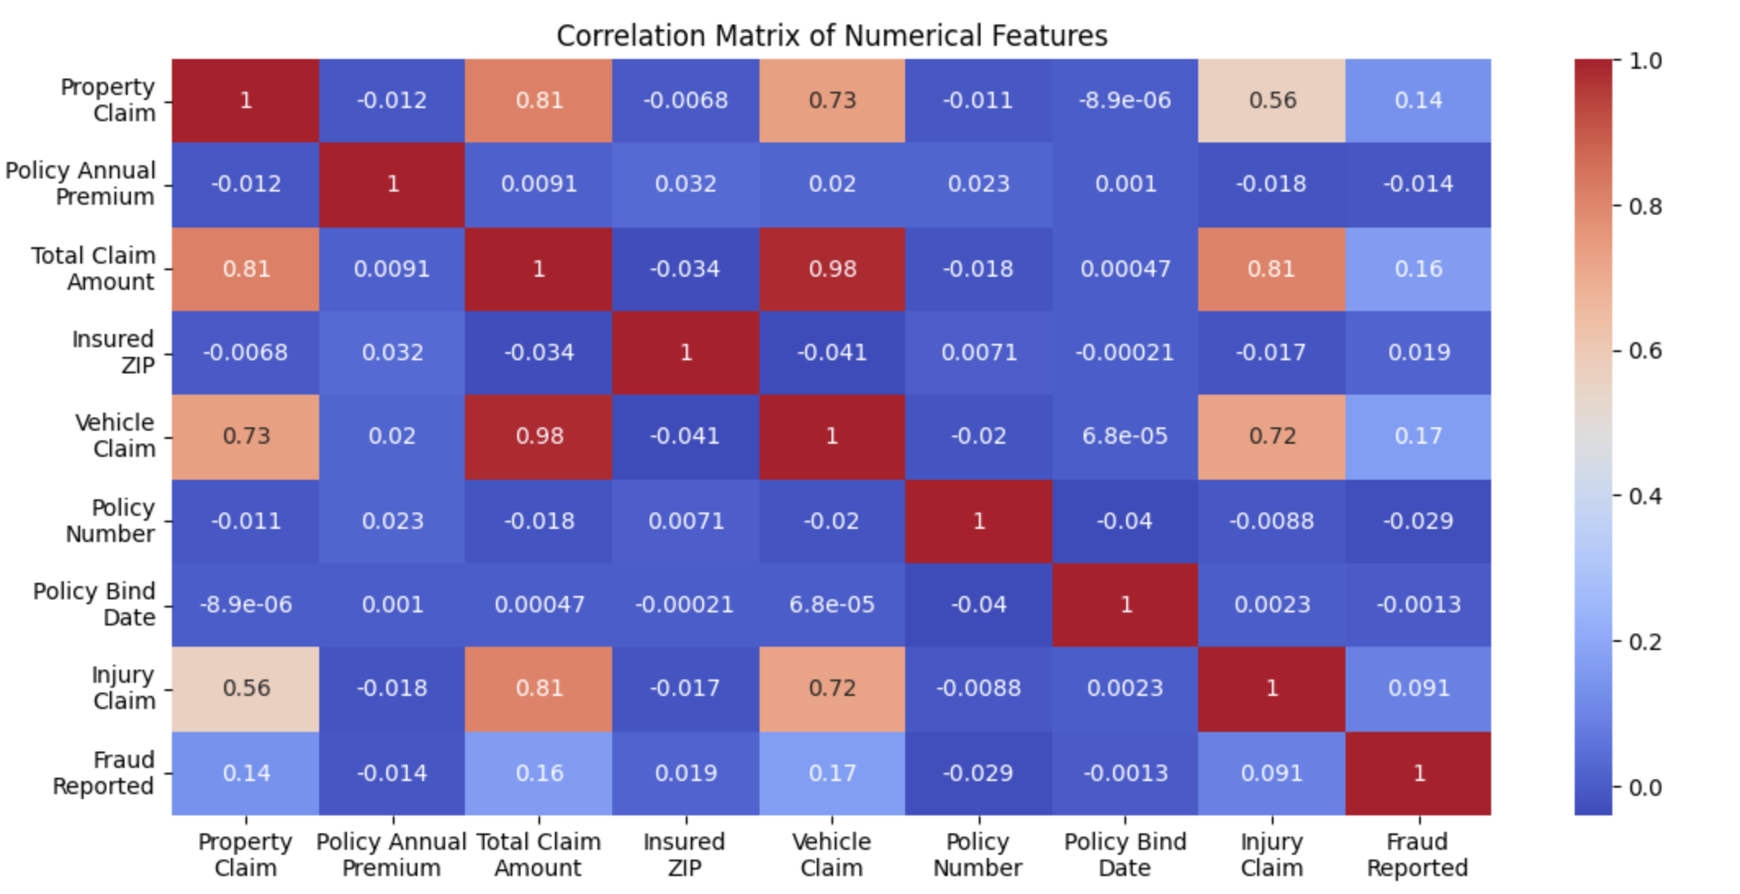
Correlation Matrix of Numerical Features

Slide 13
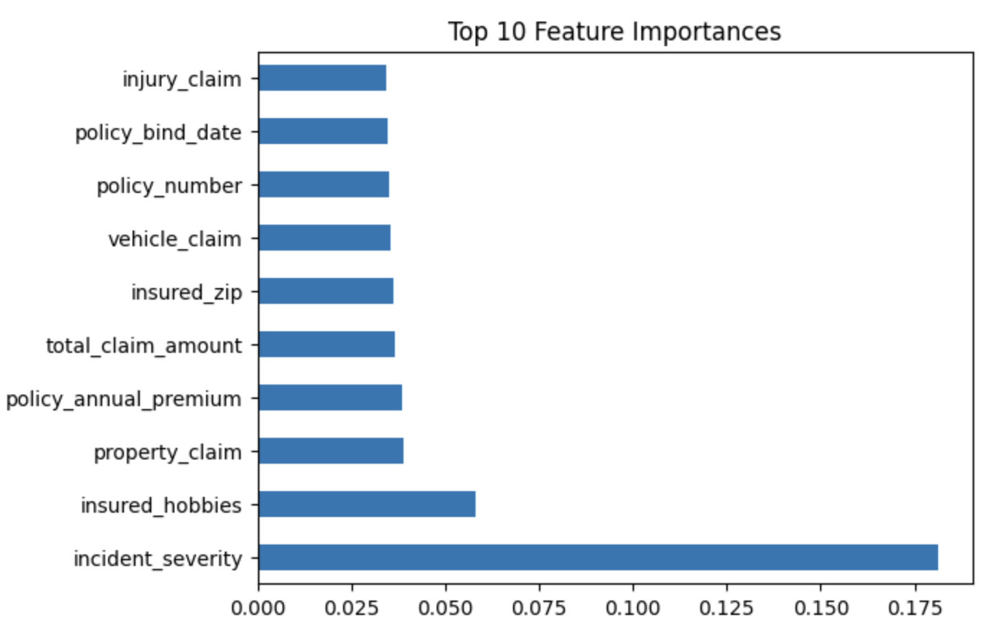
Feature Selection
Top Features: Incident_severity, insured_hobbies, and property_claim highlight the importance of incident details and personal traits in detecting fraud.
01
02
Why Random Forest: Selected for handling complex, non-linear relationships and delivering clear feature importance.
03
Model Robustness: Random Forest’s ensemble method reduces overfitting, ensuring more reliable fraud predictions

Slide 14
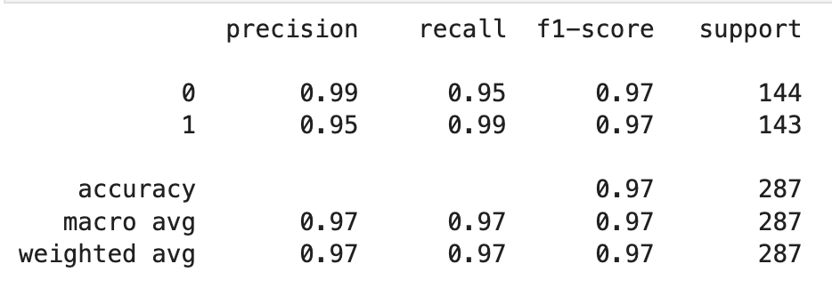
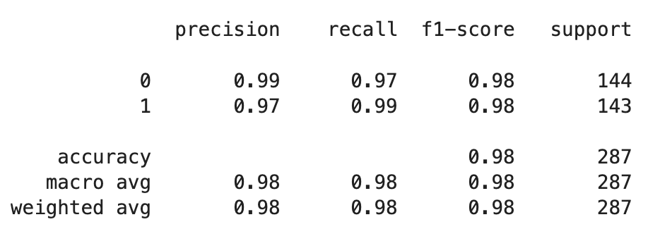
Logistic Regression
01
Accuracy Improvement: From 76% (baseline) to 97.56% (SMOTE), demonstrating the effectiveness of hyperparameter tuning.
02
Logistic Regression metrics
Enhanced Fraud Detection: Significant reduction in false negatives, improving the model's ability to catch fraudulent claims.
03
Balanced Performance: Maintains a strong balance between precision and recall, ensuring reliable and consistent predictions.
Logistic Regression metrics with oversampling

Slide 15
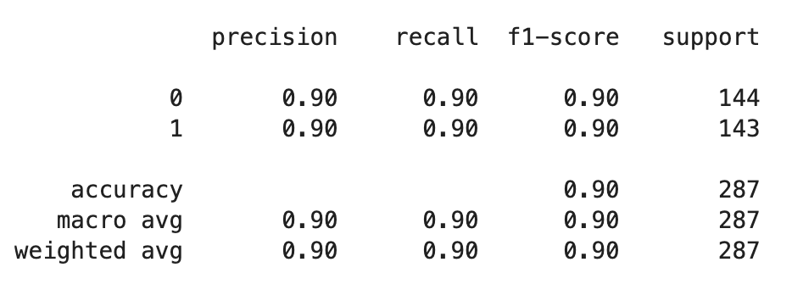
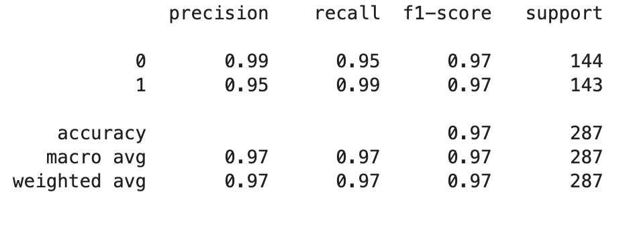
Random Forest
01
Accuracy Improvement: From 89.55% (baseline) to 90.24% (tuned), showcasing the effectiveness of hyperparameter optimization.
02
Random Forest metrics
Balanced Precision and Recall: Both models show a balance, but tuning further enhances the model’s reliability.
03
Tuned Model Robustness: The tuning process leads to a more robust model, with improved generalization and higher F1-scores.
Tuned Random Forest metrics

Slide 16
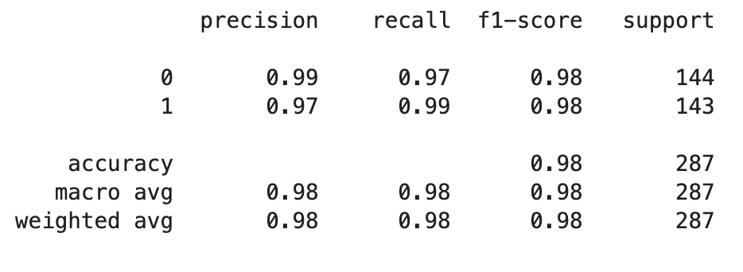
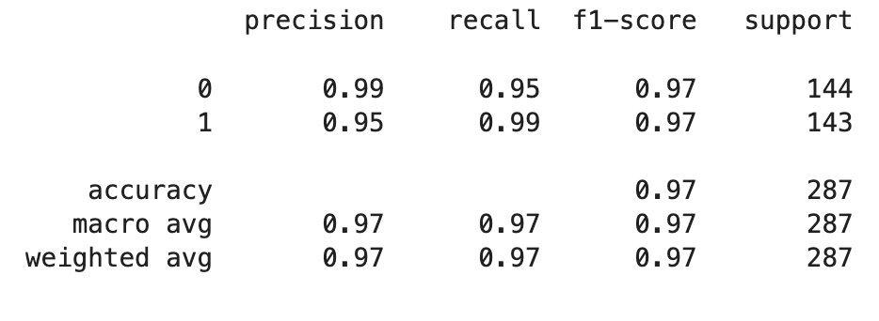
Support Vector Classifier
01
SVC Performance: Baseline SVC achieved an accuracy of 97.91%.
SVC metrics
02
Tuning Impact: Slight reduction in accuracy to 96.86% after tuning, indicating potential overfitting or data sensitivity.
03
Model Stability: Both models exhibit high precision and recall, demonstrating strong performance across fraud detection tasks.
Tuned SVC metrics

Slide 17
Overall Model Performance Comparison
Accuracy Gains: Significant improvements in accuracy were achieved across all models after tuning, with the best results seen in Logistic Regression and Random Forest.
Balanced Precision and Recall: All tuned models maintained a strong balance between precision and recall, ensuring reliable and consistent fraud detection.
Key Takeaway: Tuning hyperparameters has proven essential in enhancing model performance, reducing false negatives, and improving the overall robustness of fraud detection.

Slide 18
Conclusion
Real-World Application: Provides a reliable framework for detecting and preventing fraud in real-world scenarios
Future Improvements:
Incorporate additional data sources (e.g., social media, transaction history).
Implement real-time analytics for continuous model updates.
Impact: Lays the foundation for a more adaptive and effective fraud detection system.

Slide 19
Thank You

