Slide 1
Assignment - QA Engineer Sep 22[4293]
Haripriya Palaniswamy
18Oct2022
Notes:
© Copyright Showeet.com

Slide 2
Use case Analysis
Actor : User
System : Application
Use case: 1.Search for product
2.Add product to Bag
3.Validate Bag

Slide 3
Additional Tests
Verify Home Page and search box
Verify listed product-Yodas
Verify Add to Bag button
Verify Confirmation popup
Validate product details in the cart
Validate cart update

Slide 4
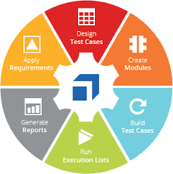
Testcase Architecture-Tricentis Tosca

Slide 5
Test Data Approach
Valid : possible input(Fireman)
Invalid: Wrong input(4657dhgfd)
Straight through: Least dependencies(Yodas)

Slide 6
Test Approach/Strategy
Approach:Test Data driven
Type : Acceptance testing
Testing : Black box testing
Script : Scripted testing
Method : Automation testing

Slide 7
Risks,Issues and Dependencies
Risk : Unable to add product to cart
Issue : Product information unavailable
Dependency : Datasource connection

Slide 8
Scalable Solution
Use of Reusable Test step blocks
Use test case design
Use Business Parameters
Use Configuration Parameters

Slide 9
Q&A
Notes:
© Copyright Showeet.com

Slide 10

THANK YOU
Notes:
© Copyright Showeet.com

