Slide 1

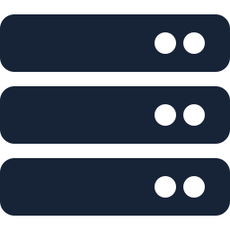

Frontend vs Backend vs Tester
Flipkart example. Think of Flipkart, the online shopping app.
Frontend
Backend
Tester

Slide 2
Frontend Developer
Builds everything you see and touch.
What they build
Tools
The home screen
Product images
The search bar
The “Add to Cart” button
The live map showing your delivery partner
React
Flutter
Kotlin
Swift
Their job is to make the app look good, feel smooth, and work well on different phones.

Slide 3
Backend Developer
Builds the hidden engine behind the screen.
When you tap “Place Order”, the backend
Tools
Checks stock at the nearest warehouse
Works out the price and discounts
Takes your payment
Saves the order in a database
Picks a delivery partner
Java
Node.js
Python
Databases
APIs
You never see it, but the whole app depends on it.

Slide 4
Tester
Makes sure everything works before real customers use it.
They try things like
Tools
What if I order an out-of-stock item?
What if the payment fails halfway?
What if the coupon expires while I’m checking out?
Selenium
Postman
Appium
They report bugs, and often write automated tests too.

Slide 5



Simple Analogy
Think of a restaurant.
Frontend
Backend
Tester
The dining area and the menu
The kitchen
The quality checker who tastes the food before it reaches you

