Slide 1
DIABETIC RETINOPATHY DETECTION
(By Axiom Team
Haseeb Axiom
Haris Axiom
Bilal Wakeel Axiom

Slide 2
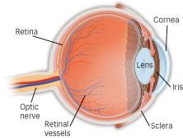
DIABETIC RETINOPATHY
People with diabetes can have an eye disease called diabetic retinopathy. This is when high blood sugar levels cause damage to blood vessels in the retina. These blood vessels can swell and leak. Or they can close, stopping blood from passing through. Sometimes abnormal new blood vessels grow on the retina. All of these changes can steal your vision.

Slide 3
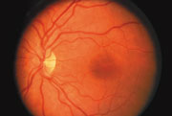
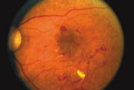
STAGES OF THE DISEASE
There are two main stages of diabetic eye
disease.
A normal retina.
A retina showing signs
of diabetic retinopathy.

Slide 4
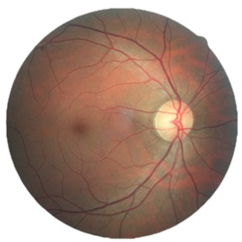
Process Flow
Colored images of eye
Adaptive Histogram Equalization
Grayscale Conversion
Discrete Wavelet Transform
Gabor Kernel
Feed into ML Model
K-means Clustering

Slide 5
Process Overview
Grayscale Conversion: Basic Dimensionality Reduction
Adaptive Histogram Equalization: Enhancing Darker portions of the image
Discrete Wavelet Transform: Fastest Wavelet Transform, it is based on sub band coding, to reduce the image features (done as a pre-processing to the next step)
Gabor Kernel: Displays Optic Nerves and Retinal pores with more precision

Slide 6
Contd..
K-Means Clustering: To separate images based on classes (2 centers are used)
MACHINE LEARNING MODELS:
Support Vector Machines (SVM): SVM with RBF Kernel is used for the training and prediction of these pre-processed images.
K-Nearest Neighbors (KNN): KNN with 3 nearest neighbors is implemented.
Then, results of both these models are compared.

Slide 7
Result and Observations
SVM Model was implemented with an accuracy of 96.62%.
KNN Model was implemented with an accuracy of 94.38%.
We find that SVM gives a higher accuracy
compared to KNN on this dataset.
(All images and results are visualized in the Python Jupyter Notebook.)

