Slide 1


Parametric Analysis of a turning operation using Taguchi Method
Haris Dilawar(18-ie-27)
Abdullah Aamir(18-ie-15)

Slide 2
Design of Experiments
DOE is also is also known as Designed Experiments or Experimental Design and begins by identifying the major factors that could cause process variance.
The Design of Experiments (DOE) method allows quality teams to simultaneously investigate multiple potential causes of process variation.

Slide 3

The Designed Experiments tool contains three elements.
Factors
(Select the Factors)
Levels
(Set the Levels)
Response
(Evaluate the Response)

Slide 4

Types of Designs of Experiments
Determining which type of DOE to use depends largely on: - Experimental goal; - Cost and resource constraints (or any practical limitations)

Slide 5
Some types of Designs of experiments
Full factorial designs
Fractional factorial designs (Screening designs)
Response surface designs(RSM)
Mixture designs
Taguchi array designs
Split plot designs

Slide 6
Taguchi philosophy
“Genichi Taguchi” (statistician and an engineer)
“Robust design method to improve quality of products/goods”.
Focused on developing of “design studying variations”.

Slide 7
Process Stages in Taguchi
System Design(involving creativity and innovations)
Parametric Design(set the detailed design)
Tolerance Design(quality inspection)

Slide 8
Robust Parametic Taguchi design
Control Factors
Noise Factors
Signal Factors
Statistic Analysis
Dynamic Analysis

Slide 9
Control factors
Internal factors ,internal Array
Factors that can be controlled by a manufacturer
Controllable factors

Slide 10
Noise factors
Factors that cant be can not be controlled by the manufacturer
Also known as external array or external factors

Slide 11
Signal factors
Factors controlled by the consumer or customer
Depends upon the conditions and the way product is used by a consumer in different conditions.

Slide 12
Static analysis
Only uses control and noise factors to optimize the parameters.
Normally performed when there is no signal factor
Signal to Noise Ratio(Signal/Noise= mean/variance)
Mean response

Slide 13
Dynamic analysis
Uses all three factors (control, noise and signal factors) in optimizing the robust parameters
Signal to Noise Ratio is produced
Slope response(from simple linear regression assuming linear relationship between signal factor and response)

Slide 14
Taguchi Design softwares
Minitab
Ms Excel

Slide 15

Taguchi design in Minitab (Simple static Analysis)
Step 1
Define all the variables factors :
Internal (control) factors
External(Noise) factors
Conditions(Signal) factors(not in this case)
Record response factors/variables(output)

Slide 16
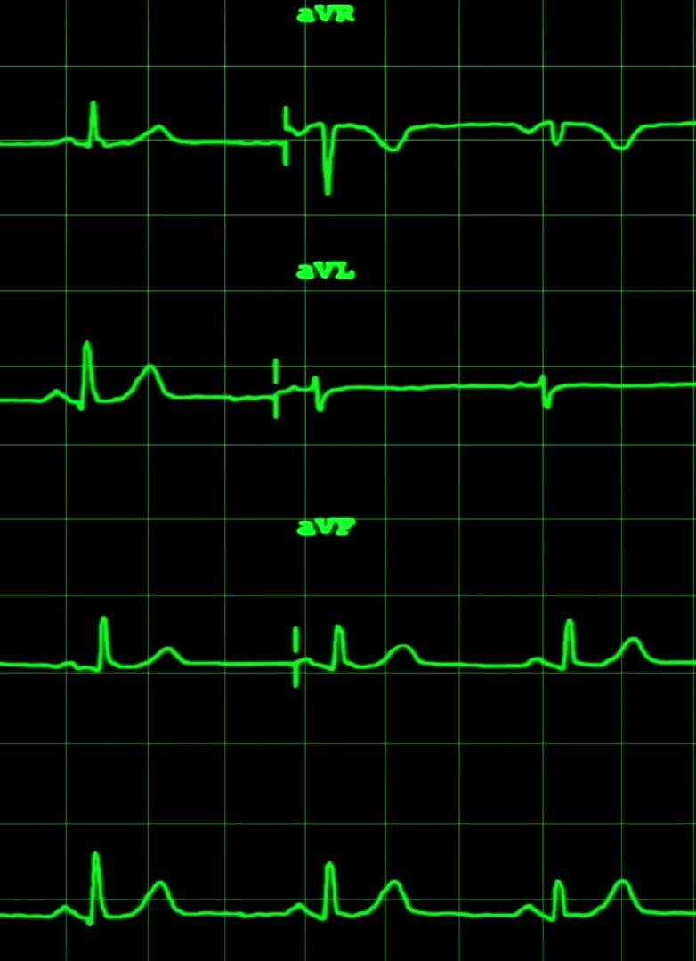
Contd.
Step2
Input the internal variables and response variables in the Minitab sheet
(Variables =factors)

Slide 17

the Taguchi design
Step3
From stats >DOE>Taguchi design Analysis
Assign factors and response variables
Assign signal factors if any
Select signal to noise ratio and means from the analyze Taguchi graphs
Select “larger is the better” (in case of finding maximum best) from Taguchi design analyze options

Slide 18

Taguchi Design in Minitab
We can use Taguchi robust parameters for
Maximum value
For excel use formula
For Minitab select “higher the better”

Slide 19
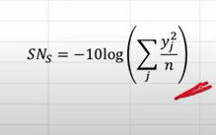
For minimum
Formula in excel or mathematically
Select “smaller the best” in minitab

Slide 20
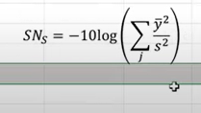
For target mean for comparison with our variations
Use formula

Slide 21

Step4
Output
We will get Data Means of Main effects plots of “Means” and “SN ratio”

Slide 22
Step5
(Analyzing the outputs)
We can analyze our outputs for maximum values of means from
Mean response
Step6
(Interpretation)
Interpret the results proving the statistical analysis has come to an end mentioning the obtained values in a summary with conclusion.

Slide 23

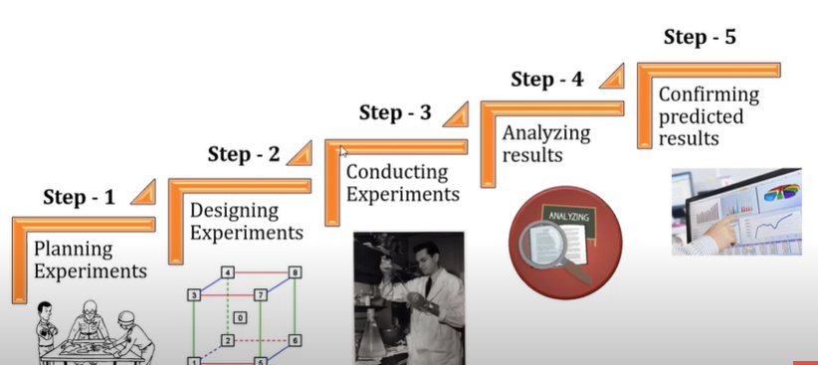




Slide 24
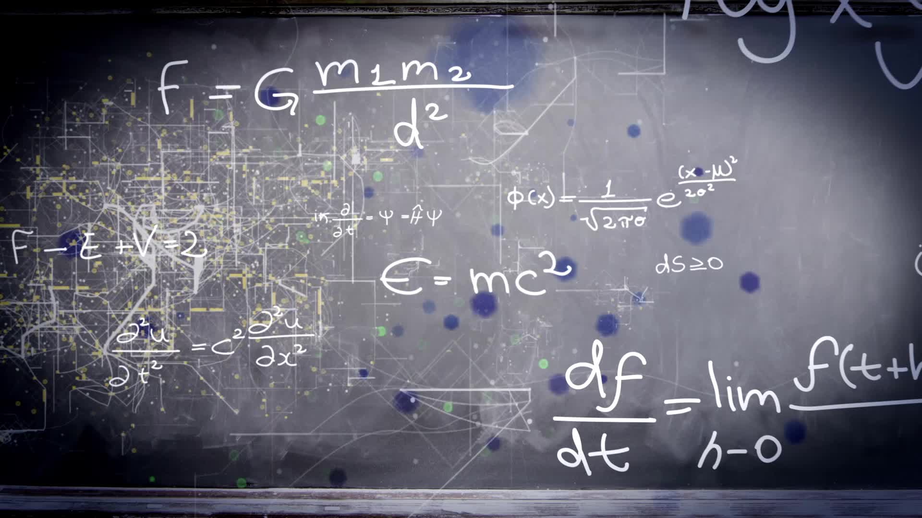
Further approaches to Taguchi
Orthogonal arrays(CR.RAO,Lambard)
Ronal Fisher(ANOVA)
QUALITY loss function and quadratic loss function

Slide 25
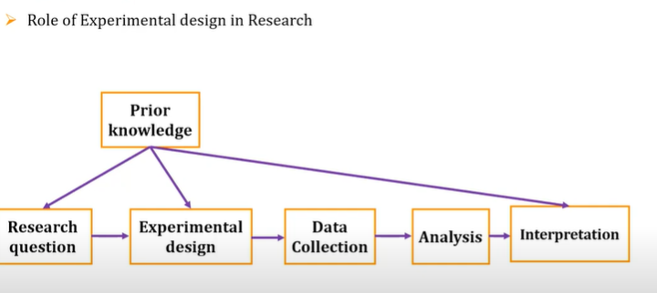

Slide 26
references
https://youtu.be/Uw76Ig-Volg
https://youtu.be/kswUMqpCxkk
https://youtu.be/1cYEyCXMTxo
https://youtu.be/p5I_vRPyUc0
https://youtu.be/2JuYwZ7fS7k

