Slide 1


TENSORFLOW TUTORIAL
Muhammad Zaid
January 28, 2018

Slide 2
Any Queries related to Linear Regression ?

Slide 3
Intro to Deep Learning Frameworks
Scales machine learning code
Computes gradients!
Standardizes machine learning applications for sharing
Zoo of Deep Learning frameworks available with different advantages, paradigms, levels of abstraction, programming languages, etc
Interface with GPUs for parallel processing
In some ways, rightfully gives Deep Learning its name as a separate practice

Slide 4
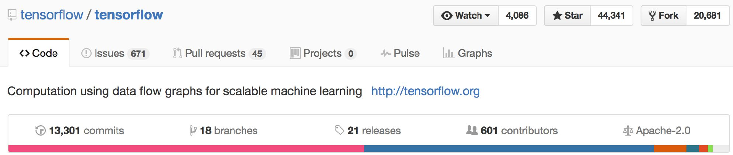
What is TensorFlow?
Open source software library for numerical computation using data flow graphs
Originally developed by Google Brain Team to conduct machine learning research
“Tensorflow is an interface for expressing machine learning algorithms, and an implementation for executing such algorithms”

Slide 5
Programming model
Big idea: express a numeric computation as a graph.
Graph nodes are operations which have any number of inputs and outputs
Graph edges are tensors which flow between nodes

Slide 6
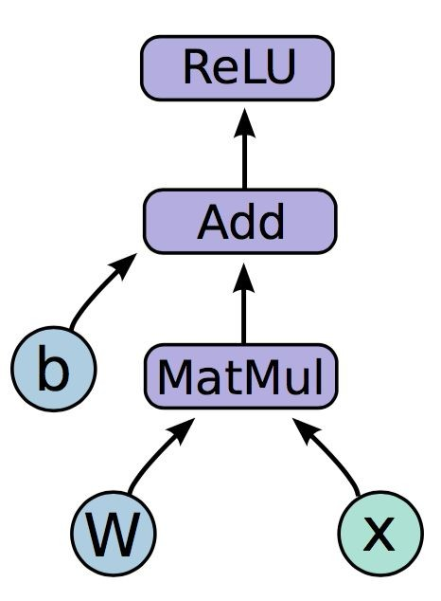
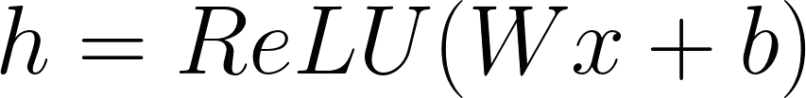
Programming model

Slide 7
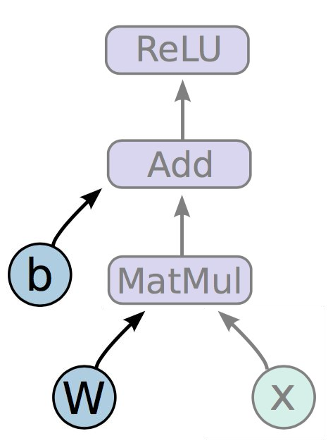
Programming model
Variables are stateful nodes which output their current value.
State is retained across multiple executions of
a graph
(mostly parameters)

Slide 8

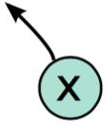
Programming model
Placeholders are nodes whose value is fed in at execution time
(inputs, labels, …)

Slide 9
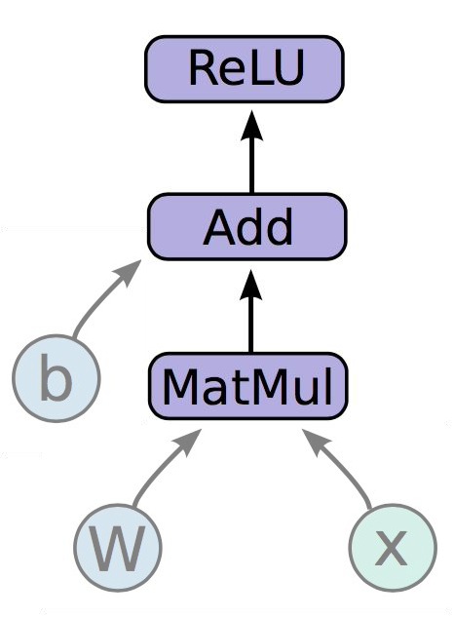
Programming model
Mathematical operations:
MatMul: Multiply two matrix values.
Add: Add elementwise (with broadcasting). ReLU: Activate with elementwise rectified linear function.

Slide 10
import tensorflow as tf
In code,
b = tf.Variable(tf.zeros((100,)))
W = tf.Variable(tf.random_uniform((784, 100), -1, 1))
1. Create weights, including initialization
W ~ Uniform(-1, 1); b = 0
x = tf.placeholder(tf.float32, (100, 784))
h = tf.nn.relu(tf.matmul(x, W) + b)
Create input placeholder x
m * 784 input matrix
Build flow graph

Slide 11
But where is the graph?
New nodes are automatically built into the underlying graph! tf.get_default_graph().get_operations():
zeros/shape zeros/Const zeros Variable
Variable/Assign Variable/read random_uniform/shape random_uniform/min random_uniform/max
random_uniform/RandomUniform
random_uniform/sub random_uniform/mul random_uniform Variable_1 Variable_1/Assign Variable_1/read Placeholder
MatMul add
Relu == h
h refers to an op!

Slide 12
How do we run it?
CPU
So far we have defined a graph.
We can deploy this graph with a session: a binding to a particular execution context (e.g. CPU, GPU)
GPU

Slide 13
import numpy as np
import tensorflow as tf
Getting output
b = tf.Variable(tf.zeros((100,)))
W = tf.Variable(tf.random_uniform((784, 100),
-1, 1))
sess.run(fetches, feeds)
Fetches: List of graph nodes. Return the outputs of these nodes.
x = tf.placeholder(tf.float32, (100, 784)) h = tf.nn.relu(tf.matmul(x, W) + b)
Feeds: Dictionary mapping from graph nodes to concrete values. Specifies the value of each graph node given in the dictionary.
sess = tf.Session() sess.run(tf.initialize_all_variables()) sess.run(h, {x: np.random.random(100, 784)})

Slide 14
So what have we covered so far?
We first built a graph using variables and placeholders
We then deployed the graph onto a session, which is the execution environment
Next we will see how to train the model

Slide 15
How do we define the loss?
Use placeholder for labels
Build loss node using labels and prediction
prediction = tf.nn.softmax(...) #Output of neural network label = tf.placeholder(tf.float32, [100, 10])
cross_entropy = -tf.reduce_sum(label * tf.log(prediction), axis=1)

Slide 16
How do we compute Gradients?
train_step = tf.train.GradientDescentOptimizer(0.5).minimize(cross_entropy)
tf.train.GradientDescentOptimizer is an Optimizer object
tf.train.GradientDescentOptimizer(lr).minimize(cross_entropy)
adds optimization operation to computation graph
TensorFlow graph nodes have attached gradient operations
Gradient with respect to parameters computed with backpropagation
...automatically

Slide 17
Creating the train_step op
prediction = tf.nn.softmax(...)
label = tf.placeholder(tf.float32, [None, 10])
cross_entropy = tf.reduce_mean(-tf.reduce_sum(label * tf.log(prediction), reduction_indices=[1]))
train_step = tf.train.GradientDescentOptimizer(0.5).minimize(cross_entropy)

Slide 18
Training the Model
sess.run(train_step, feeds)
sess = tf.Session() sess.run(tf.initialize_all_variables())
1. Create Session
for i in range(1000):
batch_x, batch_label = data.next_batch() sess.run(train_step, feed_dict={x: batch_x,
label: batch_label}
2. Build training schedule
3. Run train_step

Slide 19
Variable sharing
GPU
GPU
Model
GPU
GPU

Slide 20
Variable sharing: naive way
variables_dict = {
"weights": tf.Variable(tf.random_normal([782, 100]),
name="weights") "biases": tf.Variable(tf.zeros([100]), name="biases")
}
Not good for encapsulation!

Slide 21
What’s in a Name?
tf.variable_scope()
provides simple name-spacing to avoid clashes
tf.get_variable() creates/accesses variables from within a variable scope
with tf.variable_scope("foo"):
v = tf.get_variable("v", shape=[1]) # v.name == "foo/v:0"
with tf.variable_scope("foo", reuse=True):
v1 = tf.get_variable("v") # Shared variable found!
with tf.variable_scope("foo", reuse=False):
v1 = tf.get_variable("v") # CRASH foo/v:0 already exists!

Slide 22
In Summary:
Build a graph
Feedforward / Prediction
Optimization (gradients and train_step operation)
Initialize a session
Train with session.run(train_step, feed_dict)

Slide 23
Installing TensorFlow
Create a conda virtual environment inside Anaconda.
In the newly created environment, install jupyter and matplotlib via pip
Launch your notebook!

Slide 24
Github Repository Link
For Session # 2 of AI Saturdays,
https://github.com/PakistanAI/AI_Saturdays/tree/master/session_2

Slide 25
Acknowledgments
Cs224n Lecture 7
Dr Tahir Syed
Sadaf Behlim
Muhammad Suleman
Yameen Malik

