Slide 1


Machine Learning
Crash Course
Muhammad Zaid
January 06,2018 AI-Satudray # 01

Slide 2
DISCLAIMER!

Slide 3
Audience
Programming Experience
High School Maths
Enthusiasm for Artificial Intelligence

Slide 4
Objective
To give students a high level overview of Machine Learning!
It will be helpful for the students to understand Deep learning after having this crash course!

Slide 5
Materials
Introduction and Definition
Types of Machine Learning
Some Terminologies
Linear Regression
Live Demo

Slide 6
Introduction & Definition

Slide 7
What is Machine Learning
Artificial Intelligence is the science of making things smart! It can be defined as : “Human Intelligence exhibited by Machines”
Machine Learning can be defined as : “ An approach to achieve AI through systems that can learn from experience to find patterns in a set of data” ☹
Arthur Samuel defines ML as : “"Field of study that gives computers the ability to learn without being explicitly programmed“. ☺

Slide 8
Human Learning and Machine Learning
Learn through Data

Slide 9
Write a Program for these ?
Object Recognition
Speech Recognition
Natural Language Processing
Translation
Generation of Faces
No worries!
Machine Learning will help us!

Slide 10
Examples of Machine Learning Tasks

Slide 11
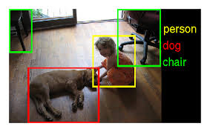
Object Detection

Slide 12
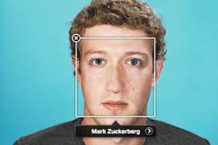
Face Tagging

Slide 13

Language Translation

Slide 14
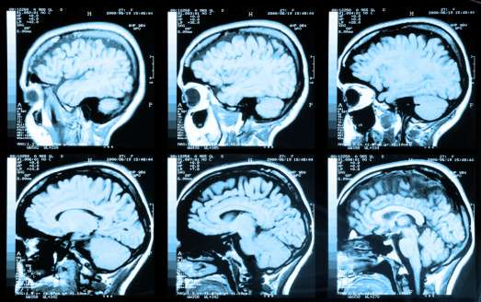
Brain Tumor Detection

Slide 15
Types Of Machine Learning
Supervised Learning
Unsupervised Learning
Reinforcement Learning

Slide 16
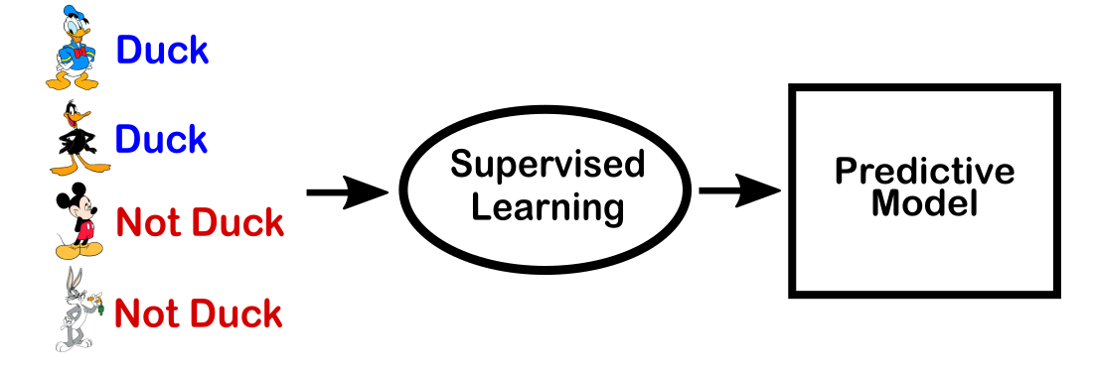
Supervised Learning

Slide 17
Supervised Learning
Data is given with associated Labels!
Most common and well established category of Machine Learning
(x,y) pairs are given in the Data Set where:
x could be : image of a person , y could be : name of person ( Face recognition) x could be : area of a house , y could be : price of house (House price prediction)
So , we tell our Model about the data and then ask it to predict for new data

Slide 18
Regression & Classification
Regression : When we need to predict a Continuous output!
Example : Finding the Price of House ( price is a real number )
Classification : When we need to predict a Discrete output!
Example : Determine whether the email is spam or not ( Only 2 possible answers )

Slide 19
Un-Supervised Learning
Only Data is given. No labels!
The model needs to find the structure with in the data without any supervision ( hence , unsupervised! )
The most common examples are Clustering , Dimensionality Reduction etc.

Slide 20
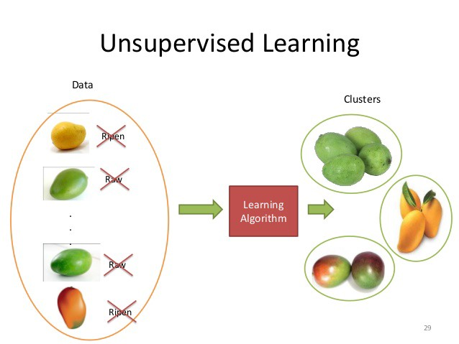
Un-Supervised Learning

Slide 21
Important Terminologies

Slide 22
Training Data and Testing Data
Data is usually divided into Training and Testing Sets
Training set is the subset of data on which our model will be trained! It will be paired with a set of labels in case of Supervised learning.
Testing set is remaining subset of the data! We check the accuracy of the model on the test (unseen) data.

Slide 23
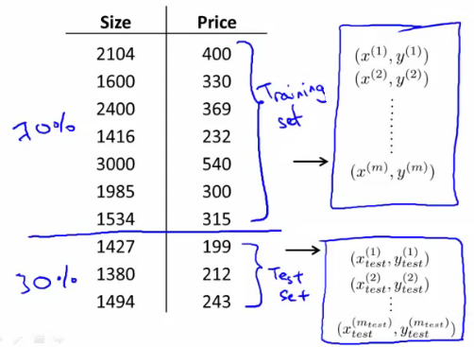
Training Data and Testing Data

Slide 24
Other Terminologies
Training Example/Instance : Single Data point ( an email in the case of spam classification)
Features : Most important thing in ML!
Every Data point is represented as a vector of its features!
For house price , the feature was its “size”
One of the reasons for the difficulty of ML!

Slide 25
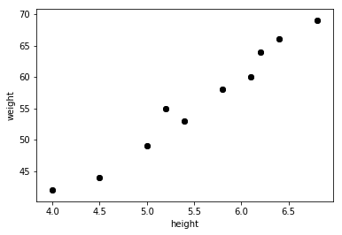
Data Set
Height -> weight
4.0 -> 42
4.5 -> 44
5.0 -> 49
5.2 -> 55
5.4 -> 53
5.8 -> 58
6.1 -> 60
6.2 -> 64
6.4 -> 66
6.8 -> 69

Slide 26
Problem Statement
Given the data set of heights and weights , train a model so that it could predict weight on the basis of heights.
Supervised or Unsupervised ?
Weight : Input variable
Height : Output variable

Slide 27
HELLO WORLD OF ML! LINEAR REGRESSION

Slide 28
What is Linear Regression
Linear Regression tries to fit a line to the data set
y=mx+b ( Two parameters to be Learned )
It do so by iteratively minimizing the Cost Function or Error Function
Cost Function is the difference between Actual Output and Predicted Output

Slide 29
ACKNOWLEDGEMENTS
I would like to pay my humble gratitude to the True Mentors for me!
Dr Tahir Syed
Sadaf Behlim
Muhammad Suleman
Yameen Malik

