Slide 1
FINANCIAL ANALYSTS
Beyond the Numbers
19
YEARS OF DATA
15
Financial Performance Analysis of Non-Financial Sectors Listed on the Pakistan Stock Exchange (2005–2023)
MAJOR SECTORS
3
RAW WORKSHEETS
The Problem
The Pakistan Stock Exchange holds nineteen years of financial statements for companies across fifteen non-financial sectors. Buried in that volume, real performance trends and the true top performers are invisible to simple observation.
01

Slide 2

OUR SOLUTION
A Complete Analytics Workflow — From Raw Statements to Clear Insight
The problem is scale and inconsistency: nineteen years of PSX financial statements, scattered across formats, cannot reveal a sector or company leader on their own. Our solution turns that raw data into a decision-ready story.
1
Clean
2
Extract
Standardize, reshape and merge 19 years of SBP financial statements into one analysis-ready dataset.
Use SQL (BigQuery) to isolate organizations with complete 19-year records for fair comparison.
Financial Performance of PSX Non-Financial Sectors, 2005–2023
3
Analyze
4
Visualize
Run correlation analysis in R across 14 financial ratios to surface real relationships.
Build an interactive Tableau dashboard to reveal sector and company performance at a glance.
02

Slide 3
THE DATASET
Real Financial Statements, Straight From the Regulator
S
SOURCE & NATURE
T
STRUCTURE — 3 WORKSHEETS
T
TOOLS & TECHNIQUES
State Bank of Pakistan
"Financial Statements Analysis of All Listed Non-Financial Companies" — official published data.
Secondary data compiled by SBP from audited annual reports already filed by companies, standardized sector-wise.
Coverage: Non-financial companies listed on the Pakistan Stock Exchange, 2005 – 2023 (19 years), across 15 major sectors.
2005–08
Earliest SBP reporting format
Excel
Cleaning & reshaping
2009–13
Revised presentation format
SQL / BigQuery
2014–23
Latest format, incl. IFRS from 2018
Extraction & filtering
R / RStudio
Non-Current & Current Assets · Shareholders' Equity · Liabilities · Operations (Sales/Revenue) · Cash Flow · Profitability, Liquidity & Solvency KPIs
KEY VARIABLE GROUPS
Correlation analysis
Tableau
Interactive dashboards
03

Slide 4
DATA PREPARATION
Seven Steps From Messy Statements to Analysis-Ready Data
Initial assessment found data split across 3 worksheets, inconsistent indicator names, a long data format, numeric prefixes on organization names, and missing values.
01
02
03
04
Standardize Indicators
Remove Non-Common Items
Reshape to Wide Format
Merge Worksheets
Unified inconsistent indicator names (e.g. multiple variants of Non-Current Assets) within each worksheet.
Dropped indicators not shared across all worksheets to keep the merged structure consistent.
Pivoted the Item Name column so each financial indicator became its own column.
Combined the three restructured sheets into one consolidated 2005–2023 dataset.
05
06
07
Standardize Column Names
Clean Organization Names
Handle Missing Values
Renamed indicators to short, underscore-formatted names; documented the mapping in a reference sheet.
Stripped numeric prefixes (e.g. "703-") from organization names for consistency.
Replaced nulls with 0 and converted fields to Integer type for efficient analysis.
04

Slide 5
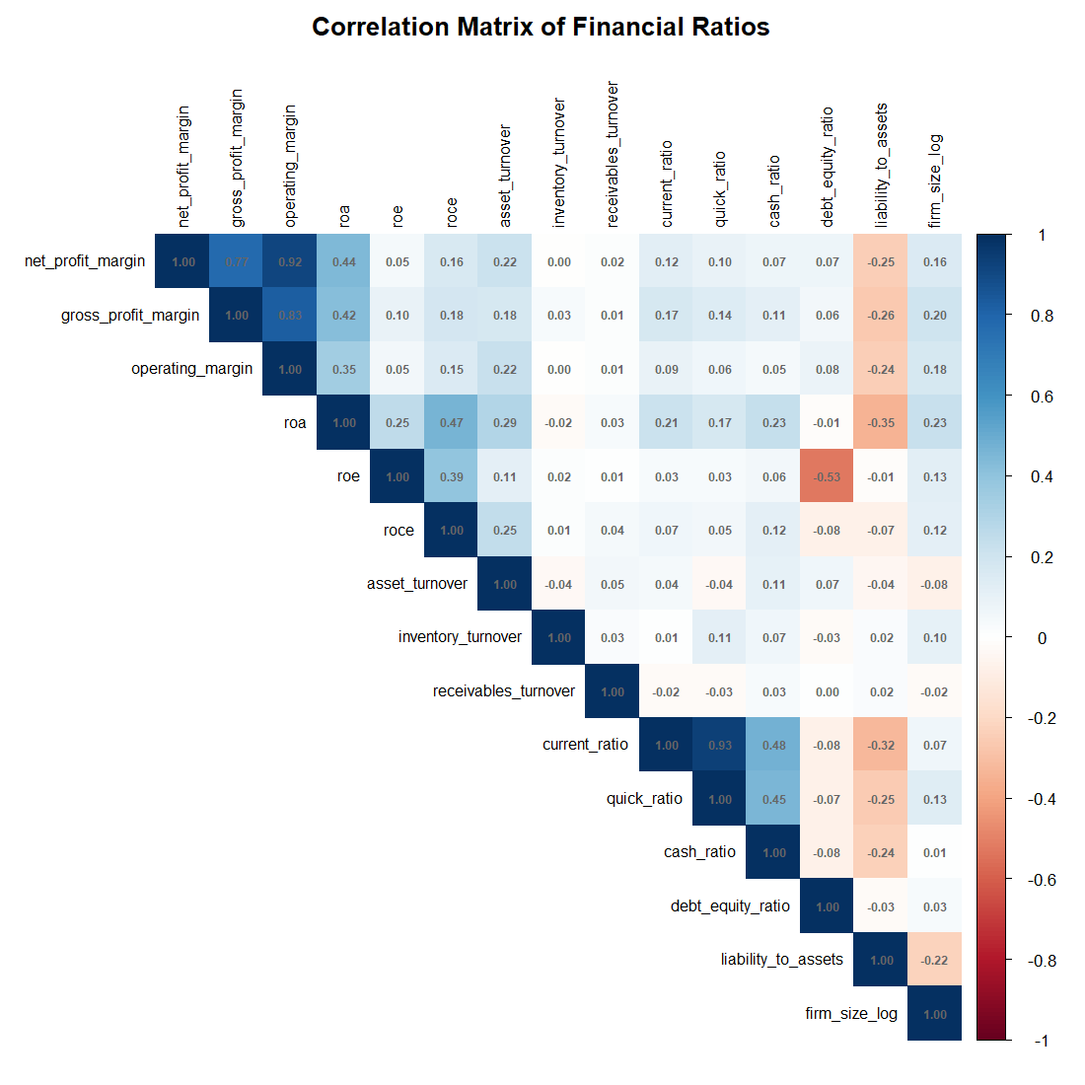
STATISTICAL ANALYSIS
Correlation Analysis of 14 Financial Ratios in R
WHAT THE MATRIX SHOWS
Net Profit Margin, Gross Profit Margin and Operating Margin move strongly together — consistent profitability measures.
ROA shows moderate positive links to profitability; ROE is comparatively weak, hinting at leverage effects.
Liabilities-to-Assets is negatively correlated with profitability — higher debt, lower returns.
Current Ratio and Quick Ratio are highly correlated, both capturing short-term liquidity.
Inventory & Receivables Turnover are largely independent of profitability, leverage and liquidity.
No evidence of severe multicollinearity — the dataset is sound for financial interpretation.
05

Slide 6
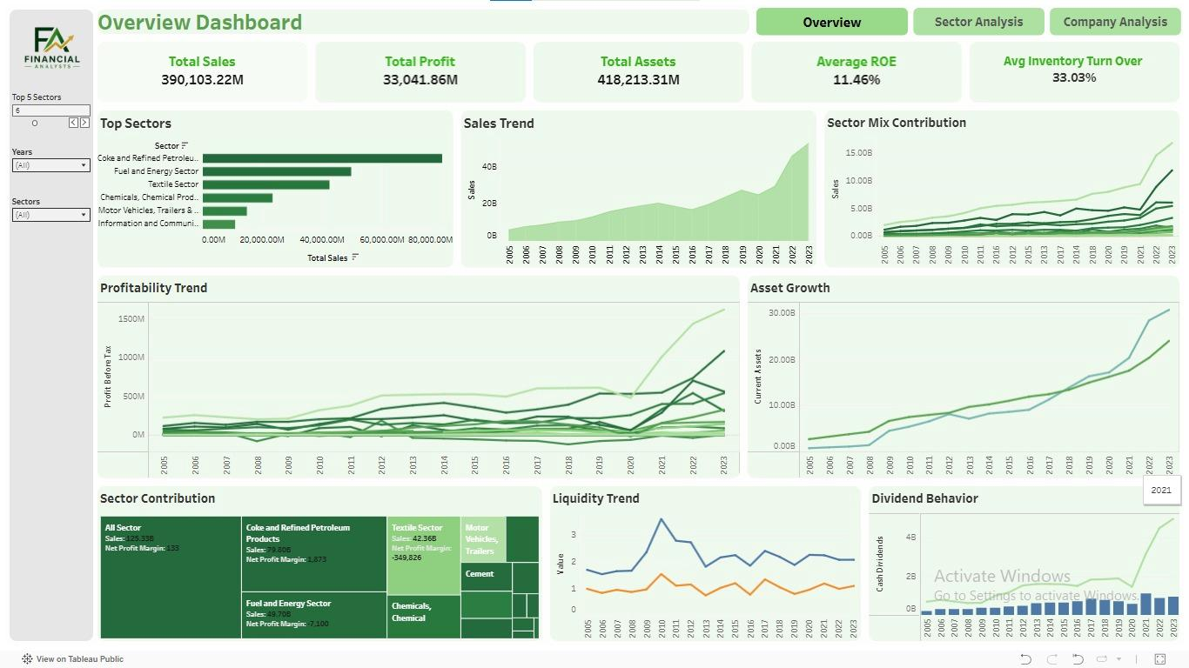
TABLEAU DASHBOARD · 1 OF 3
Portfolio Overview
KEY FINDINGS
Total sales of 390,103.22M against total assets of 418,213.31M shows a healthy, efficient asset base.
Coke & Refined Petroleum Products clearly leads total sales — the backbone of the portfolio.
Sales and profitability rise sharply from 2020 onward — post-COVID recovery plus currency effects.
Average ROE of 11.46% overall, though it varies widely by sector.
390,103.22M
33,041.86M
418,213.31M
11.46%
TOTAL SALES
TOTAL PROFIT
TOTAL ASSETS
AVERAGE ROE
06

Slide 7
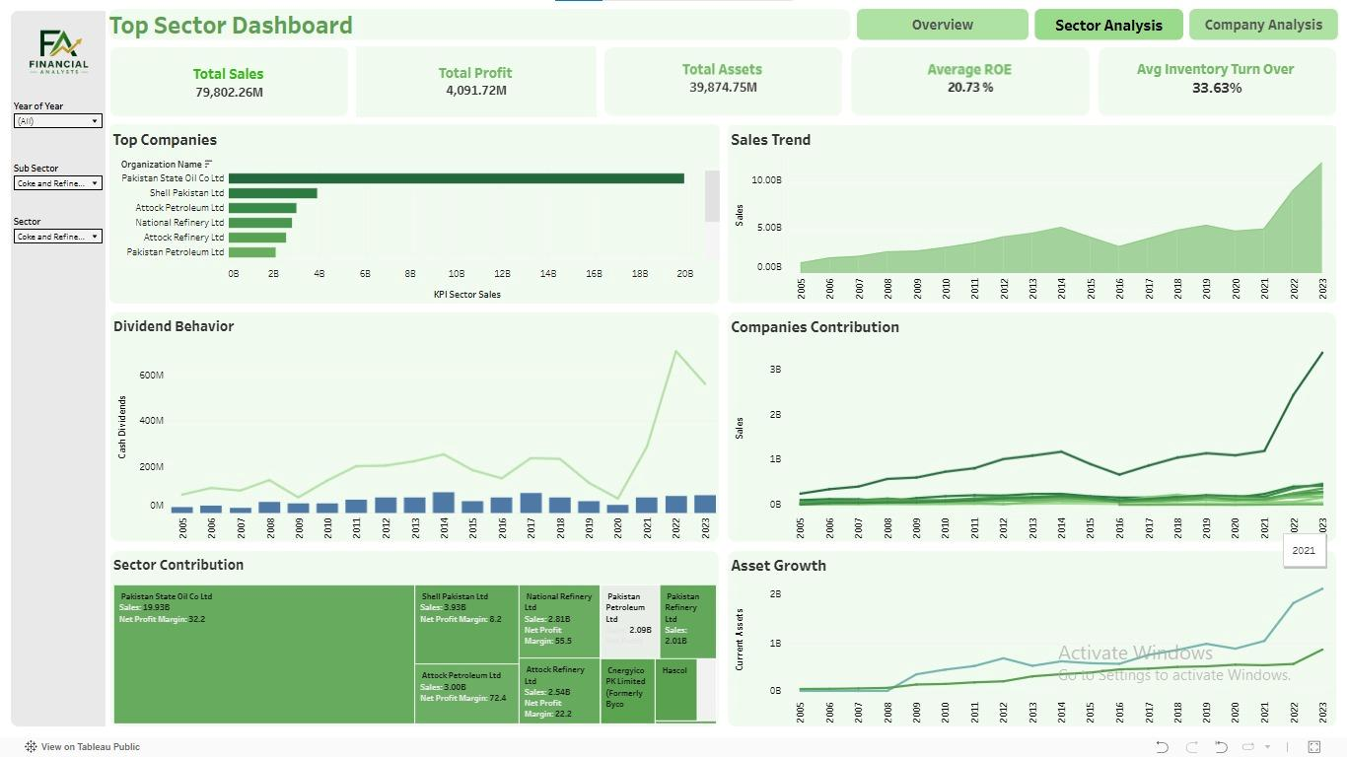
TABLEAU DASHBOARD · 2 OF 3
Top Sector — Coke & Refined Petroleum Products
KEY FINDINGS
Sector ROE of 20.73% is well above the 11.46% portfolio average.
Pakistan State Oil (PSO) leads the sector, ahead of Shell Pakistan, Attock Petroleum, National Refinery and Attock Refinery.
Sales grow steeply between 2021–2023, pointing to sector-wide expansion and favorable pricing.
Cash dividends rise markedly from 2021 onward, mirroring the portfolio-wide profitability trend.
79,802.26M
4,091.72M
20.73%
33.63%
TOTAL SALES
TOTAL PROFIT
AVERAGE ROE
INV. TURNOVER
07

Slide 8
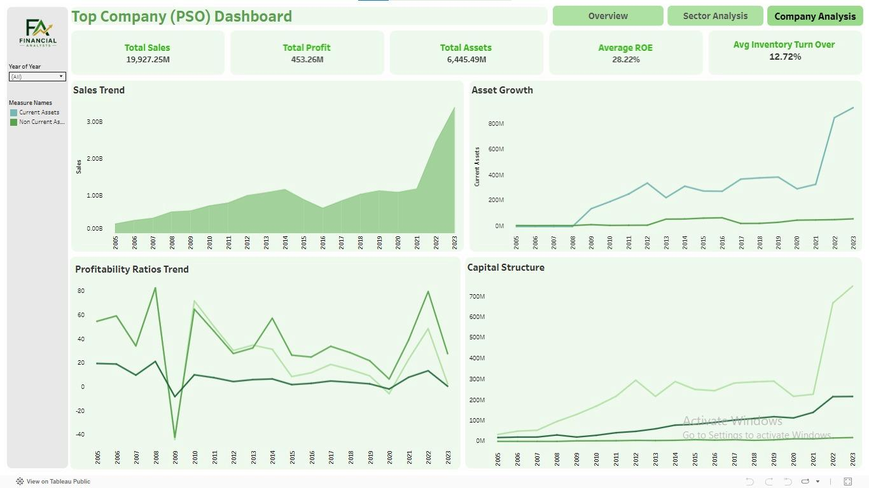
TABLEAU DASHBOARD · 3 OF 3
Top Company — Pakistan State Oil (PSO)
KEY FINDINGS
PSO's sales of 19,927.25M make up roughly 25% of the entire sector's revenue.
ROE of 28.22% beats both the sector (20.73%) and portfolio (11.46%) averages.
Current assets rise sharply in 2022–2023, signalling stronger liquidity.
Profitability dipped around 2009 (global financial crisis) but recovered steadily since.
19,927.25M
453.26M
28.22%
12.72%
TOTAL SALES
TOTAL PROFIT
AVERAGE ROE
INV. TURNOVER
08

Slide 9
THE BOTTOM LINE
Key Findings
PORTFOLIO
TOP SECTOR
TOP COMPANY
All 15 Sectors
Coke & Refined Petroleum Products
Pakistan State Oil (PSO)
11.46%
20.73%
28.22%
Average ROE across the full non-financial portfolio, on total sales of 390,103.22M and assets of 418,213.31M.
Sector ROE, generating 79,802.26M in sales — the clear backbone of overall performance.
Company ROE — about 25% of sector revenue, with a sharp liquidity gain in 2022–2023.
STATISTICAL TAKEAWAY
Profitability measures move together, leverage drags on profitability, and liquidity ratios are tightly linked — with no severe multicollinearity across the 14 ratios tested, confirming the dataset's reliability for financial interpretation.
09

Slide 10
SUSTAINABLE DEVELOPMENT GOALS
How This Project Supports the SDGs
SDG 8
SDG 9
SDG 17
Decent Work &
Economic Growth
Industry, Innovation
& Infrastructure
Partnerships
for the Goals
Evaluates the profitability, liquidity and solvency of non-financial companies across 15 major sectors — a direct read on corporate growth and economic productivity.
Covers 15 non-financial sectors including Textile, Cement, Food and Fuel & Energy — core pillars of industrial activity and infrastructure.
Transforms scattered, inconsistent SBP data into a clean, structured, analysis-ready dataset — the reliable data infrastructure SDG 17 calls for.
10

Slide 11
OUR TEAM
The People Behind the Analysis
HJ
MS
AP
Haris Jamil
Muhammad Sulaiman
Abuzar Paracha
SP25-BDA-009
SP25-BDA-004
SP25-BDA-002
Data Cleaning & Extraction
Statistical Analysis & Visualization
Reporting & PPT creation
Cleaned data in Excel and extracted required data suing Big Query.
Bulit dashboard in tableau and performed statistical analysis in R.
Developed Report and created PPT for presentation.
Submitted to Dr. Jamil Anwar · COMSATS University Islamabad, Abbottabad Campus · Department of Management Sciences
11

Slide 12
Questions &
Answers
12

Slide 13
Thank You
FINANCIAL ANALYSTS
Muhammad Sulaiman · Haris Jamil · Abuzar Paracha
13

