Slide 1
VIT • BITE305L COURSE PROJECT
RIP vs OSPF
Routing Protocol Performance
Cisco Packet Tracer + Python Streamlit Dashboard
Implementation demonstration • experimental evidence to be collected in Packet Tracer

Slide 2
The problem we are solving
Why do we compare dynamic routing?
Link failures
Communication may stop when the preferred router-to-router link becomes unavailable.
Different route metrics
RIPv2 prioritizes hop count, while OSPF uses accumulated interface cost.
Need for objective evidence
We need identical topologies and repeatable experiments to compare recovery behavior.
BITE305L • COMPUTER NETWORKS • RIP vs OSPF

Slide 3
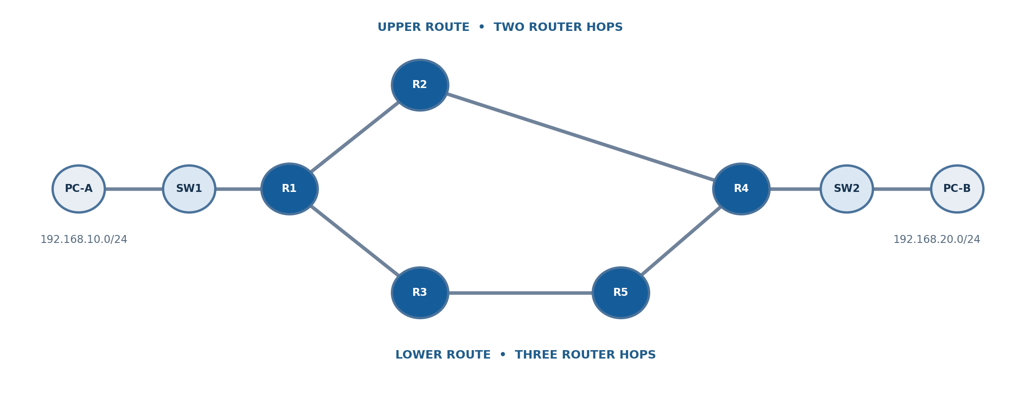
Network architecture
5 routers • 2 switches • 2 end devices
Upper route: 2 hops | Lower route: 3 hops | Controlled link: R2 – R4
BITE305L • COMPUTER NETWORKS • RIP vs OSPF

Slide 4
How the two protocols differ
Two protocols, one controlled topology
RIPv2
OSPFv2
Distance vector
Advertises routes to neighbors
Metric: hop count
Hop-minimal expected route
Link state
Shortest-path-first computation
Metric: sum of interface costs
Can favor a longer-hop path
This project compares protocols; it does not invent a new routing algorithm.
BITE305L • COMPUTER NETWORKS • RIP vs OSPF

Slide 5
Experiment scenarios
Paired tests for RIP and OSPF
01
Baseline
Confirm initial route and connectivity
02
Failure
Shutdown R2 Gi0/1; check backup route
03
Restoration
Restore R2–R4 and observe preferred route
04
Cost demonstration
OSPF upper cost 100 vs lower cost 10
BITE305L • COMPUTER NETWORKS • RIP vs OSPF

Slide 6
Python dashboard
Six screens turn configuration into an explainable experiment
Overview
Topology
Experiments
Problem and objectives
Calculated expected routes
CLI commands and methodology
Measurements
Algorithms
Submission
CSV validation and charts
BFS/Dijkstra calculation trace
Evidence checklist
BITE305L • COMPUTER NETWORKS • RIP vs OSPF

Slide 7
Results: evidence first
No fabricated convergence-time or packet-loss numbers
Observed results are entered through a CSV worksheet.
Required evidence: route tables, failed-link transitions, recovered routes, ICMP counts, and clearly defined timing basis. The dashboard generates charts only after data is recorded.
Important: Packet Tracer paths must be tested on a real Packet Tracer installation.
BITE305L • COMPUTER NETWORKS • RIP vs OSPF

Slide 8
What is already built vs still required
Clear completion status for the final demonstration
IMPLEMENTED
REQUIRES PACKET TRACER
• 5-router IP plan and CLI configs
• Separate RIP/OSPF config sets
• Streamlit dashboard source
• Routing model with unit tests
• Blank CSV + report draft
• Save and verify both .pkt files
• Execute 3 matched test runs
• Capture real screenshots
• Record actual metric values
• Verify 15 recent papers
BITE305L • COMPUTER NETWORKS • RIP vs OSPF

