Slide 1
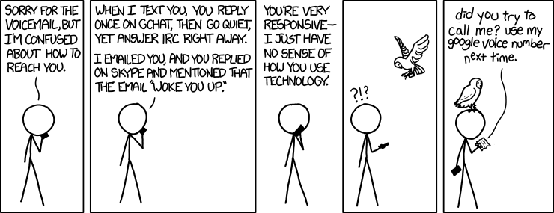
A simple chatroom server

Slide 2
Project goals
This project provides a server implementation for a chat application
  The server supports a simple, text-based API
  The project also includes a simple test client
  Depending on the assignment, the server may be running somewhere
  Normally, for a class project, you are not allowed to modify the server
The challenge is to create clients that communicate with the server
  Provide an attractive user-interface
  Support some or all of the server features
  Provide robust error handling
This is open source software (BSD 3-Clause License)
  Feel free to take the code and use it for your own purposes
  See the license file for further details

Slide 3
Overview of server features
The server listens on a port defined in Server.java
  By default, this is port 31415
The server provides the following general functionality
  Create/delete accounts, login/logout, change password
  Create, join and leave chatrooms
    Public chatrooms: anyone can join
    Private chatrooms: only the owner (creator) can add users
  Send messages to a chatroom or to individual users
  Check the online status of users, list the members of chatrooms
Data is regularly cleaned up
  Clients are disconnected after a period of inactivity
    Short if not logged in (a few minutes), longer if logged in (an hour)
  Chatrooms and accounts are removed if not used (a few days)

Slide 4
Notes about security
All messages are plain-text, including login passwords
  Solution would be an encrypted connection; too complex for this project
  Passwords are salted, hashed and saved securely
After login, the server uses token-based authentication
  The server sends the client a “token”
  The client must include this token with every request
  This provides security without requiring username/password every time
  If a server→client message fails, the current token becomes invalid
    The client must login again to get a new token
The server maintains no history of logins or messages
  The only data saved: currently defined accounts and chatrooms

Slide 5
Messaging protocol
The messaging protocol is plain-text, similar to the HTTP protocol
  Each command is a single line of text
  Names & passwords must be at least 3 characters
  Usernames and chatroom names must be different
  Messages may be 1-1024 characters
Individual messages follow the format
  MessageType [Token] Data
    MessageType identifies the kind of message
    Token must be sent with almost all messages from client to server
      Everything except Ping, Login and CreateLogin
    Data varies by MessageType
  Message parts are separated by vertical bars ‘|’
A minimal client only needs to implement a few message types

Slide 6
Messages (client → server)
MessageType | Data | Notes
CreateLogin | Username, Password | Fails if name already taken (user or chatroom), or invalid After creating an account, you still have to login
Login | Username, Password | Fails if name/password do not match
ChangePassword | New password | Fails only if token is invalid
DeleteLogin | -- | Fails only if token is invalid; after delete, token becomes invalid
Logout | -- | Never fails; token becomes invalid
CreateChatroom | Name, isPublic | Fails if name already taken (user or chatroom), or invalid After creating a chatroom, you still have to join
JoinChatroom | Chatroom, User | User can add themselves to public chatrooms Only the creator can add user to a private chatroom
LeaveChatroom | Chatroom, User | You can always remove yourself Chatroom creator can remove anyone
DeleteChatroom | Chatroom | Only the creator can delete a chatroom
ListChatrooms | -- | Returns a list of all public chatrooms
Ping | [Token] | Without a token: always succeeds With token: succeeds only if token is valid
SendMessage | Target, Message | Send message to user or chatroom Fails if user not online / Fails if not a member of the chatroom
UserOnline | User | Succeeds if the user is currently logged in
ListChatroomUsers | Chatroom | Returns a list of all users in the given chatroom You must be a member of this chatroom

Slide 7
Message types (server → client)
Responses to client commands
Server initiated messages
MessageType | Data | Notes
Result | Boolean Boolean Token Boolean List | True if the command succeeded, otherwise false After a successful login, also returns the authentication token When a list is requested, also returns list results
MessageError | Error message | Incorrect commands, wrong number of arguments, etc.
MessageType | Data | Notes
MessageText | Name, Target, Text | Name of user sending message Target is where the message was sent (chatroom or user) Text of the message

Slide 8
Sample exchange of messages with the TestClient
brad@fhnw-xubuntu-2018$ java chatroom.testClient.TestClient
Enter a valid IP address
127.0.0.1
Enter a valid port number
31415
Enter commands to server or ctrl-D to quit
CreateLogin|brad|mypassword
Received: Result|true
Login|brad|mypassword
Received: Result|true|4FA4563A5C2FFD1E703B49190DC348BD
CreateChatroom|4FA4563A5C2FFD1E703B49190DC348BD|CatChat|true
Received: Result|true
JoinChatroom|4FA4563A5C2FFD1E703B49190DC348BD|CatChat|brad
Received: Result|true
SendMessage|4FA4563A5C2FFD1E703B49190DC348BD|CatChat|Hello, all cat people!
Received: MessageText|brad|CatChat|Hello, all cat people!
Received: Result|true
SomeInvalidCommand
Received: MessageError|Invalid command
SendMessage|Wrong|Parameters
Received: MessageError|Invalid command
Logout
Received: Result|true
brad@fhnw-xubuntu-2018$
Connecting the client
→ User inputs are green
Then client messages entered by user
And server responses
Ctrl-D entered, to stop client

