Slide 1
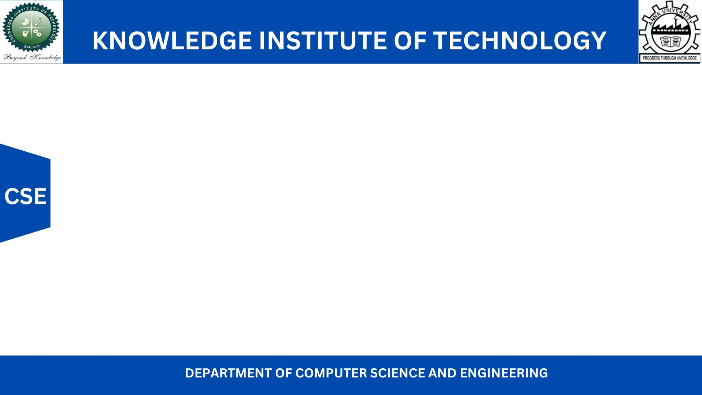
HOME AUTOMATION USING SINGLE BOARD COMPUTERS
Presented by
ARUN R G 611220104007
CHERAN J 611220104026
DHANUSSH ADITYA K 611220104031
GOKUL HARI R 611220104048
UNDER THE GUIDANCE OF
Mrs.D.Ramya B.Tech(IT)., M.E(CSE)., (Ph.D)., MISTE
ASSISTANT PROFESSOR,
DEPARTMENT OF COMPUTER SCIENCE AND ENGINEERING

Slide 2
INTRODUCTION
Home automation has gained significant popularity as homeowners seek to enhance convenience and control in their living spaces. However, the market for smart IoT devices presents challenges, including high costs and limited options, which can deter many households. In contrast, Single-Board Computers (SBCs) like Arduino and Raspberry Pi offer a cost-effective and customizable alternative for home automation. SBCs provide a wider variety of options, greater flexibility, and reliable functionality through their modular nature. This project aims to explore the advantages of SBCs over smart IoT devices and demonstrate how they empower homeowners to effectively automate their homes while leveraging existing appliances and devices. By overcoming the limitations of cost, variety, and hardware failures, SBCs provide personalized and sustainable home automation experiences, offering convenience and control within living spaces.

Slide 3
ABSTRACT
Middle-class and lower-middle-class households face barriers in adopting smart IoT devices due to limited accessibility and higher costs compared to traditional alternatives.
Utilizing Single Board Computers (SBCs) such as Arduino and Raspberry Pi offers a cost-effective alternative with enhanced functionality and customization options, overcoming the challenges faced in implementing smart IoT devices.
By mapping the electric circuits of regular household appliances to SBCs, the proposed system enables users to control and monitor their operations through programmed instructions, providing a more accessible and affordable solution for home automation in middle-class and lower-middle-class households.
Wireless communication protocols facilitate efficient data exchange between the SBCs and a central hub or gateway, enabling seamless connectivity and centralized control of the automated systems.

Slide 4
LITERATURE SURVEY
PAPER-I
TITLE: The Role Of Single-board Computers In Affordable Home Automation
TECHNOLOGY USED: Arduino and Raspberry Pi
METHODOLOGY:
Retro fitting Exiting Devices with SBC
Focuses On Customization Of SBC

Slide 5
LITERATURE SURVEY
PAPER-II
TITLE: Comparative Analysis: Single-board Computers Versus Smart/Iot Devices In Home Automation
TECHNOLOGY USED: IoT Devices, SBCs
METHODOLOGY:
Evaluate Cost Effectiveness of SBC compared to IoT Devices
Evaluate Reliability of SBCs and IoT Devices

Slide 6
LITERATURE SURVEY
PAPER-III
TITLE: Reliability And Longevity: Single-board Computers For Sustainable Home Automation
TECHNOLOGY USED: SBC
METHODOLOGY:
Investigate the Reliability of SBCs
Minimize Complete System Failure

Slide 7
LITERATURE SURVEY
PAPER-IV
TITLE: Enhancing User Experience: Single-board Computers For Intuitive Home Automation
TECHNOLOGY USED: SBC
METHODOLOGY:
1. User Intuitive Interface For SBC
2. User Friendly Setup Guides

Slide 8
DRAWBACKS IN EXISTING SYSTEM
1. Costly: Existing IoT projects can be expensive, making them unaffordable for many people.
2. Compatibility issues: IoT devices often have difficulty working together seamlessly, limiting their effectiveness.
3. Security concerns: IoT devices can be vulnerable to hacking and privacy breaches, posing risks to users' personal information.
4. Complexity: Some IoT projects are difficult to set up and use due to complicated installation processes and confusing interfaces.

Slide 9
PROPOSED SOLUTION
Utilization of Single Board Computers (SBCs)
Mapping Electric Circuits
Wireless Connectivity
Control and Monitoring through Programmed Instructions:

Slide 10
ADVANTAGES
Cost-effectiveness: The project offers an affordable solution by using inexpensive Single Board Computers (SBCs) like Arduino & Raspberry Pi
Customization and flexibility: Homeowners can personalize the system by programming the SBCs to control and monitor their appliances.
More options and adaptability: The project allows a wide range of existing appliances to be integrated into the smart home system.
Overcoming hardware limitations: By using SBCs, the project ensures a more reliable and stable home automation system, avoiding potential hardware failures that can occur with dedicated smart devices.

Slide 11
SYSTEM SPECIFICATION
HARDWARE REQUIREMENTS
Processor : Intel Core i5
RAM : 8 GB
Hard Disk : 1 TB
SOFTWARE REQUIREMENTS
Scripting Languages : Python, JavaScript
Markup Languages : HTML5, CSS5
Editor : VS Code
Simulation Tool : Packet Tracer
TOOL REQUIREMENTS
Operating System : Windows / Linux Mac
Tool Version : 8.2.1

Slide 12
MODULES
Module 1: Single Boarded Computer (SBC)
Module 2: HTTP Server
Module 3: IoE Server/Client
Module 4: Remote Access

Slide 13
MODULE DESCRIPTION
1).Single Boarded Computer (SBC):Single Board Computers (SBCs) are compact computing devices that integrate all the components of a regular computer onto a single circuit board. This SBC serves as the core platform for implementing home automation solutions, providing extensive connectivity options and programmability
2).HTTP Server:It enables the SBC to serve HTTP requests from client devices connected to the local network. By accessing the SBC's local IP address through a web browser, users can interact with the HTTP server to configure the SBC, manage connected devices, and monitor system status. The HTTP server acts as the gateway for controlling and accessing the automation features provided by the SBC.

Slide 14
MODULE DESCRIPTION
3.IoE Server/Client: The IoE server functions as the central hub for managing and controlling the registered IoT devices. It provides users with a web-based interface.The IoE server allows users to set conditions, define automation rules, and receive status updates from the connected devices. It acts as the backbone of the home automation system.
4. Remote Access: Remote access allows users to control and monitor their home automation system from a remote location. While direct control of the SBC is restricted for privacy and security reasons, users can access the IoE server remotely. This enables them to check the status of connected devices, receive notifications, and manage automation settings conveniently, ensuring seamless control even when away from home

Slide 15
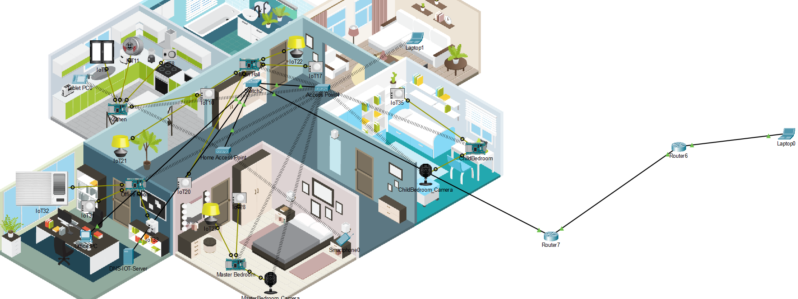
RESULT AND DISCUSSION

Slide 16
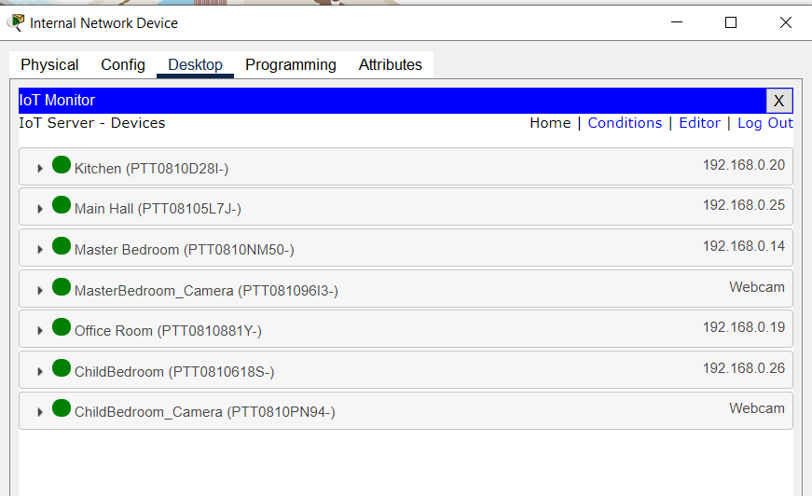
RESULT AND DISCUSSION

Slide 17
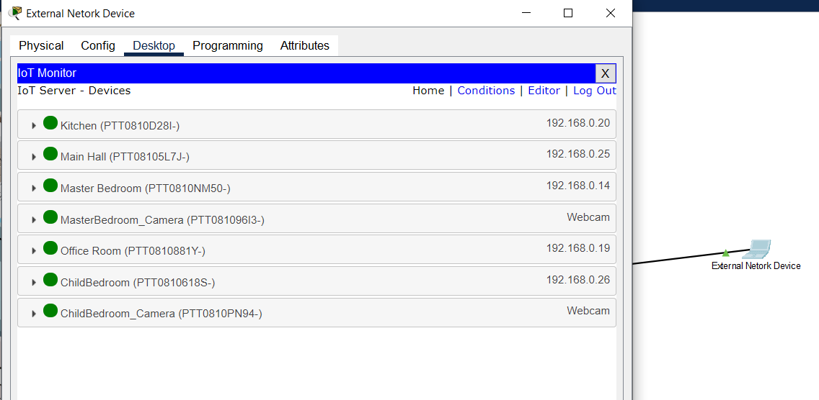
RESULT AND DISCUSSION

Slide 18
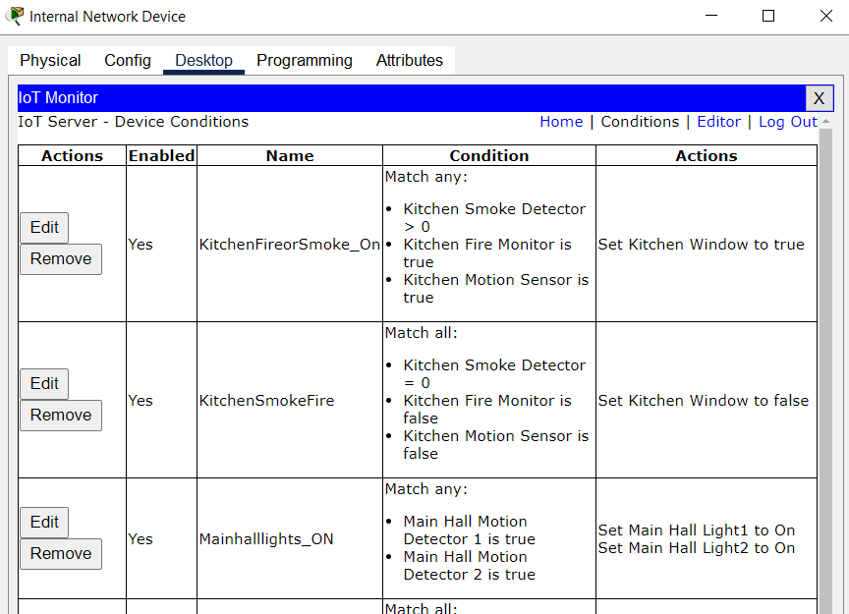
RESULT AND DISCUSSION

Slide 19
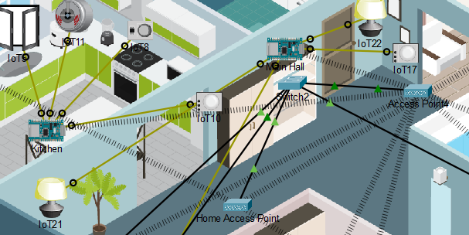
RESULT AND DISCUSSION

Slide 20
CONCLUSION AND FUTURE ENHANCEMENT
Voice control: Enable hands-free operation through voice commands.
Machine learning and AI: Optimize energy consumption based on user preferences.
Advanced energy management: Minimize energy usage with real-time monitoring and automation.
Dedicated mobile app: Control the system remotely through a user-friendly mobile app.

Slide 21
REFERENCES
[1] Smith.J,(2022)"The Role Of Single-Board Computers In Affordable Home Automation"
[2] Patel.R,(2019)"Comparative Analysis: Single-Board Computers Versus Smart/Iot Devices In Home Automation"
[3] Lee.C,(,2020)"Reliability And Longevity: Single-Board Computers For Sustainable Home Automation "
[4] Wang.L,(2018)"Enhancing User Experience: Single-Board Computers For Intuitive Home Automation"
[5] CISCO "IoE Value At Stake Global Public Sector Analysis"
[6] The Open University "Session 1: What is IoE"
[7] What is My IP Address "What is Network Address Transalation

Slide 22
THANK YOU

