Slide 1
Foreign policy of Pakistan

Slide 2
What is a foreign policy
It is defined as a policy managing connections and associations amongst sovereign states
Those general principles by which state governs its reaction in the international arena
Hubert huphrey said:it’s a domestic policy with its hat on.
Set of guiding principles that lets a state steer smoothly in the ocean of sovereign state
A compatible stand point taken by state while dealing with other nation
Every state needs a concrete foreign policy determined keeping in mind the internal as well as external factors
Jf Kennedy:domestic policy can defeat us ,foreign policy can kill us.

Slide 3
Guiding principles of Pakistans foreign policy
Based on countries Islamic ideology,cultural heritage and historical background
An Islamic and non aligned country Pakistan upholds Islamic principles
Respect for sovereignty independence and territorial integrity of states
Non use of force,peacefull coexistence amicable collaboration for mutual gains.
Respect for un charter and promotion of world peace

Slide 4
Quaid e azams vision of pakistans foreign policy
Quaid lived for one year after independence in this short period of time he described the major objectives of foreign policy and stated.
Our foreign policy wil be of friendship with all irrespective of colour creed or religion, we do not cherish aggressive designs against any country or nation there lies infront of us a new chapter and it will be our endeavor to create and maintain good will and friendship with Briton and our neighbor Hindustan along with other sisterly nations toothat we together make our greatest contribution for the peace and prosperity of human kind

Slide 5
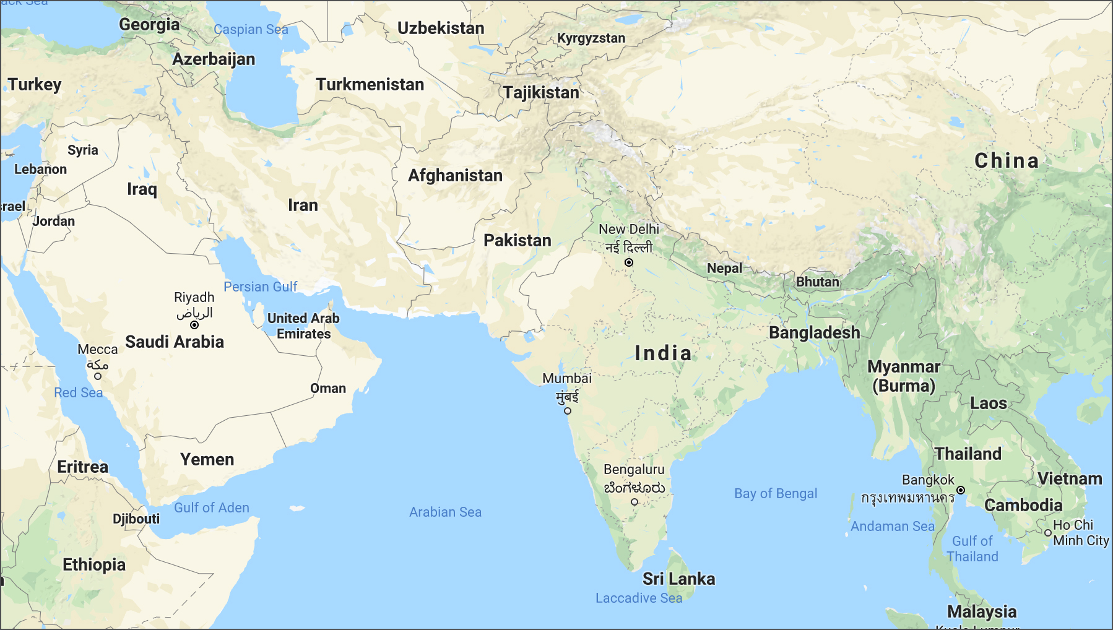

Slide 6
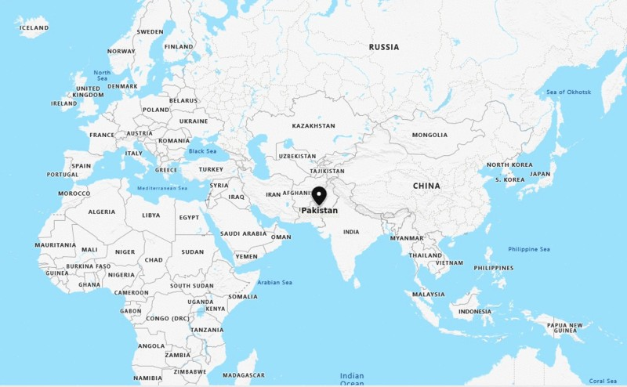

Slide 7
Determinants of Pakistan foreign policy
Foreign policy of Pakistan is extention of its domestic consideration.the amalgamation of domestic as well as international determinants account for a comprehensive foreign policy:
1.ideological obligation:Islamic ideology is the bedrock of pakistans FP since it was created to meet the irrestible urge the need to practice islam freely as well s 85% of pakistans population is muslim.
First pm Liaqat ali khan said:Pakistan came into being as a result of the urge felt by muslims of the subcontinent to secure territory however limited where Islamic ideology and the wayof life could be practiced and demonstrated to the world.

Slide 8
2.Geographical location:Napolean said foreign policy of a country is determined by its geography,and the FP of Pakistan particularly ends and begind at the Indian border,roughly half of the border coincide eith india one third with Afghanistan one sixth with iran and a small strip with china
russia is in close proximity through Tajikistan,Pakistan is gate way to middle east and mineral rich central Asian nations
Borders with india are dominated by fer of aggression Pakistan is a neighbor to two emerging south Asian giants china and Russia
Climate topography and energy resources are also taken into account
3.a hostile neighbor:Pakistan inherited a hostile neighbor thatconsidered Pakistan as an invalid state.it expected roll back of independence,since then pakistans has faced wars infiltrations machinations cyberwars hybrid warfare and full fledge wars
4.Kashmir the jugular vein of Pakistan:liberation and right of self determination of Kashmiri brethren remained the top priority.every war with india had Kashmir as a reason

Slide 9
5.Friendship with china and china Pakistan economic corridor:this friendship with china is prioritized and kept above all domestic and international turbulations,completion protection and stability of $64 billion project remains important.
6.economic compulsions:a poor state since inception has defined FP objectives in the light of its ailing economypakistan sat in Americas lap initially then it moved to communist corner.presently it is an ardous task mantainig relations with china Russia iran and America in economic prism
7.Domestic structure:Pakistan is a parliamentary democracy it upholds domestic principles though it has seen dictatorships as well as feudalistic chikanaries.it has untapped resources a booming population unemployment.

Slide 10
8.an evolving world order:multipolarity,tradewars,climate change,nationalism,populism,destabilized world economy.
9.national interest
10.sovereignty and security
11.technological advancements
12.role in world organisations.

Slide 11
Certain important events
World war 2:started in 1939 and ended in 1945 a conflict thet involved virtually every part of the world, the principle belligerents were axis (Germany Italy and japan) against the allies (France<britian and usa),it was basically a continuation of unsolved issues after world war 1, basic causes include the treaty of varsailles(signed by Germany they had to pay financial reparations,disarm ,loose territorynd give up all over seas colonies) economic depression all over the world and rise of Nazism
Unipolarity:at the end of ww2 a new world order emerged where America became the sole super power
Cold war:1945 :It started at the foot hold of world war 2, an ongoing rivalry beteen us(western bloc) and soviet union,(eastern bloc)the term was used by George orwell in an article,it was a face off between communism and capitalism blocks were created and smaller countries that just got independce from british colonialism were expected to join the either.nato and warsaw pact were products of the cold war,it ended at disintegration of soviet union negative effects were arms race.

Slide 12
Soviet invasion of Afghanistan:1979 --1991:soviet union intervened in support of afghan communist government in its conflict with anti communist gurellis,pro communist leader ,MOHHAMAD DAUD KHAN when overthrown called in Russian help against the userpers.after 9 years of turbulence the war ended with disintegration of ussr,internal weaknesses lack of accountability and economic stagnation were also factors.
Non aligned movement a forum of 120 countries that was founded in the context of cold war confrontation ,it aimed at furthering the interest of developing countries and protect the world from extreme polarization,it was formed at the juncture where 2 major powers were pulling rest of the world in their orbit.the initiative was of yugoslavianpresident Josip broz tito, Indian pm Nehru Egyptian president gamal abdel nassir it gained traction from 1950 to 1960

Slide 13
Phases of pakistans foreign policy
1.1947 –1953: as per principles of quaid Pakistan aimed at developing friendly relation with the states,Indian in this juncture occupied Kashmir ,it had antagonistic behavior just to roll back pakistans new found independence,the relation were completely and permanently marred.
2.1953—1963(joining western pacts):pakistan primeminister LIAQAT ALI KHAN getting invited from usa also ussr choose to visit usa
It was due to spread of communism and security threat from india and ussrs ailing economy after world war 2 as it was not in position to support nascent Pakistan neither it could provide sophisticated weaponry this gesture invited the wrath of russiand who aligned with india.
Pakistan bagged MUTUAL DEFENCE ASSISTANCE AGREEEMENT in which us agreed to train pakistans military personell
Pakistan joined seato and cento these pacts were aimed at curtailing spread of communism
Pakistan bagged massive military and economic aid later us backed off during1965 war u2 incidenr also soured the relations it also placed sanctions on pakistan

Slide 14
3.the changeover(1963--1972):
Us offered assistance to india in sino Indian war <soviet union threatened Pakistan due to u2 incident ,under these circumstances Pakistan was forced to realighn
President ayub and pm zulfiqar ali bhutto paid a visit to Moscow despite its hostile attitude in 1965
Soviet union mediated the Tashkent declaration in 1965
Relations with china rapidly developed it also declared support for Kashmir cause.
4.non alignment(1972—1979)
Za Bhutto assumed office as president after didmemberment of east Pakistan he launched efforts to restore confidence and morale,reorient failed policies at home and abroad and rehabilate pakistans juncture in world community
Left ceato and sento and joined non align movement in 1979
Bhuttu also tried to maintain relations with usa (president Nixon)
Simla agreement was cocluded to bring in povs from india
Soviet union provided lavish loans to help pakistans economy

Slide 15
5.pakistans nuclear program
In responve to Indian nuclear armament Pakistan developed a nuclear ambition it was reinforced by 1971 chaos in which india had a covert and overt role.
This ambition invited us wrath
6.The Afghanistan war (1979—1988)
Soviet intervention irked the neighbour Pakistan it felt it would be next in line in soviets plan of action to reach warm waters
Pak us relation saw détente against soviet union soviet forces were defeated with the connivance of cia and isi
Pakistan became the largest aid receiver from us after Israel
The refugee infiltration effected economy ,klashinkov culture weapon proliferation also extremism.

Slide 16
7,post cold war stance(990—2001)
Pak us relations nose dived as Pakistan refused to back off from nucler ambition
Us applied pressler amendmet and cut off $700 million that was promised to Pakistan
It also halted the promised f 16 supply an military equipment
Pakistan recognition of Taliban government in 1997 called our more disapproval from western world.
8.9/11 aftermath:
E perplexing situation for Pakistan us expected utmost cooperation from Pakistan certain sanctions on Pakistan were also lifted it was with us or against us Pakistan was stuck between an unstable jingoist muslim neighbor and a revenge hungry superpower.
During musharrafs era an olive branch was lent to inidia
Soft diplomavy wa utilized to solve Kashmir issue yet indias stern stance nd certain spoilers ruined the efforts.(Indian parliament attack)

Slide 17
92008—2013:
Pakistan had ppps government the tilt was towards usa however efforts wee being made to keep Russian in the loop as well
Pak iran relations also improved the gas pipeline project was signed.
10.2013 onwards:
Pmln came to power the prime minister Nawaz sharif kept the position of foreign minister to himself
The tilt was towards usa
Personal relations were preffered over national interest
India was again extended olive branch in the garb of business

Slide 18
10.2019 onwards
Primeminister Imran khan along with a poised foreign minister shahb Mahmood Qureshi refurbished a vibrant foreign policy
a major stance was taken over Kashmir all diplomatic ties were cut off on robbing Kashmir off its special status
Kartarpur gate way was opened for sikh pilgrims to manage relations with india
Ties with Islamic world were diversified
Russia was given due importance
Paid the price of aspiring for an independent foreign policy that would suit the national interest

