Slide 1
DATASPARK:ILLUMINATING INSIGHTS FOR GLOBAL ELECTRONICS
BY HARI SARAVANAN

Slide 2
SYNOPSIS:
Data cleaning and Preprocessing
SQL
Power bi

Slide 3
Introduction
In this project, I did preprocessing of data and visualization of data to get better insights about the company named global electronics. The global electronics was a leading electronics manufacturing company. The data's of global electronics are given by them . I cleaned the data and creating dashboard to visualize the insights about the fields, where they perform well and where they are not. To get a better understanding about the companies growth and the areas that they want to perform well.

Slide 4
Data Cleaning and PREPROCESSING
In Data preprocessing, I found the null values present in the csv files and remove that ,to make the csv files better for the visualization.
While preprocessing, I found that the datatypes are different for many columns, especially the column with the day, month and year. I changed the datatype to date from object.
The datatype for some columns are also in object instead of integer.
There also some columns ,which consist more than 60% Nan values ,So I dropped the column form the table.

Slide 5
SQL DATA LOADING
After successful completion of data preprocessing and cleaning, I load the preprocessed data to PostgreSQL database.
First I make the connection for python to PostgreSQL .After I creating the table and import the table to the PostgreSQL by using SQL Alchemy.

Slide 6
Power BI
Actually in power BI , I export the data from PostgreSQL . After exporting, we load and transform the changes in the respective table to create understandable dashboards.
I done the ELT(Export Load Transform)method in the power BI.
I created separated dashboards for separate table.
In the power bi , I learned more about the total orders ,total sales, store values by visualizing them in the form of charts and graphs. I attached few visualization for better insights .

Slide 7
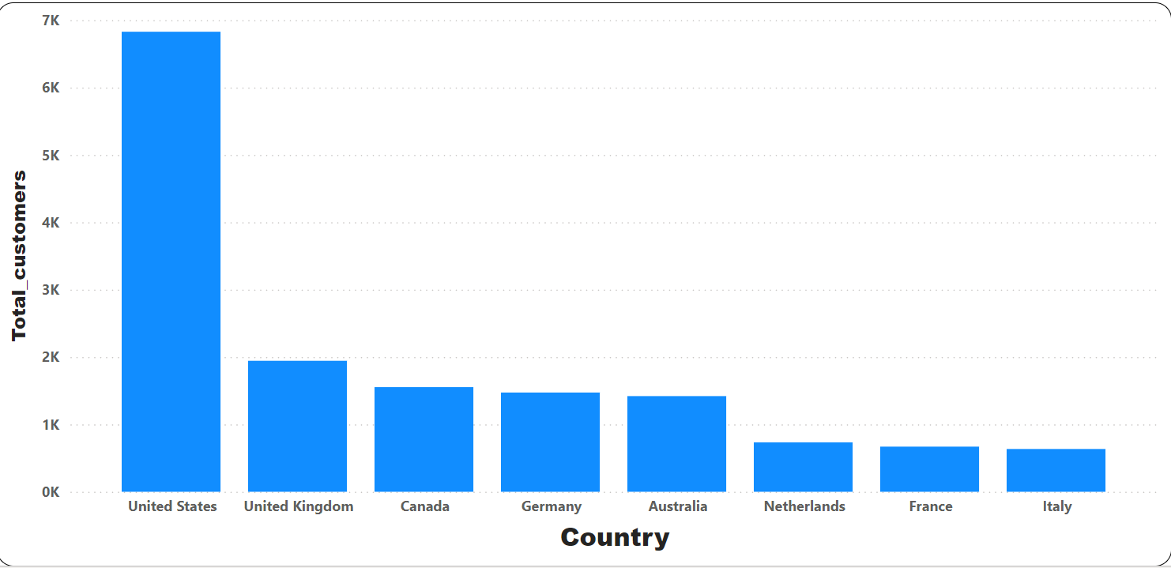
Power BI
In this visualization, it shows how the total customers are varies from different countries, we are able to find out that united states has more customers for global electronics than other countries.

Slide 8
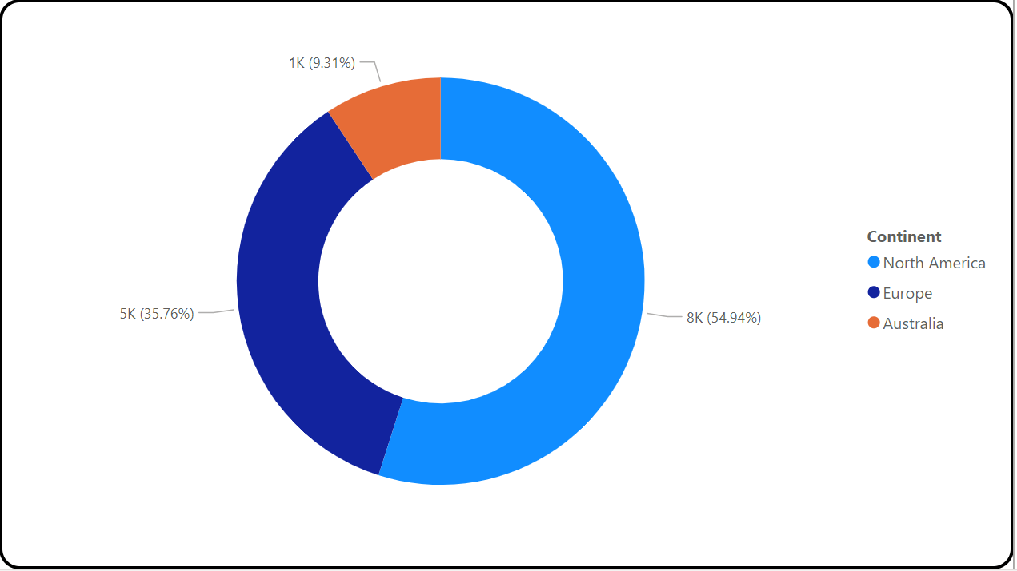
Power BI
The pie chart shows ,that the number of customers in north America was higher than all other customers in the continent.

Slide 9
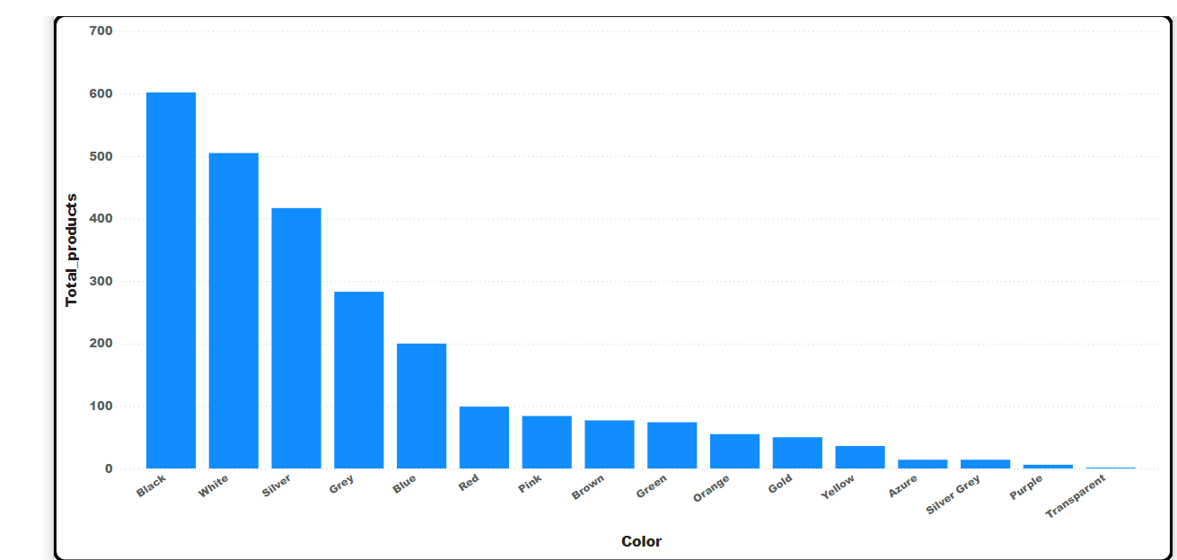
Power BI
This bar chart was showing which color has highest number of products, from this bar chart we clearly see that mostly every product with black has high and it is the most demanding color.

Slide 10
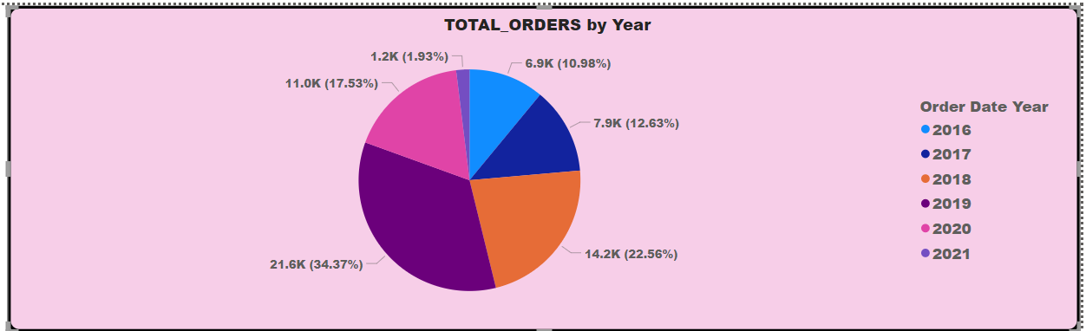
POWER BI
This pie chart showing that the year 2019 has the highest number of sales than any other year.

Slide 11
Conclusion
From the charts and visualization, we clearly know what are all the things we need to concentrate and improve to get a better profit to the the company.

