Slide 1

Project Title - Seasonal Agriculture Performance Analysis
Student Name: Harischandra Prasad Vissamsetti
College Name: Parvathaneni Brahmayya Siddhartha College of Arts & Science
AICTE STU ID: STU65325acd226401697798861

Slide 2

PROBLEM STATEMENT
Agricultural activities are influenced by seasonal variations in environmental conditions, farming practices, resource availability and market conditions. As a result, agricultural performance may differ from one season to another. However, raw agricultural data does not clearly explain how agricultural performance changes across seasons or what patterns can be observed in different seasonal conditions. The problem is to analyze the given agricultural dataset and investigate seasonal differences in agricultural performance by identifying meaningful patterns, trends, relationships and variations within the available data.

Slide 3
Project Description
This major project focuses on conducting a comprehensive, data-driven analysis of agricultural performance across different seasons. Utilizing a robust dataset containing 4,000 farm-level records across 8 states, the project examines the complex relationships between climatic conditions, resource usage, crop characteristics, and financial outcomes.
Data Preprocessing: Cleaning and structuring raw agricultural records to ensure high data quality and reliability.
Exploratory Data Analysis (EDA): Performing descriptive and statistical evaluations to uncover underlying trends in crop yield, production volume, total costs, and net profits.
Seasonal & Resource Evaluation: Analyzing variations in seasonal performance alongside factors such as irrigation methods, fertilizer application, water efficiency, and pest risks.
.
Ultimately, the project transforms raw agricultural data into actionable, evidence-based insights to better understand what drives productivity and profitability across different farming seasons

Slide 4

WHO ARE THE END USERS?
Farmers and Agricultural Producers: Individuals who can use the insights to optimize crop selection, improve water efficiency, and manage costs across different seasons.
Agricultural Policymakers and Government Bodies: Authorities who can utilize seasonal performance trends and resource data to plan subsidies, shape agricultural policies, and support rural development.
Agri-Tech and Input Companies: Businesses providing fertilizers, irrigation systems, or pest management solutions that can target their offerings based on regional and seasonal demand patterns.
Agricultural Researchers and Analysts: Academics and data scientists who can build upon these exploratory data analysis frameworks and visualizations for future studies.

Slide 5

Technology Used
Python: The core programming language used for data processing, analysis, and execution.
Pandas & NumPy: Essential libraries used for data manipulation, cleaning, and mathematical computations.
Matplotlib & Seaborn: Visualization libraries used to create clean, informative charts and data plots.
Google Colab: The cloud-based development environment used to write, run, and document the code.
GitHub: The platform used for publishing, sharing, and presenting the well-structured project repository.

Slide 6
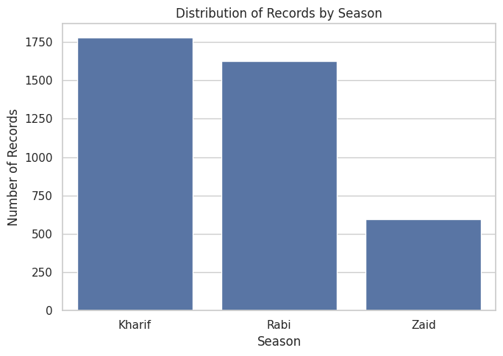
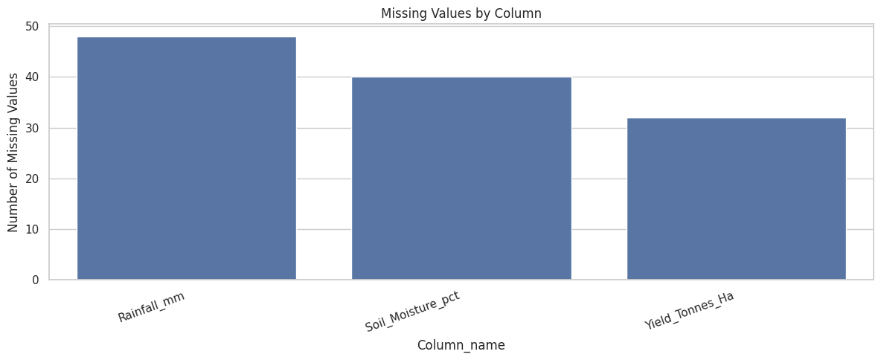
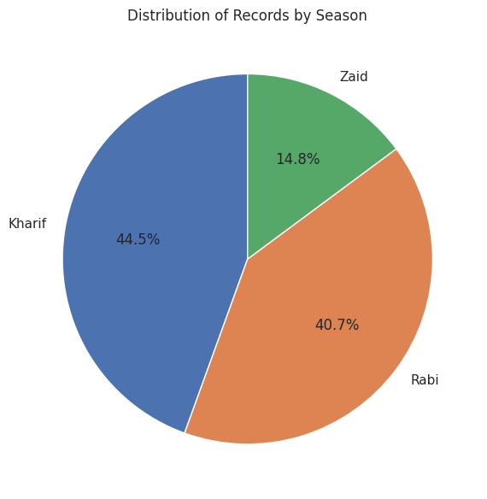
RESULTS

Slide 7
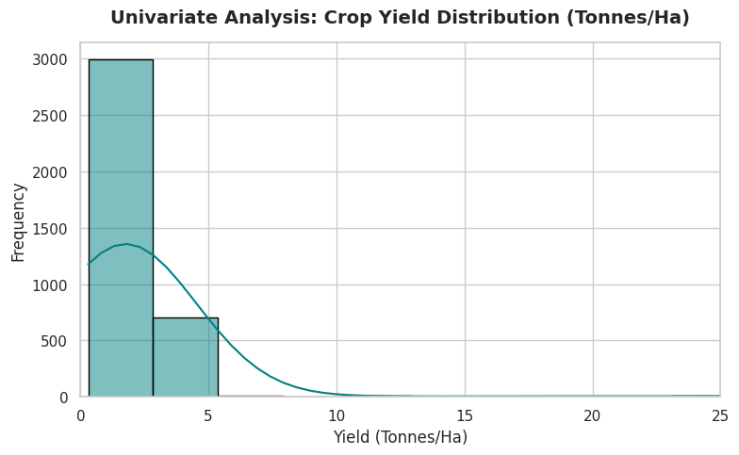
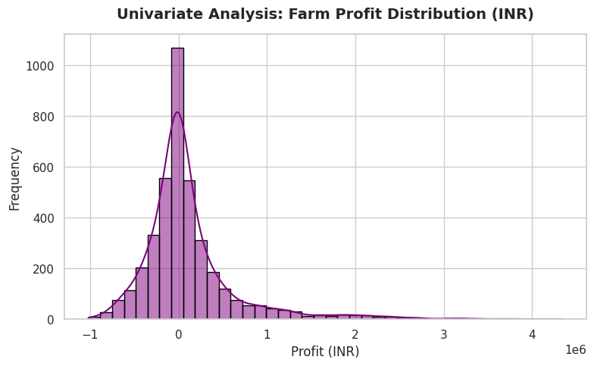
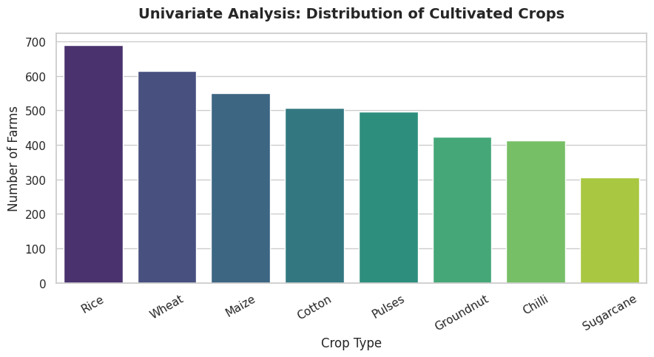
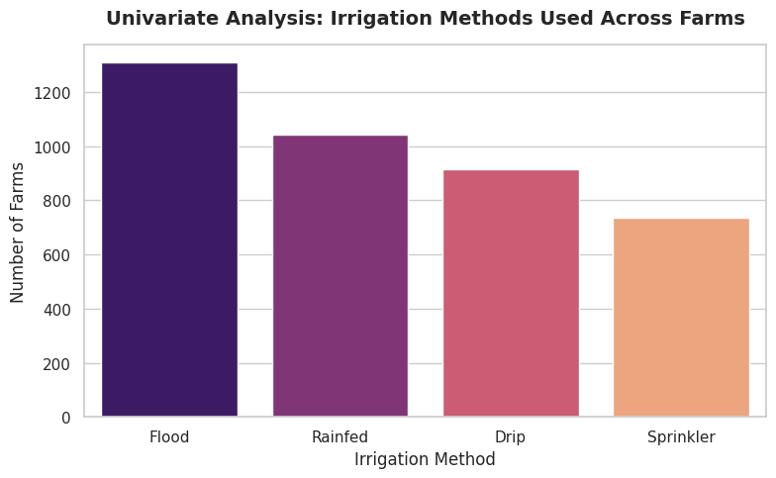
RESULTS

Slide 8
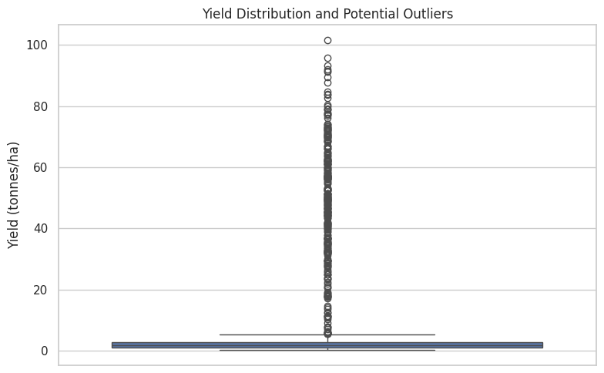
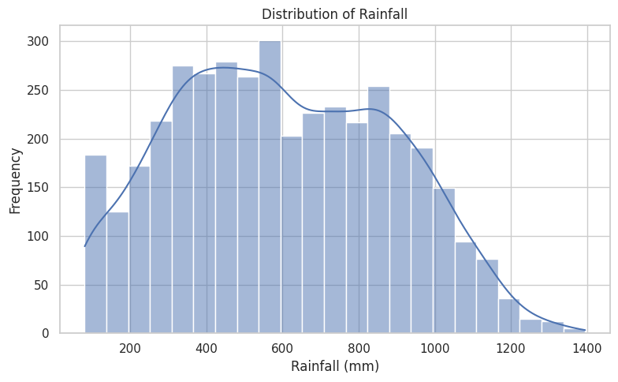
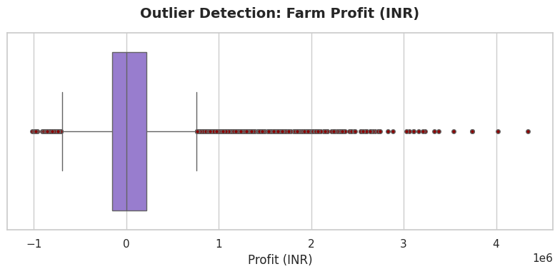
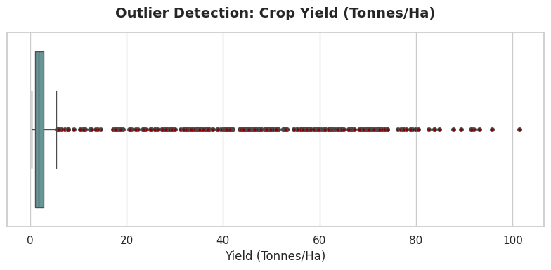
RESULTS

Slide 9
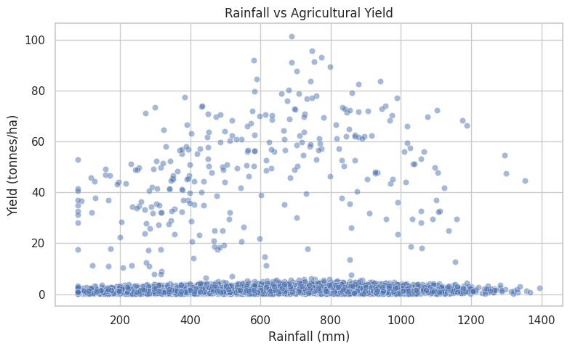
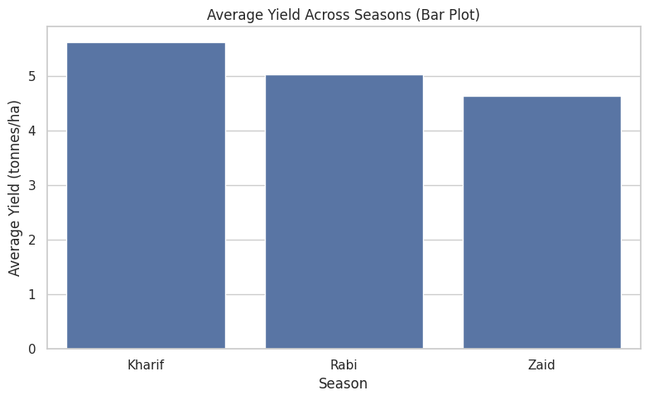
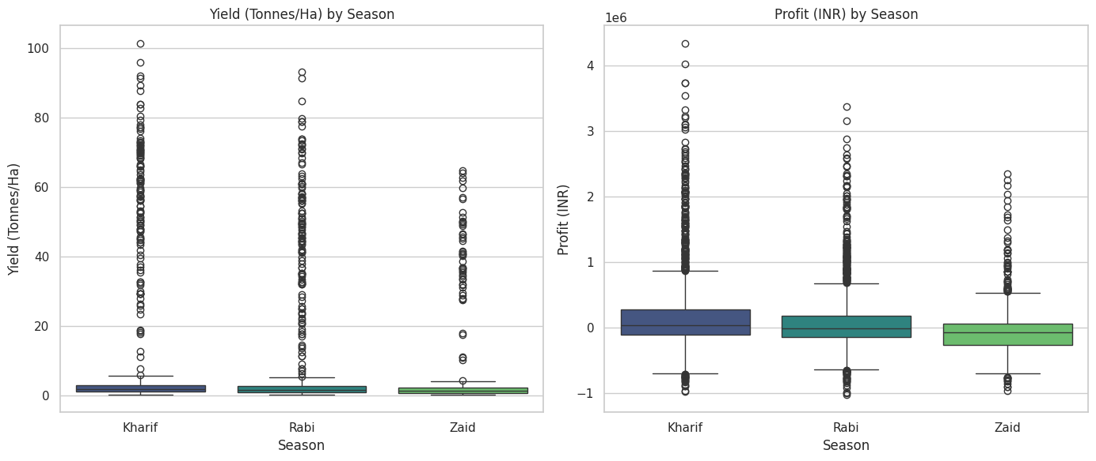
RESULTS

Slide 10
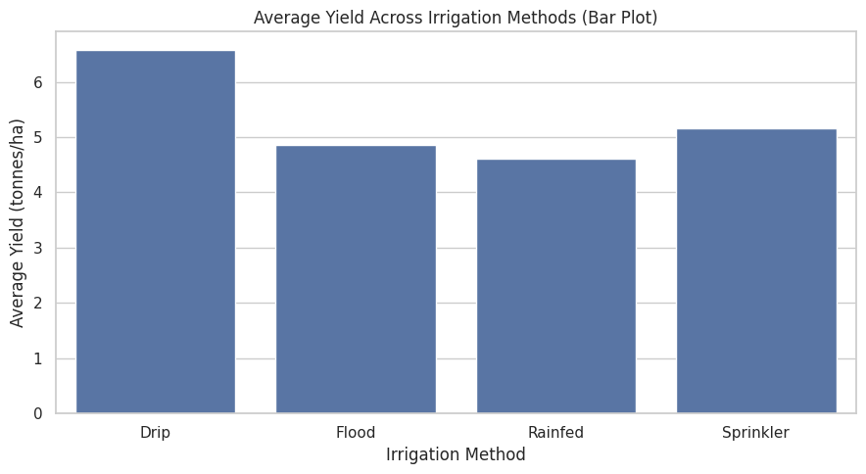
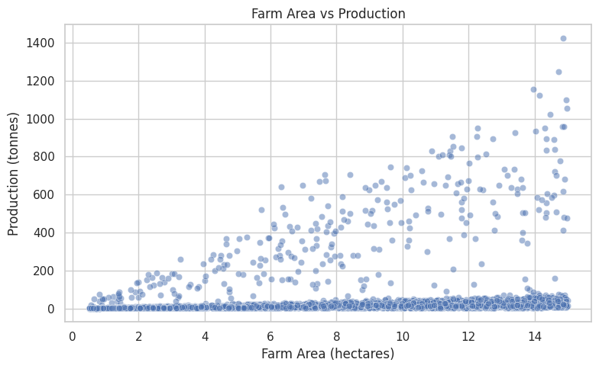
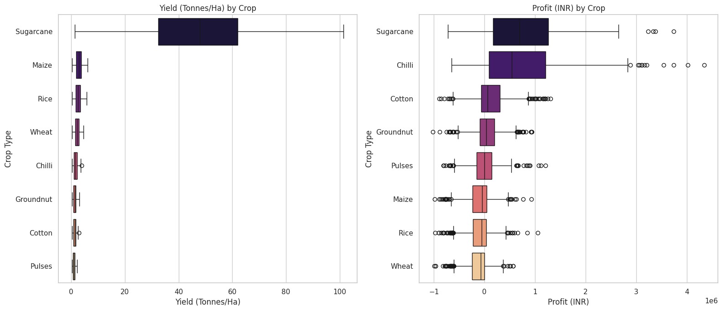
RESULTS

Slide 11
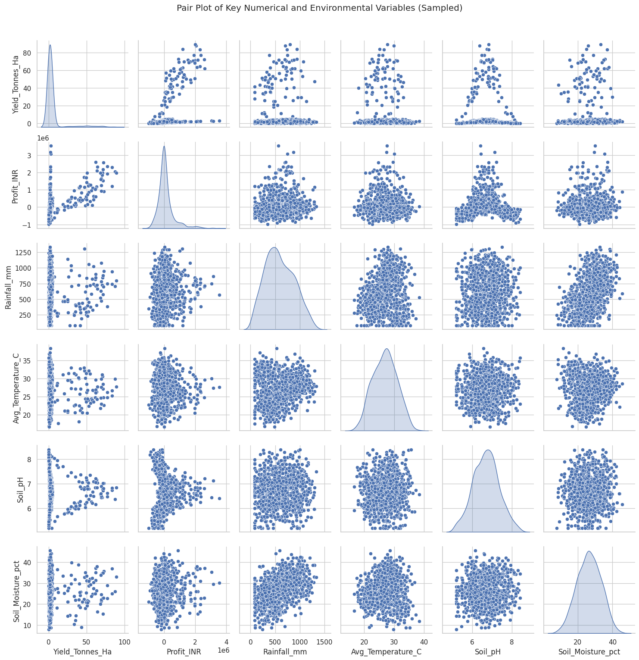
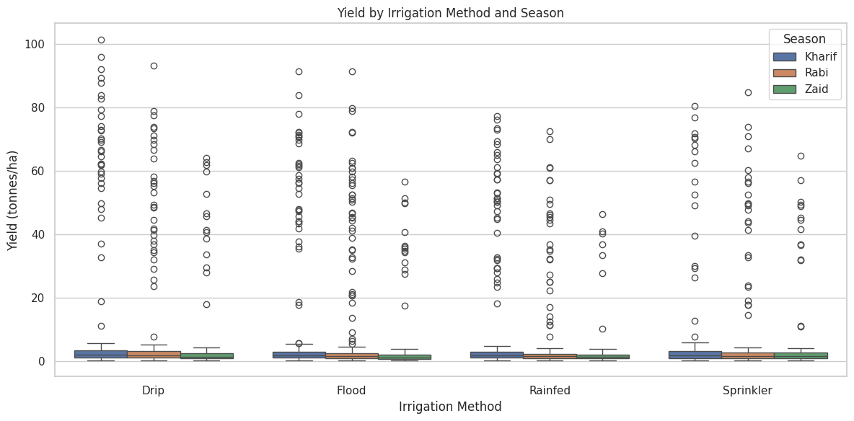
RESULTS

Slide 12
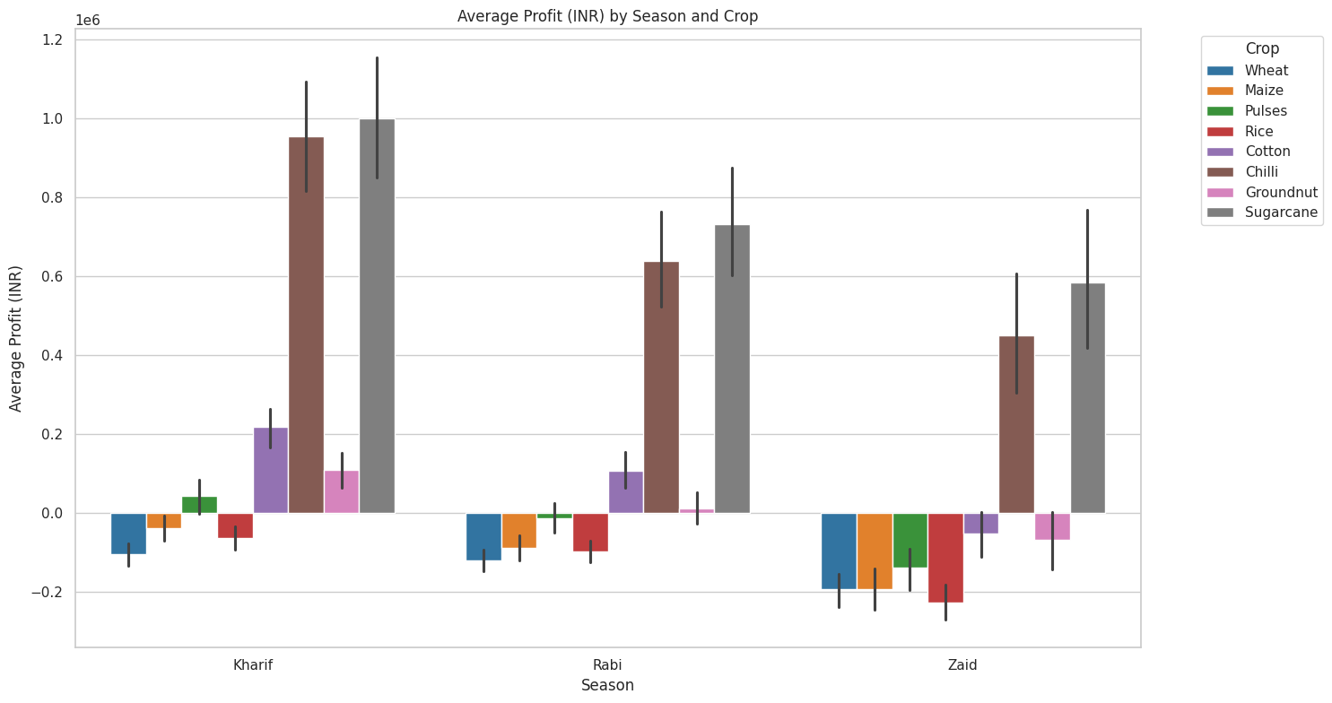
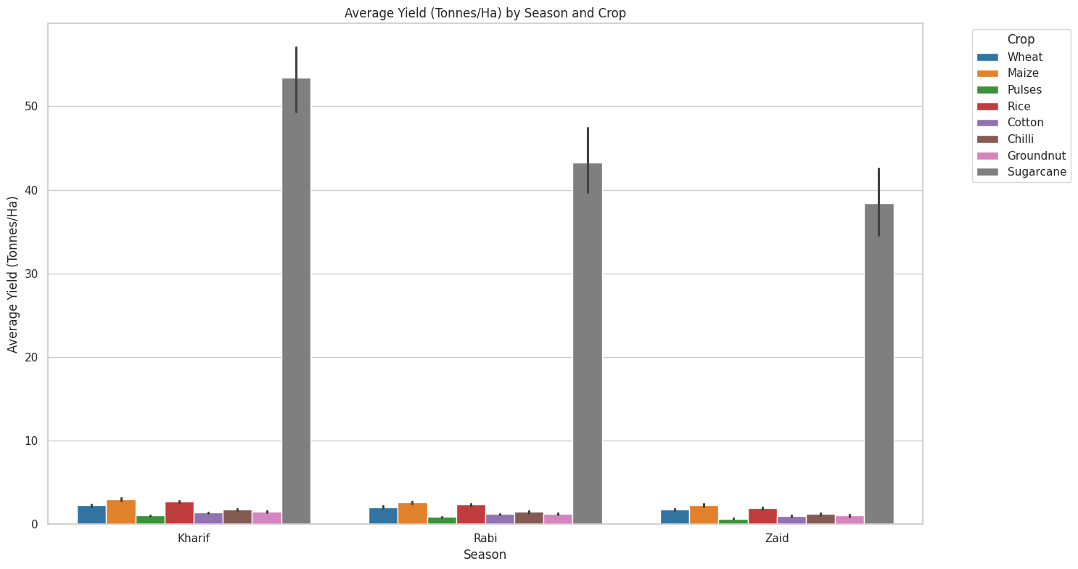
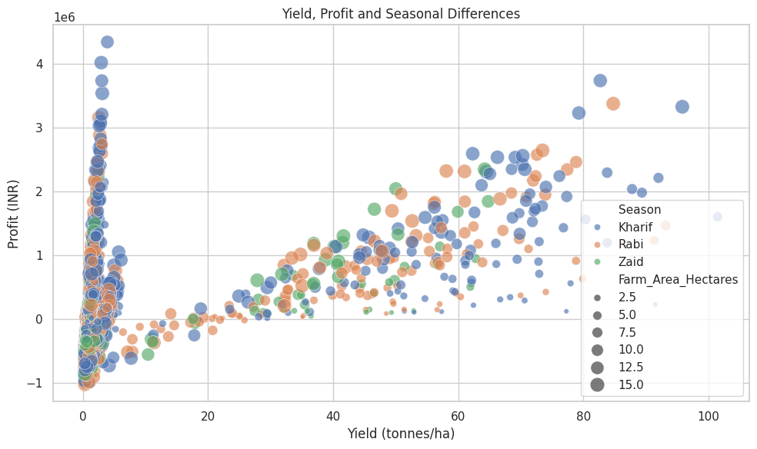
RESULTS

Slide 13
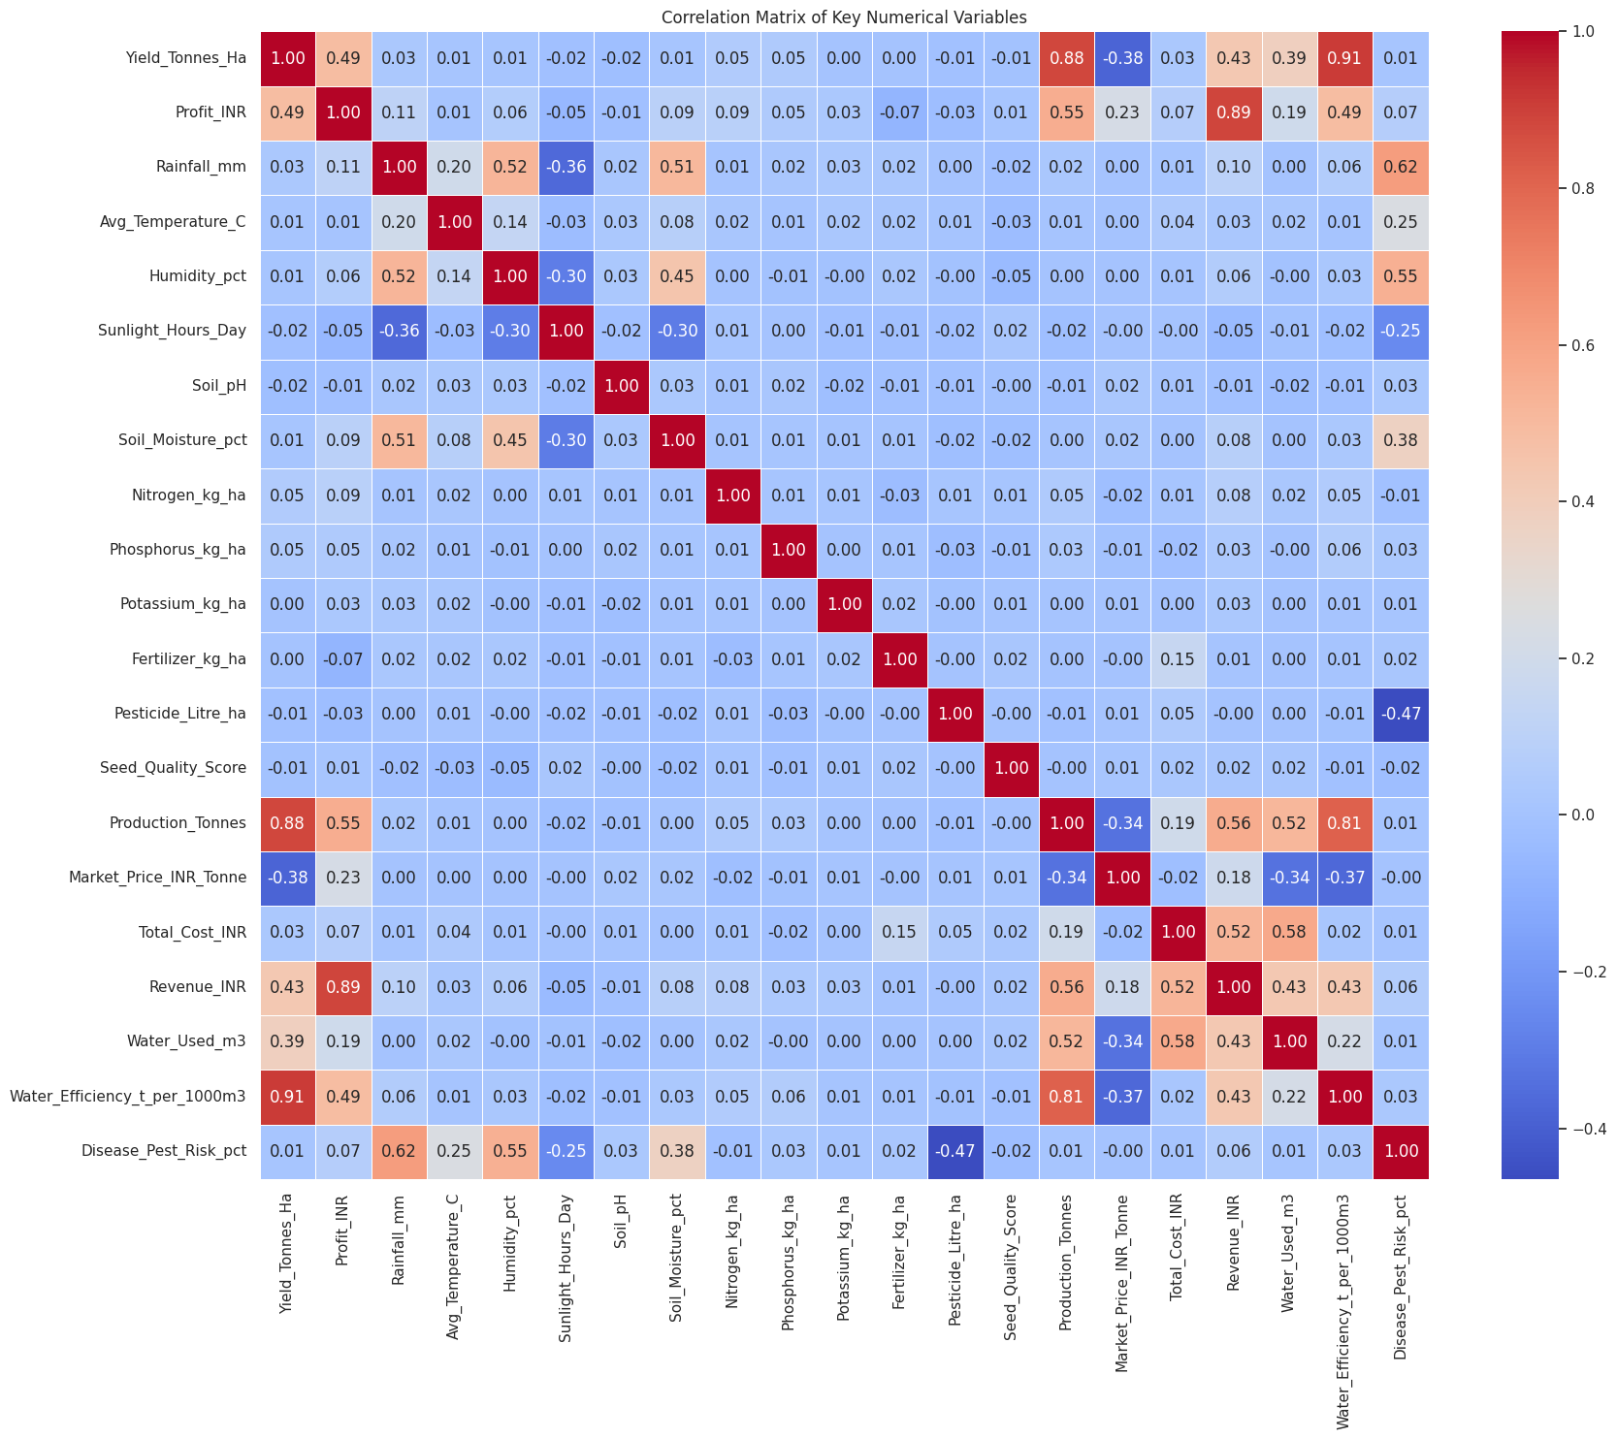
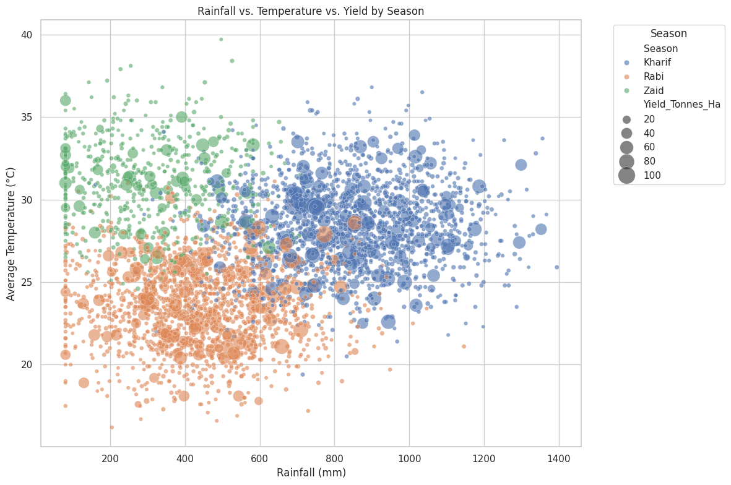
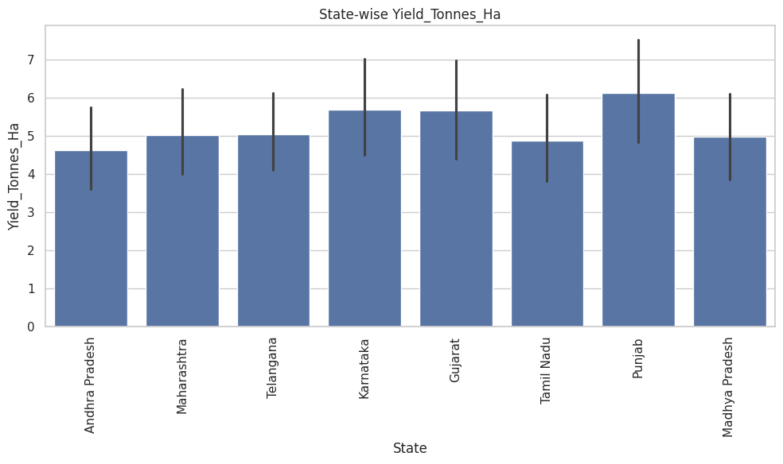
RESULTS

Slide 14
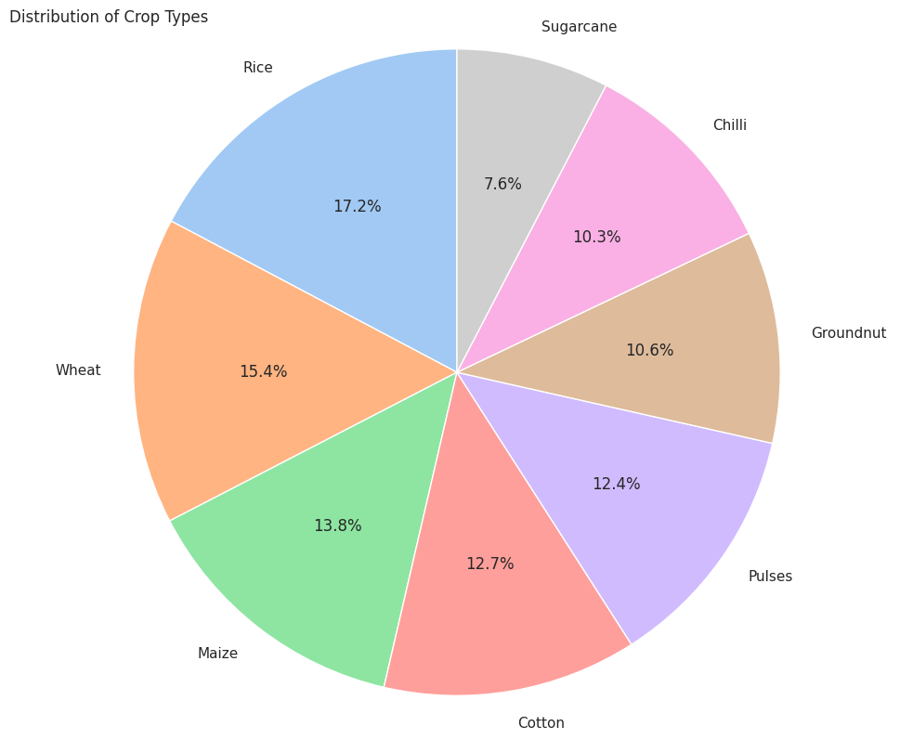
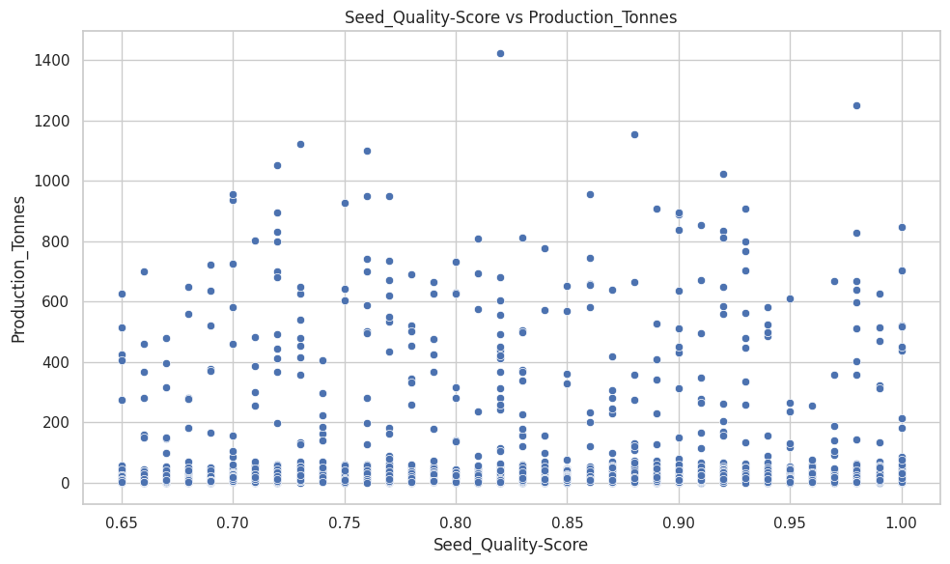
RESULTS
Seasonal Yield & Profit Trends: Identified clear performance patterns, highlighting how crop yields and profit margins fluctuate across different farming seasons.
Resource & Irrigation Impact: Evaluated the direct role of various irrigation methods and resource utilization on overall farm productivity and cost efficiency.
Data-Driven Efficiency Insights: Established key performance indicators to help understand what drives success across farm-level records and regional conditions.

Slide 15
Future scope
Integration of Predictive Machine Learning Models: Extend the exploratory analysis into predictive modeling by implementing machine learning algorithms (such as Random Forest or XGBoost) to forecast future crop yields and net profits based on upcoming climatic and soil conditions.
Real-Time IoT and Weather Integration: Incorporate live weather APIs and IoT sensor data (such as live soil moisture and temperature feeds) to provide dynamic, real-time recommendations for irrigation and fertilizer use.
Expanded Regional Coverage: Scale the dataset to include a broader range of districts, agro-climatic zones, and international farming regions to test the robustness and adaptability of the analytical framework.
AI-Driven Sustainability Policy Frameworks: Align future iterations with advanced AI applications to support national long-term agricultural development goals and sustainable farming initiatives.

Slide 16
GitHub Link
https://github.com/Harischandra-Prasad-Vissamsetti/Seasonal-Agriculture-Performance-Analysis.git
Explore the Code & Analysis: Check out the complete source code, detailed Google Colab notebooks, and full project documentation on GitHub.

Slide 17

VOIS Course Completion Certificate - Course Name- Data Visualization

Slide 18
Thank you
Grateful for the opportunity to share data-driven insights for sustainable agriculture.
.
.

