Slide 1
Digital Portfolio
STUDENT NAME: HARISH.M
REGISTER NO AND NMID: 222407865 AND 5AEE2938E6BED47B0A54D65A3DC10372
DEPARTMENT: B.Sc Computer Science with Data science
COLLEGE: TAGORE COLLEGE OF ATRS AND SCIENCE,CHROMPET/ UNIVERSITY OF MADRAS

Slide 2
PROJECT TITLE
Digital Portfolio Website.

Slide 3


AGENDA
Problem Statement
Project Overview
End Users
Tools and Technologies
Portfolio design and Layout
Features and Functionality
Results and Screenshots
Conclusion
Github Link
3/21/2024 Annual Review

Slide 4

PROBLEM STATEMENT
*Traditional portfolios lack interactivity and real-time updates for students in technical domains.
*There is a need for a dynamic platform showcasing academic background, skills, and projects for students.

Slide 5

PROJECT OVERVIEW
*The project is a web-based digital portfolio for Harish M, aimed at presenting his academic journey, skills, and projects.
*It features education history, technical skills, sample projects, and contact details, supporting visibility for employers and collaborators

Slide 6

WHO ARE THE END USERS?
*Prospective employers/hiring managers seeking talent in web development or data analysis.
*Academic faculty needing student achievements and skills information.
*Collaborators interested in joint projects or networking.

Slide 7

TOOLS AND TECHNIQUES
*HTML & CSS : Used to structure and style the digital portfolio website, giving it a user-friendly and visually organized layout.
*JavaScript : Provides dynamic interactivity and enhances user experience on the website.
*SQL & Databases : Used for managing structured data and enabling secure backend storage/retrieval if required for expanded portfolio functionality.
*Git & GitHub : Essential for version control and collaborative project management, as noted in the skill section and by the intent to share code repositories.

Slide 8
POTFOLIO DESIGN AND LAYOUT
*Single-page clean design with sections for education, skills, projects, and contact info.
*Easy navigation and responsive layout for accessibility.
8

Slide 9
FEATURES AND FUNCTIONALITY
*Sections: Education, Skills, Projects, Contact Component (phone and email).
*Project highlights: Mystery Shopping Website (HTML/CSS/JS), Python *Data Analysis (Pandas/NumPy/Matplotlib).
*Updatable Skills: Allows showcasing new technologies learned.

Slide 10

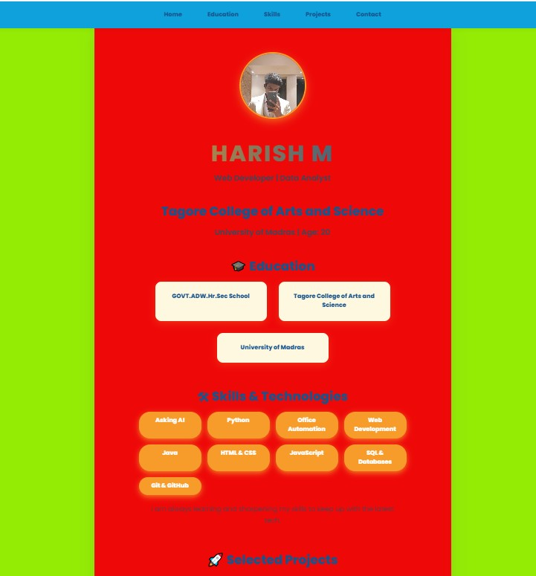
RESULTS AND SCREENSHOTS
*The digital portfolio successfully centralizes and presents all key academic and project details in an engaging format.
*Screenshots can be included from the HTML/CSS layout showing profile, skills, and project summary sections.
3/21/2024 Annual Review
10

Slide 11
CONCLUSION
*The portfolio addresses the need for a modern, interactive profile for students, making it easier for employers and collaborators to assess skills and connect.
*The modular design enables ongoing updates and skill enhancements for future growth.
11

