Slide 1
SecureUrl -A Phishing website detection application
- GAYATHRI bELIDE (1602-21-733-013)
- Ch harish reddy (1602-21-733-012)
Internal Guide: Dr.T.Adilakshmi
Project Co ordinator : T.Jalaja

Slide 2
Introduction
What is Phishing?
A cyberattack where hackers use deceptive methods to obtain sensitive information.
Targets include:
Personal Information: Passwords, credit card numbers, etc.
Financial Data: Bank account details, transaction credentials.
How Does Phishing Work?
Conducted via:
Fake emails or messages.
Fraudulent websites imitating legitimate businesses.
Malicious links or attachments.

Slide 3
Introduction
Phishing attacks usually involve the creation of fake websites or emails that seem like those of legitimate businesses, such as banks, social networking platforms, or online stores.
Phishing websites are fraudulent websites that imitate legitimate ones, aiming to deceive users into disclosing sensitive information.
These websites often have URLs that closely resemble those of reputable websites, making it challenging for users to distinguish between them.

Slide 4
Introduction
Why Detect Phishing Websites?
Protect Users:
Prevent identity theft and financial losses.
Maintain Trust:
Ensures businesses and users retain confidence in online platforms.
Combat Evolving Threats:
Phishing tactics are constantly evolving, requiring robust detection mechanisms.

Slide 5
Introduction
In order to avoid getting phished,
• users should have awareness of phishing websites.
• have a blacklist of phishing websites which requires the knowledge of website
being detected as phishing.
• detect them in their early appearance, using machine learning and deep neural network algorithms.

Slide 6
Literature survey-1
Paper Title: "List-Based Detection Methods for Phishing Websites"
Approach: This study explores list-based detection mechanisms, which include maintaining blacklists of known phishing URLs and whitelists of trusted URLs. Blacklists, used in browsers like Google Chrome and Mozilla Firefox via Google Safe Browsing, provide warnings when malicious sites are detected. Whitelists, on the other hand, help identify trusted websites by flagging URLs not present in the list as suspicious.
Limitations: List creation and updates should be based on lightweight mechanisms not to introduce delays in the detection process,Lists should be constantly updated to defend against newly discovered phishing attacks, Rules and heuristics devised for creating and updating the lists should reflect in a timely manner the evolution of the tactics adopted by attackers.

Slide 7
Literature survey-2
Paper Title: Page similarity based detection
Approach: The paper explores page similarity methods for detecting phishing websites. It compares suspicious pages to legitimate ones based on textual (HTML, CSS, DOM) and visual (images, logos) content. The similarity scores help identify phishing attempts by comparing these elements, with final decisions based on predefined thresholds.
Limitations: Effectiveness(Evasion techniques like code obfuscation and image distortions can reduce detection accuracy.), Approaches relying on external services can be slow.,Large datasets of legitimate pages require significant storage capacity.

Slide 8
Literature survey-3
Paper Title: "Phishing Attack, Its Detections and Prevention Techniques “
Approach: The study outlines various phishing techniques, including email phishing, spear phishing, whaling, smishing, vishing, clone phishing, and social media phishing. It emphasizes the sophistication of modern attacks, which leverage social engineering and advanced technologies like AI.
Limitations: Although the paper provides a broad review, it lacks detailed explanations of the technical implementation of detection and prevention techniques, such as specific algorithms or systems.

Slide 9
Literature survey-4
Paper Title: "Study on Phishing Attacks “
Approach: The paper emphasizes methods like:Using custom DNS services to block malicious sites.Leveraging browser-based phishing lists.Manual verification of links for authenticity.
Limitations: While the paper categorizes and discusses phishing attacks, the analysis of detection and prevention methods lacks depth, particularly in emerging phishing techniques (e.g., AI-driven phishing).

Slide 10
Proposed solution
The objective of this project is to train machine learning models and deep neural nets on the dataset created to predict phishing websites. Both phishing and benign URLs of websites are gathered to form a dataset and from them required URL and website content-based features are extracted. The performance level of each model is measures and compared then we assign with highest performance as the model and predict the new url with the extracted features from the url to be legitimate or Phishing.

Slide 11
Algorithms
Ensemble Technique-Random Forest Classifier
from sklearn.ensemble import RandomForestClassifier
forest = RandomForestClassifier(n_estimators=10)
forest.fit(X_train,y_train)
y_train_forest = forest.predict(X_train)
y_test_forest = forest.predict(X_test)
acc_train_forest = metrics.accuracy_score(y_train,y_train_forest)
acc_test_forest = metrics.accuracy_score(y_test,y_test_forest)
storeResults('RandomForest',acc_test_forest,f1_score_test_forest,
recall_score_train_forest,precision_score_train_forest)

Slide 12
Algorithms
Ensemble Technqiue-XGBoost
from xgboost import XGBClassifierxgb = XGBClassifier()
y_train_xgbcopy = np.where(y_train == -1, 0, y_train.copy())
y_test_xgbcopy = np.where(y_test == -1, 0, y_test.copy())
xgb.fit(X_train,y_train_xgbcopy)
y_train_xgb = xgb.predict(X_train)
y_test_xgb = xgb.predict(X_test)
acc_train_xgb = metrics.accuracy_score(y_train_xgbcopy,y_train_xgb)
acc_test_xgb = metrics.accuracy_score(y_test_xgbcopy,y_test_xgb)
storeResults('XGBoost Classifier',acc_test_xgb,f1_score_test_xgb,
recall_score_train_xgb,precision_score_train_xgb)

Slide 13
algorithms
KNN Algorithm:
from sklearn.neighbors import KNeighborsClassifier
knn = KNeighborsClassifier(n_neighbors=1)
knn.fit(X_train,y_train)
y_train_knn = knn.predict(X_train)
y_test_knn = knn.predict(X_test)
acc_train_knn = metrics.accuracy_score(y_train,y_train_knn)
acc_test_knn = metrics.accuracy_score(y_test,y_test_knn)

Slide 14
algorithms
MULTI-LAYER PERCEPTRON
from sklearn.neural_network import MLPClassifier
mlp = MLPClassifier()
mlp.fit(X_train,y_train)
y_train_mlp = mlp.predict(X_train)
y_test_mlp = mlp.predict(X_test)
acc_train_mlp = metrics.accuracy_score(y_train,y_train_mlp)
acc_test_mlp = metrics.accuracy_score(y_test,y_test_mlp)
storeResults('Multi-layerPerceptron',acc_test_mlp,f1_score_testmlp,
recall_score_train_mlp,precision_score_train_mlp)

Slide 15
Steps for implementation
DATA COLLECTION
• Legitimate URLs are collected from the dataset provided by University of New Brunswick, https://www.unb.ca/cic/datasets/url-2016.html.
• From the collection, 5000 URLs are randomly picked.
• Phishing URLs are collected from opensource service called PhishTank . This service provide a set of phishing URLs in multiple formats like csv, json etc. that gets updated hourly.
• Form the obtained collection, 5000 URLs are randomly picked.

Slide 16
Steps for implementation
2)Feature Selection
• Address Bar based Features considered are Domian of URL ,Redirection ‘//’ in URL ,IP Address in URL,‘http/https’ in Domain name ,‘@’ Symbol in URL ,Using URL Shortening Service ,Length of URL , Prefix or Suffix "-" in Domain ,Depth of URL
• Domain based Features considered are DNS Record , Age of Domain ,Website Traffic,End Period of Domain .
• HTML and JavaScript based Features considered are: Iframe Redirection ,Disabling Right Click ,Status Bar Customization ,Website Forwarding

Slide 17
Steps for implementation
3)MACHINE LEARNING MODELS
• This is a supervised machine learning task and this data set comes under classification problem, as the input URL is classified as phishing (1) or legitimate (0). The machine learning models (classification) considered to train the dataset in this notebook are:
• Decision Tree
• Random Forest
• Multilayer Perceptrons
• XGBoost
• Support Vector Machines

Slide 18
Steps for implementation
4. Model training and efficiency evaluation
The sample data set of urls along with the extracted features is split into train (80) and test data.
Train data is used to train the model,test data is used to test the efficiency of model after the training process.
Model having high efficiency with test data is chosen for further usage.

Slide 19
Steps for implementation
Apart from the base URL,the application is designed to analyse the redirection URLs,and tell how safe they are to use .

Slide 20
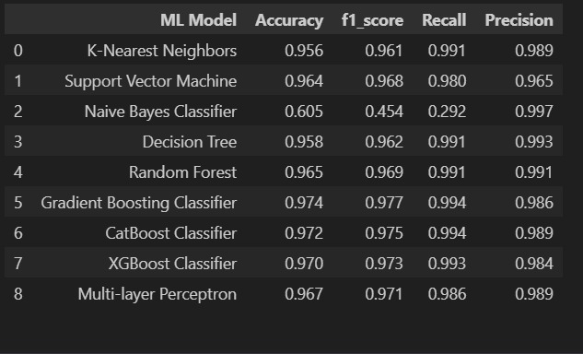
ReSULTS
The Results of different models for the dataset

Slide 21
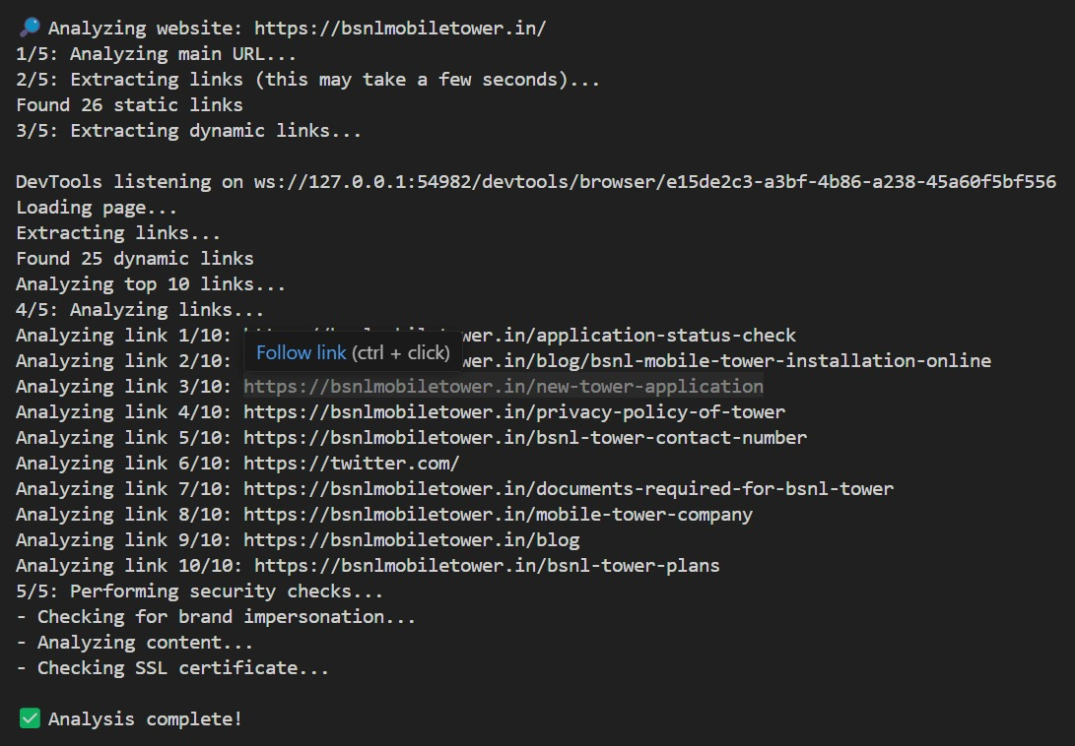
Results

Slide 22
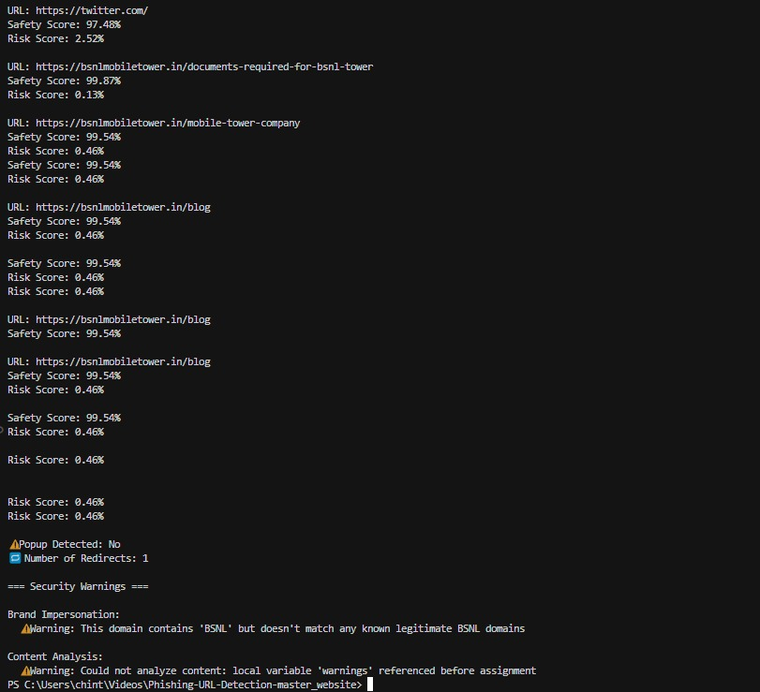
RESUlts

Slide 23
conclusion
This project demonstrates a robust approach to detecting phishing websites using machine learning algorithms with high efficiency in classifying the websites as legitimate or phishing.
This project aims to protect people from cyberattacks and increase customers’ trust towards legitimate businesses.

Slide 24
Future work
To implement this application as a browser extension,instead of user manually entering the URL in the application.
This application when implemented as a browser extension can also detect how malicious the redirections are.

Slide 25
references
1. " Phishing or Not Phishing? A Survey on theDetection of Phishing Websites "
Rasha Zieni , Lusia Massari, and Maria Carla Calzarosa, (Senior Member,,IEEE),Department of Electrical, Computer and Biomedical Engineering, Università di Pavia, 27100 Pavia, Italy
2. " A Study on Adversarial Sample Resistance and Defense Mechanism for Multimodal Learning-Based Phishing Website Detection”
VO QUANG MINH, BUI TAN HA
3. "A Review on Phishing Attacks “
Reference:Akarshita Shankar, Ramesh Shetty, International Journal of Applied Engineering Research ISSN 0973-4562 Volume 14, Number 9 (2019) pp. 2171-2175
Source: IEEE Xplore.

Slide 26
references
4. "A systematic literature review on phishing website detection techniques “
Asadullah Safi a , Satwinder Singh b,Nangarhar University, Ministry of Higher Education, Afghanistan,Dept. of Computer Science & Technology, Central University of Punjab, Bathinda, Punjab, India
5. "An Effective Phishing Websites Detection Model Based on Optimal Feature Selection and Neural Networks“
Reference:Erzhou Zhu,Yuyang chen,Anhui University.
Source:IEEE Access
6. "Phishing Website Detection Based on Multidimensional Features Driven by Deep Learning“
Source:IEEE Access

Slide 27
THANK YOU

