Slide 1





SMART INDIA HACKATHON 2026
Problem Statement ID : 26042
Problem Statement Title :
Theme : Smart Education
PS Category : Software
Team ID :
Team Name : Messi Verse
AI - Powered Vernacular Pedagogy and Real Time Translation Tool for Mother Tongue-Based Primary Education

Slide 2
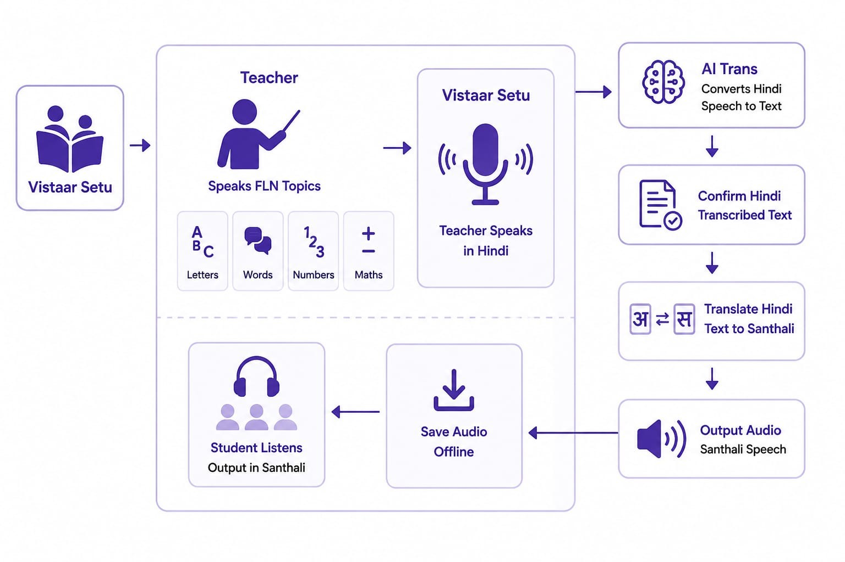
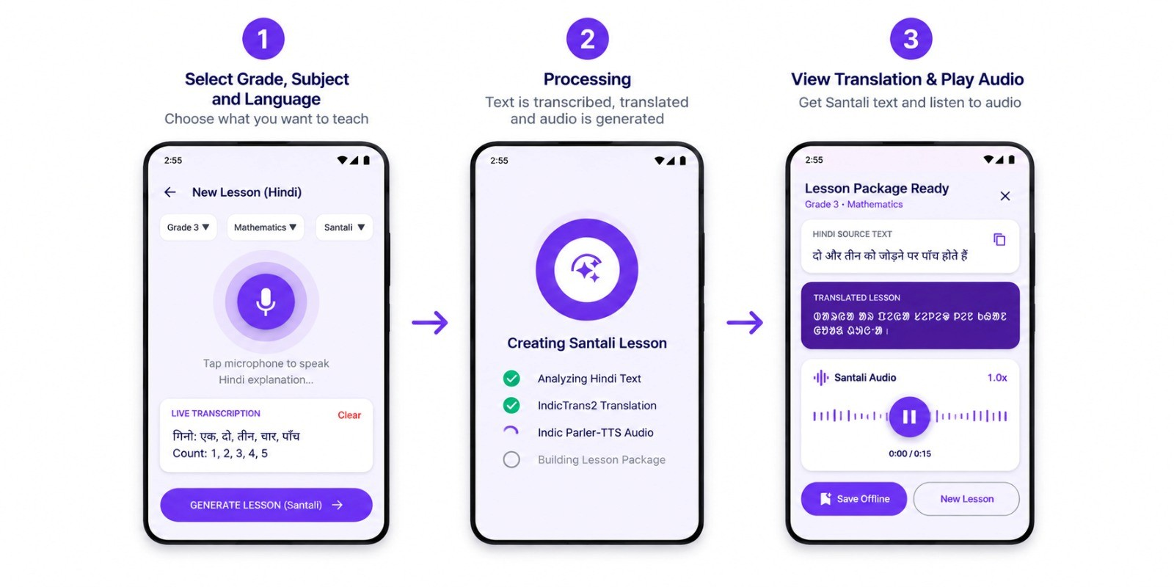
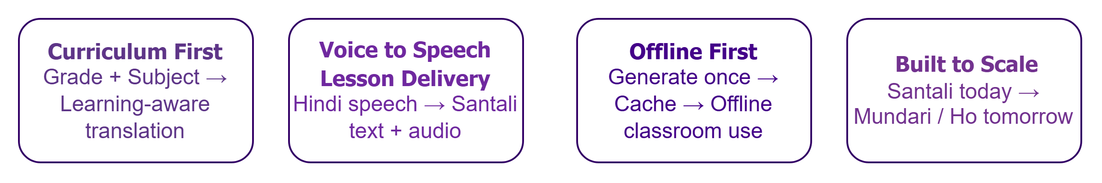
Messi Verse
VISTAAR SETU
AI-Powered Mother-Tongue Learning for Tribal Classrooms
Problem Existing
5000 + tribal area schools struggle to scale mother-tongue education.
Most teachers are Hindi-Medium trained,while students speak Ho,Santali or Mundari at home.
Existing tools translate; none are built for classroom lesson delivery with grade/subject structure.
Solution Architecture & Approach
Addressing the Problem
Teacher - Student Language Gap Enables Hindi-trained teachers to deliver lessons in students’ mother tongue.
Limited Mother-Tongue Resources Converts existing FLN content into usable tribal-language learning material.
Lack of Classroom-Ready Support Provides translated text and audio that can be directly used during lessons.
Poor Connectivity Keeps lessons available even without continuous internet access.
Android Flow (Key Screens)
Innovation & Uniqueness

Slide 3
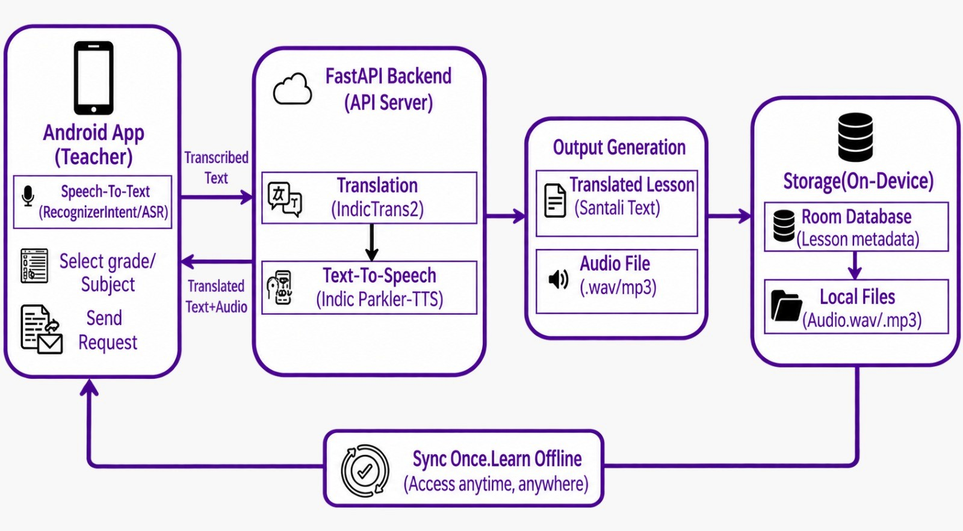
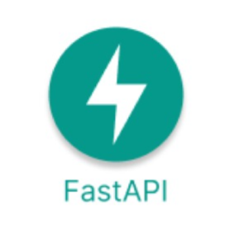









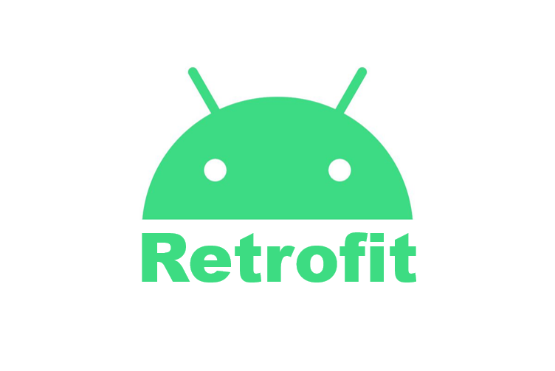





TECHNICAL APPROACH
Messi Verse
Tech Stack
Backend (API Server)
Android (Mobile App)
Python
Uvicorn
Transformers
IndicTrans2
IndicTrans2
Indic-Parler TTS
/audio(static files)
Kotlin
Jetpack
Compose
{ }
GSON
Recognize Intent(Exoplayer)
Speech-to-Text
Room DB
Hardware & Deployement
Target Device : Android 9 + and 2GB
RAM
Deployement : FastAPI on Server
(Render / Cloud)
verified Cache Architecture:pre-translated, human-checked lesson content served instantly offline; live AI only for novel/unplanned speech

Slide 4
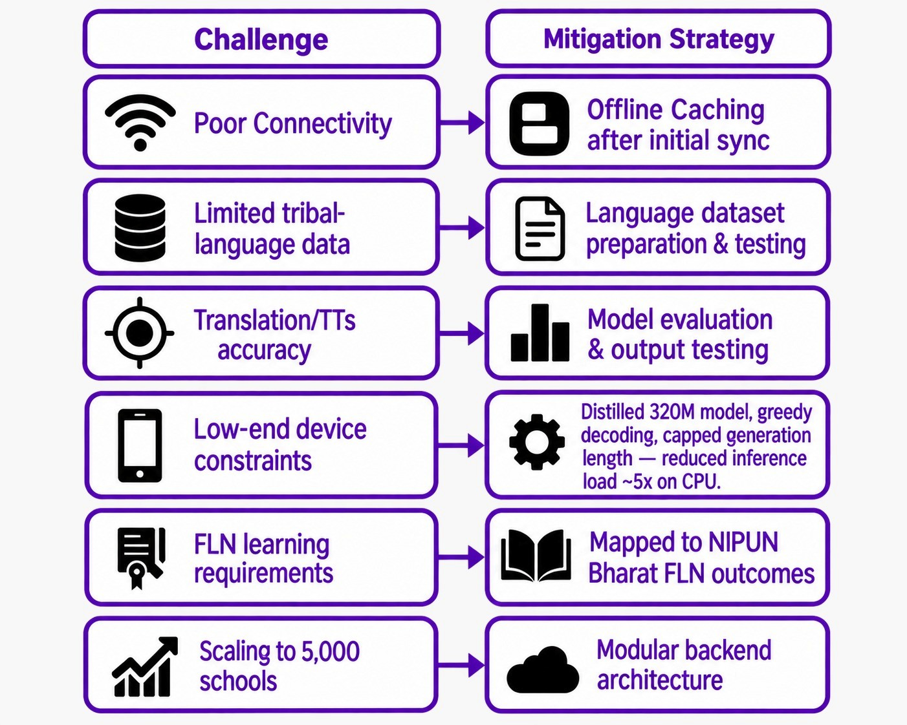


FEASIBILITY AND VIABILITY
Messi Verse
Feasibility of Vistaar Setu : A practical & deployable solution for real classrooms
Key Challenges and Mitigation Strategies
Anticipated risks and our approach
Low-cost Deployement
AI Translation
Android 9+ ~2GB RAM designed for classroom use
Hindi →
Ho/Mundari/Santhali
Offline Acess
Voice-to-Voice
Use after Initial Synchronization
Hindi ↔ Tribal languages
<= 3 sec traget latency
Vistaar Setu
FLN Content Generation
Teacher-Centric
Worksheets, and visual flash
cards (NIPUN Bharat aligned)
Teacher -led , simple workflow
Select → Generate → Teach

Slide 5
IMPACT AND BENEFITS
Messi Verse
1,041 Schools
35,400 Children
(Learners Reach)
One Teacher → Many Lessons
PALASH teaching-learning
materials are being used across 8 districts in Jharkhand
Impact
Primary learners supported
through mother-tongue-based
multilingual education
Each approved translation, audio clip and worksheet can be saved and reused Offline
Immediate Classroom Support
Santali in Daily Learning
Better Learner Engagement
Benefits
Hindi explanation to Santhali text + audio.
Teachers can create localized lesson support without manually preparing separate translations.
Localized explanations help learners connect classroom concepts with their familiar language.
Local language becomes part
of classroom instruction
not just a language option
Sources: JEPC / PALASH • UNICEF • UNESCO 2025

Slide 6
RESEARCH AND REFERENCES
Messi Verse
Low-Resource & Munda NLP
Industry Outlook
Competitor Comparision
Towards Santali Linguistic Inclusion - mT5 + Data Augmentation, arXiv 2024
NER in Low-Resource Languages of Ho - GI Global, 2024
IndicTrans2 vs. ByT5 for English–Santali - ACL Anthology, 2025
Bhaasha, Bhasa, Zaban: Survey of Low-Resourced South Asian Languages -arXiv, 2025
Feature | Adi Vaani | Bhashini | Google Translate | PALASH (manual) | Vistaar Setu
Ho language support | ✗ | ✗ | ✗ | ✓ | ✓
Mundari support | ✓ | ✗ | ✗ | ✓ | ✓
Santali support | ✓ | ✓ | ✓ | ✓ | ✓
Offline / no-internet mode | ✗ | ✗ | ✗ | ✓ | ✓
NIPUN-aligned worksheet gen. | ✗ | ✗ | ✗ | ✗ | ✓
Real-time voice-to-voice | ✓ | ✓ | ✗ | ✓ | ✓
Usable w/o teacher language training | ✓ | ✓ | ✓ | ✗ | ✓
$19B
India EdTech & Smart Classrooms market by 2030, 16.4% CAGR (MarketsandMarkets, 2025)
5.2M+
Santali + Mundari + Ho mother-tongue speakers in Jharkhand alone (2011 Census)
Offline / Edge Deployment
1,041+
PALASH schools already running MTB-MLE across 8 districts
Flavors of Moonshine: Tiny ASR Models for Edge Devices - arXiv, 2025
Quantization for Whisper Models: A Comparative Analysis - arXiv, 2025
Privacy-Preserving Real-Time Translation on iOS (Edge AI) - arXiv, 2025
96%
of Jharkhand children speak a non-Hindi mother tongue at home(in tribal survey)
2026-27
National deadline for universal FLN under NIPUN Bharat
Policy & Program
NIPUN Bharat & FLN Outcomes 2024 - Mehta, Jun 2025
Jharkhand Language Mapping Report, Phase 1 Language & Learning Foundation, 2025
Linguistic Survey of India - Jharkhand (2011 Census)
Working today: Hindi→Santali text+audio generation, save-to-device.
Building next: fully offline replay, worksheet generation
Product Status →

