Slide 1
Harish Goud Ediga -2016A7PS0110H
GENERALISED SEQUENTIAL PATTERN ALGORITHM

Slide 2
Data Pre-processing:
The online retail data is has lot of mixed data like invoice of items which were cancelled/return etc., and has data in text format , missing values.
So using pandas we filtered invoices and we used one hot encoding to convert the strings to int we can work upon and saved in a lookup file.
Filled missing values using approximation (if transaction above and below have same i we assume this has same customerID) and removed other rows which can’t be changed.
Dropped other columns from main data frame for algorithm analysis part .

Slide 3
GSP Algo:
F1 = the set of frequent 1-sequence
k=2,
do while Fk-1 != Null;
Generate candidate sets Ck (set of candidate k-sequences);
For all input sequences s in the database D
do
Increment count of all a in Ck if s supports a
End do
Fk = {a ∈ Ck such that its frequency exceeds the threshold}
k = k+1;
End do
Result = Set of all frequent sequences is the union of all Fk’s
The Main difference between apriori and GSP is that apriori is itemset mining while GSP is sequence mining, GSP is similar to apriori but takes in order of element and thus find sequence,
A->B->C and A->C->B different in GSP

Slide 4
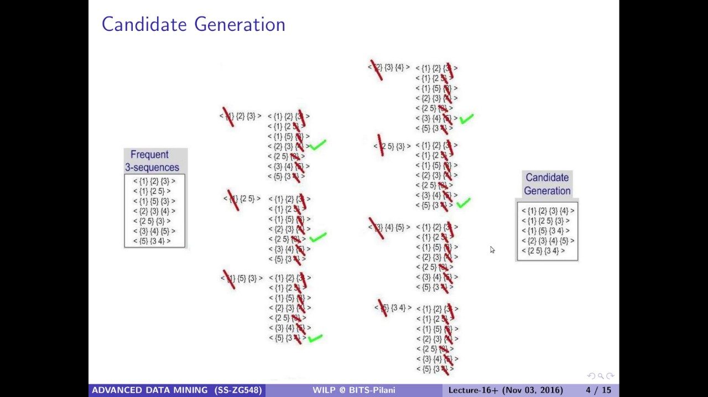

Slide 5
Algo Implementation:
I have written functions to count support and the support together we removed outlier items and then we generated two sequence ,3 seq data sets using GSP algo ,the main draw back is the number of data points while pruning resulting in exponential time I explained in report.
We generating various plots across data that gives analysis of purchases using mat plot library.
Thank You

