Slide 1
Sales Channel Performance Analysis
Descriptive Analysis

Slide 2

AGENDA
Introduction
Problem Statement
Sales Channel Overview
Methodology
Data Collection
Data Modelling
KPI
Measures
Analysis and Findings
Dashboard

Slide 3

introduction
Today, we are assessing 'Sales Channel Performance.' We're examining how effectively we sell our products or services through different methods. Our aim is to find what's working well and what needs improvement to boost our success. We've gathered data to guide our decisions, and now we'll discuss our findings and strategies for enhancement. Let's get started.

Slide 4
Problem statement
Objective: Analyze data from various sales channels (e.g., retail, distributors, direct sales) to assess their performance.
Benefits: Identify revenue generators, cost-effective channels, and areas needing improvement.
Analysis Techniques: Channel profitability, customer segmentation by channel.
Visualizations: Sales channel revenue comparison charts, customer acquisition cost by channel graphs.
Impact: Supports strategic sales planning, enhances customer experiences, maximizes revenue through successful channels.

Slide 5


Sales channel overview
Sales channel Overview
In this section, we'll explore the various sales channels that drive our business. Think of sales channels as different paths we use to reach our customers. Today, we'll focus on three main channels: Direct, Distributor, and Retailer.
Direct Channel: This is the path where we sell our products or services directly to customers without any intermediaries. It's like our own store where customers can buy from us directly.
Example:

Slide 6




Sales channel overview
Sales channel Overview
Distributor Channel: Here, we work with partners or distributors who buy our products in bulk and then sell them to other businesses or retailers. It's like a bridge that connects us to a wider market.
Retailer Channel: This is where our products are sold through retail stores or online marketplaces owned by other companies. It's like having our products available in various shops.

Slide 7



Methodology
Research Methods:
Our analysis employs quantitative research methods.
We utilize statistical and data-driven techniques for comprehensive insights.
Data Sources:
Primary Data Source: Internal sales data from AtliQ Hardware Company.
This exclusive data source provides a comprehensive view of sales performance.
Analysis Tools:
We leverage Power BI, a powerful data visualization tool.
Power BI allows us to create interactive dashboards for data exploration.

Slide 8
Data collection
Sales Data:
We collected comprehensive sales data, including transaction records, sales volumes, and revenue figures.
This data allowed us to assess the financial performance of different sales channels.
Customer Data:
Customer data includes demographic information, purchase history and channel preferences details.
By analyzing customer data, we gained insights into customer behavior and preferences.
Market Data:
Market data encompasses industry trends, competitor analysis, and market size information.
This data contextualized our performance within the broader market landscape.

Slide 9
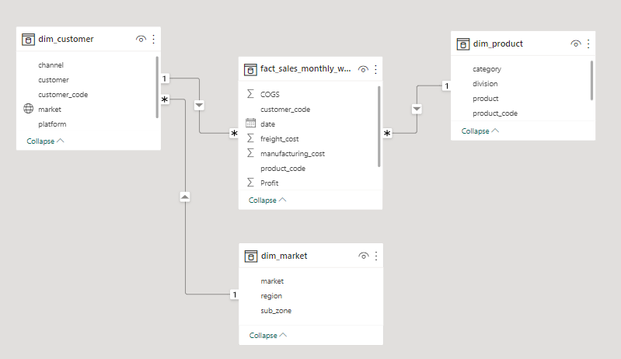
Data modelling

Slide 10
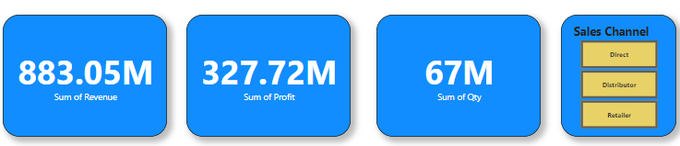
KPI
Revenue:
Revenue is a fundamental KPI, indicating the total income generated from each sales channel.
It helps us understand the financial impact of each channel on our business.
Profit Margin:
Profit margin measures the profitability of each channel by assessing the percentage of profit earned on sales.
It allows us to identify which channels are the most cost-effective.
Quantity Sold:
Quantity sold represents the number of products or services sold through each channel.
It helps gauge the sales volume and demand for our offerings.

Slide 11


Custom columns and measures
New column called COGS (Cost Of Goods Sold) is created using the DAX Expressions.
It is created by using the sum of freight cost and the manufacturing cost.
Profit is determined by subtracting the Cost of Goods Sold (COGS) from the total Revenue.
Evaluates the ratio of profit to revenue, expressed as a percentage, indicating profitability efficiency.

Slide 12
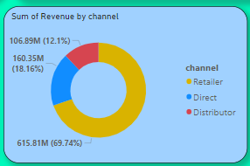

Analysis and findings
From this visualization, it is shown that the Retailer channel has the highest share of revenue with 615.81M (69.74%). The Direct Channel comes in second with 160.35M (18.16%), and the Retailer channel has the third highest share with 106.85M (12.1%).
The Profit % for the distributor channel is 35.81%
The Sum of Qty sold through the distributor channel is 48M.

Slide 13
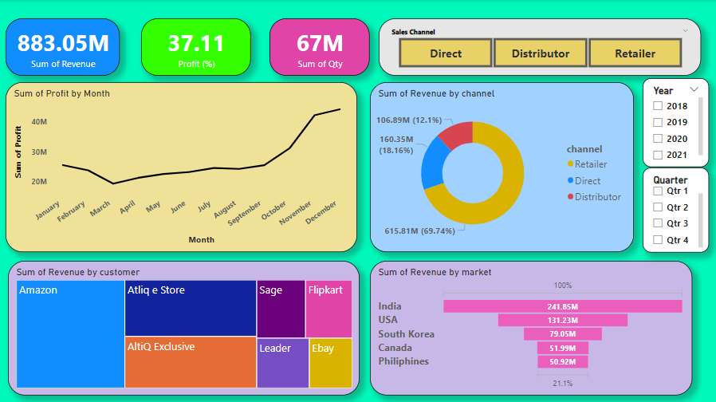
DASHBOARD

Slide 14


