Slide 1
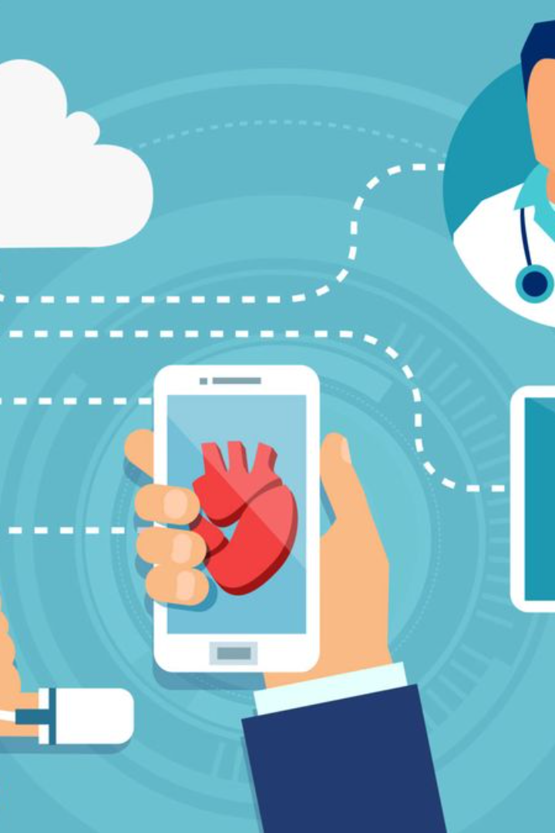

Health Monitoring System Using IoT
A comprehensive overview of health monitoring systems, the application of IoT technology, and the benefits and challenges of implementing an IoT-based system.

Slide 2

Overview of Health Monitoring Systems
1
Real-time Monitoring
2
IoT Technology
Understand the importance of real-time monitoring and its impact on proactive healthcare.
Learn about IoT technology and its role in revolutionizing health monitoring.
3
Application in Health Monitoring
Discover the various ways IoT is applied in health monitoring for different conditions.

Slide 3
Components of an IoT Health Monitoring System
Sensors and Wearable Devices
Data Collection and Transmission
Data Analysis and Interpretation
Explore the use of sensors and wearable devices in collecting vital health data.
Learn how data collected from sensors is transmitted securely for analysis.
Discover how data is analyzed and interpreted to provide meaningful insights.

Slide 4

Benefits of Using IoT in Health Monitoring
Improved Convenience and Accessibility
Early Detection and Intervention
See how IoT enables remote monitoring and easy access to healthcare services.
Learn how real-time data helps in early detection and timely intervention.
Personalized and Proactive Care
Understand how IoT facilitates personalized and proactive healthcare practices.

Slide 5

Challenges and Considerations in Implementing an IoT Health Monitoring System
1
Privacy and Security Concerns
Examine the potential risks and safeguards associated with IoT healthcare systems.
2
Integration and Interoperability Issues
Explore the challenges of integrating diverse IoT devices and platforms.
3
Cost and Scalability Considerations
Understand the economic factors and scalability challenges in deploying IoT systems.

Slide 6
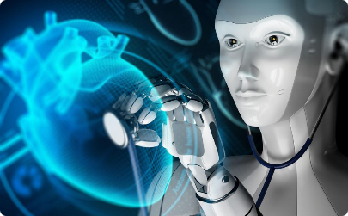
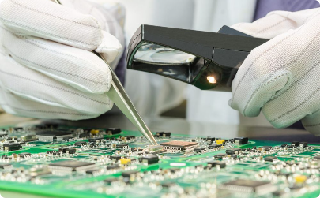
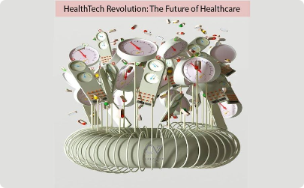
Future Trends in IoT Health Monitoring
Use of Artificial Intelligence
Advancements in Sensor Technology
Potential Impact on Healthcare Industry
Discover how AI is transforming health monitoring and enhancing diagnostics.
Explore the latest developments in sensor technology for accurate and detailed health data.
Consider the future implications of IoT health monitoring on healthcare delivery.

Slide 7

Conclusion
1
Recap of Key Points
2
Future Potential of IoT in Health Monitoring
Summarize the main highlights of the presentation on IoT health monitoring systems.
Discuss the promising future prospects and potential breakthroughs in IoT health monitoring.

