Slide 1
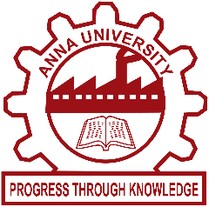
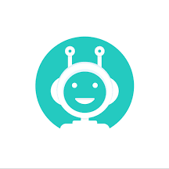
AI BASED VIRTUAL ASSISTANT
ANNA UNIVERSITY REGIONAL CAMPUS MADURAI
DEPARTMENT OF COMPUTER SCIENCE AND ENGINEERING
SmartDB
Presented By:
Mr. S Midhun(910020104025)
Mr. E Krishnan(910020104022)
Mr. T Harish(910020104013)
Mr. T R Shiva Kumar(910020104041)
MENTOR:
DR.S.C.RAJKUMAR

Slide 2
PROBLEM STATEMENT
SQL is Strictly Syntax based Query language. It Results in error even if there is a small change in the syntax.
Design and develop an AI-based virtual assistant for Database Management Systems (DBMS) to assist users in managing and interacting with databases efficiently and effectively.
An AI-based virtual assistant for Database Management Systems (DBMS) is a software application that utilizes artificial intelligence technologies to assist users in managing and interacting with databases effectively.
This virtual assistant acts as an intelligent intermediary between the user and the DBMS, simplifying complex tasks and improving the user experience.

Slide 3
ABSTRACT
This project proposes the development of an AI virtual assistant for answering DBMS-related questions.
The AI virtual assistant uses NLP to understand user queries and provide accurate answers from a database of DBMS-related knowledge.
Overall, the proposed AI virtual assistant aims to offer an efficient and reliable solution for users to manage and understand their DBMS data.

Slide 4
OBJECTIVE
The AI virtual assistant should be capable of understanding natural language queries and providing accurate solution.
The user can easily access database without knowledge of SQL query structures.
This project assists to learn SQL queries structure and database management systems.

Slide 5
EXISTING SYSTEM
Amazon Alexa:
Amazon's virtual assistant, Alexa, has integration with various DBMS platforms. Using Alexa Skills Kit (ASK), developers can build custom skills to interact with databases and perform tasks like retrieving information, querying data, and executing commands.
Microsoft Cortana:
Microsoft's virtual assistant, Cortana, also supports DBMS integration. With the help of Cortana Skills Kit (CSK), developers can create skills that leverage AI and natural language processing to interact with databases and perform tasks.

Slide 6
IBM Watson Assistant:
IBM's Watson Assistant is a powerful AI-based virtual assistant that can be integrated with DBMS systems. It allows developers to build conversational interfaces that can retrieve and manipulate data from databases using natural language queries.
Google Assistant:
Google Assistant is another popular virtual assistant that can be integrated with DBMS platforms. Developers can create custom actions for Google Assistant using Dialogflow, which enables interaction with databases through natural language understanding and processing.

Slide 7
PROPOSED SYSTEM
Natural Language Interface:
The virtual assistant is to have a natural language interface that allows users to interact with the DBMS using spoken or written language.
Query Processing and Optimization:
It is able to analyze user queries, optimize them for efficient execution, and generate the corresponding SQL statements to retrieve or manipulate data from the database.

Slide 8
Intelligent Suggestions:
The virtual assistant should provide intelligent suggestions to users based on their queries and actions. It can analyze the user's intent and context to offer relevant recommendations, such as suggesting alternative queries, proposing optimizations, or providing insights on data patterns or trends.
Machine Learning and Automation:
The virtual assistant can leverage machine learning techniques to continuously learn from user interactions and improve its performance over time. It can automate repetitive tasks, such as generating routine reports or performing database maintenance activities, based on learned patterns and user preferences.

Slide 9
TOOLS USED FOR IMPLEMENTATION
SmartDB is a large language model that was created using a combination of several different tools and technologies. Here are some of the key components that were used :
OpenAI API:
The OpenAI API provides access to a wide range of machine learning models,which was used to train SmartDB.
TensorFlow:
TensorFlow is a popular open-source machine learning framework that was used to develop and train the neural network that powers SmartDB.

Slide 10
Python:
Python is a programming language that is widely used in the field of artificial intelligence and machine learning. It was used extensively in the development of SmartDB.
Deep Learning libraries:
Libraries such as Keras and PyTorch were used to build and train the neural network architecture for SmartDB.

Slide 11
Data cleaning tools:
Various data cleaning tools such as Pandas, NumPy, and Scikit-learn were used to preprocess the data and perform feature engineering.
Natural Language Processing (NLP) libraries: Several NLP libraries, such as NLTK, spaCy, and TextBlob, were used to preprocess and clean the text data that was used to train SmartDB.

Slide 12
ADVANTAGES
Enhanced User Experience About Database System
Improved Efficiency and Productivity to understand Sql Queries
Continuous Learning and Improvement
User Friendly

Slide 13
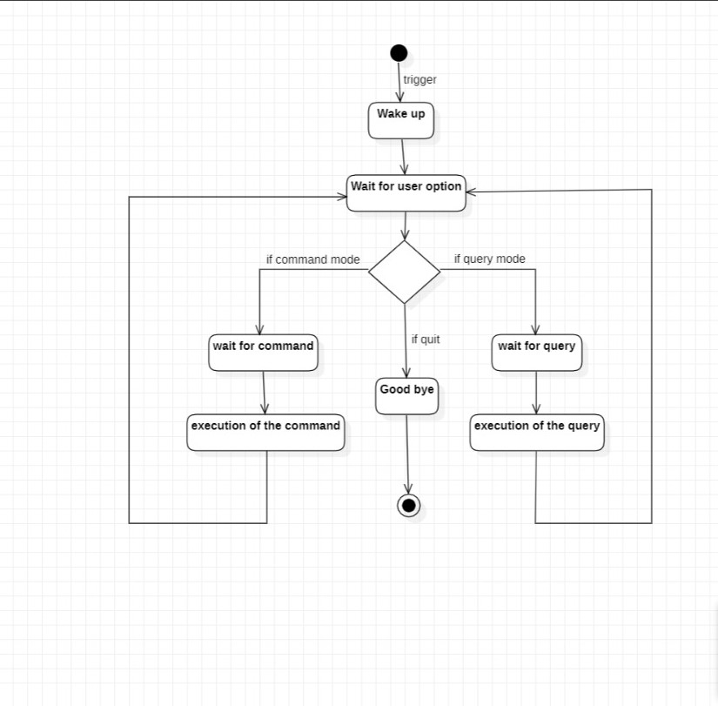
FLOW CHART

Slide 14
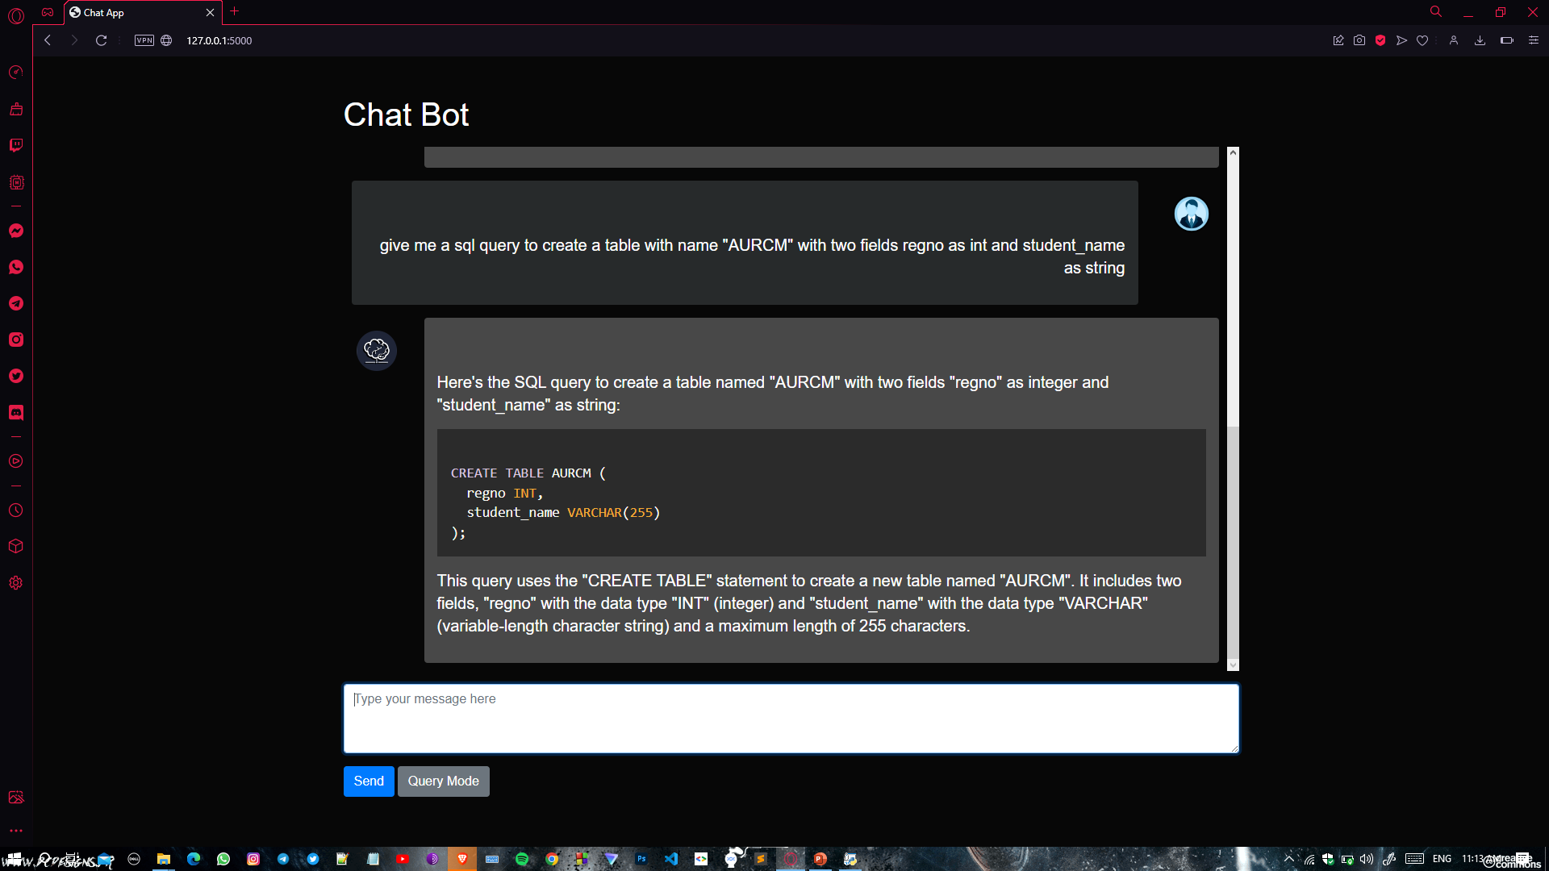
OUTPUT

Slide 15
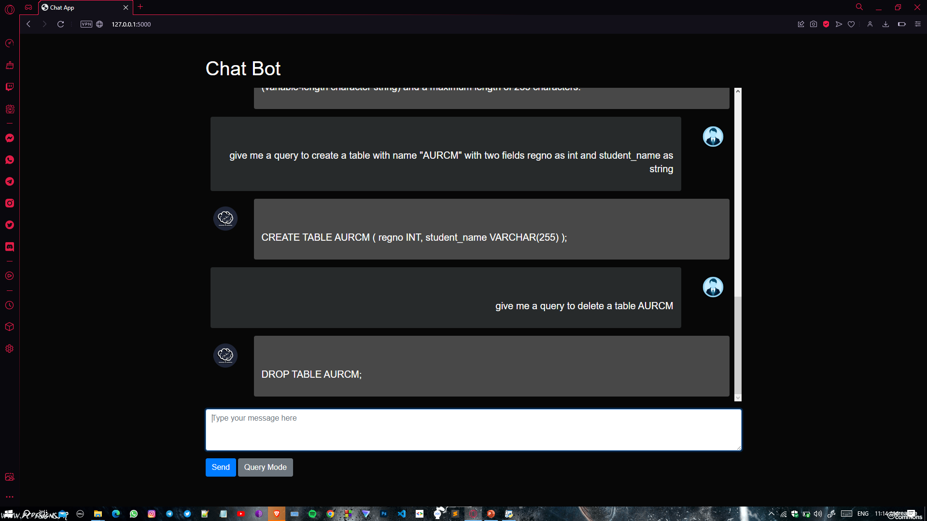
OUTPUT

Slide 16
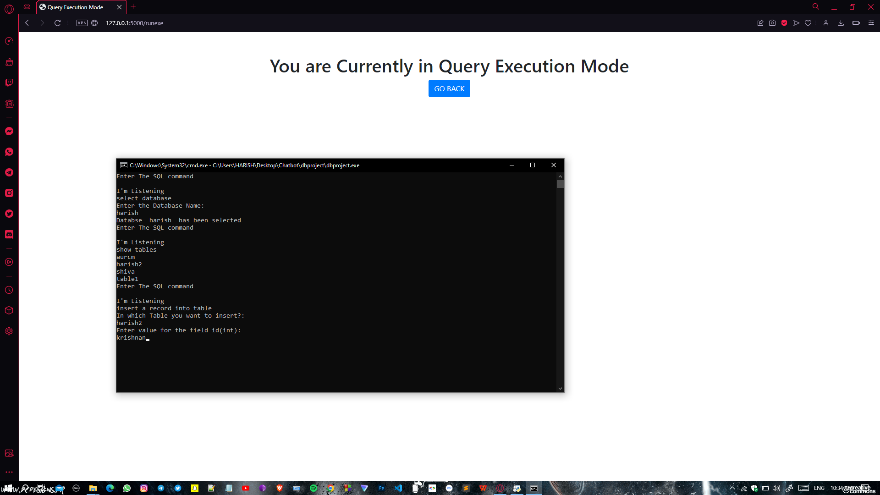
OUTPUT

Slide 17
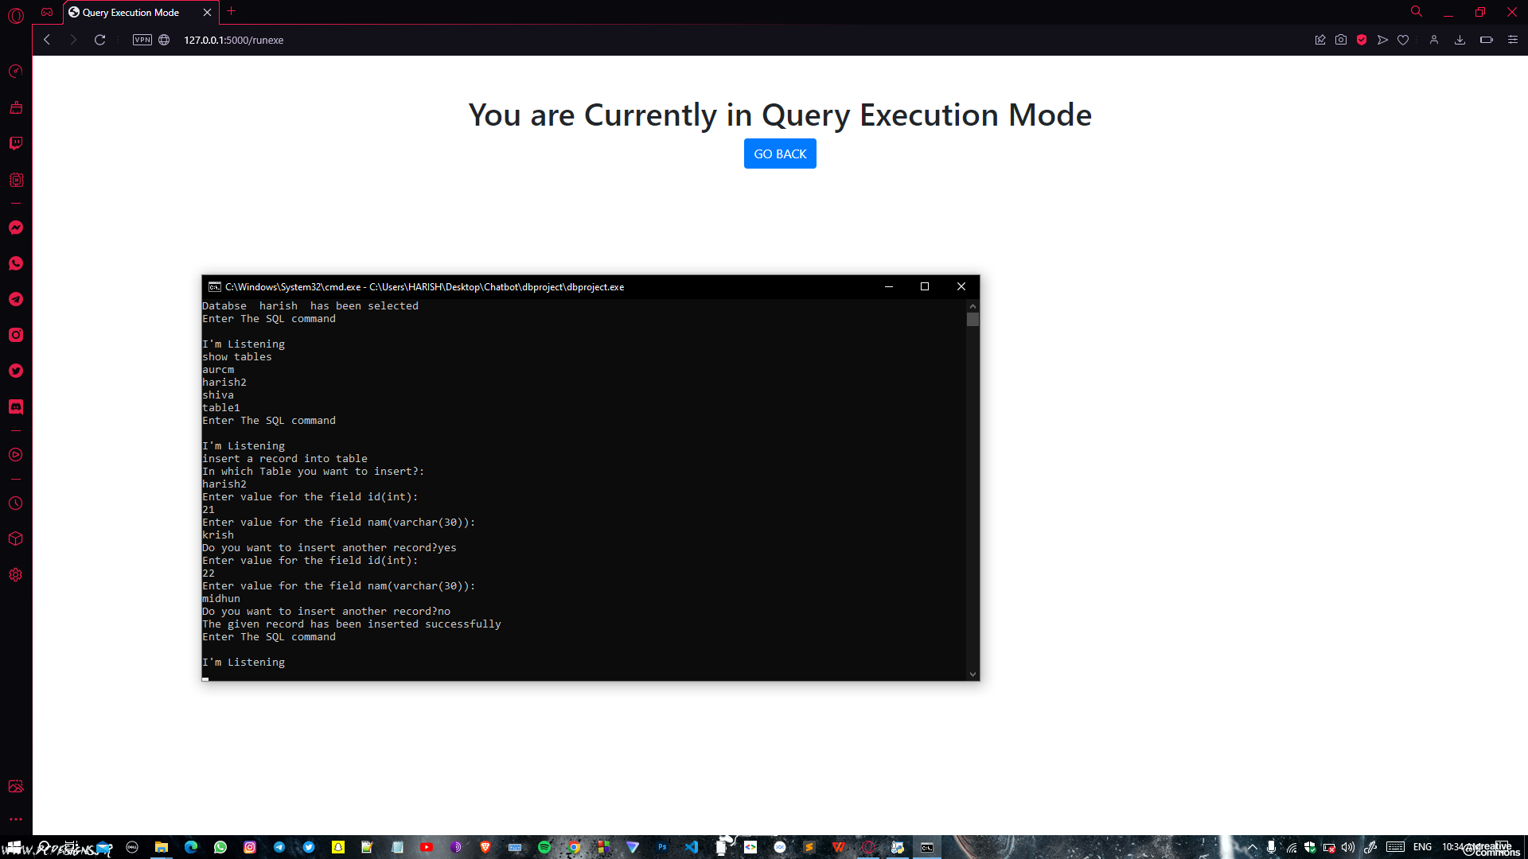
OUTPUT

Slide 18
CONCLUSION
In conclusion, the development of an AI virtual assistant for answering DBMS-related questions offers a promising solution for managing and understanding complex data.
This virtual assistant can handle a wide range of queries, from simple questions to complex analytical tasks, and provide users with meaningful insights and recommendations based on their data.

