Slide 1
Title: "Case Study: Setting Toll Prices for a New 800km Highway
Subtitle: "Optimizing Toll Strategies for the Future"

Slide 2
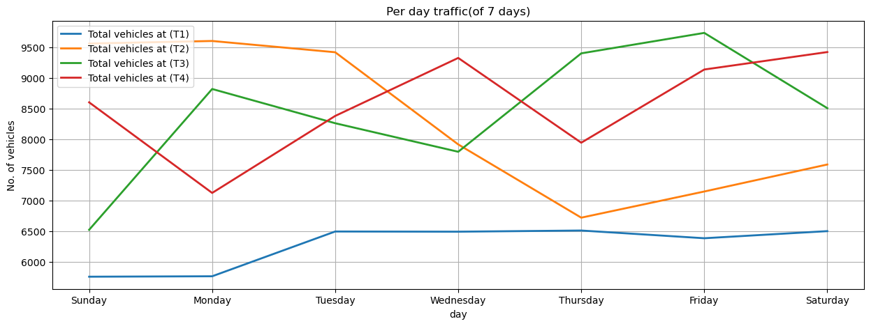
graph in Python to represent the expected vehicle flow at each toll booth over a 24-hour period(weekly)

Slide 3
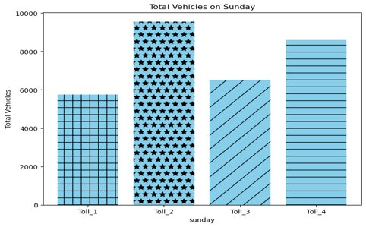
graph in Python to represent the expected vehicle flow at each toll booth over a 24-hour period(24 hours)

Slide 4
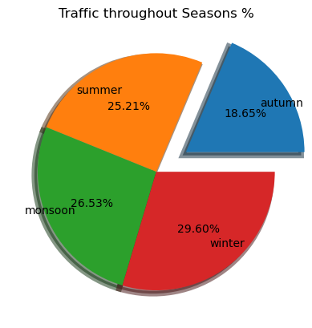
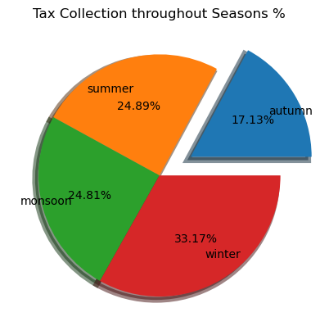
Impact of seasons on traffic flow and toll revenues

Slide 5
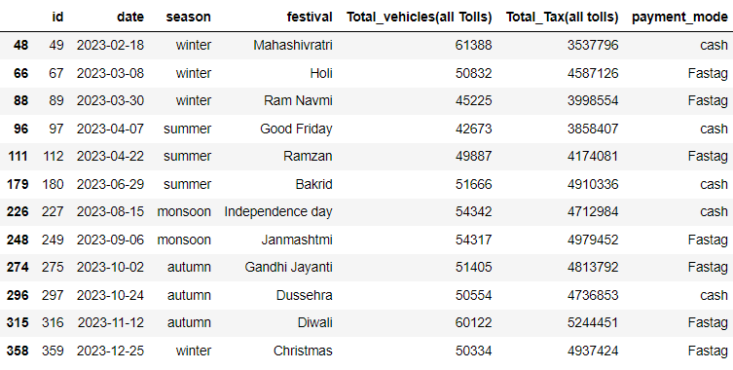
Impact of "festivals" on traffic flow and toll revenues
Observation:- Here we can see that the "Total number of Vehicles" increases on the "Festive days" so does the " Tax collection"

Slide 6
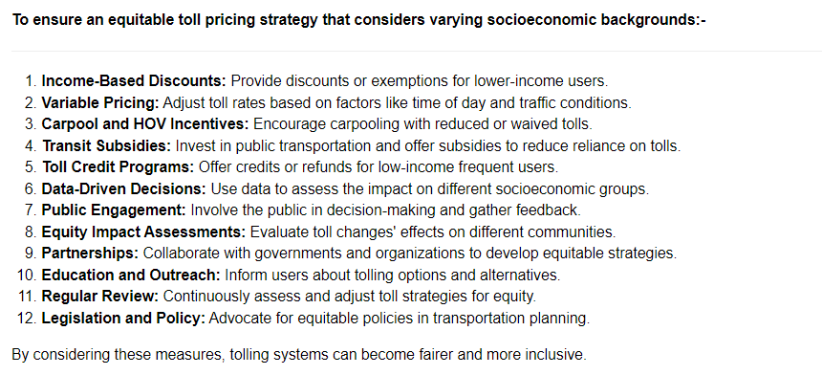

Slide 7
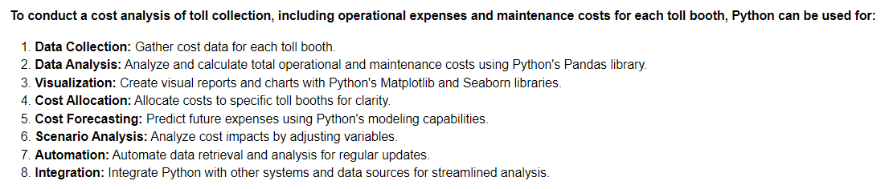

Slide 8
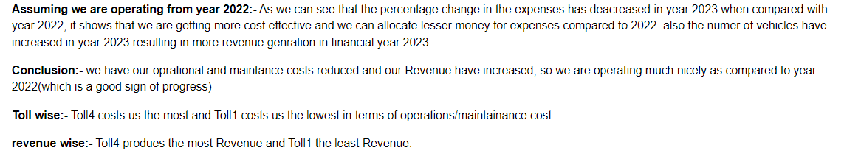
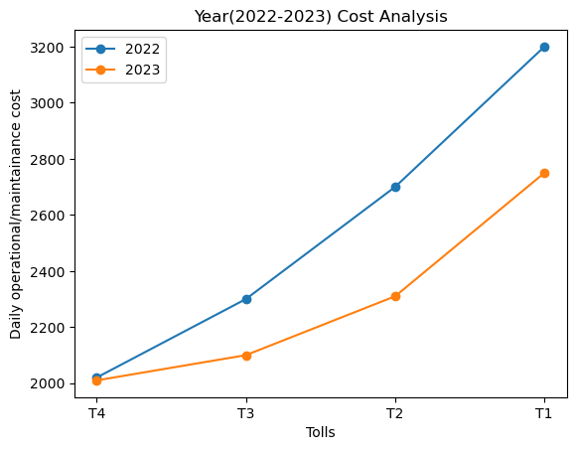

Slide 9
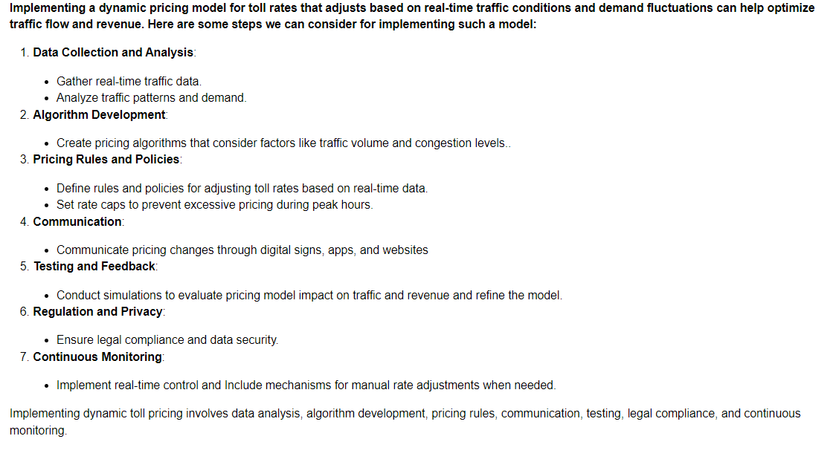

Slide 10
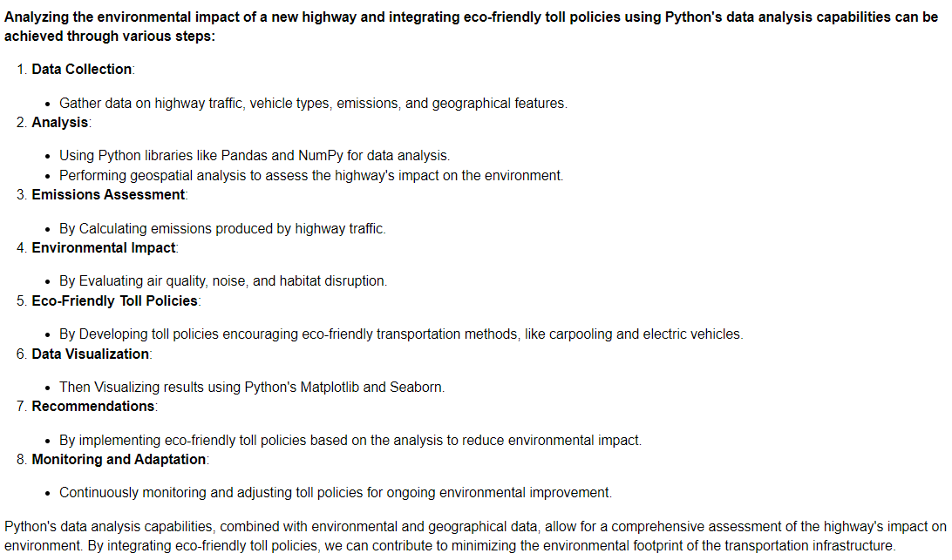

Slide 11
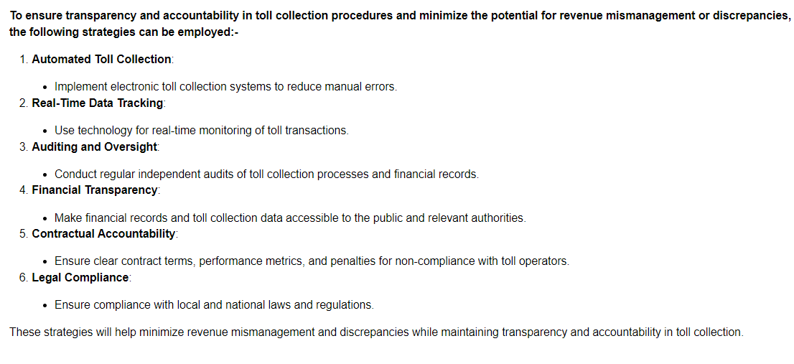

Slide 12
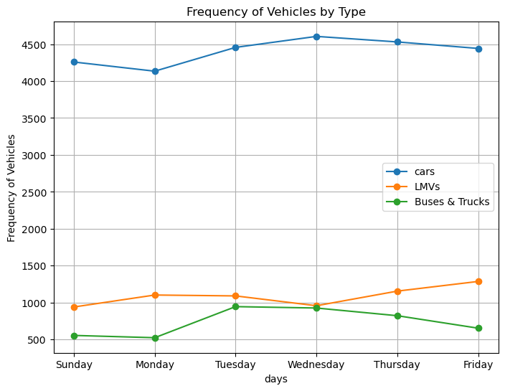


Slide 13
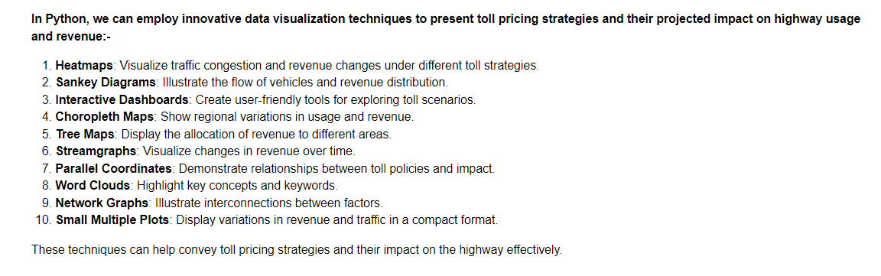

Slide 14
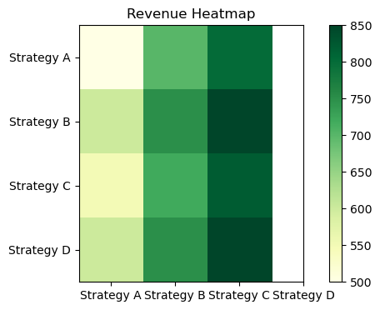
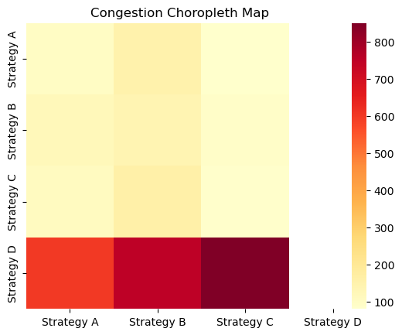
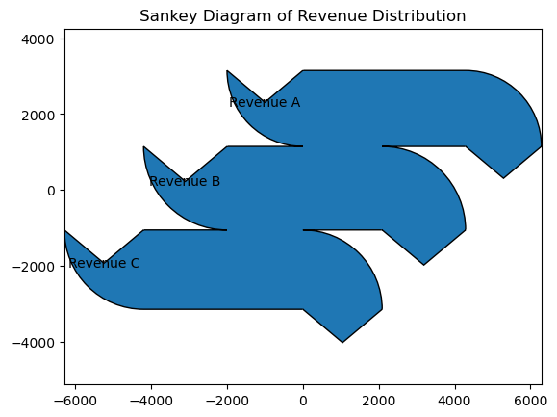
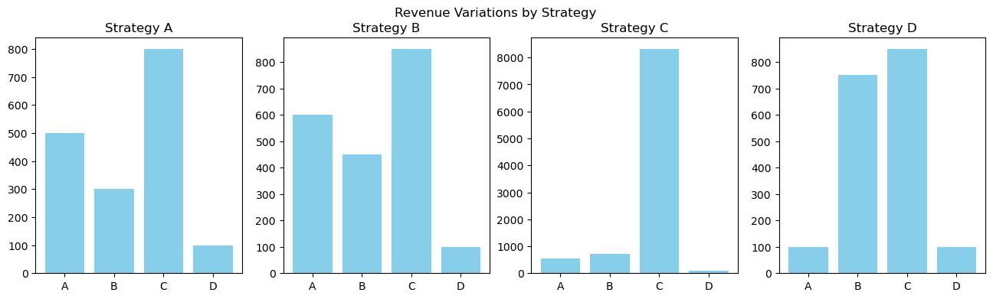

Slide 15
Conclusion:-
- Lucrative Investment:- This project promises substantial returns on investment, driven by the high demand for the new 800km highway and the toll collection opportunities it presents.
- Steady Revenue Stream:- With toll booths strategically placed along the highway, a steady revenue stream is ensured, contributing to the project's long-term profitability.
- Economic Growth Catalyst:- The new highway is expected to stimulate economic growth in the region, leading to increased traffic and toll collections, further enhancing profitability.
- Operational Efficiency:- Implementing toll collection systems, backed by data analysis, ensures efficient and cost-effective toll operations, maximizing revenue.
- Scalability:- The project's success can be replicated for additional highways, offering scalability and the potential for significant profit expansion in the future.

Slide 16
Thank you
Name:- Harish Sharma
Batch:- Data Analytics

