Slide 1
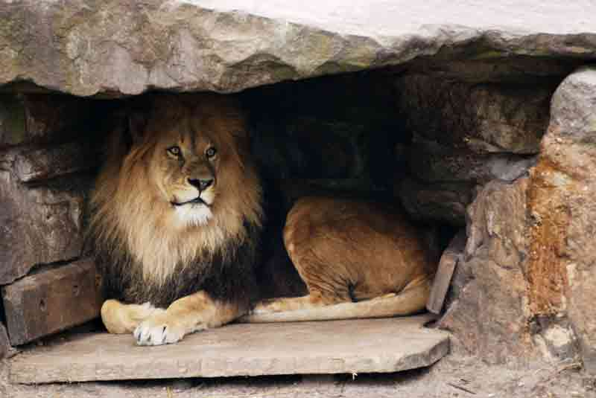
St .Little Flower Matric Higher Secondary School

Slide 2
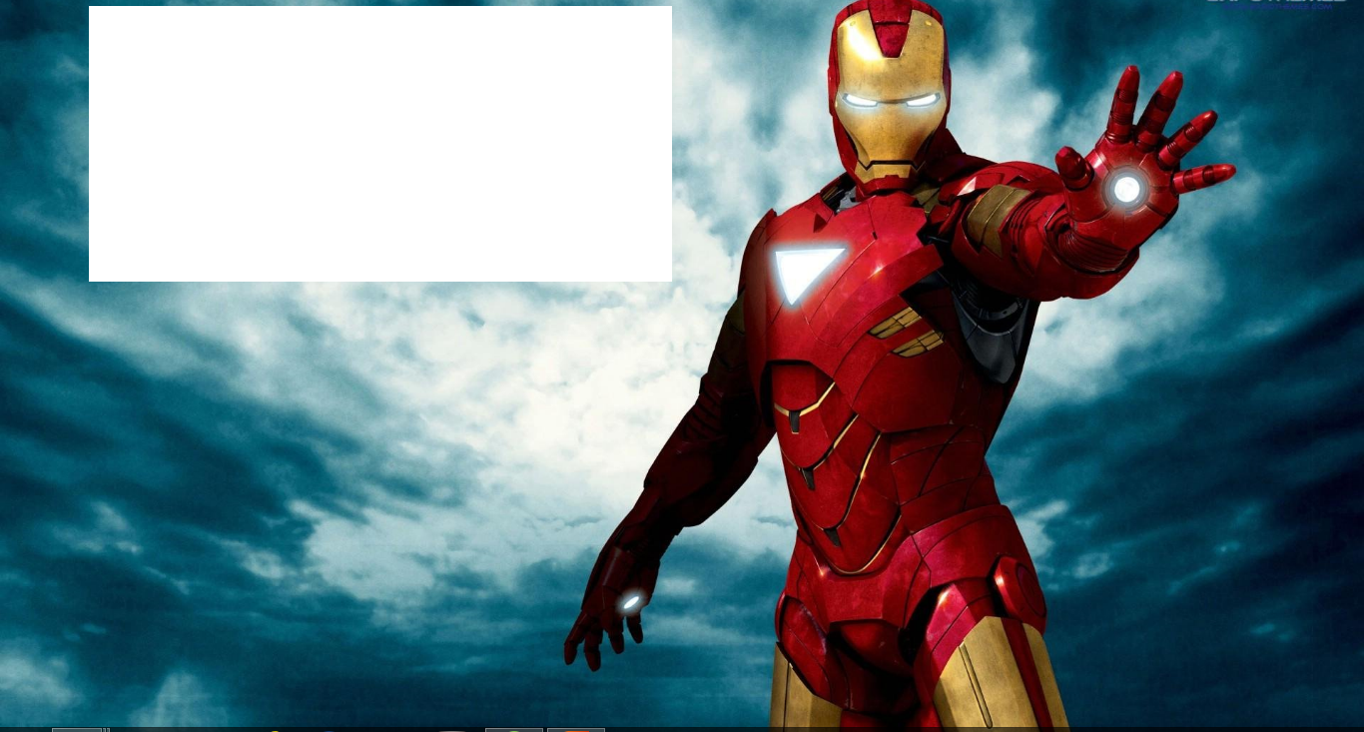
LFMS QUIZ CLUB

Slide 3
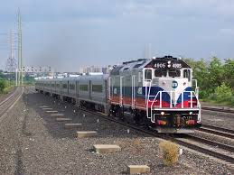
Lets Begin

Slide 4
Children’s day dhamaka

Slide 5
On behalf of our LFMS Quiz club we welcome our
Rev .Sister Principal
And All

Slide 6
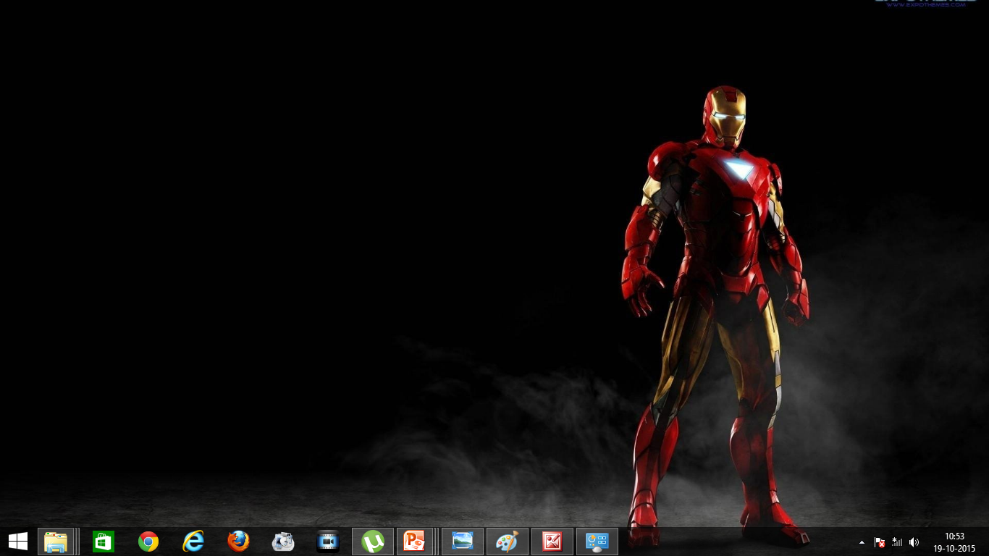
RULES OF THE SHOW
This show consists of 7 rounds .
Four pairs of participants should participate in this show
In each round each team will be given a question
For rapid fire round there are only 30 seconds
And other rounds consists of 20 seconds

Slide 7
Rapid fire

Slide 8
Team-a

Slide 9
The book “ Golden Gate” is written by whom?
Expand MINT…..
The Vehicle registration number for Central Chennai is TN __
How many seats are allotted for Asian countries in the UNO?
Who got Arjuna Award for weight lifting in 2015?
Time UP
`

Slide 10
Team-B

Slide 11
Who got Bronze boot in FIFA World cup in 2014?
Who coined the term Biology?
Who wrote the book “Buddha”?
who is the present vice president of India?
what is the currency of Switzerland?
Time UP

Slide 12
Team-C

Slide 13
Coco-Cola trophy is associated with Which sport________
Who wrote the book “My story”?
Which state in India will be changing its capital after 10 years________
Who is the CEO of Amazon. in the largest online retailer?
Which South Asian Country not yet captured by any other countries?
Time UP

Slide 14
Team-D

Slide 15
Who is the last CEO of Nokia?
Which is the tallest bridge in the world?
Who wrote the book “The Story of my life”?
Who is the shortest term prime minister of India?
What is the nature of cow’s milk?
Time UP

Slide 16
Audience ”be alert”
It’s your turn….

Slide 17
BOYS
Who is the founder of our institution?

Slide 18
GIRLS
Who got Raman Magsaysay Award in 2015?

Slide 19
FUSION
ROUND

Slide 20
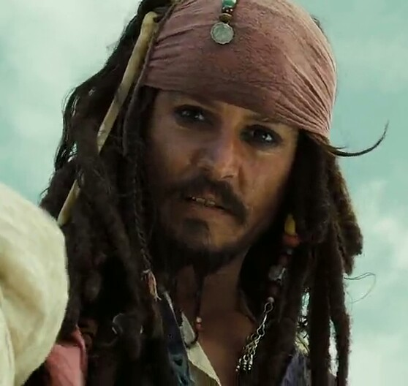
TEAM-A
Time Up

Slide 21
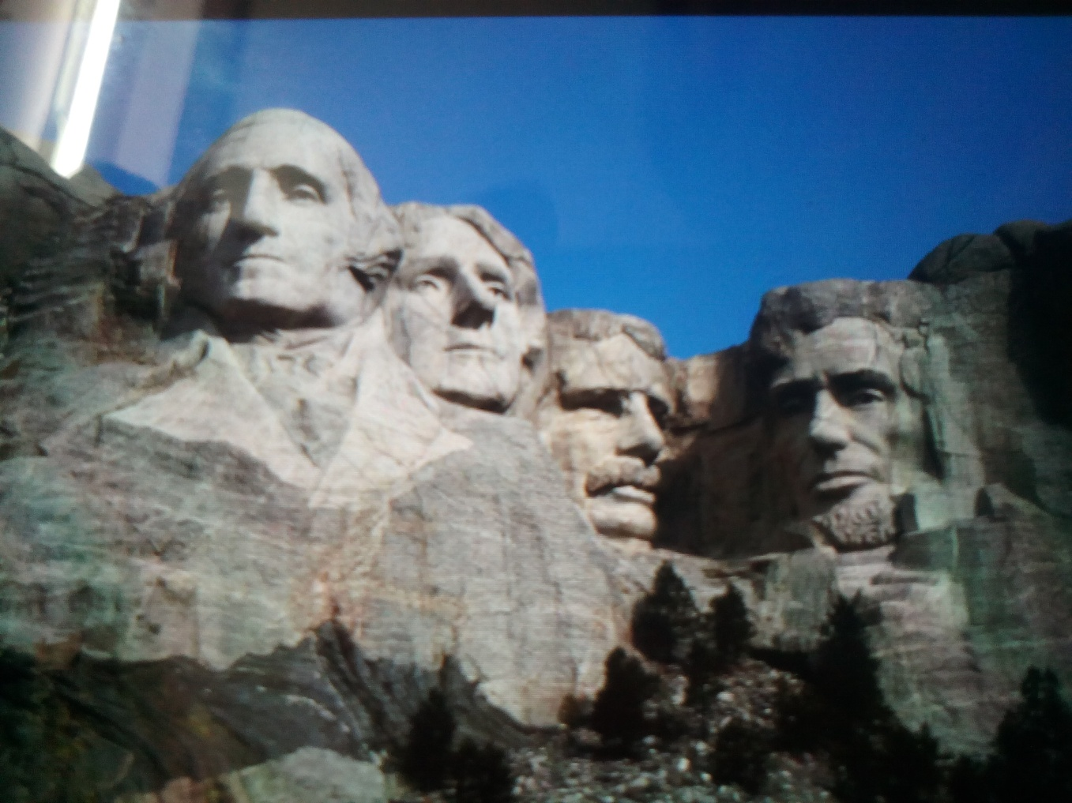
TEAM-B
Time Up

Slide 22
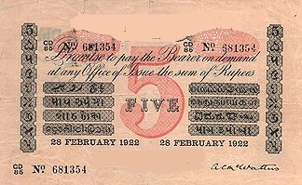
TEAM-C
Time Up

Slide 23

TEAM-D
Time Up

Slide 24
Audience ”be alert”
It’s your turn….

Slide 25
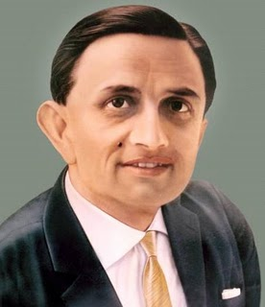
BOYS

Slide 26
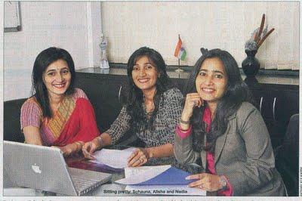
GIRLS

Slide 27
Link and Connect

Slide 28
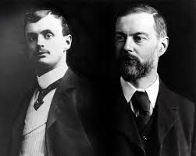
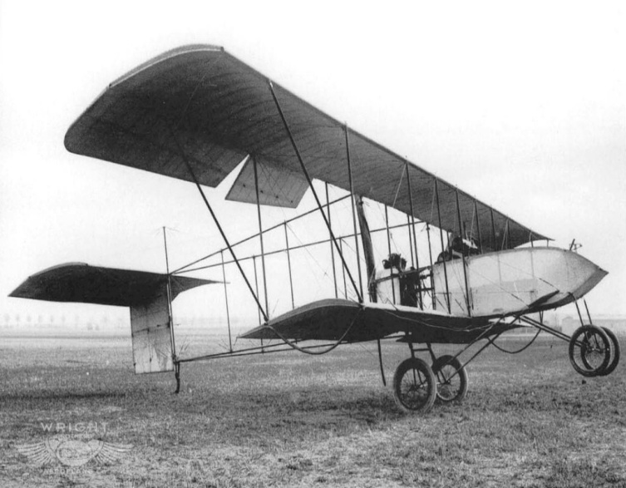
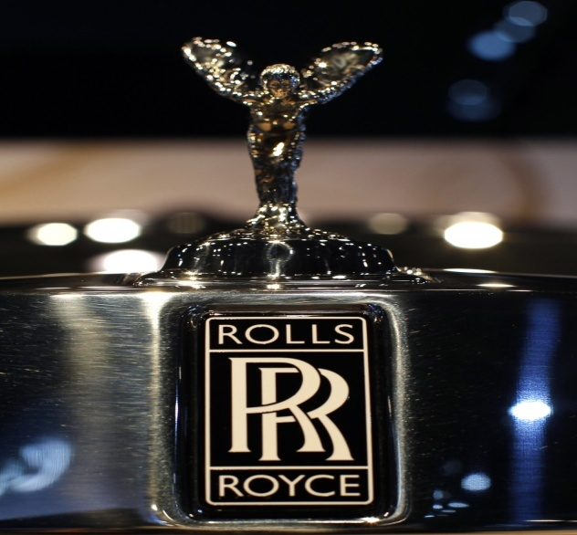
Team-A
Time Up

Slide 29
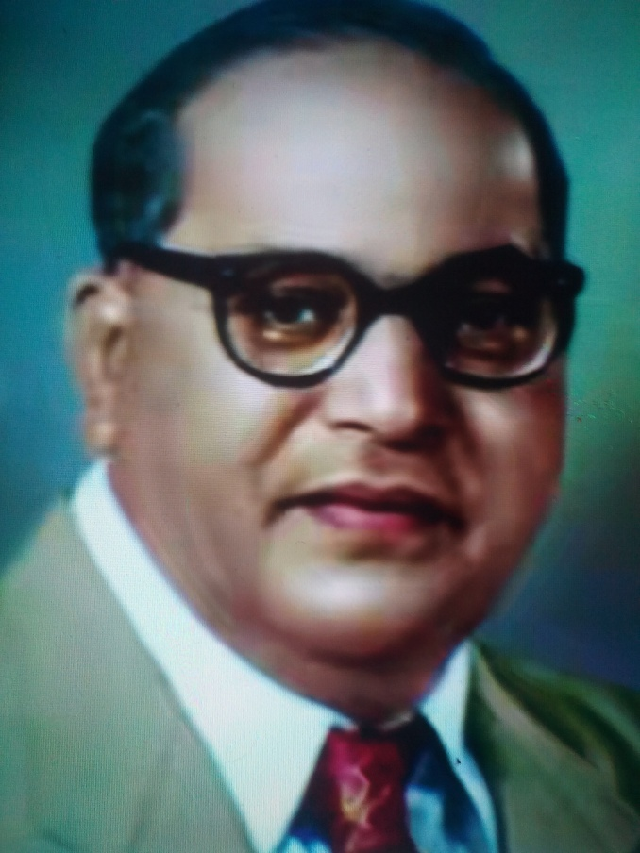
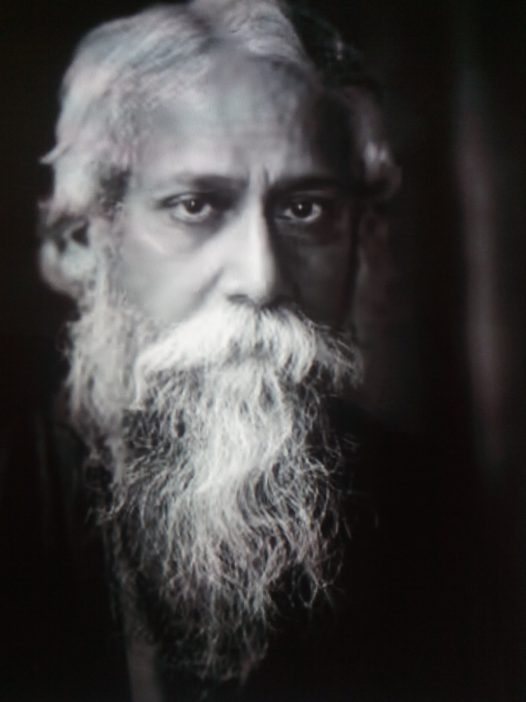
Team-B
Time Up

Slide 30
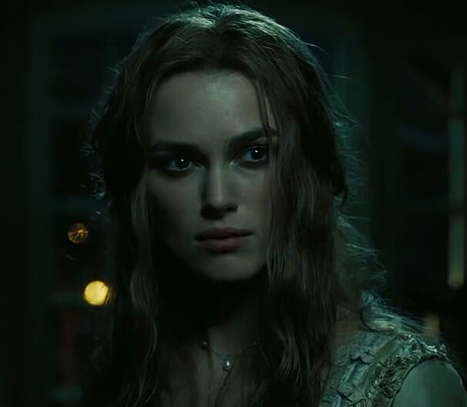
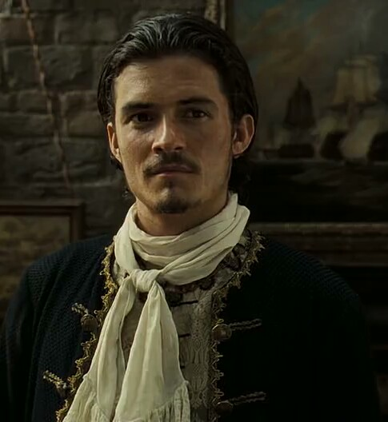
Time Up
Team-c

Slide 31
Team-D
Time Up

Slide 32
Audience ”be alert”
It’s your turn….

Slide 33
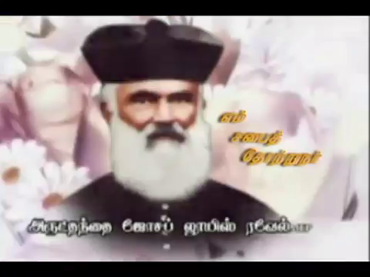
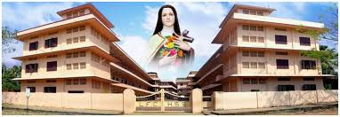
BOYS

Slide 34
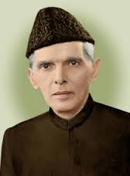
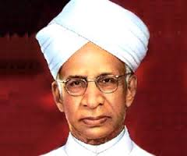
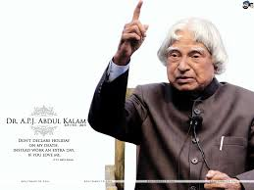
GIRLS

Slide 35
Literature Round

Slide 36
Team-A
Time Up
The first person to get Gynanapit award ?

Slide 37
Time Up

Slide 38
Time Up

Slide 39
Time Up

Slide 44
Funny round

Slide 45
TEAM-A

Slide 47
Team-b

Slide 49
Team-c

Slide 51
Team-d

Slide 53
Audience ”be alert” It’s your turn….

Slide 54
boys

Slide 55
girls

