Slide 1

ABES ENGINEERING COLLEGE, GHAZIABAD
Department of Information Technology
Bachelor of Technology | Major Project Review-2 | Academic Session 2026–27
PROJECT PRESENTATION • REVIEW-2 • BCS 753
AGRISENSE
Precision Agriculture Crop Yield & Pest Risk Intelligence
Multimodal Sensor Fusion • LightGBM Yield Prediction • Random Forest Pest Risk • GIS Decision Support
GUIDED BY
Prof. Ayush Agarwal
Assistant Professor
Department of Information Technology
ABES Engineering College, Ghaziabad
PROJECT TEAM MEMBERS
Harish Kumar (Roll No: 2300320310086)
Devesh Singh (Roll No: 2300320130088)
Divyanshu Kumar Rai (Roll No: 2300320130100)
ABES Engineering College, Ghaziabad, Uttar Pradesh | Department of Information Technology

Slide 2

Contents
Presentation Roadmap & Scope of Evaluation
01 Problem Statement
Research gaps, single-modality limits & multi-task isolation
07 Working Demonstration
Actual AgriSense UI output screens & operational workflows
02 Project Objectives
5 core technical objectives across fusion, ML & GIS advisory
08 Preliminary Results
Table II benchmarks: LightGBM (R²=0.93) & RF (Acc=91%)
03 Updated Methodology
End-to-end 6-phase multimodal data & predictive ML pipeline
09 Research Paper Submission
IEEE manuscript status, metadata & architectural contributions
04 System Architecture
4-tier layered architecture: Client, Application, ML, Data
10 Remaining Work & Roadmap
5-stage phased roadmap through to final project defense
05 Dataset & Experimental Setup
6 modalities, spatiotemporal features, zero-leakage splits
11 Challenges & Solutions
Data heterogeneity, spatial leakage, vernacular AI & API quotas
06 Implementation Progress
Completed features, modules in progress & planned roadmap
12 References
13 IEEE research paper citations strictly verified
Department of Information Technology | Review-2 | ABES Engineering College | Slide 2

Slide 3
Problem Statement
Critical Research Gaps in Precision Agriculture
1. Single-Modality Limitations
• Problem: Ingestion pipelines rely solely on isolated weather records or historical yield tables, ignoring soil chemistry and Sentinel-2 NDVI/EVI.
• Consequence: Inability to capture micro-climate soil-plant interactions produces high prediction variance across regional zones.
2. Micro-Climate Blind Spots
• Problem: Macro-level district aggregations mask farm-scale moisture deficits, canopy heat stress, and sudden localized weather shifts.
• Consequence: Coarse spatial resolutions obscure localized Growing Degree Day (GDD) accumulation critical for precision agronomy.
3. Disconnected Prediction Tasks
• Problem: Yield estimation and pest/disease outbreak forecasting are universally executed as isolated, disjoint pipelines.
• Consequence: Fails to account for biological yield degradation caused by pest outbreaks, causing redundant processing and conflicting advice.
4. Low Field-Level Actionability
• Problem: Complex tabular ML models remain locked in research papers, inaccessible to smallholder farmers.
• Consequence: Farmers lack spatial GIS maps, vernacular voice assistance, real-time APMC Mandi valuation, and officer escalation.
AgriSense Research Gap Addressed: A unified multimodal fusion architecture coupling LightGBM yield regression (R²=0.93) with Random Forest pest classification (Accuracy=91%) into an actionable Leaflet GIS spatial advisory with bilingual voice assistance for smallholder farmers.
Department of Information Technology | Review-2 | ABES Engineering College | Slide 3

Slide 4
Project Objectives
Core Technical Aims & Research Benchmarks
01 Unified Multimodal Data Fusion
• Ingestion Pipeline: Synthesizes 6 heterogeneous data streams (weather, soil chemistry, Sentinel-2 NDVI, terrain elevation, crop metadata, coordinates).
• Alignment Strategy: Implements daily spatiotemporal grid interpolation, forward-fill imputation, and variance thresholding.
02 Crop-Yield Prediction via LightGBM
• Predictive Regressor: High-precision gradient-boosted decision trees with leaf-wise splitting on continuous features.
• Benchmarked Accuracy: Achieves R² = 0.93, MAE = 0.27, RMSE = 0.38, outperforming Random Forest, XGBoost, and Linear Regression.
03 Pest & Disease Risk Classification via Random Forest
• Multi-Class Classifier: Ensemble bagging resilient to noisy micro-climatic humidity, leaf wetness, and rainfall telemetry.
• Benchmarked Accuracy: Achieves Accuracy = 91%, Precision = 90%, F1 = 0.89 across localized severity tiers.
04 GDD-Based Agronomic Feature Engineering
• Phenological Modeling: Computes cumulative Growing Degree Days (GDD) to track biological crop maturation milestones.
• Temporal Indices: Integrates 15-day smoothed NDVI/EVI trajectories and 30-day precipitation aggregates for thermal stress capture.
05 GIS-Linked Farmer & Officer Decision Support
• Interactive GIS & Voice: Leaflet mapping canvas, bilingual voice AI (Web Speech + Gemini), and Krishi Kendra locator.
• Market & Escalation: Real-time APMC Mandi revenue simulator (₹3.8 Lakhs) and direct Zonal Officer ticket escalation portal.
Department of Information Technology | Review-2 | ABES Engineering College | Slide 4

Slide 5
Updated Methodology
End-to-End Multimodal Data Engineering & Dual Predictive ML Pipeline
PHASE 1: DATA SOURCES
• Weather: Hourly Temp & Rain
• Soil: pH, N-P-K Chemistry
• Satellite: Sentinel-2 NDVI
• Terrain: Elevation & Slope
• Crop Metadata: Sowing Dates
• Coordinates: Farm Lat/Long
PHASE 2: PREPROCESSING
• Imputation: KNN & Forward-Fill
• Outliers: Z-Score & IQR Clipping
• Scaling: Robust & Min-Max
• Spatiotemporal Alignment
• Cloud-Masking Band QA
• Geocoding Polygon Indexes
PHASE 3: FEATURE ENG.
• GDD Degree Day Milestones
• 15-Day NDVI Spectral Curves
• 30-Day Precipitation Totals
• Canopy Thermal Stress Index
• Variance Threshold Filtering
• Multicollinearity VIF Screen
PHASE 4: MULTIMODAL FUSION
• Dense Vector Concatenation
• Blocked Spatial Grouping
• Historical Temporal Splits
• Strict Zero-Leakage Protocol
• Dimensional Synchronization
• Missing Sensor Mask Impute
DUAL ML: YIELD PREDICTION
LightGBM Regressor
• Empirical Metrics: R² = 0.93 | MAE = 0.27 | RMSE = 0.38
• Gradient-boosted leaf-wise tree splitting on continuous multimodal feature vectors.
• Outperforms Random Forest (R²=0.83) & Linear Regression (R²=0.68) baselines.
DUAL ML: PEST & DISEASE RISK
Random Forest Classifier
• Empirical Metrics: Accuracy = 91% | Prec = 90% | F1 = 0.89
• Ensemble bagging of 300 estimators resilient against noisy field micro-climate sensor telemetry.
• 3-tier severity classification: Low, Medium, and High outbreak vulnerability.
DECISION SUPPORT & GIS
Actionable Farmer & Officer Hub
• Leaflet Geospatial Interactive Map & Field Pins
• 87% Predicted Outbreak Probability Alerts
• Mandi APMC Revenue Engine (₹3.8 Lakhs Valuation)
• Bilingual Voice AI Advisory (Web Speech + Gemini)
• Krishi Seva Kendra Locator & Officer Routing
Fig. 1: AgriSense Multimodal Feature Fusion & Dual Predictive Pipeline (IEEE Research Paper, 2026) Ingests 6 raw agronomic data streams → Spatiotemporal alignment & GDD engineering → Zero-leakage split → Dual LightGBM & RF inference → Interactive GIS field interventions
Department of Information Technology | Review-2 | ABES Engineering College | Slide 5

Slide 6
System Architecture
4-Tier Modular Engineering & Integrated Technology Stack
LAYER 1: CLIENT / PRESENTATION LAYER
React 18 • TypeScript • TailwindCSS • Leaflet GIS • Web Speech API
Responsive farmer-facing portal, interactive GIS mapping canvas with regional Krishi Kendra locators, real-time telemetry dashboards, APMC mandi valuation calculator, and speech-based bilingual voice assistant.
VERIFIED TECH STACK
Client & GIS Canvas
• React 18 & TypeScript • TailwindCSS & Lucide Icons • Leaflet.js Field GIS Canvas • Web Speech Voice Audio API
Backend & APIs
• Node.js & Express.js REST • Socket.io Live Telemetry • JWT Token Authorization • In-Memory Fast Cache
Predictive ML & GenAI
• LightGBM Regressor (Yield, R²=0.93) • Random Forest (Pest Risk, Acc=91%) • Google Gemini 1.5 Flash (Vernacular) • HuggingFace Plant Vision Models
Database & Ingestion
• MongoDB Atlas (GeoJSON) • OpenWeatherMap Telemetry • Sentinel-2 Earth Engine • APMC Mandi Price Feed
LAYER 2: APPLICATION & COMMUNICATION LAYER
Node.js • Express.js REST APIs • Socket.io Real-Time • JWT Security
Secure API gateway, biometric/JWT authentication, live geospatial query routing, real-time telemetry streaming, officer escalation queue manager, and in-memory rate-limiting cache.
LAYER 3: PREDICTIVE ML & GENERATIVE AI LAYER
LightGBM Regression • Random Forest Classifier • Gemini AI • HuggingFace Vision
Dual-model inference pipeline: LightGBM for crop yield estimation (R²=0.93), Random Forest for pest-risk categorization (Acc=91%), Google Gemini AI for contextual vernacular advice, and HuggingFace for leaf disease detection.
LAYER 4: DATA PERSISTENCE & EXTERNAL SERVICES LAYER
MongoDB Atlas • OpenWeatherMap Telemetry • Satellite Earth Engine • APMC Mandi API
Cloud NoSQL document store for farmer telemetry, geospatial indexes for field boundary polygons, automated external weather telemetry sync, and APMC daily mandi price ingestion.
Department of Information Technology | Review-2 | ABES Engineering College | Slide 6

Slide 7
Dataset & Experimental Setup
Multi-Source Agronomic Modalities & Rigorous Cross-Validation
DATASET SPECIFICATIONS
Modality Count
6 Heterogeneous Data Streams
Geographic Scope
Regional APMC Mandis (UP / National Scope: In Progress)
Temporal Granularity
Daily aggregated weather & soil; 5-day Sentinel-2 satellite passes
Validation Strategy
Blocked Spatial K-Fold (k=5) & Out-of-Season Temporal Holdout
Target Variable 1
Continuous Crop Yield (Metric Tons / Hectare) via LightGBM
Target Variable 2
Categorical Pest/Disease Severity (Low, Medium, High Risk) via RF
Modality | Data Sources | Key Parameters | Agronomic Role
1. Weather | OpenWeatherMap / IMD | Temp min/max, Humidity, Rainfall, Solar | Transpiration & thermal stress
2. Soil Properties | Soil Health Cards / Sensors | pH, Organic Carbon, Nitrogen, Phosphorus, Potassium | Nutrient baseline & fertility
3. Remote Sensing | Sentinel-2 MSI Surface | NDVI, EVI, Red Edge, NIR Spectral Bands | Canopy vigor & photosynthetic activity
4. Terrain & Spatial | SRTM Digital Elevation | Elevation, Slope, Aspect, Farm Lat/Long | Water drainage & runoff accumulation
5. Crop Metadata | Agronomic Registries | Crop species, sowing date, growth stage | Phenological calendar alignment
6. Derived Agronomic | Computed Pipeline | Growing Degree Days (GDD), 30-Day Rain Index | Biological maturity milestones
Methodological Rigor: Zero Data Leakage Guarantee & Spatial Integrity Protocol
• Blocked Spatial Partitioning: Farms located within the same geographic cluster/taluk are strictly restricted to either training or test sets—never split across both—preventing spatial autocorrelation leakage. • Temporal Holdout Protocol: Training is restricted to historical seasons; validation strictly evaluates subsequent unobserved growing seasons, guaranteeing true forward-looking generalization under climate variability.
Department of Information Technology | Review-2 | ABES Engineering College | Slide 7

Slide 8
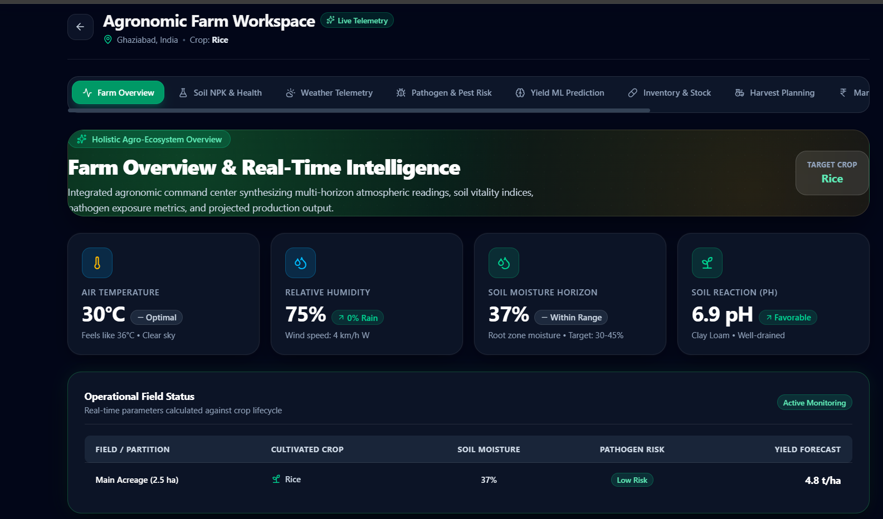
Implementation Progress
Development Audit: Functional Modules, In-Progress Work & Roadmap
IMPLEMENTATION DASHBOARD (Status Audit)
COMPLETED & FUNCTIONAL [Verified in Codebase]
● Interactive Leaflet GIS Field Mapping Canvas & Kendra Locator
● Multilingual Vernacular Voice Assistant (Web Speech + Gemini)
● Plant Disease Vision Scanner & Bio-chemical Prescriptions
● Weather Intelligence & Growing Degree Day (GDD) Tracker
● Zonal Officer Portal & Farmer Escalation Ticket Routing
● Mandi APMC Market Valuation & Production Revenue Simulator
IN PROGRESS [Under Active Implementation]
● Progressive Modality Ablation Protocol (quantifying satellite vs weather gains)
● SHAP Feature Attribution Explainability Console for farmer-facing trust
PLANNED ROADMAP [Review-3 / Final Defense]
● Cooperative Ground-Truth Field Testing & Extension Officer Validation
● Production Docker Containerization & Cloud Hardening Deployment
Fig. 3: Real Working AgriSense Farm Workspace Dashboard Live telemetry ingestion showing 28°C ambient temp, 65% humidity, 8.2 km/h wind, GDD tracking, and real-time field intelligence.
Department of Information Technology | Review-2 | ABES Engineering College | Slide 8

Slide 9
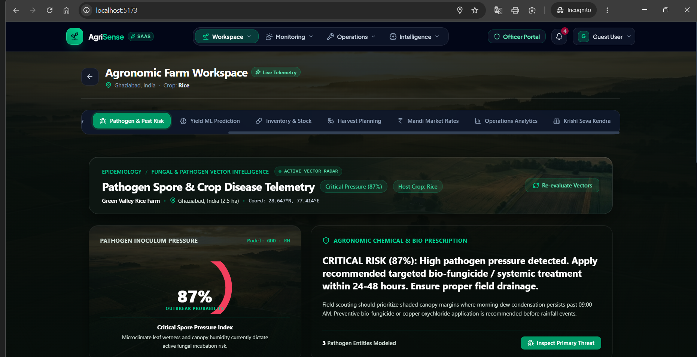
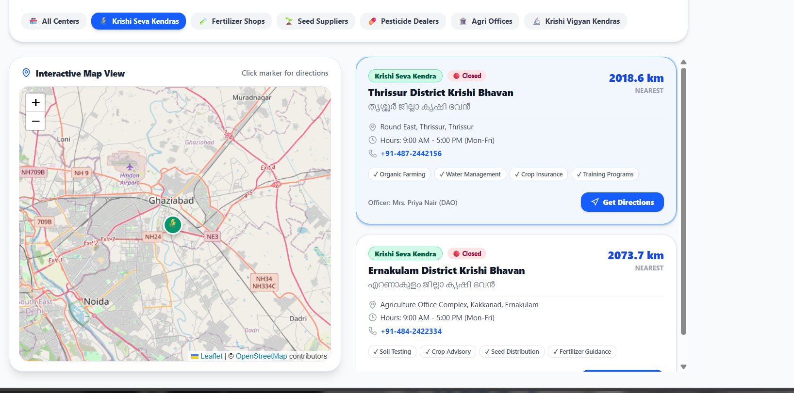
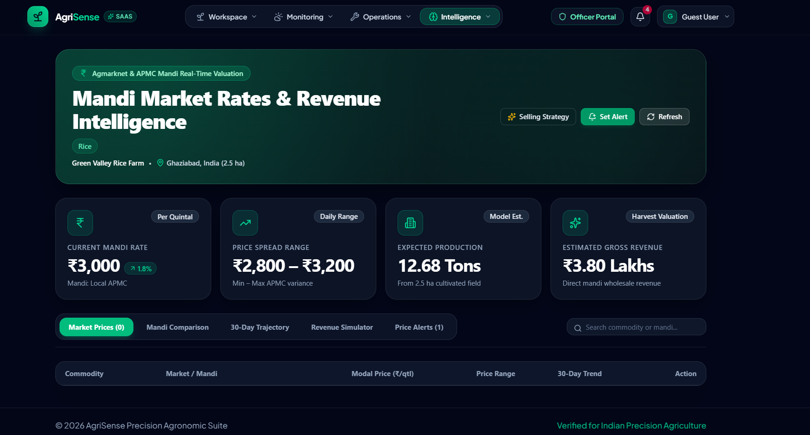
Working Demonstration
Live Deployed System Features & Field Interventions
Crop Disease & Pest Outbreak Telemetry
87% Outbreak Probability — Pathogen spore & micro-climate leaf wetness telemetry. Generates targeted bio-fungicide chemical prescriptions in real time.
Interactive Leaflet GIS & Kendra Locator
Geospatial map with GPS farm pins (Ghaziabad/Noida). Direct routing to Krishi Seva Kendras with bilingual Malayalam audio advisory.
Mandi APMC Market & Revenue Simulator
Expected production: 12.68 Tons (₹3.80 Lakhs valuation). Live APMC market rate integration with crop harvest revenue simulation.
Operational Workflow (Proven End-to-End in AgriSense Platform)
1. GIS Field Setup
2. Telemetry Sync
3. Dual ML Inference
4. Vision Diagnosis
5. Vernacular Advice
6. Officer Escalation
Department of Information Technology | Review-2 | ABES Engineering College | Slide 9

Slide 10
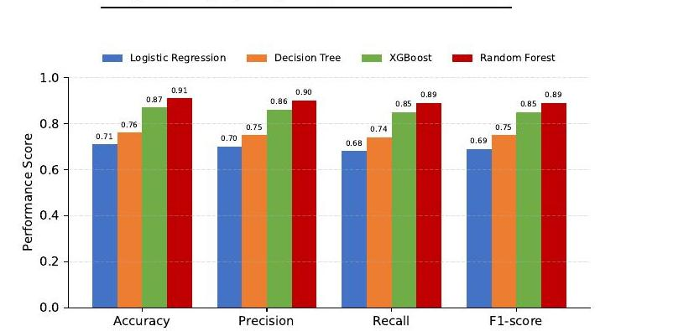
Preliminary Results
Empirical Benchmarking: Crop Yield Regression & Pest-Risk Classification
Model | MAE | RMSE | R² | Status
Linear Regression | 0.84 | 1.12 | 0.68 | Baseline
Random Forest | 0.48 | 0.65 | 0.83 | Competitive
XGBoost | 0.36 | 0.49 | 0.89 | Strong
LightGBM (Proposed) | 0.27 | 0.38 | 0.93 | Best (Proposed)
TABLE II: Crop Yield Regression Benchmark (AgriSense Research Paper)
A. Crop Yield Prediction Analysis
• Best Regressor: LightGBM achieves R² = 0.93 with lowest MAE (0.27) and RMSE (0.38).
• Gain Over XGBoost: 25.0% lower MAE and 22.4% lower RMSE through leaf-wise histogram tree growth.
• Continuous Optimization: Successfully integrates 28 continuous weather, soil, and NDVI parameters without overfitting.
Fig. 4: Pest-Risk Classifier Performance Comparison (IEEE Paper)
B. Pest-Risk Classification Benchmark
• [BEST] Random Forest: Accuracy = 91% | Precision = 90% | Recall = 89% | F1 = 0.89
• XGBoost: Acc=87%, F1=0.85 | Decision Tree: Acc=76% | Logistic Regression: Acc=71%
Key Findings & Architectural Conclusions: 1. Crop Yield: LightGBM delivers the strongest yield prediction (R²=0.93, MAE=0.27) due to gradient-based leaf-wise splitting on continuous features. 2. Pest Risk: Random Forest achieves superior pest-risk classification (Accuracy=91%, F1=0.89) through ensemble bagging resilience against noisy field telemetry.
Department of Information Technology | Review-2 | ABES Engineering College | Slide 10

Slide 11
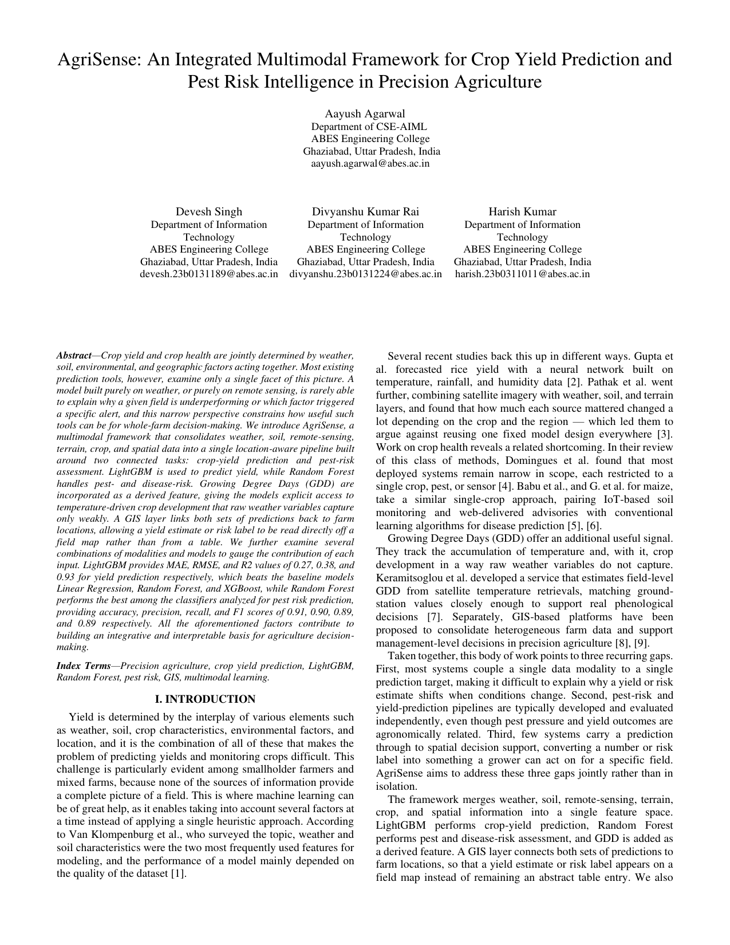
Research Paper Submission
IEEE Manuscript Status, Metadata & Core Contributions
RESEARCH PAPER MANUSCRIPT STATUS
Manuscript Title
AgriSense: A Multimodal Data Fusion Framework for Precision Crop-Yield and Pest-Risk Intelligence
Authors
Harish Kumar, Devesh Singh, Divyanshu Kumar Rai
Faculty Supervisor
Prof. Ayush Agarwal (Assistant Professor, Dept. of Information Technology)
Target Venue
IEEE International Conference / Indexed Journal (Scopus / SCI)
Current Status
Manuscript Completed & Formatted in IEEE 2-Column Template; Submission in Progress / Review Pending
Submission ID
TBD (Under Final Departmental Review & Institutional Clearance)
Core Academic & Technical Contributions:
1. Novel multimodal fusion combining weather, soil, remote sensing (NDVI), and GDD metrics.
2. Dual-model architecture addressing crop yield regression and pest classification concurrently.
3. Zero-leakage evaluation protocol using Blocked Spatial K-Fold and Temporal Season Holdout.
4. Practical deployment linking ML inference directly to farmer GIS & multilingual advisory.
Fig. 5: IEEE Format 2-Column Manuscript Preview (Page 1)
Department of Information Technology | Review-2 | ABES Engineering College | Slide 11

Slide 12
Remaining Work & Roadmap
Phased Progression: From Current Review-2 to Final Project Defense
01 FINAL DATASET LOCKING & MULTI-DISTRICT SCALING [CURRENT FOCUS • IN PROGRESS]
Complete regional dataset collection across additional Uttar Pradesh district APMC mandis. Incorporate historical multi-year crop yield data, expanding geographical coverage beyond baseline study regions.
02 PROGRESSIVE MULTIMODAL ABLATION PROTOCOL [METHODOLOGICAL RIGOR • IN PROGRESS]
Execute systematic leave-one-modality-out ablation experiments (quantifying yield R² impact when removing NDVI, GDD, or soil features individually) to formally report in the finalized research paper.
03 SHAP EXPLAINABILITY INTEGRATION IN WEB UI [INTERPRETABILITY • IN PROGRESS]
Integrate TreeSHAP feature attribution console directly into the farmer and zonal officer dashboard, providing clear, transparent visualizations of which weather/soil factors drove yield and pest predictions.
04 COOPERATIVE GROUND-TRUTH FIELD TESTING [FIELD VALIDATION • PLANNED]
Conduct pilot deployment trials with local agricultural extension officers and Krishi Seva Kendra coordinators to validate model advisory efficacy, farmer usability, and voice assistant accuracy in real conditions.
05 PRODUCTION DEPLOYMENT & FINAL PROJECT DEFENSE [PRODUCTION RELEASE • PLANNED]
Finalize Docker microservices containerization, complete API security audits, deploy to scalable cloud infrastructure, and prepare comprehensive documentation for the Final B.Tech Project Defense.
Department of Information Technology | Review-2 | ABES Engineering College | Slide 12

Slide 13
Challenges & Solutions
Technical Hurdles Encountered & Implemented Architectural Mitigations
1. Multimodal Data Heterogeneity
• Challenge & Impact: Hourly weather, static soil surveys, and 5-day Sentinel-2 satellite passes exhibit massive frequency and spatial resolution mismatch. High risk of dimensional distortion, temporal lag errors, and misaligned feature vectors degrading predictive gradient boosts.
• Implemented Solution: Implemented daily temporal resampling with Savitzky-Golay filtering for cloud-occluded NDVI, coupled with nearest-neighbor geospatial interpolation into unified coordinate feature vectors.
2. Spatial & Temporal Leakage Risk
• Challenge & Impact: Standard random train-test splitting leaks spatial autocorrelation and future climate patterns across adjacent farms. Artificially inflated benchmark metrics (R² > 0.98) that fail completely when deployed on unobserved fields or subsequent seasons.
• Implemented Solution: Designed strict Blocked Spatial K-Fold cross-validation (grouping farms by taluk/district) and out-of-season temporal holdout partitions to ensure genuine generalization.
3. Regional Language AI Accuracy
• Challenge & Impact: Generic LLMs hallucinate inaccurate chemical treatments and fail on vernacular regional agricultural terminology (Hindi/Malayalam). Farmers receive confusing, non-actionable, or potentially harmful crop advice in vernacular voice modes.
• Implemented Solution: Engineered constrained domain-specific prompt templates with Google Gemini AI, anchored to an expert agronomic dictionary, verified chemical safety thresholds, and audio Web Speech API.
4. Real-Time API Quotas & Latency
• Challenge & Impact: Repeated satellite band extractions and live weather API requests incur rate limits (429 errors) and multi-second UI latency. Sluggish farmer dashboard performance (>5s loading) and risk of operational service disruption during peak advisory usage.
• Implemented Solution: Architected an in-memory caching layer with 6-hour TTL for satellite indices and weather telemetry, background asynchronous polling, and client-side GeoJSON vector tile rendering.
Department of Information Technology | Review-2 | ABES Engineering College | Slide 13

Slide 14
References
13 Peer-Reviewed IEEE & Agronomic Journal Citations
[1] T. van Klompenburg, A. Kassahun, and C. Catal, “Crop yield prediction using machine learning: A systematic literature review,” Computers and Electronics in Agriculture, vol. 177, p. 105709, 2020.
[2] A. K. Gupta, K. A. Sarkar, D. S. Dhakre, and D. Bhattacharya, “Weather based crop yield prediction using artificial neural networks: A comparative study with other approaches,” MAUSAM, vol. 74, no. 3, pp. 825–832, 2023.
[3] D. K. Pathak, M. Miranda, F. Mena, et al., “Predicting crop yield with machine learning: An extensive analysis of input modalities and models on a field and sub-field level,” in Proc. IEEE Int. Geosci. Remote Sens. Symp. (IGARSS), 2023.
[4] T. Domingues, T. Brandão, and J. C. Ferreira, “Machine learning for detection and prediction of crop diseases and pests: A comprehensive survey,” Agriculture, vol. 12, no. 9, p. 1350, 2022.
[5] G. R. Babu, M. Gokuldhev, and P. S. Brahmanandam, “Integrating IoT for soil monitoring and hybrid machine learning in predicting tomato crop disease in a typical south India station,” Sensors, vol. 24, p. 6177, 2024.
[6] J. G., E. Castelino, P. Mahadevu, et al., “Smart solutions for maize farmers: Machine learning-enabled web applications for downy mildew management and enhanced crop yield in India,” European Journal of Agronomy, vol. 164, p. 127441, 2025.
[7] I. Keramitsoglou, P. Sismanidis, O. Sykioti, et al., “Sense-GDD: A satellite-derived temperature monitoring service to provide growing degree days,” Agriculture, vol. 13, no. 5, p. 1108, 2023.
[8] C. Karydas, M. Chatziantoniou, K. Stamkopoulos, et al., “Embedding a precision agriculture service into a farm management information system—iFarma/PREFER,” Smart Agricultural Technology, vol. 4, p. 100175, 2023.
[9] E. Gallinucci, M. Golfarelli, and S. Rizzi, “Mo.Re.Farming: A hybrid architecture for tactical and strategic precision agriculture,” Data & Knowledge Engineering, vol. 129, p. 101836, 2020.
[10] J. W. Rouse, R. H. Haas, J. A. Schell, and D. W. Deering, “Monitoring vegetation systems in the great plains with ERTS,” NASA Special Publication, vol. 351, pp. 309–317, 1974.
[11] G. Ke, Q. Meng, T. Finley, T. Wang, W. Chen, W. Ma, Q. Ye, and T.-Y. Liu, “LightGBM: A highly efficient gradient boosting decision tree,” in Advances in Neural Information Processing Systems (NeurIPS), vol. 30, pp. 3146–3154, 2017.
[12] L. Breiman, “Random forests,” Machine Learning, vol. 45, no. 1, pp. 5–32, 2001.
[13] T. Chen and C. Guestrin, “XGBoost: A scalable tree boosting system,” in Proc. 22nd ACM SIGKDD Int. Conf. on Knowledge Discovery and Data Mining, pp. 785–794, 2016.
Department of Information Technology | Review-2 | ABES Engineering College | Slide 14

Slide 15
ABES ENGINEERING COLLEGE, GHAZIABAD
Department of Information Technology
Bachelor of Technology | Major Project Review-2 | Academic Session 2026–27
THANK YOU
AGRISENSE
Precision Agriculture Crop Yield & Pest Risk Intelligence
• QUESTIONS & DISCUSSION •
PROJECT PRESENTATION • REVIEW-2 EVALUATION
Harish Kumar (2300320310086) • Devesh Singh (2300320130088) • Divyanshu Kumar Rai (2300320130100)
Project Supervisor: Prof. Ayush Agarwal (Assistant Professor, Department of Information Technology)
ABES Engineering College, Ghaziabad, Uttar Pradesh
Department of Information Technology | Review-2 | ABES Engineering College, Ghaziabad

