Slide 1

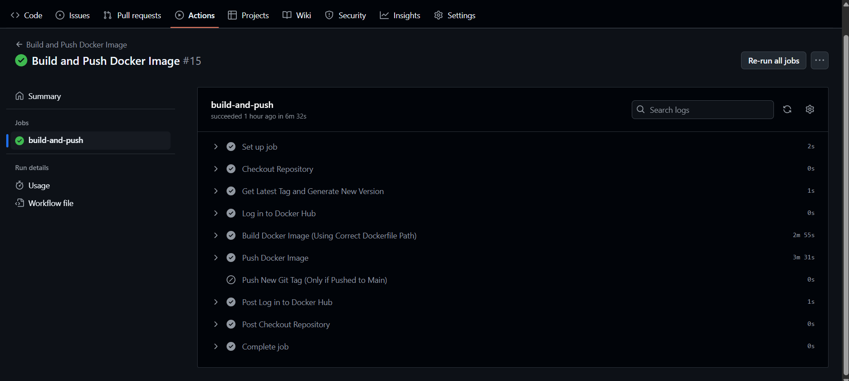
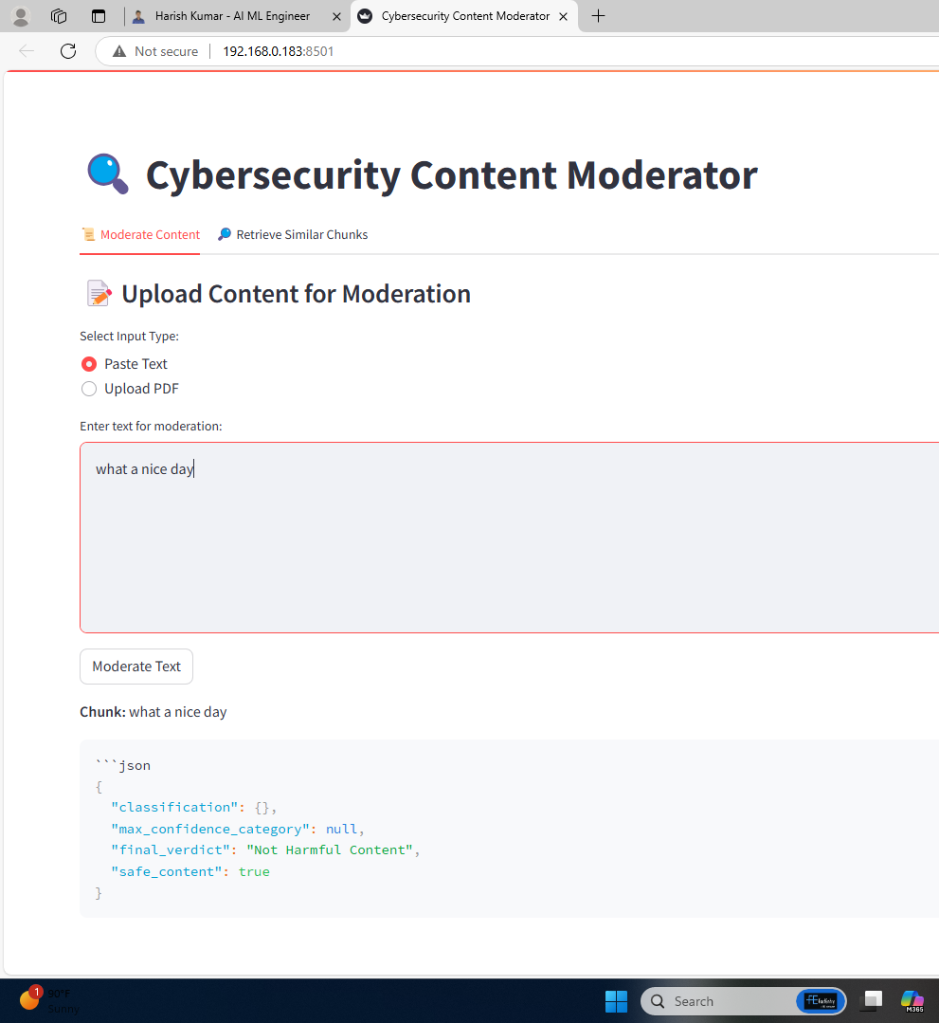
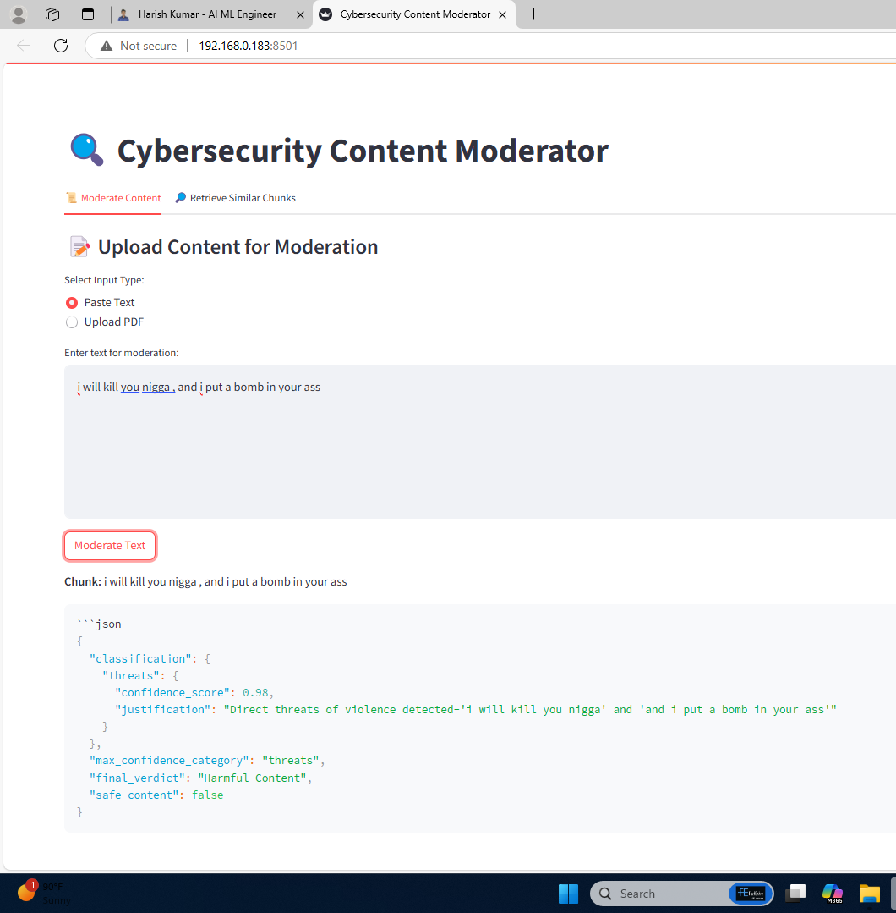
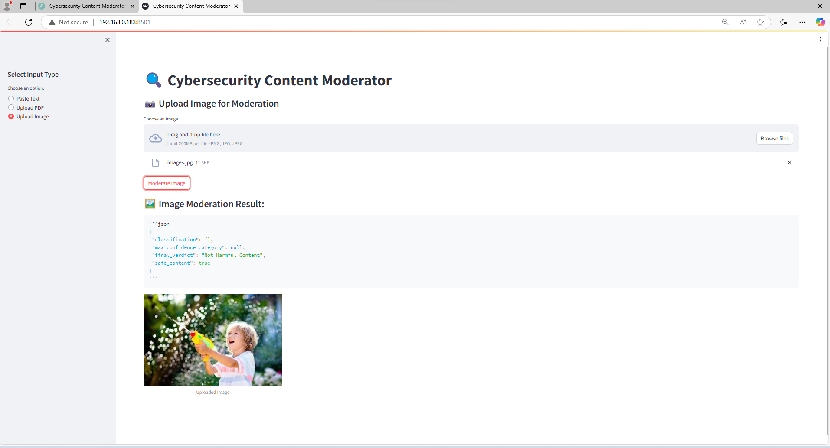
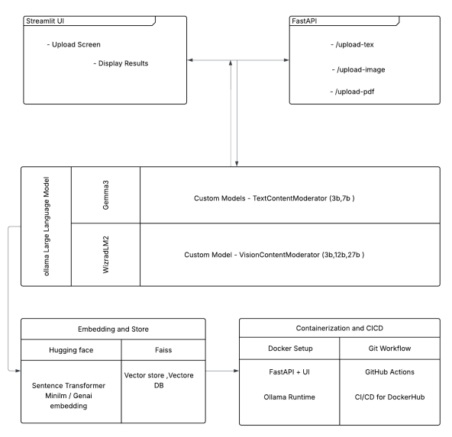
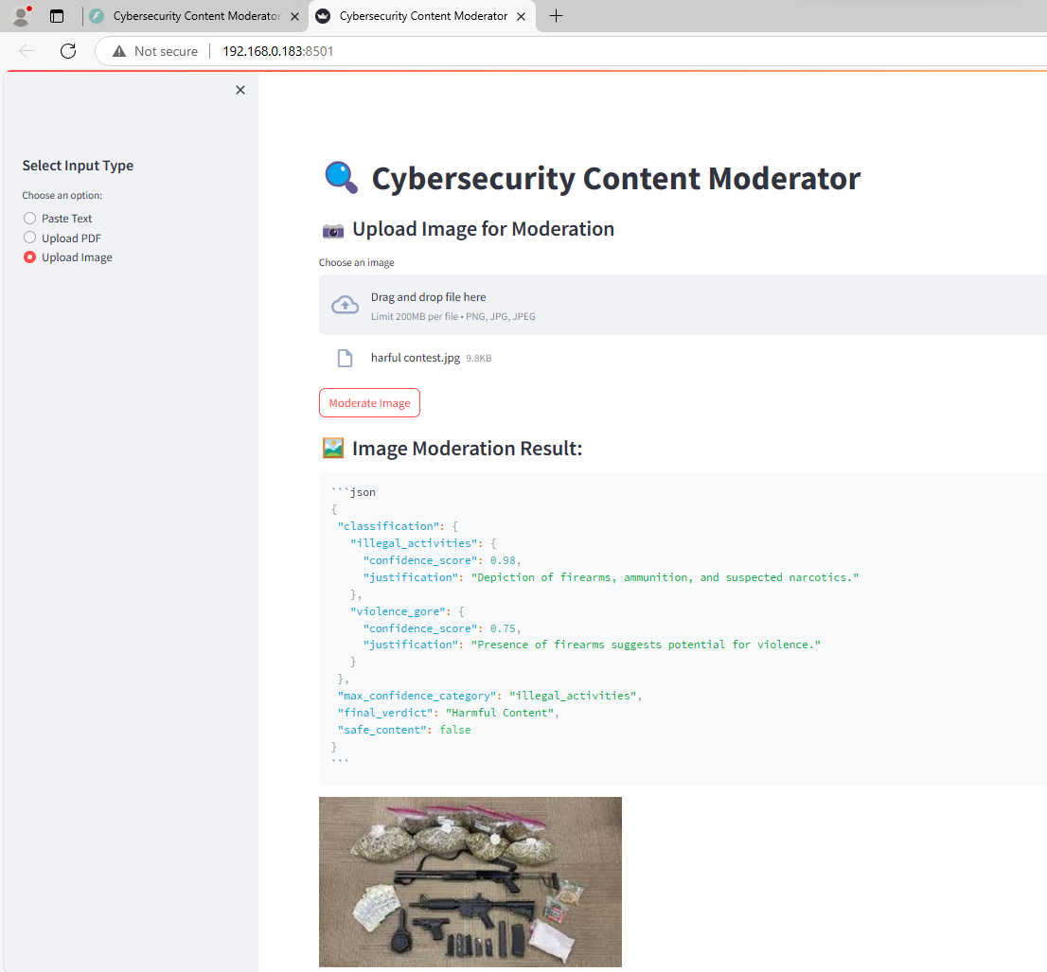
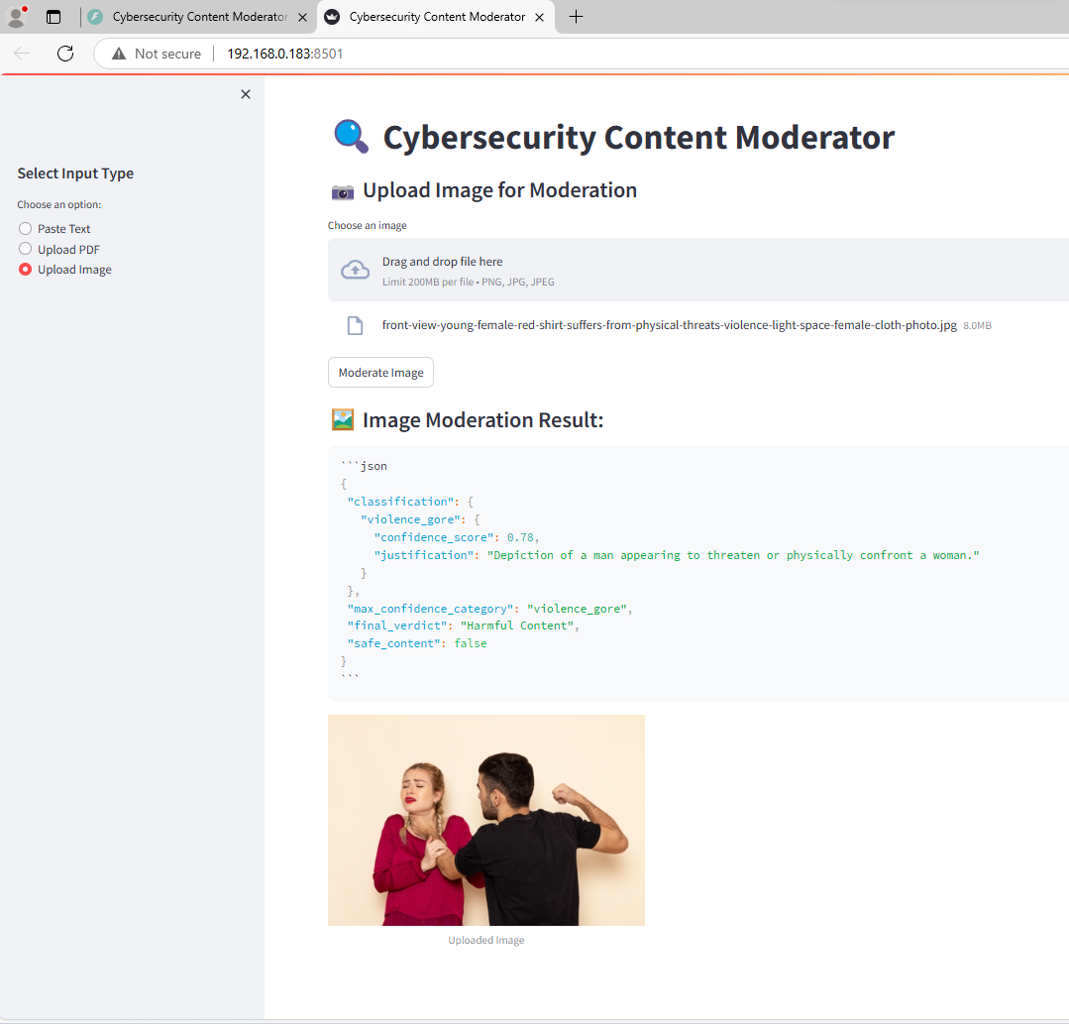
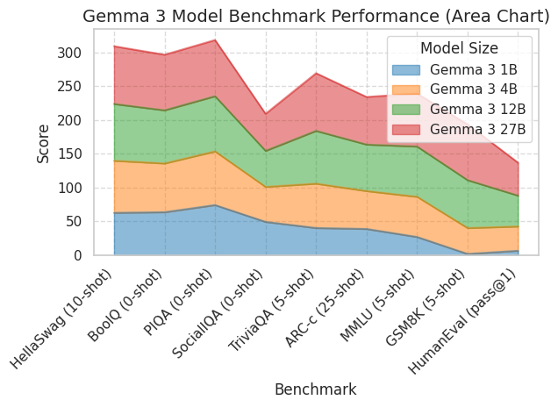
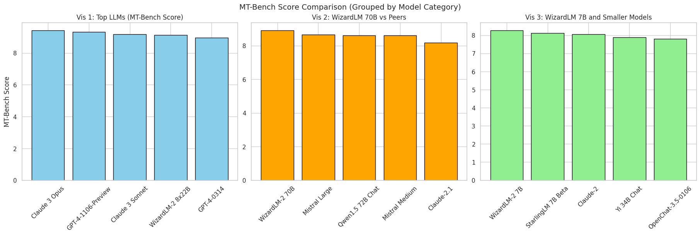
Web-Sourced News Content Classification for Cybersecurity: A Comparative Study on Hate Speech Detection Models
Introduction
Harish Kumar S |Dr.Mehfooza | Scope
Results
With the rise of user-generated content, harmful material like hate speech and threats is also increasing. This project introduces an AI-powered moderation system using NLP and computer vision to detect such content in real-time. Built with FastAPI, Ollama, and FAISS, it ensures private, scalable, and explainable moderation.
Git action CI CD :
Text Model Outputs:
Vision Model Outputs:
Motivation
The rise of harmful online content has made manual moderation ineffective and unsafe. Most existing tools miss context by analyzing text and images separately. This project introduces a private, multimodal AI system that detects harmful content in real time using fine-tuned open-source models.
SCOPE of the Project
This project focuses on building a real-time, multimodal AI system for moderating harmful content across text and images, ensuring safer digital interactions. Designed to be privacy-preserving and locally hosted via Ollama, the system can be integrated into various platforms like Discord, Reddit, or other social forums. It is scalable, explainable, and extensible to support additional modalities such as audio or video in future developments.
Methodology
The Cybersecurity Content Moderator employs a multimodal pipeline to analyze text, images, and PDFs for harmful content. Users upload content via a Streamlit UI, which is preprocessed accordingly—text is normalized, images undergo OCR, and PDFs are parsed structurally. A fine-tuned WizardLM 2 (7B) model handles text moderation, while Gemma Vision (4b/12B) detects graphic or violent elements in images. Semantic similarity using Sentence Transformers and FAISS enhances classification. The backend, built with FastAPI, returns results with category, confidence, and explanation. The entire system runs locally via Docker and Ollama, ensuring privacy and real-time performance.
Users upload text, images, or PDFs via a Streamlit UI.
FastAPI backend routes content to custom moderation models.
LLMs (Gemma, WizardLM2) analyze and classify harmful content.
Semantic matching via Sentence Transformers + FAISS improves accuracy.
Results are displayed, with the system running via Docker & CI/CD.
Gemma 3 Benchmark Performance: Area chart showing how Gemma 3 models improve across tasks with increasing size, from 1B to 27B parameters.
MT-Bench Score Comparison: Comparison of top LLMs grouped by scale — showing how larger models like Claude 3 Opus and GPT-4 lead, while WizardLM variants perform strongly across different size categories.
Conclusion
By reconfiguring base models (WizardLM 2, Gemma 3) with custom fine-tuned files, the system enables accurate, multimodal content moderation. Combined with semantic search, a simple UI, and Docker-based deployment, it delivers explainable and scalable real-time moderation.
References
Model Info : https://huggingface.co/google/gemma-3-27b-it
https://wizardlm.github.io/WizardLM2/ ,
Custom Model info : https://github.com/ollama/ollama/blob/main/docs/modelfile.md

