Slide 1


COLLECTION DATA TYPES

Slide 2
About Team
K . Ritish
P . Harish
K . Srinath

Slide 3
COLLECTION OF DATA TYPES
Data types are the fundamental building blocks in programming. They define the kind of data a variable can hold and the operations that can be performed on it.
Types :
LISTS
TUPLE
DICTIONARY
SET

Slide 4

PYTHON LISTS :
Syntax: my_tuple = (1, 2, 3, "apple")
Supports multiple data types
A list is an ordered collection of items
Items can be changed, added, or removed.
Features :
Mutable (can be modified)
Ordered
Indexed (supports positive & negative indexing)
Allow Duplicates

Slide 5
LIST METHODS :
append(x) → add element at end
extend(iterable) → add multiple elements
insert(i, x) → insert at position
remove(x) → remove first occurrence
pop([i]) → remove and return element (default last)
clear() → remove all elements
index(x) → return index of first occurrence
count(x) → count occurrences
sort() → sort list in place
reverse() → reverse list in place
copy() → shallow copy

Slide 6
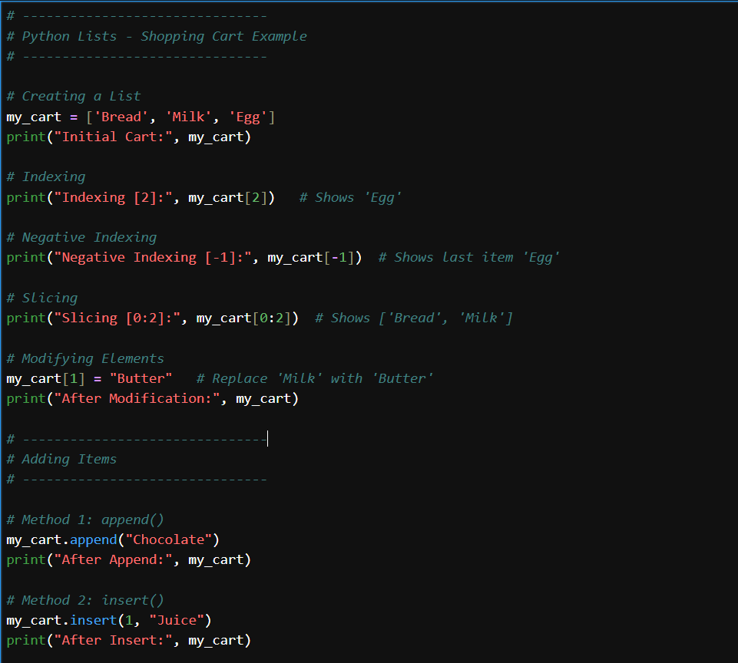
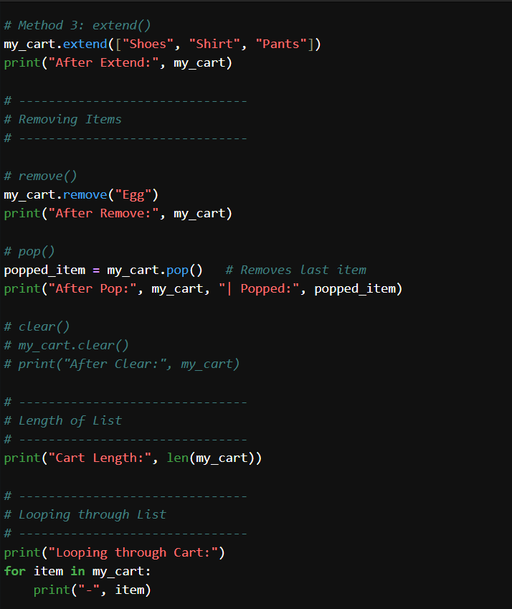
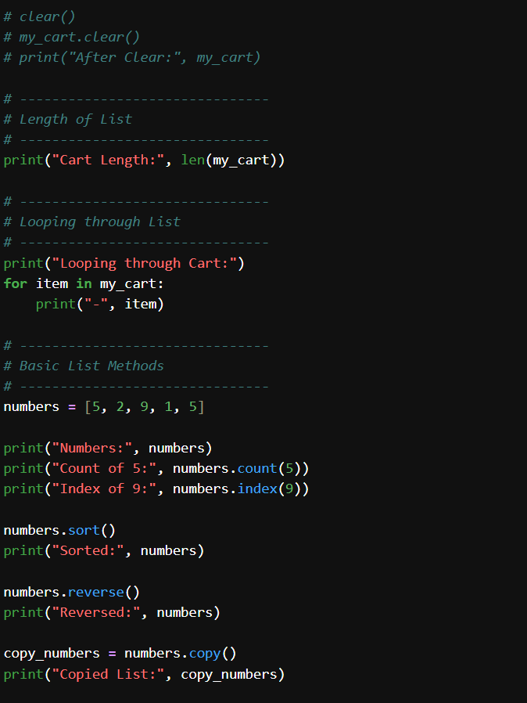
EXAMPLE CODE :

Slide 7

PYTHON TUPLE :
Syntax: my_tuple = (1, 2, 3, "apple")
Supports multiple data types
A tuple is an ordered collection of items
Features :
Immutable (can be modified)
Ordered
Indexed (supports positive & negative indexing)
Allow Duplicates

Slide 8
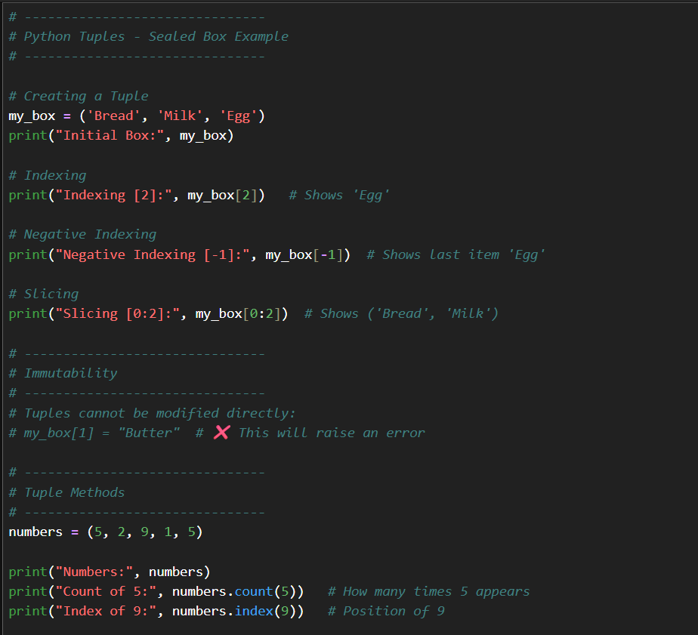
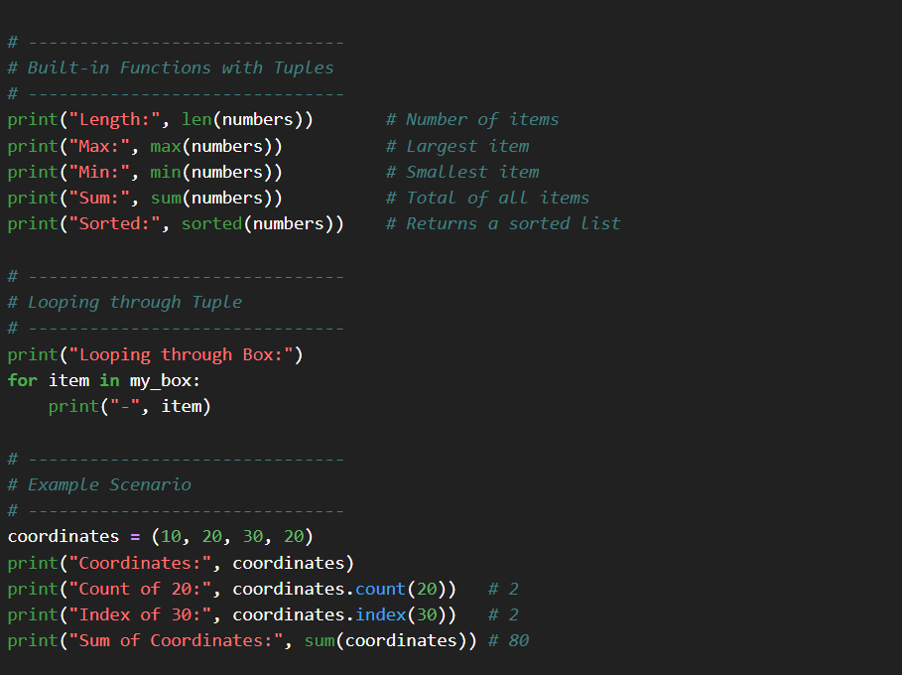
TUPLE METHODS :
count(x) → tells you how many times an item appears in the box.
index(x) → tells you where the item is located in the box."*
Example :

Slide 9
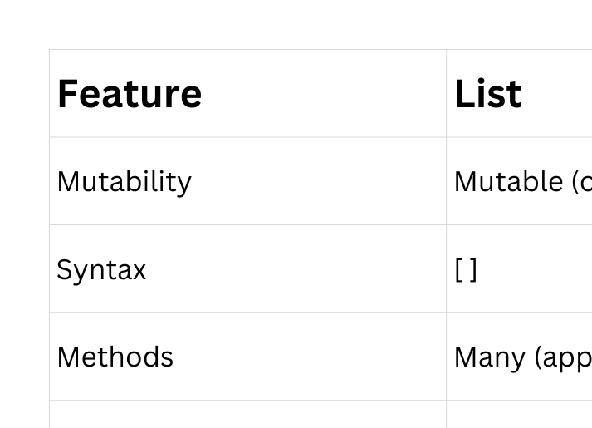
Comparison Table

Slide 10
PYTHON
{key:Value}
Dictionaries.
In Python, a dictionary is a collection of information stored in pairs:
a key and a value.
syntax:
dict_var = {1 : ‘good morning’}
Key
Value

Slide 11


PYTHON
{key:Value}
Dictionaries.
Key
Value
Mutable
Ordered
Duplicates
Indexing

Slide 12



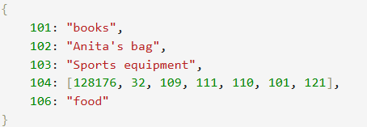
PYTHON
{key:Value}
Dictionaries.
Problem Statement.
The money is manipulated. Investigate and find the money in the lockers.
lockers = { . . . }

Slide 13
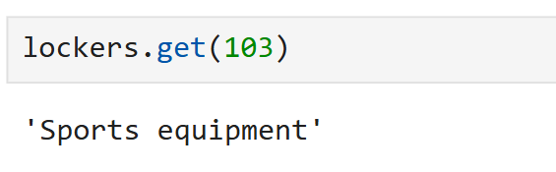
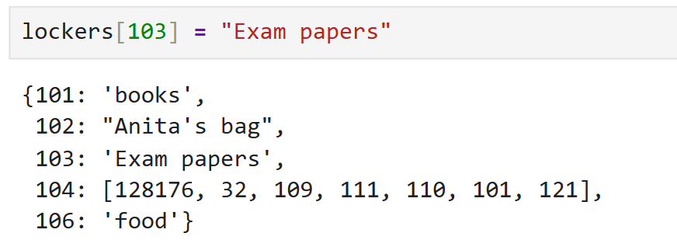
PYTHON
Problem Statement.
Dictionaries.
The money is manipulated. Investigate and find the money in the lockers.
lockers = { . . . }

Slide 14

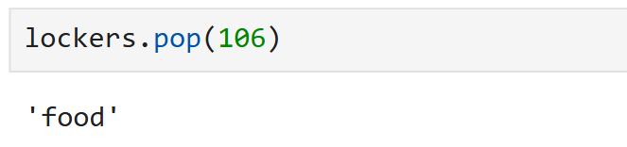
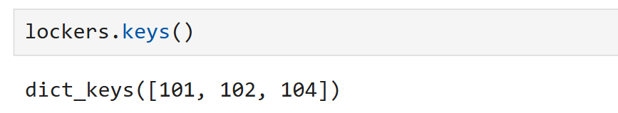
PYTHON
Problem Statement.
Dictionaries.
The money is manipulated. Investigate and find the money in the lockers.
lockers = { . . . }

Slide 15
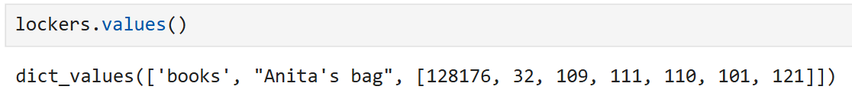
PYTHON
Problem Statement.
Dictionaries.
The money is manipulated. Investigate and find the money in the lockers.
lockers = { . . . }
key(), value(), items() -----> Return view object

Slide 16
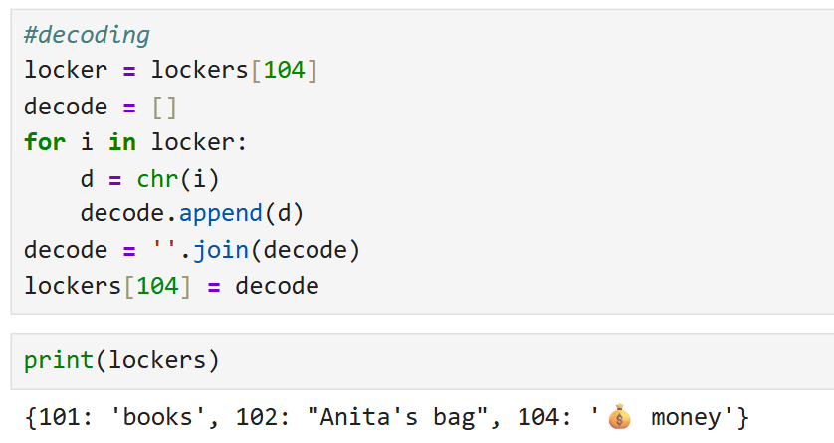
PYTHON
Problem Statement.
Dictionaries.
The money is manipulated. Investigate and find the money in the lockers.
lockers = { . . . }

Slide 17
Set’s.
Python
Introduction
A set in Python is an unordered collection used to store multiple unique items in a single variable.
It does not allow duplicates and ‘set’ automatically removes repeated values.
Sets are mutable, so we can add or remove items, but the elements themselves must be immutable.

Slide 18
What is set?
✦
Unordered
Items have no guaranteed order or index.
✦
Unique values
Duplicate values are automatically removed
✦
Mutable
Items can be added or removed after creation

Slide 19
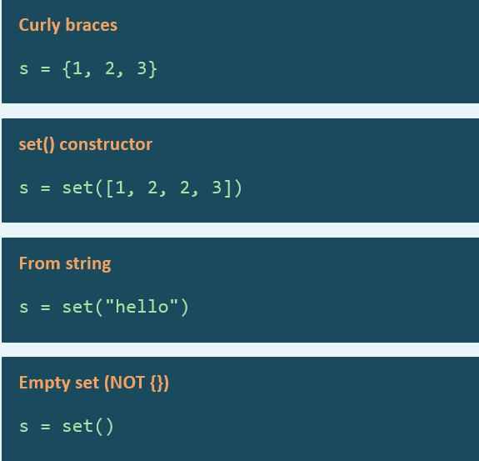
Creating Sets
Create set using curly braces.
Removes duplicates automatically.
Create set of unique characters.
Create an empty set (not{}).

Slide 20
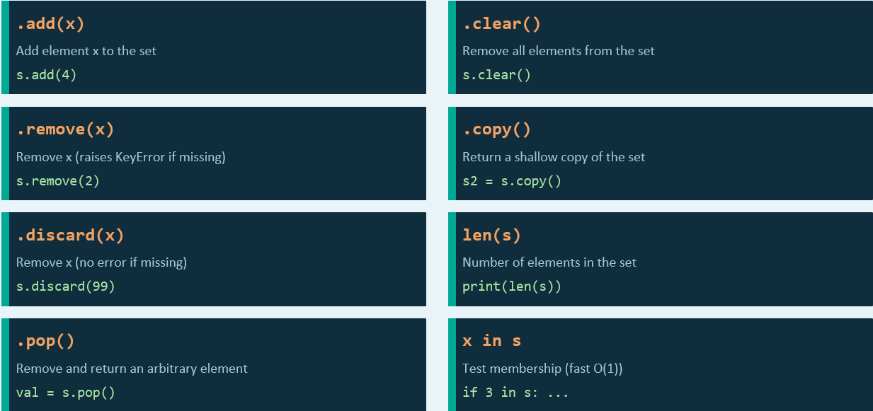
Common Set Methods

Slide 21
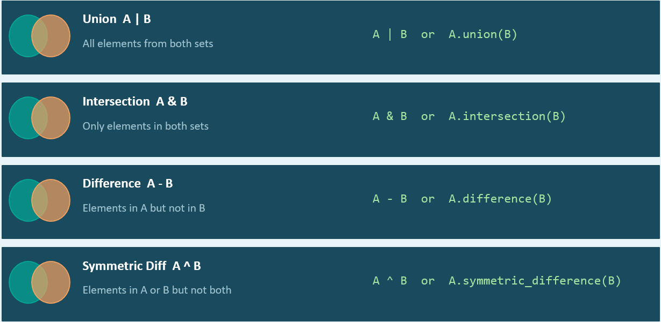
Set Operations

Slide 22

THANK YOU

