Slide 1

IMDB Data Analysis & Visualization
BY
Harish Reddy.Y
BATCH –277, 291_292

Slide 2
Problem statement:
Determining which genre and director to choose for creating a successful movie involves a combination of factors, including audience preferences, industry trends, directorial style, and the specific vision for the film.
Goal:
Filmmakers and studio executives can navigate the uncertainty surrounding genre and director selection with greater confidence and clarity, ultimately increasing the likelihood of creating a successful and impactful movie.

Slide 3
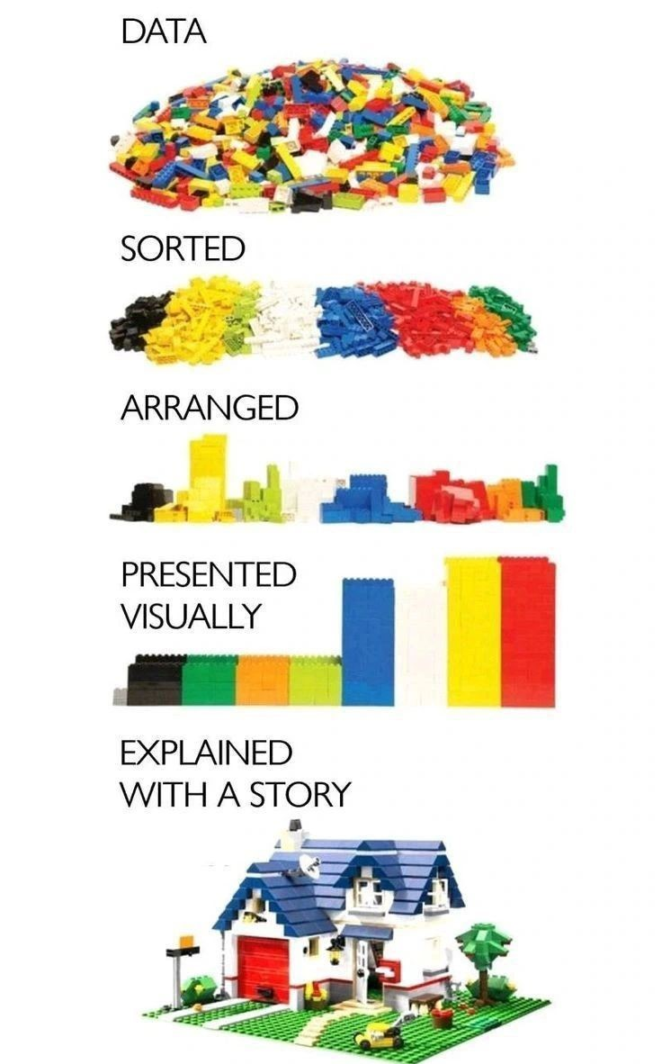
Libraries Used:
Regex (re)
Requests
Beautiful Soup
Pandas
NumPy
Matplotlib.pyplot
Seaborn
Extracting the Data:
By using Beautiful Soup and Request Libraries, the data is extracted from the Imdb website.

Slide 4
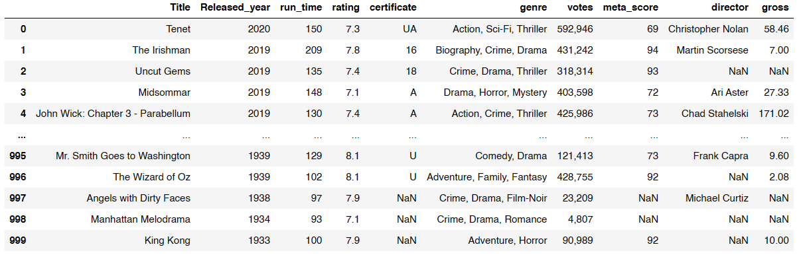
Raw Data

Slide 5
Data Cleaning:
Filling Missing/Null values
Dropping Duplicates
Noisy Data

Slide 6
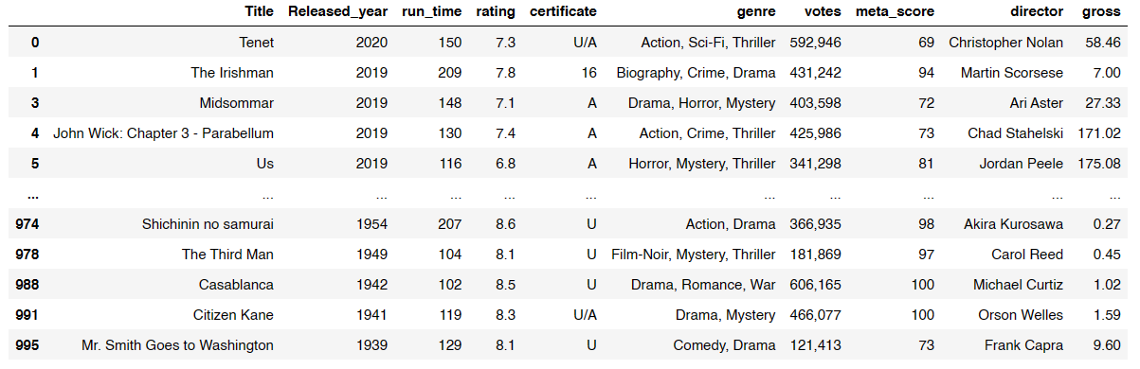
After Data Cleaning

Slide 7
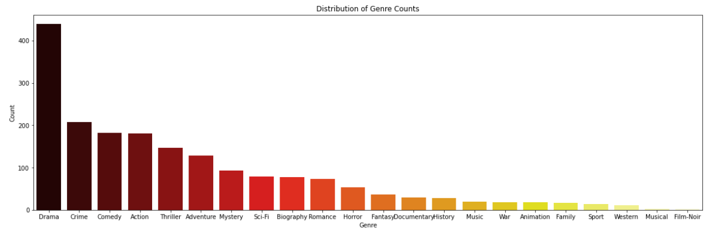
Univariate Analysis
Drama Genre is present in highest number of movies with around 450, followed by crime(210) and comedy(180)
Film-Noir Genre is present in less number of movies almost zero

Slide 8
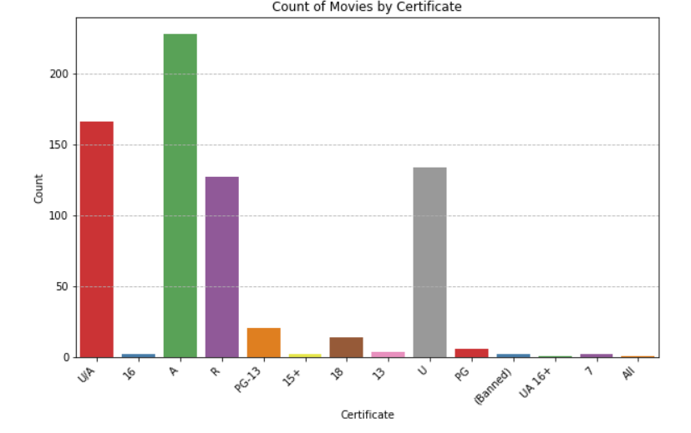
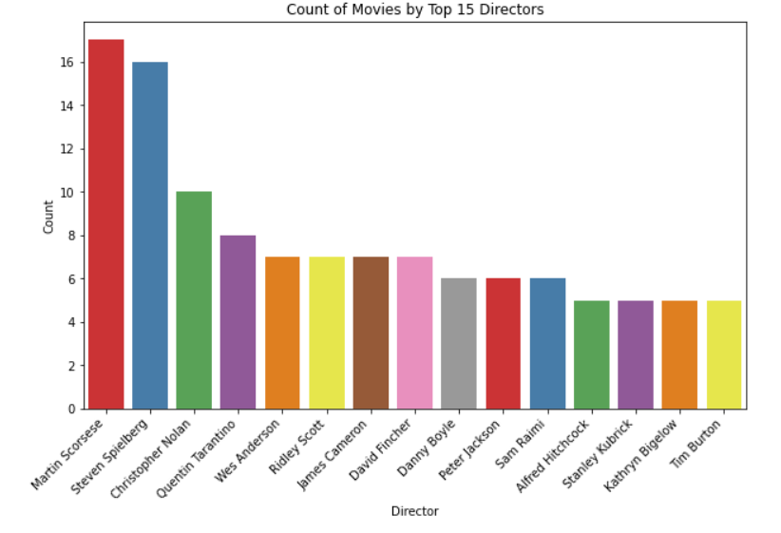
Around 230 Movies got A certificate, 170 Movies got U/A certificate and 140 movies got U certificate.
Top 15 Directors based on number movies they done

Slide 9
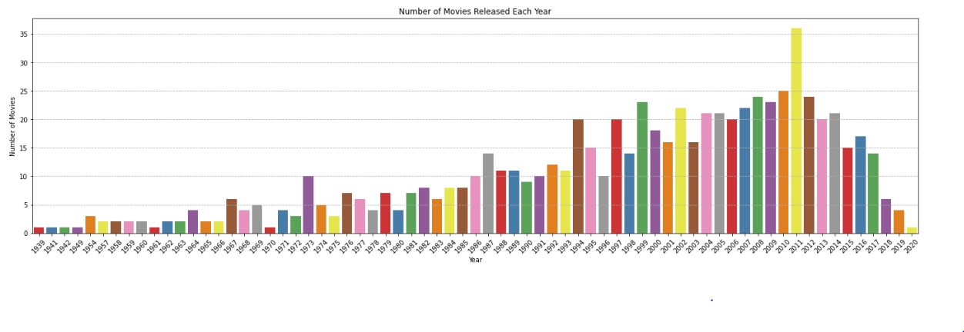
In 2011 more number of movies are released followed by 2010 and 2012

Slide 10
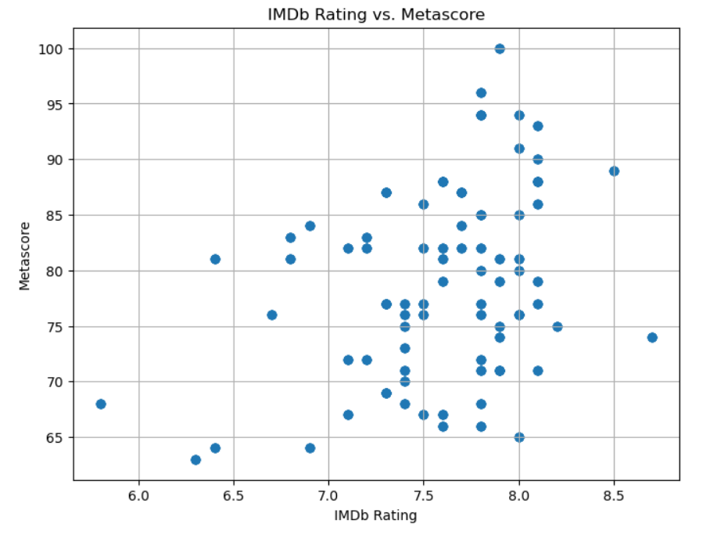
Bivariate Analysis
There is no relation between rating and meta_score
We can see 5.5 rating as 68 meta_score, 8.8 rating as 74 meta_score

Slide 11
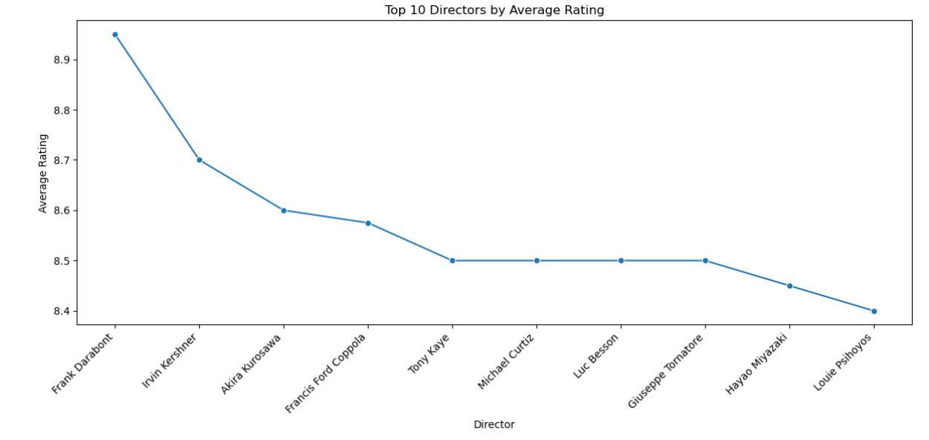
Top 10 directors with rating on their movies collection

Slide 12
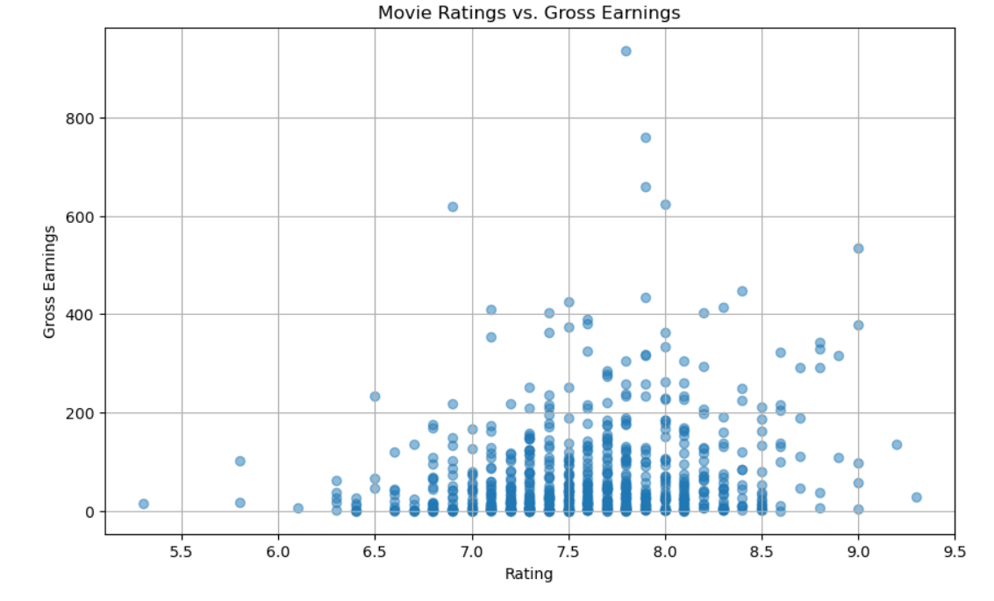
Gross earnings doesn’t depend on Rating

Slide 13
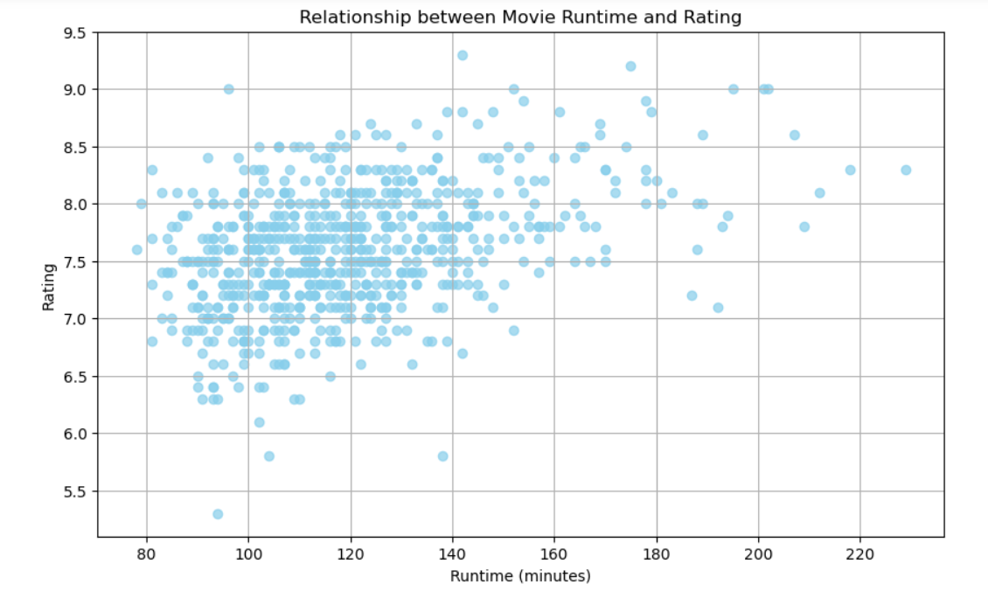
Rating doesnot depend on run time

Slide 14
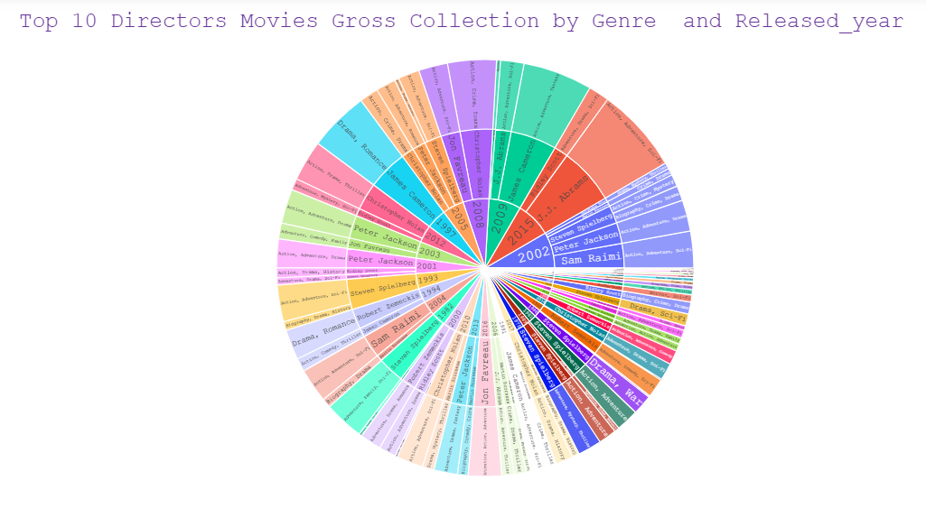
Multivariate Analysis

Slide 15
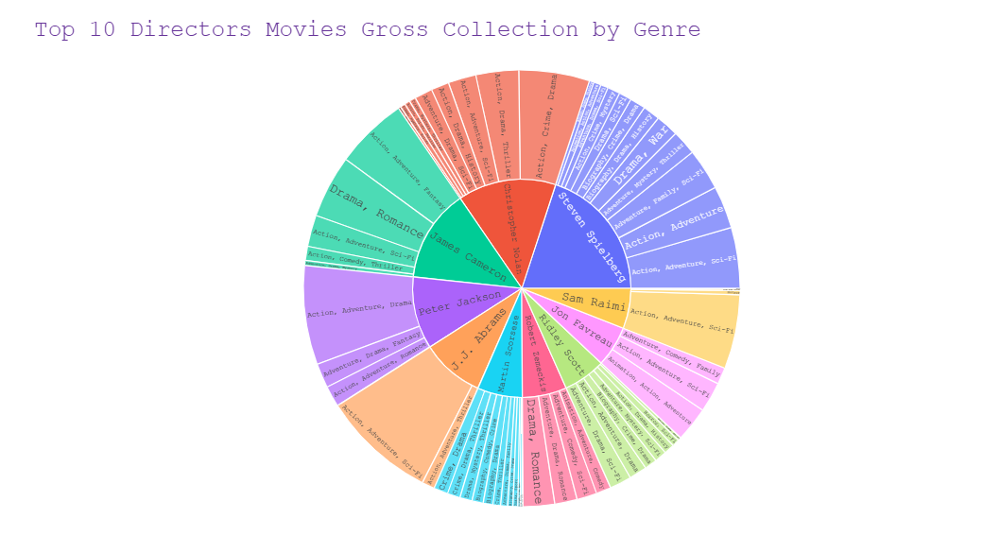

Slide 16
Conclusion :
Certain directors consistently produce high-grossing films within specific genres
.
Collaborating with these directors and focusing on their successful genres can maximize income potential.
Align creative endeavors with audience preferences to increase revenue generation.

Slide 17
THANK YOU

