Slide 1


Why De-normalization? - Database Tuning - Database Performance Tuning to Improve DBMS Performance.
Boomika DM 24mx105
Akshaya M 24mx203
Harish 24mx208
Midhuna GT 24mx214
Mohamed Riyaz S 24mx216

Slide 2
Introduction to Database Performance Tuning
Definition:
Database performance tuning is the process of optimizing the efficiency and speed of a database to ensure fast access and retrieval of data while minimizing system resource consumption (CPU, memory, disk I/O).
Goals:
Improve query response times, reduce system load, optimize storage, and ensure scalability.

Slide 3
Key Areas of Performance Tuning
Query Optimization: The process of refining SQL queries to ensure they execute more efficiently (e.g., minimizing unnecessary joins, avoiding suboptimal queries).
Indexing: Creating indexes on frequently queried columns to speed up data retrieval.
Schema Design: Designing a well-structured schema to minimize redundant data and optimize queries. This is where denormalization comes into play.
Caching: Storing frequently accessed data temporarily to reduce database load and improve response times.

Slide 4
Understanding Database Normalization
What is Normalization?
Definition: The process of organizing data in a database to minimize redundancy and dependency by dividing the database into smaller tables and linking them through relationships (e.g., foreign keys).
Purpose: Ensure data integrity (no anomalies) and reduce redundancy to make updates more efficient.

Slide 5
Types of Normalisation
1st Normal Form (1NF): Ensures that each column contains atomic (indivisible) values and eliminates repeating groups of data.
2nd Normal Form (2NF): Achieved when the database is in 1NF and all non-key attributes are fully dependent on the primary key (no partial dependencies).
3rd Normal Form (3NF): Achieved when the database is in 2NF, and there is no transitive dependency (non-key attributes depend only on the primary key).

Slide 6
Introduction to Denormalization
Definition: Denormalization is the process of intentionally introducing redundancy into a database schema to optimize the performance of read-heavy applications.
Key Goal: Improve the performance of SELECT queries by reducing the need for joins and simplifying complex queries.

Slide 7
Why is Denormalization Used?
Performance Improvement: Denormalization helps speed up query performance by reducing the complexity of joins, which can be slow, especially in large databases.
Data Retrieval: It is used in read-heavy systems, where the performance of queries (especially complex aggregations and multi-table joins) is more critical than the costs of redundant data.

Slide 8
Types of Denormalization Techniques
Adding Redundant Columns:
Storing the same data in multiple places, often in a single table to reduce the need for joins.
Precomputing Aggregate Data:
Storing the results of common aggregate operations (e.g., SUM, AVG, COUNT) directly in the database.

Slide 9
Flattening Hierarchical Data:
Combining hierarchical data (e.g., parent-child relationships) into a single table, rather than keeping them in separate tables.
Using Indexed Views/Materialized Views:
Storing the results of complex queries (e.g., aggregations, joins) as a view that gets refreshed periodically to avoid the need for repeated complex calculations.
Concatenating Data:
Combining multiple columns into one to avoid repeatedly performing string concatenation in queries.

Slide 10
When to Use Denormalization
Scenarios Where Denormalization is Beneficial:
Data Warehouses: Typically read-heavy, with large amounts of data. Denormalization helps optimize reporting queries.
Reporting Systems: For systems that generate frequent reports and dashboards, where performance and query speed are critical.
E-commerce Systems: Where frequent queries (e.g., product catalog searches) require rapid data retrieval.
Real-Time Analytics: For applications needing fast analytics over large datasets (e.g., monitoring, fraud detection).

Slide 11
Impact of Denormalization on Database Performance
Improved Read Performance: Denormalization significantly improves read performance by reducing or eliminating the need for joins, which are often expensive.
Increased Storage Requirements: The trade-off for faster reads is that more disk space is consumed due to duplicated data.
Effect on Write Performance: Writing data becomes slower due to the need to update multiple redundant entries in the database.

Slide 12
Reason of Denormalization
Faster Query Execution
Eliminates complex joins, allowing queries to access data directly from a single table.
Improved Read Performance
Reduces the number of database operations required for data retrieval, resulting in faster response times.
Simplified Data Access
Makes it easier for applications to retrieve related information without the need for complex joins.

Slide 13
Best Practices for Denormalization
Selective Denormalization: Only denormalize the parts of the database where performance improvements are significant. For example, frequently accessed data or data that requires complex joins.
Monitoring and Performance Testing: Regularly monitor query performance to ensure denormalization is having the desired effect. Use EXPLAIN and query execution plans to identify bottlenecks.
Balancing Read and Write Performance: Carefully assess whether the benefits of faster reads outweigh the trade-offs in slower writes and higher storage costs. Example: Denormalize a read-heavy reporting system but keep transactional data normalized for faster updates.

Slide 14
Alternatives to Denormalization
Indexing: Indexes can be used to improve query performance without introducing redundancy. Example: Indexing foreign keys or commonly queried fields (e.g., customer_id in the orders table).
Caching: Using caching systems (e.g., Redis, Memcached) to store frequently accessed data in memory, reducing the load on the database.
Partitioning and Sharding: Breaking large tables into smaller, more manageable pieces (horizontal partitioning) to improve query speed.
Materialized Views: Pre-aggregating data into materialized views can speed up report generation and analytics without fully denormalizing the schema.

Slide 15
Case Studies and Real-World Examples
E-Commerce System: An online store might denormalize by storing product details directly in the orders table for fast order processing and quick access to product information during order management.
Reporting System: A financial reporting system where large sets of transactional data are pre-aggregated in materialized views to improve the speed of financial reporting queries.

Slide 16
Example
Book_ID | Book_Title | Author_Name | Author_Phone | Publisher_Name | Publisher_Address
1 | Database Design | John Smith | 1234567890 | TechBooks Ltd | 123 Main St, New York
2 | SQL Mastery | Jane Doe | 9876543210 | CodePress Inc | 456 Elm St, Los Angeles
3 | Database Design | Alice Johnson | 5556667777 | TechBooks Ltd | 123 Main St, New York

Slide 17
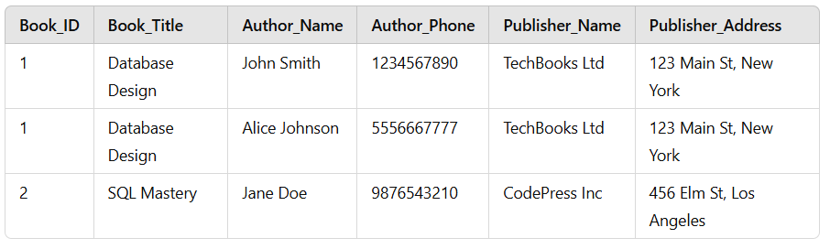
First Normal Form (1NF)
Rules:
Every column must contain atomic values, meaning each value in a column should be indivisible. There should be no repeating groups or arrays.

Slide 18
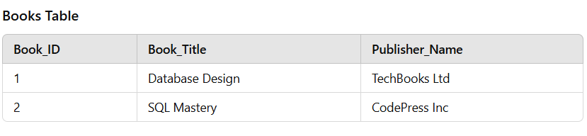
Second Normal Form (2NF)
Rules: Must satisfy 1NF. Remove partial dependencies (attributes dependent on part of a composite primary key).

Slide 19
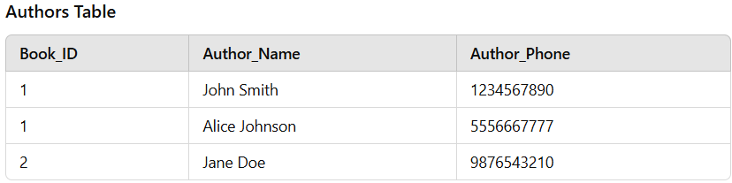


Slide 20
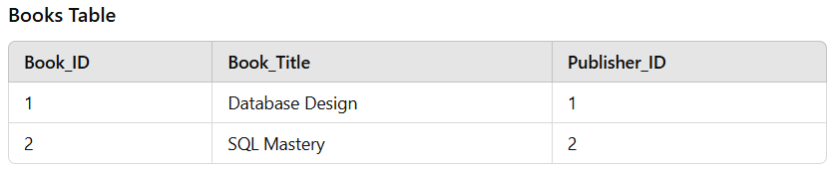
Third Normal Form (3NF)
Rules:
Must satisfy 2NF.
Remove transitive dependencies (non-key attributes dependent on other non-key attributes).

Slide 21
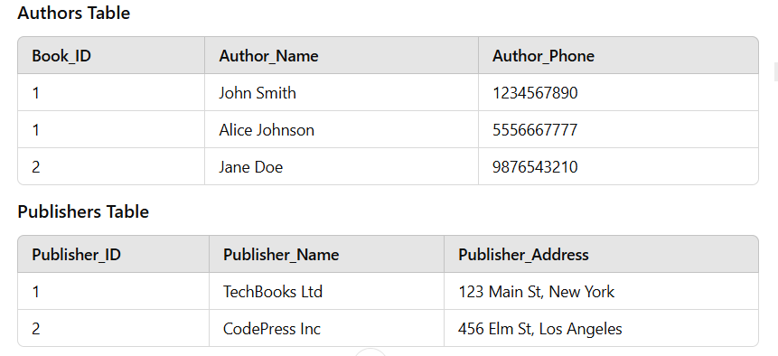

Slide 22
Conclusion
De-normalization is most effective in scenarios where performance demands—particularly for read-heavy operations—are paramount. However, its implementation requires a thorough understanding of the trade-offs, as well as careful monitoring and maintenance to ensure data integrity and system efficiency. Use de-normalization selectively, focusing on high-impact areas to strike a balance between performance and manageability

