Slide 1
SYSTEM SIMULATION
EMMANUEL PRATHYUSHCHAND
24MS02

Slide 2
INTRODUCTION
What is System Simulation?
Given a mathematical model of a system it is sometimes possible to derive information about the system by analytical means, where this is not possible it is necessary to use numerical computation methods for solving the equations.
Analytical methods directly produce general solutions whereas numerical methods produce solutions insteps each step gives the solution for on set of condition and calculations must be repeated to expand the range of the solution
SIMULATION is used to describe any procedure of establishing a model and deriving a solution numerically, the word simulation is used in preference to the general term numerical computation.

Slide 3
TECHNIQUES OF SIMULATION
Simulation breaks down the system's behavior into time steps.
At each step, the current state of the system is computed, representing its behavior at that specific point in time.
Previously we saw the equation of the vehicles stability : The wheel model's motion stability depends on specific conditions (e.g., damping factor ζ) When solved analytically, we observe stable motion if ζ≥1 If solved numerically, we focus on incremental computation without directly knowing the full motion dynamics.

Slide 4
SIMULATION CHARACTERSTICS AND APPLICATION
It's the study of dynamic systems using numerical computations to observe their performance over time.
It is broad enough to include both mathematical models and physical models, such as dynamic testing of physical systems.
Some simulations involve making successive decisions with given probabilities.
Example: Finding the likelihood of different outcomes in a probabilistic system.
In certain problems, time is divided into a uniform intervals for step-by-step computation.

Slide 5
MONTE CARLO METHOD
A numerical computation technique involving experimental sampling with random numbers. It is used to estimate values such as integrals by simulating a large number of random inputs.
The Monte Carlo Method is a numerical computation technique that uses random sampling to solve mathematical problems that may be deterministic in principle but are too complex to solve analytically or efficiently using standard methods.

Slide 6
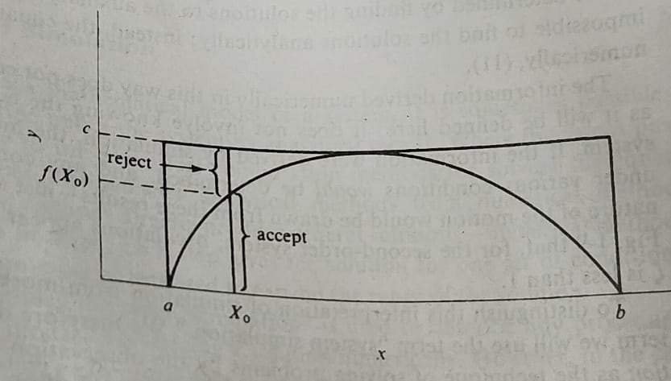
EXAMPLE
Let us consider a function, f(x) is positive and has lower and upper bounds a and b, respectively. The function is also bounded above by the value c.
As shown in the figure is then contained within a rectangle with sides of length c, and b – a2.

Slide 7
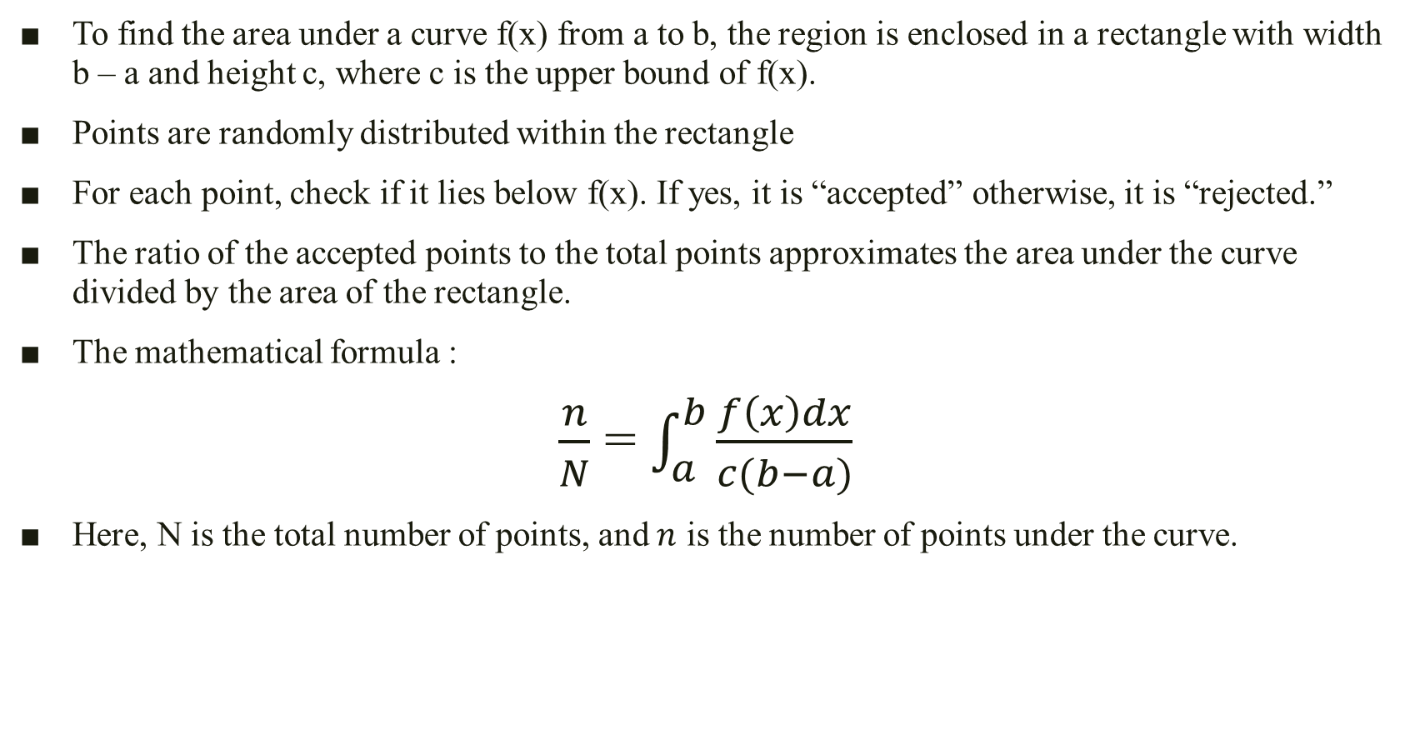
To find the area under a curve f(x) from a to b, the region is enclosed in a rectangle with width b – a and height c, where c is the upper bound of f(x).
Points are randomly distributed within the rectangle
For each point, check if it lies below f(x). If yes, it is “accepted” otherwise, it is “rejected.”
The ratio of the accepted points to the total points approximates the area under the curve divided by the area of the rectangle.
The mathematical formula :
​$\frac{n}{N}$ = $\int_{a}^{b}{\frac{f\left(x\right)dx}{c(b−a)}}$
Here, N is the total number of points, and $n$ is the number of points under the curve.

Slide 8
The computational technique is illustrated. For each point, a value of x is selected at random between a and b, say X0. A second random selection is made between 0 and c to give Y. If Y ≤ f(X0) the point is accepted in the count n otherwise it is rejected and the next point is picked.
It is not likely that the Monte Carlo method would be used to evaluate an integral of a single variable: there are more efficient numerical computation methods for that purpose. However, the method is often used on integrals of many variables by using a random number for each of the variables.
Monte Carlo applications are sometimes classified as being simulations. In addition, simulation is sometimes described as being an application of the Monte Carlo method, presumably because so many simulations involve the use of random numbers.

Slide 9
EXPERIMENTAL NATURE OF SIMULATION
PURPOSE OF SIMULATION :
Simulation does not focus on isolating specific relationships between variables. Instead, it observes how all variables of the system evolve over the time.
Relationships between variables are derived from these observations.
For example :
In the study, the relationship between variables such as D (damping), K (spring constant), and M (mass) is not predefined. Instead, their interaction to prevent oscillations is determined experimentally through the simulation.
This observation could lead to the discovery of patterns that might not be evident through analytical methods alone.

Slide 10
2. NATURE OF SIMULATION :
Simulation is a problem-solving and experimental technique.
Multiple simulation runs are often required to fully understand and explore a system’s relationships.
3. PLANNING :
The use of simulations must be carefully planned as a sequence of experiments to uncover meaningful insights.
Therefore, Simulation is essentially an experimental problem–solving technique.
It is an experimental tool used to study dynamic systems by observing variable interactions, rather than strictly analyzing them mathematically.

Slide 11
TYPES OF SYSTEM SIMULATION
1. CLASSIFICATION OF SYSTEM:
Systems are categorized as continuous or discrete based on how changes occur within them.
Continuous systems: exhibit smooth, gradual changes.
Discrete systems: experience sudden, distinct changes.
The classification of models does not emphasize whether the analysis uses analytical or numerical techniques.
Instead, the distinction between continuous and discrete models becomes critical during simulation, especially when implemented on a computer or a programming system.

Slide 12
NUMERICAL COMPUTATION TECHNIQUE FOR CONTINUOUS MODELS
A continuous model is a mathematical model that describes a system whose state changes smoothly over time
This topic introduces a general numerical technique for simulating continuous models. The core idea is to approximate a continuous system using discrete time steps.

Slide 13
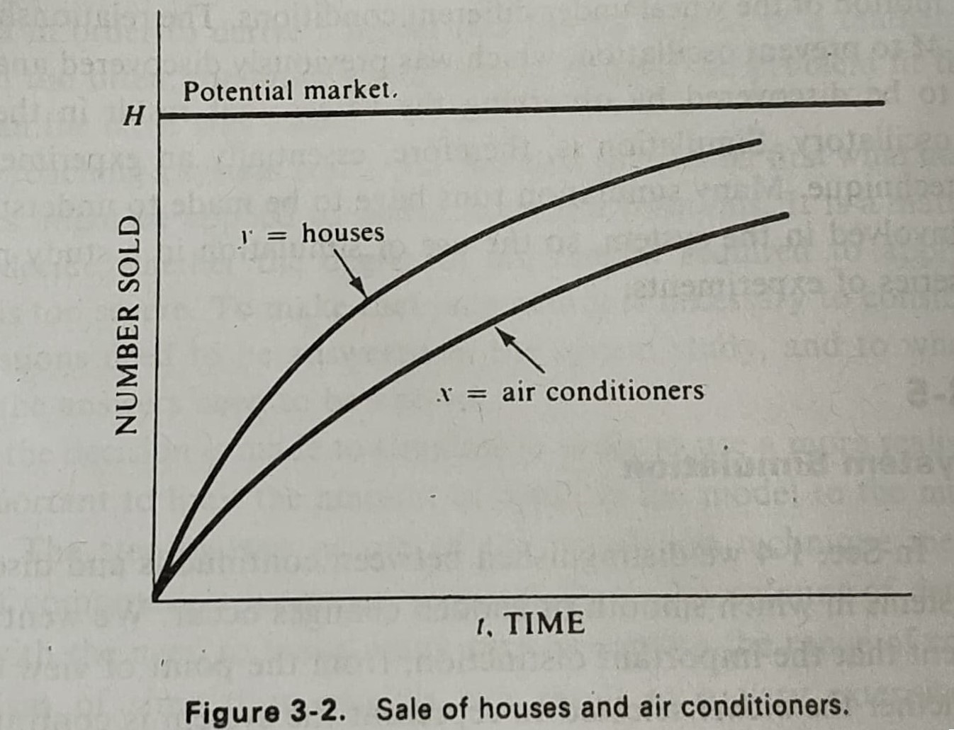
EXAMPLE: HOUSE AND AIR CONDITIONER SALES
Potential Market (H): Represents the total number of potential households.
Number of Houses Sold (y): The number of houses sold at a given time.
Rate of House Sales: The rate at which houses are sold decreases as the number of unsold houses diminishes. This is represented by the equation:
dy/dt = k1 * (H - y)

Slide 14
EXAMPLE: HOUSE AND AIR CONDITIONER SALES
Potential Market (H): Represents the total number of potential households.
Number of Houses Sold (x): The number of houses installed air conditioners
Rate of House Sales: The rate at which houses with air conditioners decreases as the number of houses sold.
This is represented by the equation:
dx/dt = k2 * (y - x)

Slide 15
The two equations constitute a model of the growth of air conditioner sales. Because of its simplicity, it is possible to solve the model analytically.
However, it quickly becomes insoluble if it is more representative of an actual marketing condition.
The market limit may not be stable, It could grow with population growth or fluctuate with economic conditions.
The coefficients that determine the rates of growth could be influenced by the amount of money spent on advertising, and there could be competitive influences, such as mobile homes or apartment housing. These influences could also depend upon the population growth or the economic conditions

Slide 16
The simulation technique is to compute the output, step by step. Suppose that the computation is made at uniform intervals of time and that the calculation has already progressed to the time ti
Assuming the rates of change are constant over the time interval Δt, we can approximate the changes in y and x.

Slide 17
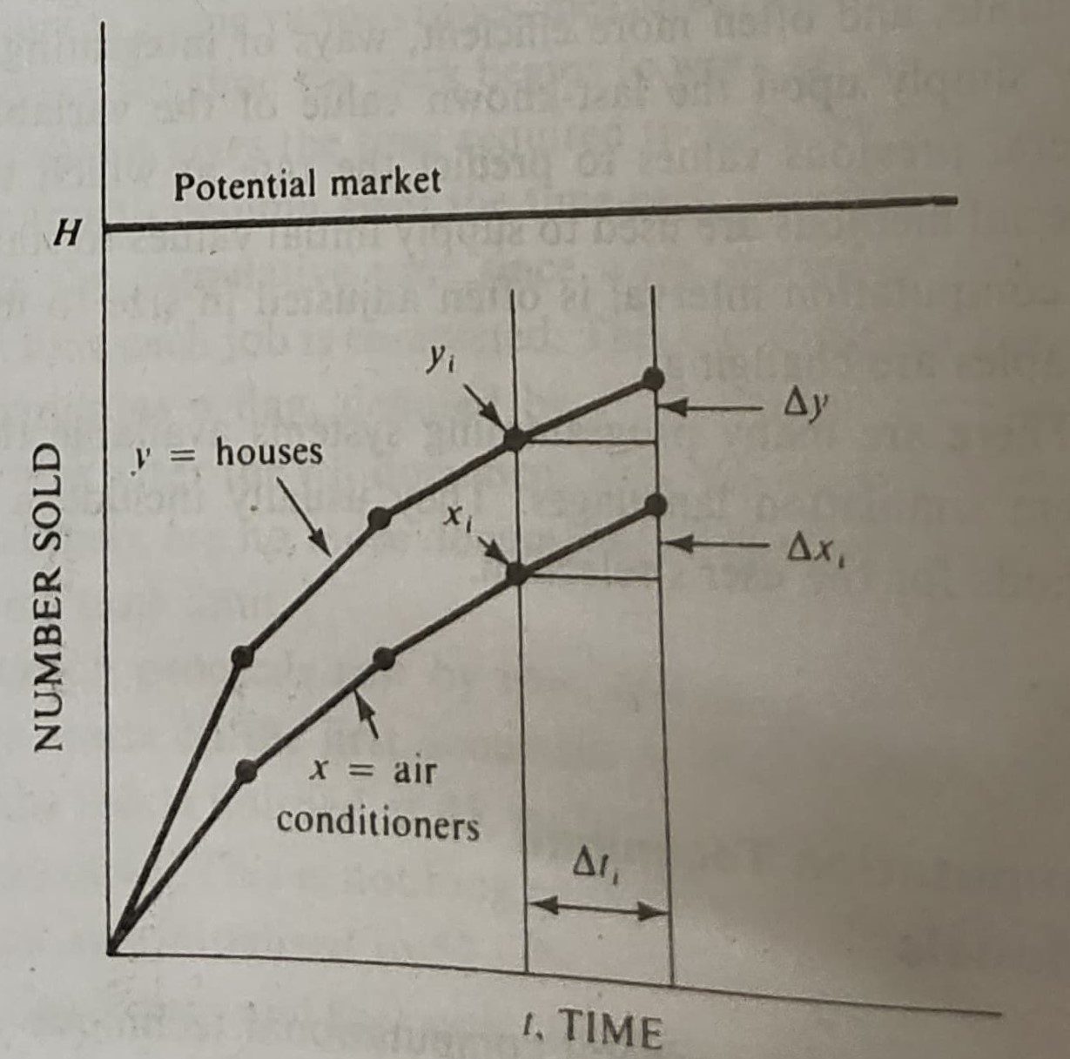
The changes in y and x are :
Δyt = (dy/dt) * Δt
Δxt = (dx/dt) * Δt
The updated values of y and x at the end of
the time interval (t+Δt) can be calculated as:
Δyt = k1 * (H - yt) * Δt
Δxt = k2 * (yt - xt) * Δt

Slide 18
Repetition of the calculation using the new values of y and x produces the output at the end of the next interval. As illustrated in Fig. 3-3, the calculation is equivalent to calculating the slope at each point and projecting a short straight line at that slope.
The method described is a very simple way of integrating differential equations numerically, but it is not a very accurate method unless small steps are used.
There are many programming systems available that incorporate continuous system simulation languages. They usually include several computational methods for the user's selection.

Slide 19
NUMERICAL COMPUTATION TECHNIQUE FOR DISCRETE MODELS
A discrete model is a mathematical model that describes a system whose state changes in discrete steps or at specific points in time. In such models, time is divided into discrete intervals
Unlike continuous models, where variables change smoothly over time, discrete models involve variables that change in discrete steps or at specific points in time.

Slide 20
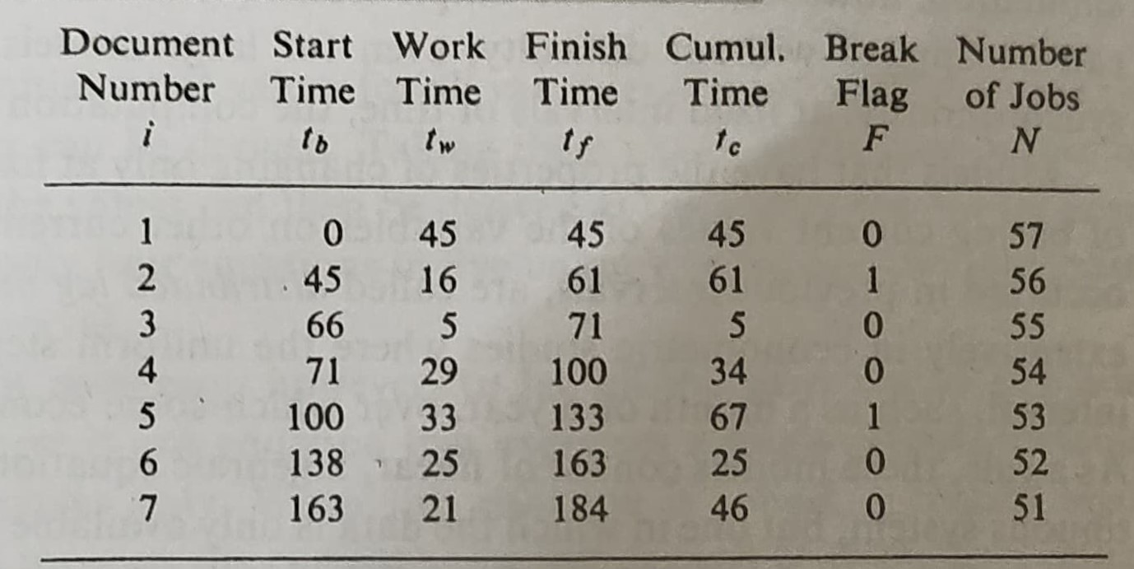
EXAMPLE: PROCESSING DOCUMENTS
Document Number: This column simply numbers the documents in the order they are processed.
Start Time: This column indicates the time at which the clerk starts working on a particular document.
Work Time: This column shows the time required to process the document.
Finish Time: This column gives the time at which the processing of the document is completed.
Cumulative Time: This column tracks the cumulative time since the start of work or the last break.
Break Flag: This column indicates whether the clerk should take a break after finishing the current document. A value of 1 signifies a break, while 0 indicates no break.
Number of Jobs: This column keeps track of the remaining number of documents to be processed.

Slide 21
SIMULATION
Initialization: The simulation starts with the first document, and the start time is set to 0.
Processing: The work time for the first document is 45 minutes. The finish time is calculated as the start time plus the work time, which is 45 minutes.
Break Check: The cumulative time is 45 minutes, which is not enough for a break, so the break flag is set to 0.
Decrement Jobs: The number of remaining jobs is decremented to 56.
Next Document: The second document is started at 45 minutes, which is the finish time of the previous document.
Repeat: The process continues, with the start time of each document being the finish time of the previous one. The break flag is set to 1 when the cumulative time exceeds the threshold for a break.

Slide 22
KEY FEATURES
Feature | Continuous Models | Discrete Models
Time | Continuous | Discrete
Change | Smooth | Stepwise
Numerical Methods | Differential equation solvers | Discrete event simulation
Examples | Population growth, heat transfer | Manufacturing systems, queuing systems

Slide 23
DISTRIBUTED LAG MODELS
The previous computation for the model was straight forward, but it can be imagined that the record keeping quickly becomes burden as the model becomes larger or more complex.
If the events in the system occur synchronously, at a fixed intervals of time, the computation remains simple.
But if the models have the properties of changing only at fixed intervals of time and a basing current values of the variables on other current values and values that occurred in previous intervals are called DISTRIBUTED LAG MODELS.
They represent a continuous system but one in which the data is only available at fixed points in time.

Slide 24
These are models that use past values of variables (lags) to predict the current value. They operate on the principle that the effects of a change in a variable (e.g., an economic policy) are distributed over time.
They are helpful for analyzing systems were data changes only at fixed time intervals, such as monthly or yearly.

Slide 25
EXAMPLE
Let us consider an example of a simple mathematical model of the national economy
Let , C – CONSUMPTION
I – INVESTMENT
T – TAXES
G – GOVERNMENT EXPENDITURE
Y – NATIONAL INCOME
C=20+0.7(Y−T) - Consumption depends on income after taxes.
I=2+0.1Y - Investment depends on national income.
T=0.2Y - Taxes are 20% of income.
Y=C+I+G - National income is the sum of consumption, investment, and government expenditure.

Slide 26
All quantities are in billions of dollars.
The model is static because it considers variables only at one fixed interval (e.g., yearly)
This is a static model, but it can be made dynamic by picking fixed time interval say one year and expressing the current value of the variables in terms of values at previous intervals
The static model is transformed into a dynamic model by introducing lagged variables. Lagged variables are denoted with a subscript indicating the time interval (e.g., Y−1) Y−1​ : for the previous year’s national income.

Slide 27
I=2+0.1Y−1​ : Investment depends on the previous year’s income.
T=0.2Y :Taxes are proportional to the current income.
Y=C−1+I−1+G−1 ​ :Current national income is derived from previous values
C=20+0.7(Y−1−T−1) : Consumption depends on the previous year’s disposable income
The final simplified equation :
I=2+0.1Y−1​
T=0.2Y
Y=45.45+2.27(I+G)
C=20+0.7(Y−T)

Slide 28
The dynamic process involves computing the current values of all variables using their lagged values (from previous intervals).
The calculated value of Y (national income) for the current interval is then used as the lagged variable Y−1​ in the next interval.
This process can be repeated iteratively to simulate the system over multiple time periods.

Slide 29
Although distributed lag models are conceptually simple, and they can be computed by hand, computers are extensively used to run them.
However, the value of the computer is its more conventional data – processing capability. Unlike other types of model used for simulation purposes there is not need for a special programming language to organize the simulation task.
Widely used in econometric modeling to study national economies, particularly in industrialized countries.
Businesses and industries often use these models to understand the effects of economic factors (e.g., tax policy, government expenditure) on their operations.

Slide 30
PROBLEM
Find the growth in national consumption for five years using the model that was discussed before. Assume the initial income Y-1 is 80 and take the government expenditure in the 5 years to be as follows : 1st Year : G = 20
2nd Year : G = 25
3rd Year : G = 30
4th Year : G = 35
5th Year : G = 40
MODEL EQUATION FORMULA:
I=2+0.1Y−1​
T=0.2Y
Y=45.45+2.27(I+G)
C=20+0.7(Y−T)

Slide 31
SOLUTION
Year | Government Expenditure (G) | Investment (I) | National Income (Y) | Taxes (T) | Consumption (C)
1 | 20 | 10 | 113.55 | 22.71 | 83.59
2 | 25 | 13.36 | 132.52 | 26.5 | 94.21
3 | 30 | 15.25 | 148.17 | 29.63 | 102.98
4 | 35 | 16.82 | 163.07 | 32.61 | 111.32
5 | 40 | 18.31 | 177.81 | 35.56 | 119.57

Slide 32
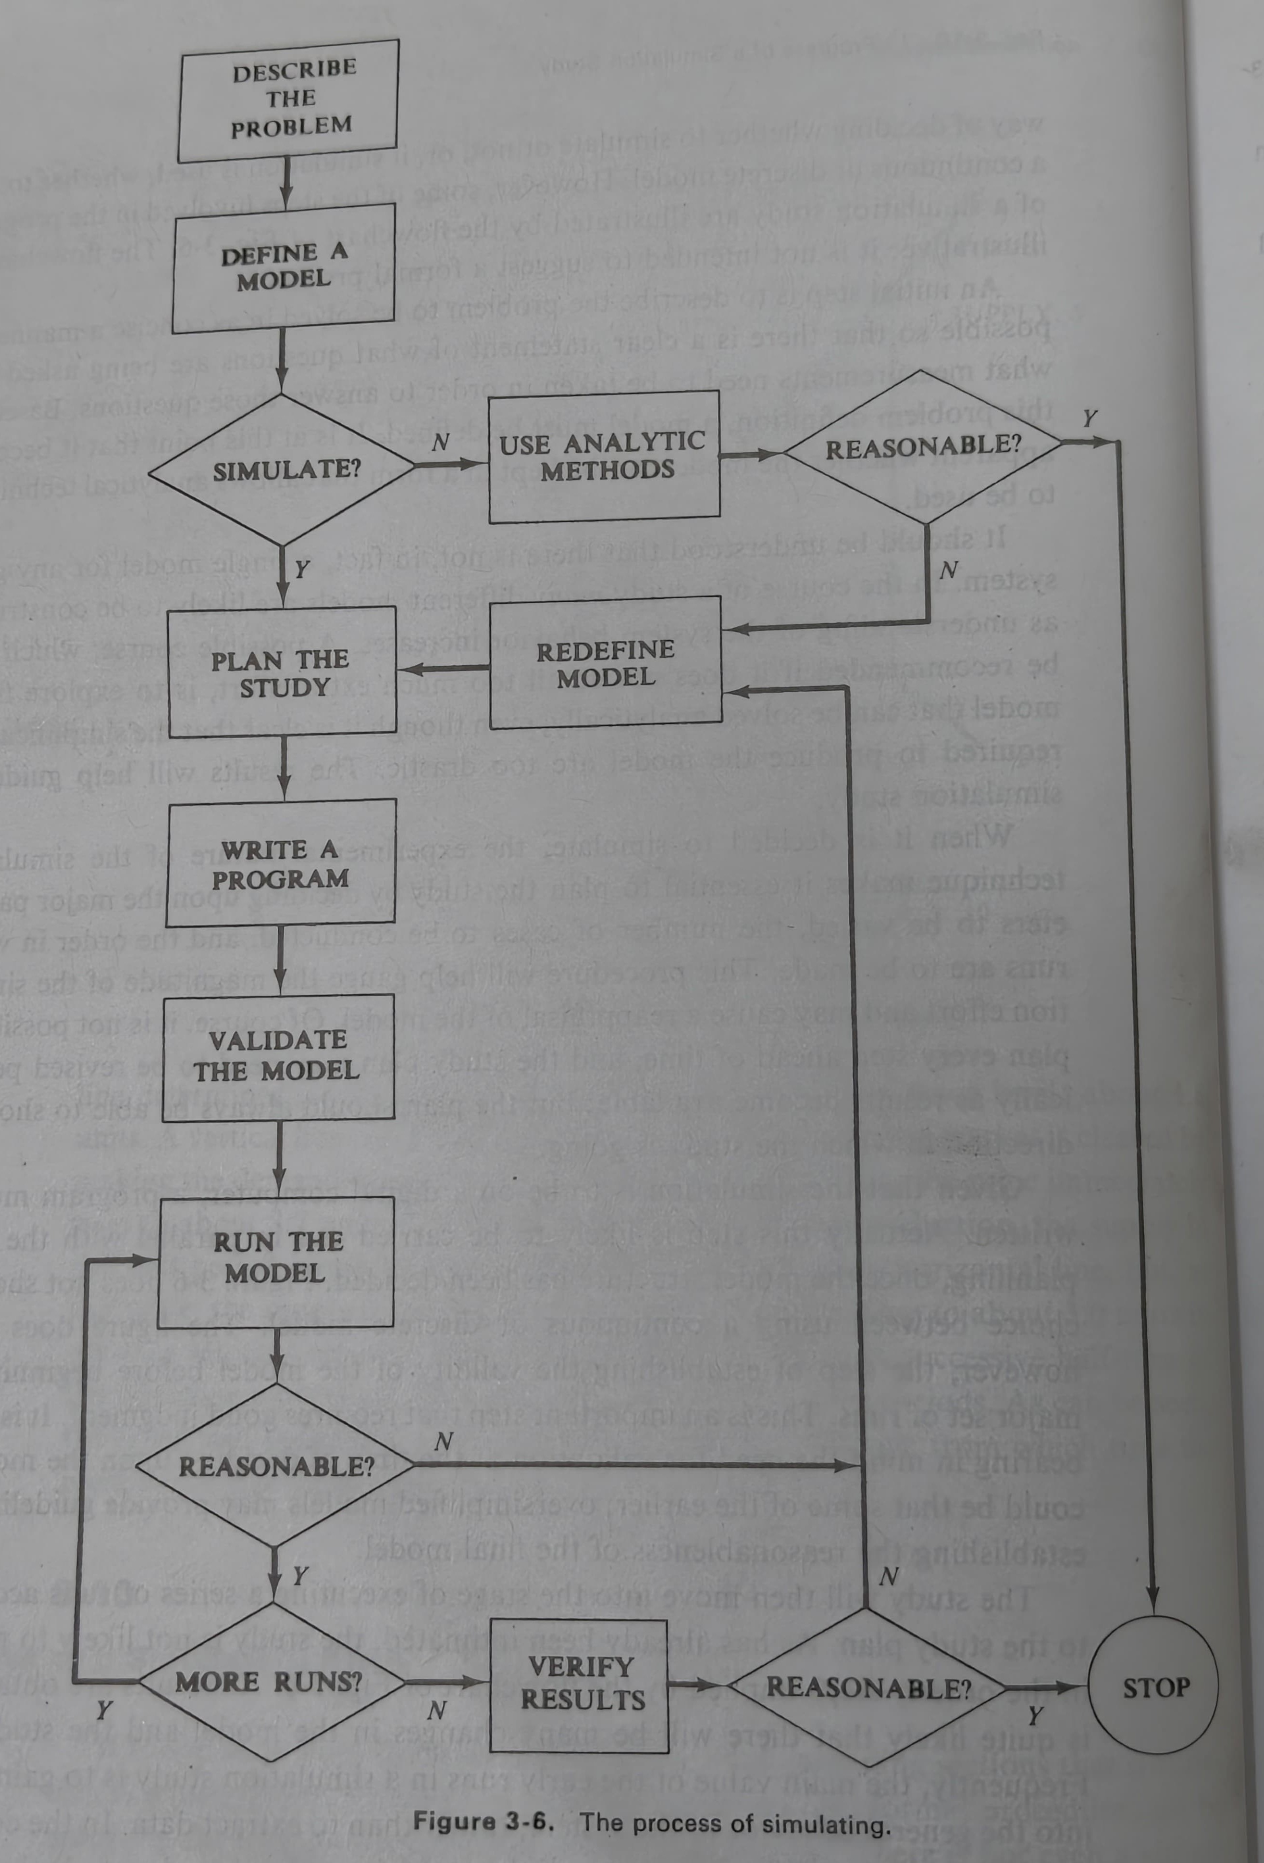
PROGRESS OF A SIMULATION STUDY

Slide 33
1. Describe the Problem :
Clearly define the problem to be solved.
Identify the questions to be answered.
Determine the metrics to be measured.
2. Define a Model :
Develop a mathematical or computational representation of the system.
Consider the level of detail required and the inclusion of relevant random variables.
Make simplifying assumptions to create a manageable model.
Validate the model to ensure its accuracy and reliability.
3. Simulate:
Decide whether an analytical or simulation approach is appropriate.
Consider the complexity of the problem and the availability of analytical solutions.

Slide 34
4. Use Analytic Methods:
Apply mathematical techniques to solve the problem directly.
Consider the limitations of analytical methods and the potential for inaccuracies.
5. Reasonable:
Evaluate the reasonableness and accuracy of the analytical solution.
If it is reasonable then stop the process, if not then redefine the model
6. Simulate:
Implement the simulation model in a programming language.
Generate random numbers and run multiple simulations to obtain statistically significant results.

Slide 35
7. Plan the Study:
Design the simulation experiment, including the number of runs, the experimental design, and the statistical analysis plan.
Set the initial conditions and parameter values for the simulation.
Determine the appropriate statistical techniques to analyze the simulation results.
8. Write a Program :
Develop the simulation code, including the model equations, random number generation, and statistical analysis functions.
Choose a suitable programming language and simulation software.
Test and debug the code to ensure its correctness.
9. Validate the Model:
Compare simulation results to real-world data or known analytical solutions.
Adjust the model as needed to improve its accuracy and reliability.
Assess the sensitivity of the results to changes in model parameters.

Slide 36
10. Run the Model :
Execute the simulation program to generate the results.
Monitor the progress of the simulation and check for errors.
Analyze the simulation output to identify trends and patterns.
11. Reasonable:
Evaluate the reasonableness and consistency of the simulation results.
If the model is Reasonable simulate more runs, if not then redefine the model again
12. More Runs:
Decide whether additional simulation runs are needed to improve the precision of the results or to explore different scenarios.
Consider the computational cost and the trade-off between accuracy and efficiency.

Slide 37
13. Verify Results :
Conduct statistical analysis of the simulation results, such as hypothesis testing and confidence interval estimation.
Compare the results to theoretical predictions and empirical data.
Assess the overall quality and reliability of the simulation study.
14. Reasonable:
Evaluate the overall usefulness of the simulation study in addressing the original problem.
If the result is Reasonable then stop the simulation, if not redefine the model again
15. Stop :
Conclude the simulation study and document the findings.

Slide 38
COMPONENTS OF A SIMULATION STUDY
1. Statement of the Decision Problem and Objectives
Define the problem and the goals for the simulation. This ensures the model will be focused on relevant decisions and avoids unnecessary complexity.
2. System Analysis
Analyze and document the existing system carefully. This step helps in identifying the important components and relationships that need to be modeled.
3. Analysis of Input Distributions and Parameters
Determine the data and parameters required for the simulation. Input parameters should reflect the actual system's characteristics accurately.
4. Model Building
Create a conceptual model that represents the system. This involves identifying the logic, structure, and assumptions that will govern the simulation.

Slide 39
5. Design and Coding of the Simulation Program
Translate the conceptual model into a computational simulation program. This step involves programming and ensuring the model operates as intended.
6. Verification of the Simulation Program
Test the program to ensure it runs correctly without logical or coding errors. This step confirms that the model behaves as designed.
7. Analysis of Output Data to Estimate Parameters
Analyze the data generated by the simulation to estimate performance parameters. This includes applying statistical techniques to validate results.
8. Validation of the Model
Check if the model accurately represents the real-world system. Data from the actual system is compared to the simulation outputs to confirm validity.

Slide 40
9. Experimental Design
Plan and determine the set of experiments (scenarios) to evaluate. Decisions are made about what alternative systems or conditions to simulate.
10. Simulation Production Runs
Conduct the experiments using the simulation. Sometimes, initial "pilot runs" are used to determine the appropriate run length for reliable results.
11. Statistical Analysis and Interpretation of Data
Perform a statistical analysis of the simulation results to measure accuracy. Use these findings to evaluate performance or recommend alternatives.
12. Recommendations for Decisions and Implementation of the Model
Based on the analysis, provide recommendations for decision-making. This step may include installing the model on computers for repeated use.
13. Final Documentation of the Model and Simulation Program
Document the entire model and simulation program.

Slide 41
SUMMARY
Most decision-makers rely on some form of model to assess various alternatives.
Operations Research (OR) and Management Science (MS) employ explicit mathematical models to analyze the effects of different decisions.
A system is a collection of interconnected components working together towards a shared goal.
Real-world systems are often complex, necessitating the creation of a model—a simplified representation—for analysis.

Slide 42
There are two ways to determine the relationship between input parameters and operating policies and output parameters :
(1) Mathematical Analysis: This technique calculates exact or approximate values for output parameters.
(2) Simulation: This technique generates statistical estimates of output parameters through sampling experiments
Types of Simulations:
(1) Gaming Simulations: Involve the interaction of one or more individuals.
(2) Static Simulations: Produce output parameters without advancing time.
(3) Dynamic Simulations: on a digital computer.

Slide 43
Dynamic system simulation can further be classified into Continuous and discrete event simulation
A simulation study consists of the following steps:
stating the decision problem and its objectives
analyzing the system, analyzing data on input parameters and distributions
building the model
writing the simulation program
verifying the simulation program
analyzing output data
validating the model
making production runs
analyzing and interpreting data from production runs
making recommendations and implementing the model
documenting the model and simulation.

Slide 44
THANK YOU !!

