Slide 1

NAAN MUDHALVAN DATASCIENCE FUDAMANETAL PROJECT
PROJECT TITLED:
Heart disease data compiled from uci
PRESENTED BY:
HARISH .S
SACS M.A.V.M.M. ENGINEERING COLLEGE
III YR EEE DEPT

Slide 2

Project statement:
The UCI Machine Learning Repository hosts several datasets related to heart disease.
These datasets typically contain various features such as age, sex, cholesterol levels, and more, which are used to predict the presence or absence of heart disease. Would you like more specific information about a particular dataset, or are you interested

Slide 3
Project solution:
It sounds like you're looking for a solution or analysis based on the heart disease data from the UCI Machine Learning Repository. Could you please clarify what specific type of solution or analysis you're seeking? Are you interested in predictive modeling, statistical analysis, data visualization, or something else? Let me know, and I'll do my best to assist you further.

Slide 4
System approach
Building the proposed solution would involve a combination of data processing, pyth0n programming and visualization skills.
System requirements:
Hardware :
A computer with sufficient processing power, preferably with multiple cores or a GPU for faster training of machine learning models.
Adequate RAM to handle the size of the dataset and computational requirements.
Software:
- An operating system compatible with the required python libraries (e.g., windows,linux,macOS).

Slide 5
System approach – CONT.
Library Requirements:
Data processing and analysis:
Pandas : For data manipulation and analysis.
Numpy : For numerical operations on data.
Data visualization:
Matplotlib and seaborn: For creating visualizations to understand data patterns.
Plotly or Bokeh: Interactive visualization libraries for more complex visualizations.

Slide 6
ALGORITHM & DEPLOYMENT
Algorithm selection
Data exploration :
Explore the movie rating structure, features and variables.
Identify potential patterns, correlations and outliners.
Problem formulation:
Define the problem: Predict optimal booking times, likelihood of special requests based on historical data.
Algorithm selection:
Regression tasks(e.g., predicting daily rates)
Consider linear regression, decision tree, or ensemble methods
classification tasks(e.g., predicting special requests);
Consider logistic regressive, decision trees or random forests.

Slide 7
ALGORITHM & DEPLOYMENT
Data input:
Data collection:
Gather historical data including booking dates ,special requests,and relevant details.
Data cleaning:
Handle missing values, outliners, and any inconsistencies in the dataset.
Convert categorical variables into numerical representation through encoding techniques.
Feature Engineering:
Create new features or modify existing ones based on domain knowledge.
Extract meaningful information from date variables, such as day-of-week or month.

Slide 8
ALGORITHM & DEPLOYMENT
Training process:
Data splitting:
Divide the dataset into training and testing sets to evaluate the model’s performance.
Feature scaling:
Standardize or normalize numerical features to ensure they have consistent scale.
Modeling training:
Use the selected algorithm to train the model on the all sites scores dataset.
Adjust hyperparameters to optimize model performance.
Model evaluation:
Evaluate the model on the dataset using appropriate metrics(e.g., Mean Squared Error for regression,accuracy,precision, recall for classification).
Fine-tune the model if necessary.

Slide 9

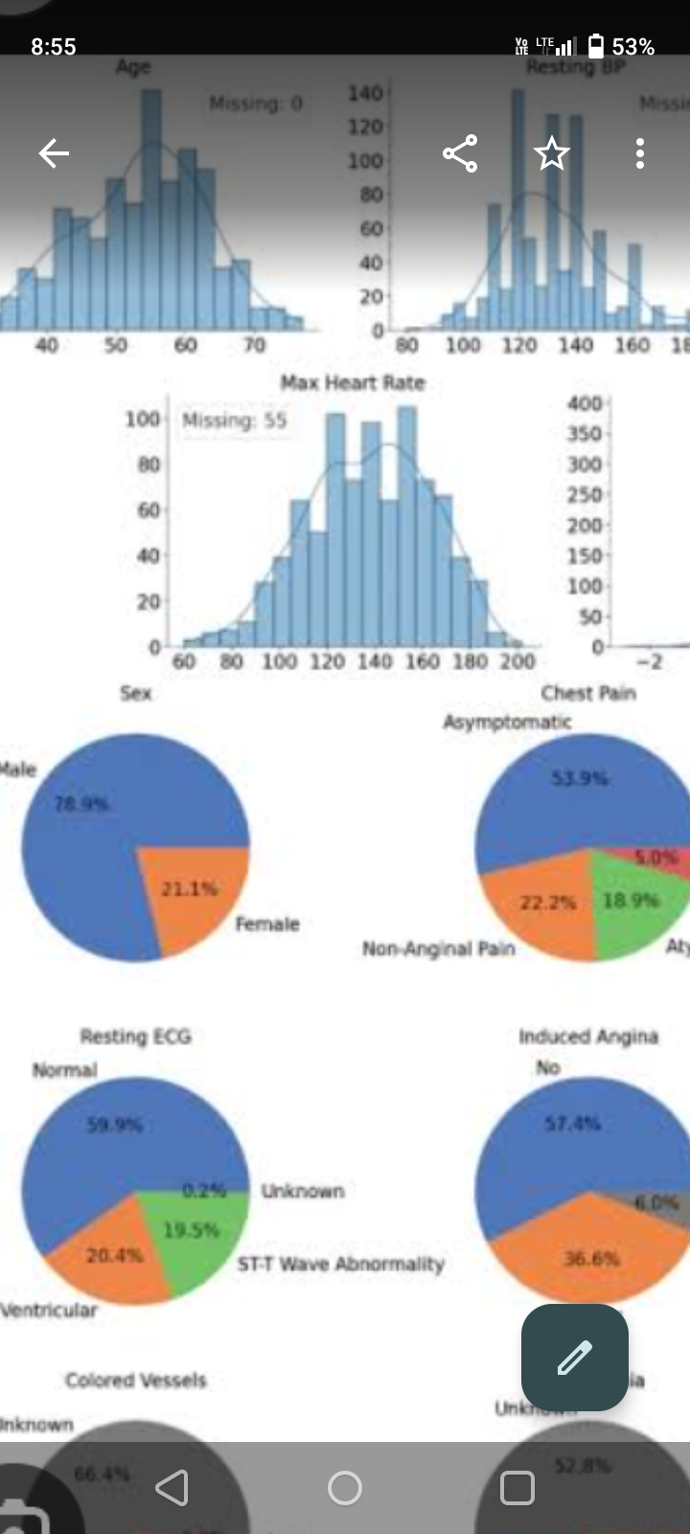
Result:

Slide 10
Conclusion:
The heart disease dataset from the UCI repository is often used for machine learning research. It includes various attributes such as age, sex, cholesterol levels, and more, to predict the presence of heart disease. The conclusions drawn from analyzing this data vary depending on the specific research goals and methods employed. Would you like a summary of some common findings

Slide 11
THANK YOU

