Slide 1
PARKSENSE
Intelligent Dual-Role Parking Operations & Management System
Comprehensive System Architecture, Objectives, Features & Functionalities Showcase
Production Release v1.0 • Flask Enterprise Application • Python 3.10+
ParkSense v1.0 Release | Enterprise Parking Operations Platform Slide 1 of 12

Slide 2
PARKSENSE SYSTEM PRESENTATION
Project Objectives & Vision
Background & Problem Statement
• Traditional Parking Friction: Lack of real-time slot visibility leads to congestion and wasted search time.
• Role Confusion: Mixed admin/user interfaces create security risks and poor operator ergonomics.
• Manual Billing Errors: Inconsistent hourly rounding, unverified employee discounts, and missing tax calculations.
• Lack of Utilization Insights: Facility managers lack 30-day bay analytics, peak hour data, and audit trail exports.
Core Solution Objectives
• Dual-Role Isolation: Explicitly separate Customer (Driver) workflow from Administrator operations.
• Smart Nearest-Bay Allocation: Automated matching of 2W, 3W, and 4W vehicles to the closest compatible free slot.
• Advance Reservations: Future time-window slot holding with simulated advance payment confirmations.
• Automated Policy Pricing: Hour-rounding billing with employee exemptions, loyalty discounts, and GST calculation.
• Data-Driven Analytics: Real-time capacity dashboard, utilization trends, and filterable CSV audit logs.
ParkSense v1.0 Release | Enterprise Parking Operations Platform Slide 2 of 12

Slide 3
PARKSENSE SYSTEM PRESENTATION
System Architecture & Technology Stack
Backend Core
Python 3.10+ & Flask App Factory
Modular structure using SQLAlchemy ORM, Flask-Login, Flask-Migrate, and environment configuration via python-dotenv.
Database Layer
SQLite / MySQL 8+ Dual Mode
Defaults to zero-config SQLite for dev; supports high-concurrency MySQL for shared production environments.
Frontend & UI
Jinja2 Templates & Bootstrap CSS
Server-rendered responsive UI with modular components, interactive vanilla JS (`spots.js`), and clean CSS themes.
API & Security
REST API with JWT Bearer Token
Role-based route authorization decorators, JWT token issuance for API clients, and password hashing via Werkzeug.
ParkSense v1.0 Release | Enterprise Parking Operations Platform Slide 3 of 12

Slide 4
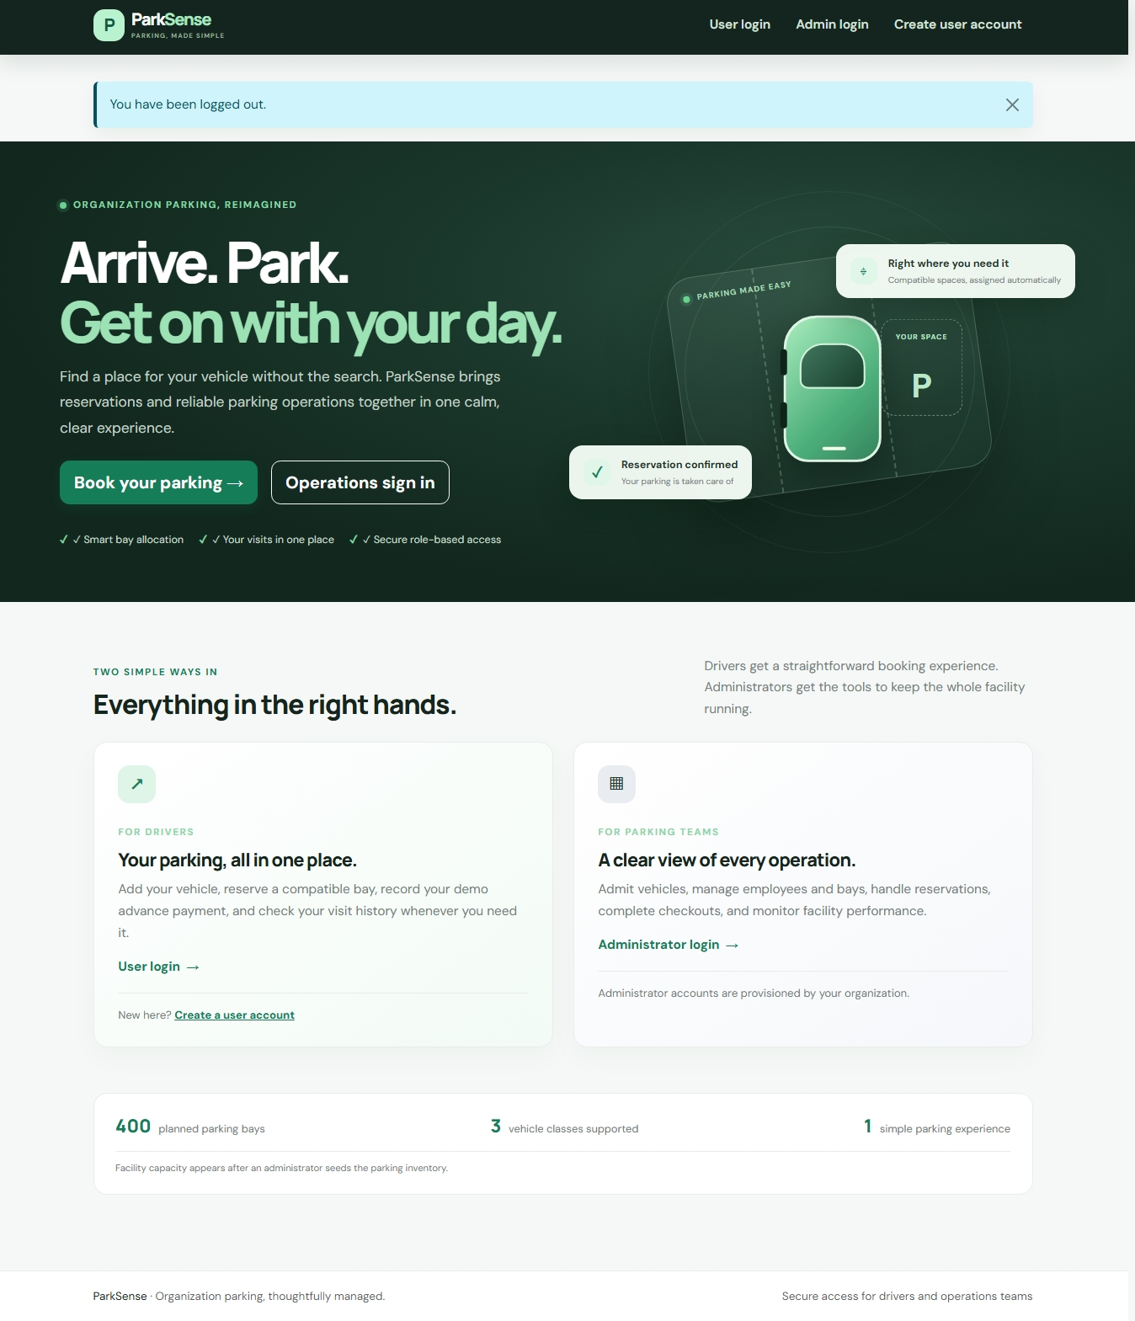
PARKSENSE SYSTEM PRESENTATION
Dual-Role Authentication & Access Control
Role Separation Architecture
👤 Customer (Driver) Portal (/auth/user-login):
Self-service registration, multi-vehicle registry, advance booking with demo payment, and personal visit history.
🔧 Administrator Portal (/auth/admin-login):
CLI-only provisioning (`flask create-admin`), manual vehicle check-in/out dispatch, inventory control, and employee policy setup.
🛡️ Security & Route Guards:
Decorators independently verify session roles and JWT scopes, blocking unauthorized access regardless of UI navigation links.
ParkSense v1.0 Release | Enterprise Parking Operations Platform Slide 4 of 12

Slide 5
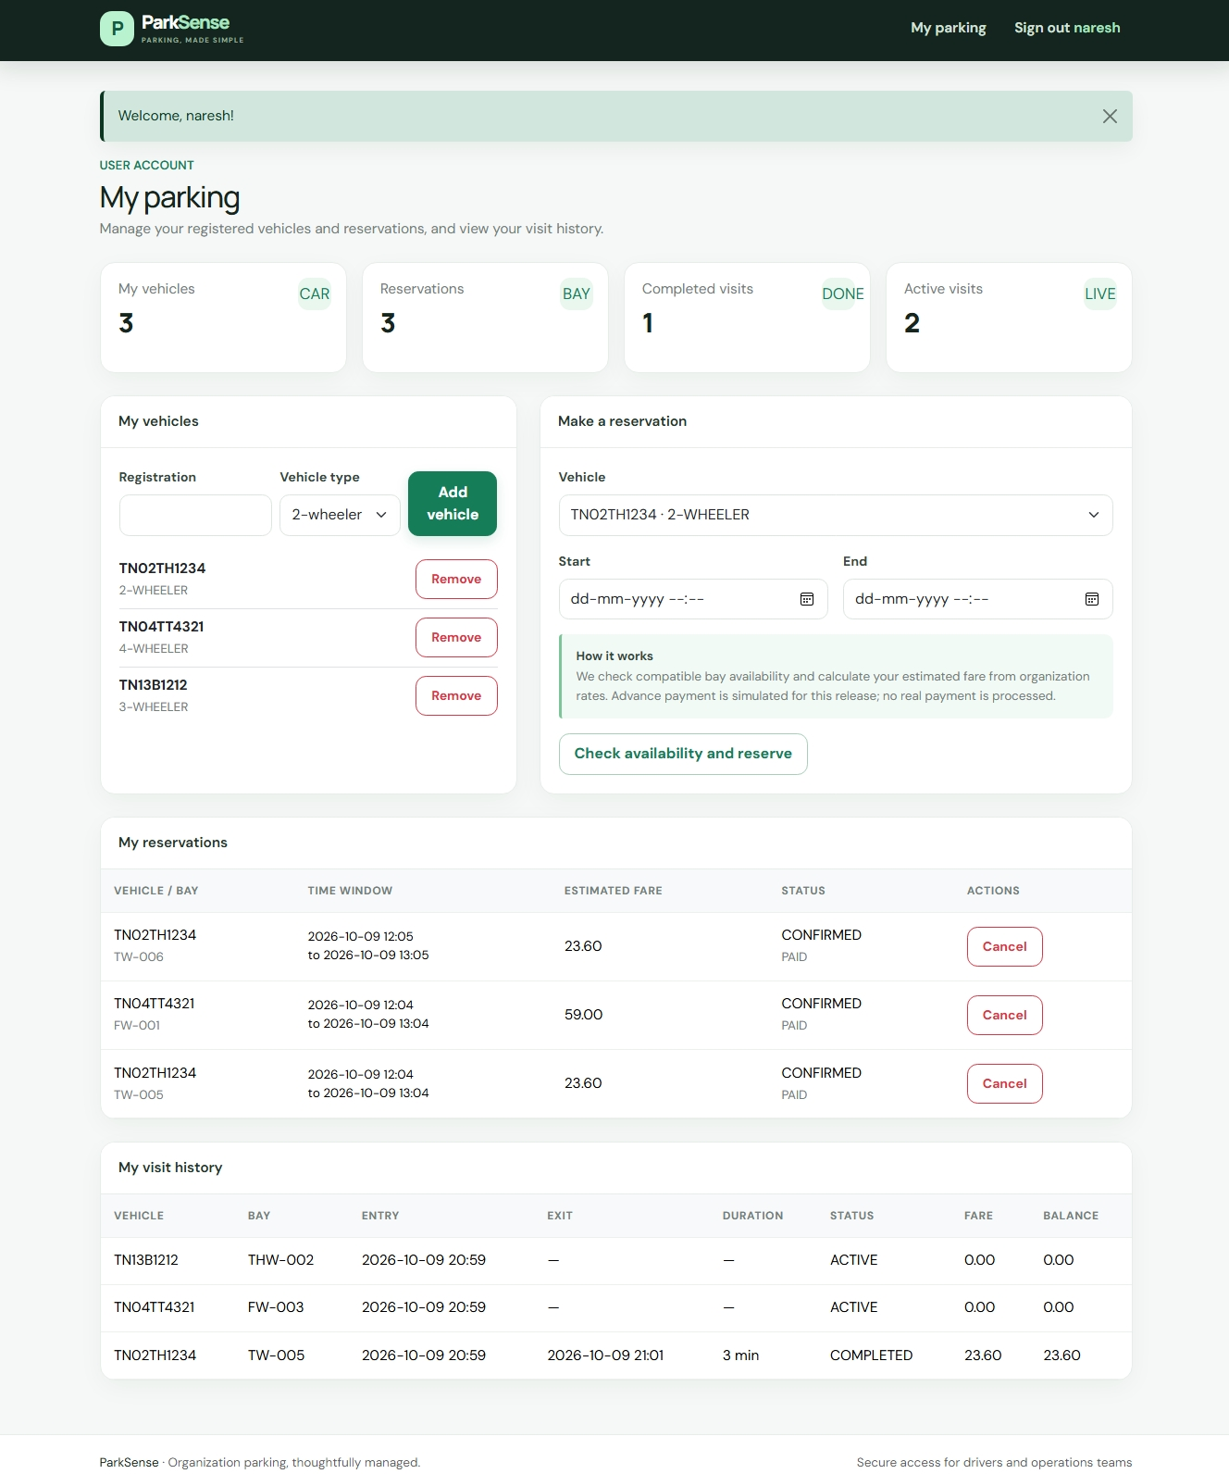
PARKSENSE SYSTEM PRESENTATION
Customer Portal: Fleet Registry & Reservations
Key Driver Functionalities
• Vehicle Fleet Registry: Register 2W, 3W, and 4W vehicles with license plate normalization.
• Advance Slot Holding: Pick future start/end time windows; system locks a compatible bay.
• Demo Advance Payment: Simulated one-click payment confirmation converts reservation status to CONFIRMED.
• Live Active Sessions: Real-time duration timer, assigned bay number, and entry timestamp tracking.
• Personal History: Complete past visit records with fare breakdowns and receipts.
ParkSense v1.0 Release | Enterprise Parking Operations Platform Slide 5 of 12

Slide 6
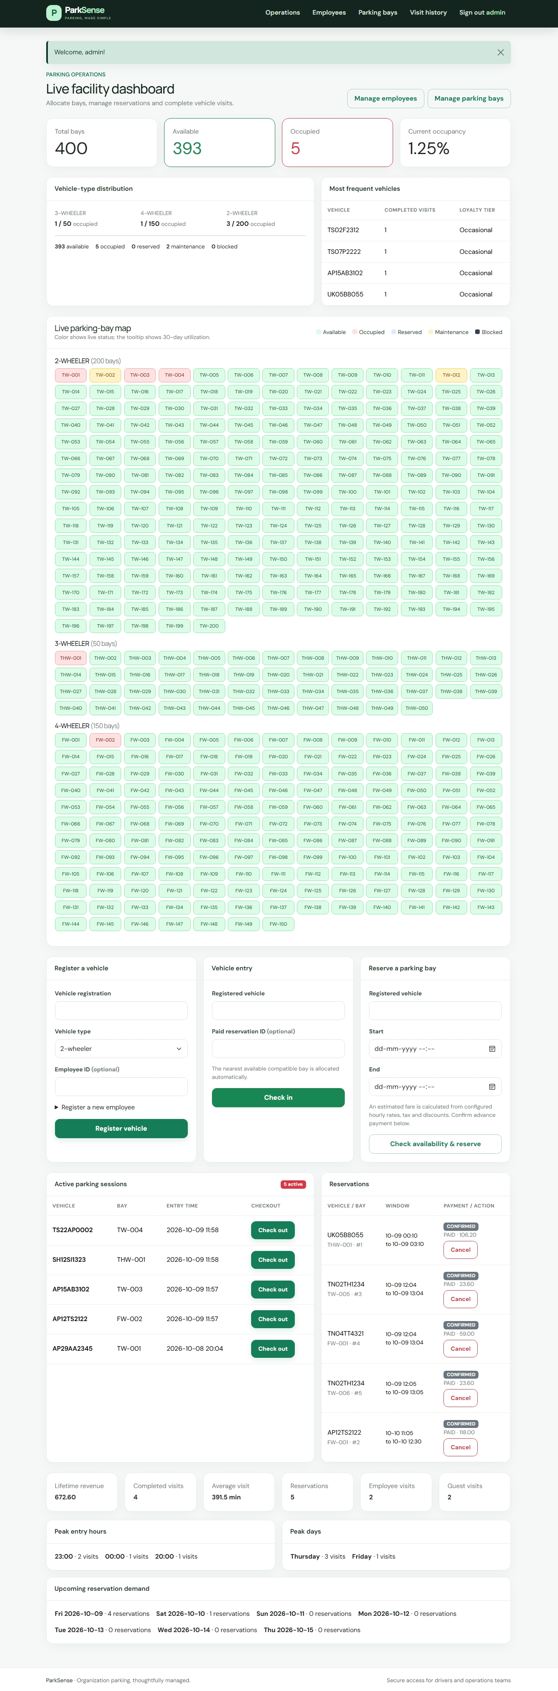
PARKSENSE SYSTEM PRESENTATION
Administrator Operations & Facility Control
Real-Time Facility Operations
• Live Metric Counters: Total Bays (400), Occupied, Available, Reserved, Maintenance, Revenue & Avg Visit Time.
• Rapid Check-In / Check-Out: Submit license plate for instant nearest-bay allocation or fare calculation exit.
• Interactive Live Bay Map: Color-coded visual matrix showing live status across all facility bays.
• Vehicle Distribution Charts: Visual breakdown of 2W, 3W, and 4W vehicle ratios.
• Peak Hour & Day Trends: Insights into busiest entry windows and frequent vehicle leaderboards.
ParkSense v1.0 Release | Enterprise Parking Operations Platform Slide 6 of 12

Slide 7
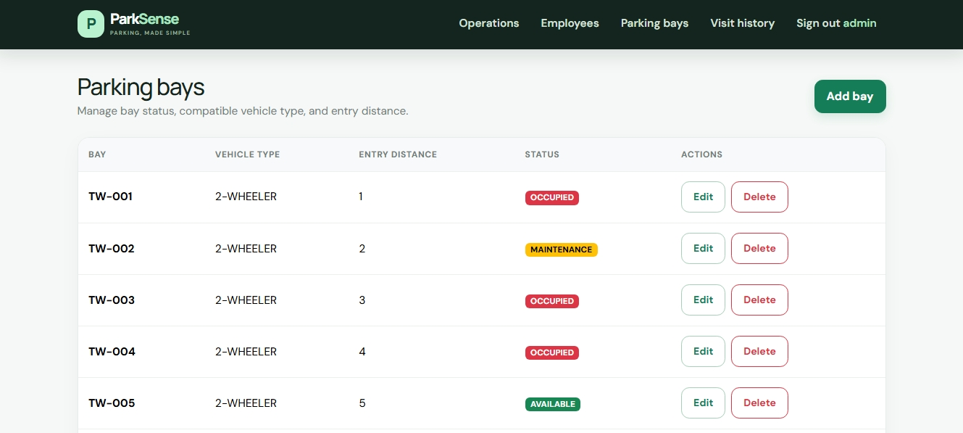
PARKSENSE SYSTEM PRESENTATION
Inventory Management & Nearest-Bay Allocation
Inventory Control Highlights
• 400 Seeded Bay Capacity: 200 2-Wheeler, 50 3-Wheeler, and 150 4-Wheeler bays created via CLI.
• Nearest-Bay Algorithm: Automatically assigns the closest available compatible bay based on distance (meters).
• Bay Status Management: Toggle individual bays between AVAILABLE, MAINTENANCE, and BLOCKED.
• Conflict Prevention: Bays under maintenance or reserved in active time windows are excluded from entry candidates.
ParkSense v1.0 Release | Enterprise Parking Operations Platform Slide 7 of 12

Slide 8
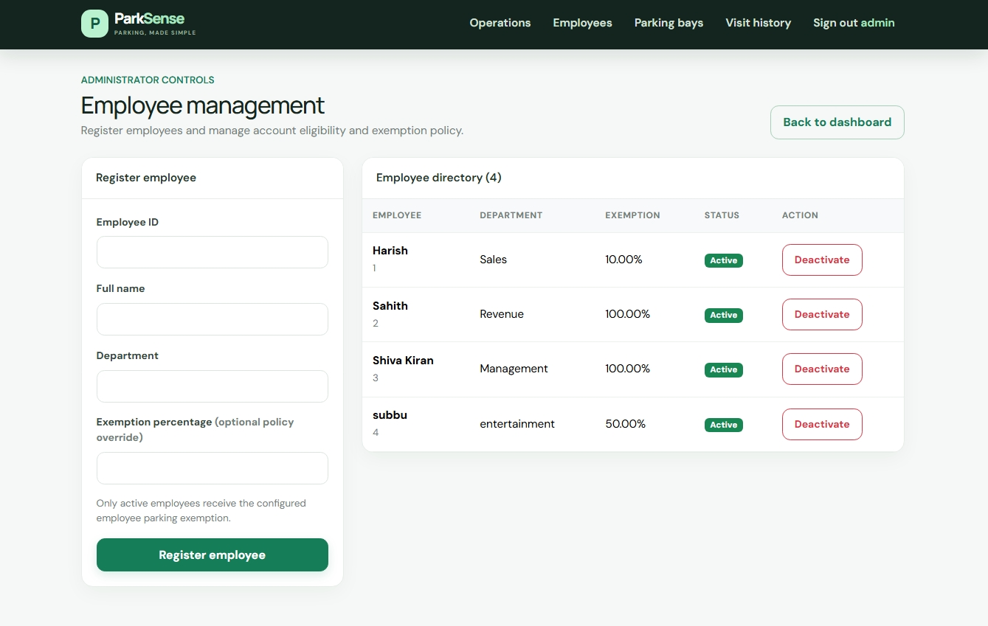
PARKSENSE SYSTEM PRESENTATION
Employee Directory & Exemption Policy
Corporate Perk Management
• Employee Directory: Register employees with verified Employee IDs and department tags.
• Configurable Exemption Rates: Set custom exemption percentages per employee (overriding global 100% default).
• Automated Verification: Vehicles linked to an active employee automatically receive designated discounts.
• Active Status Toggle: Deactivate former employee records instantly without losing historical parking logs.
ParkSense v1.0 Release | Enterprise Parking Operations Platform Slide 8 of 12

Slide 9
PARKSENSE SYSTEM PRESENTATION
Fare Calculation & Billing Policy Engine
Base Rates per Vehicle Type
2-Wheeler: 20 units/hr
3-Wheeler: 30 units/hr
4-Wheeler: 50 units/hr
Duration rounded up to next billable hour (1h min).
Employee Exemption
Global Default: 100% discount.
Per-Employee Rate: Custom % override.
Applied directly to Base Fare prior to loyalty tier.
Loyalty Discount Tiers
10+ Completed Visits: 5% Off
25+ Completed Visits: 10% Off
50+ Completed Visits: 15% Off
Applied to remaining post-employee fare.
Tax & Final Billing
Tax Rate: 18% GST default.
Calculated on post-discount subtotal.
All amounts stored to 2 decimal places in UTC.
ParkSense v1.0 Release | Enterprise Parking Operations Platform Slide 9 of 12

Slide 10
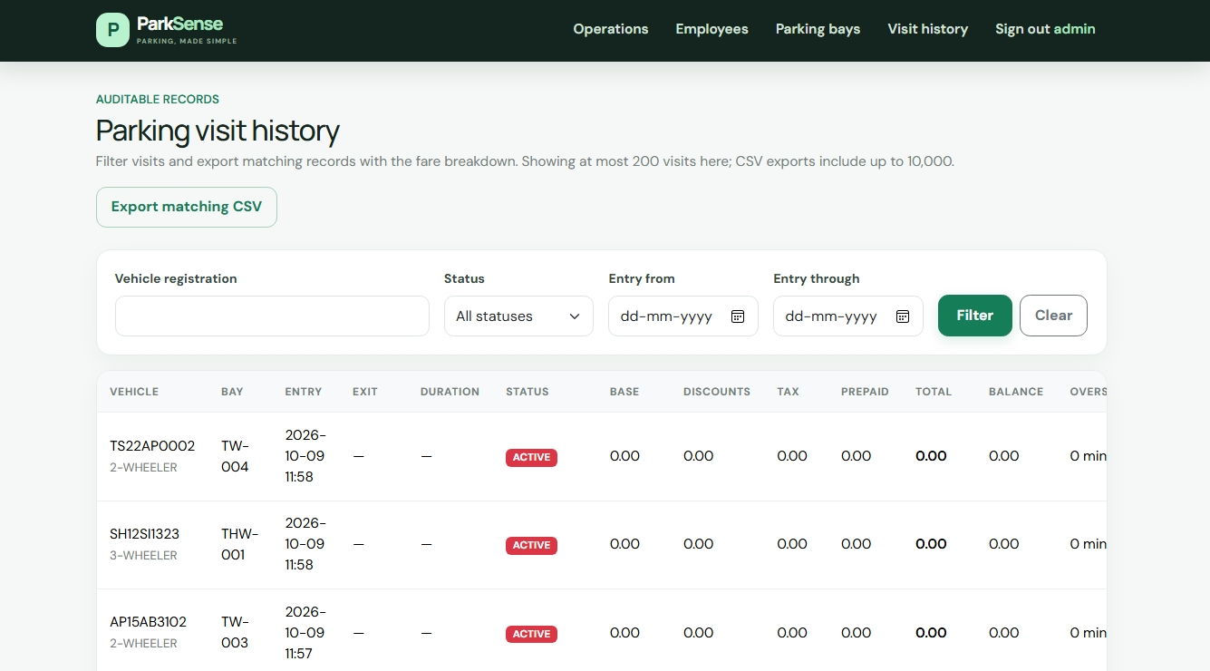
PARKSENSE SYSTEM PRESENTATION
Visit History & CSV Audit Reporting
Audit Ledger & Export Capabilities
• Comprehensive Audit Log: Itemized records of every vehicle entry, assigned bay, checkout time, and duration.
• Multi-Parametric Filtering: Filter completed/active sessions by license plate, status, and entry date range.
• Financial Breakdown: Shows base fare, employee discount, loyalty discount, tax, and final amount billed.
• Instant CSV Export: Export filtered search results directly into formatted CSV files for financial compliance.
ParkSense v1.0 Release | Enterprise Parking Operations Platform Slide 10 of 12

Slide 11
PARKSENSE SYSTEM PRESENTATION
RESTful API & System Administration CLI
JWT RESTful API Endpoints
POST /api/auth/token
Exchange credentials for JWT bearer token
POST /api/entry
Check-in vehicle & allocate nearest bay
POST /api/exit
Complete visit & calculate final fare
GET/POST /api/reservations
List or create slot reservations
GET/POST /api/spots
Query or update bay inventory
GET /api/analytics
Retrieve real-time facility metrics
CLI & Automated Testing
python -m flask create-admin
Interactively provisions an admin account with password hashing.
python -m flask seed-parking
Populates 400 bays (200 2W, 50 3W, 150 4W) safely.
python -m flask db upgrade
Applies schema migration scripts seamlessly.
pytest
Executes full automated test suite for roles, JWT, and booking flow.
ParkSense v1.0 Release | Enterprise Parking Operations Platform Slide 11 of 12

Slide 12
PARKSENSE SYSTEM PRESENTATION
Summary & Future Enhancement Roadmap
Key System Achievements
✔ Fully Operational Dual-Role Architecture: Complete separation of Driver and Admin portals.
✔ Zero-Docker Simplicity: Runs smoothly on standard Python virtual environment with SQLite/MySQL.
✔ Robust Allocation & Pricing: Automated nearest-bay engine and 3-step discount cascade.
✔ High Quality Codebase: Flask application factory, clean ORM models, Pytest verification.
Future Enhancement Roadmap
🚀 Payment Gateway Integration: Connect Stripe / Razorpay for real-time online checkout.
🚀 Automatic Number Plate Recognition (ANPR): Integrate camera feeds for zero-click entry/exit.
🚀 IoT Boom Barrier Hardware Integration: Relay controls for automated barrier gates.
🚀 Native Mobile Application: Flutter / React Native app for driver booking on iOS & Android.
ParkSense v1.0 Release | Enterprise Parking Operations Platform Slide 12 of 12

