Slide 1
LG Rag Agent

Slide 2
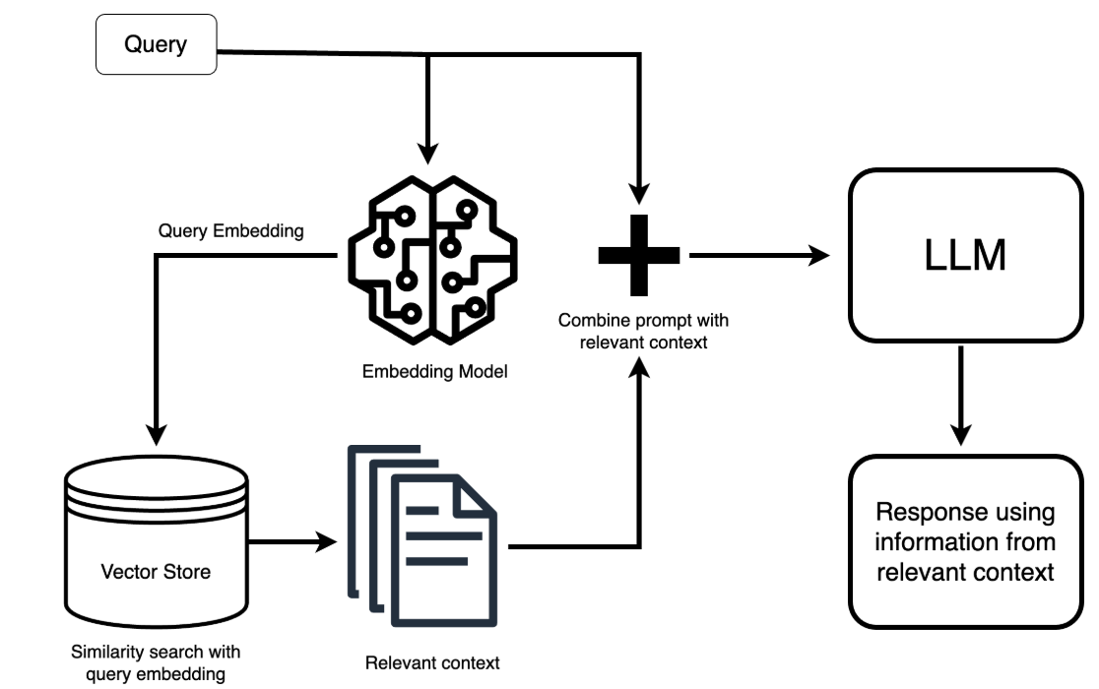
Architecture
gemini-2.5-flash-lite
gemini-embedding-001
Fast API
PGVec

Slide 3
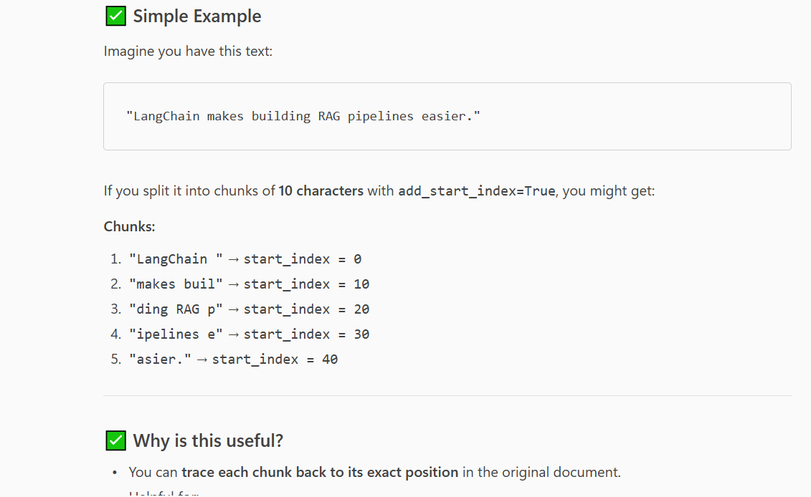
Load Document
We have 2 PDF docs

Slide 4
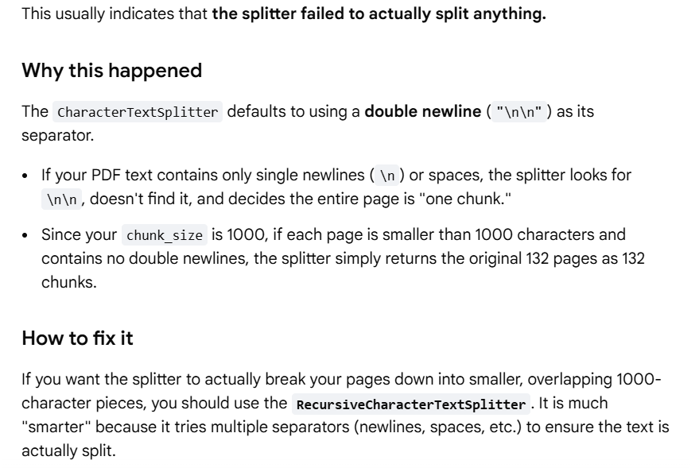

Slide 5
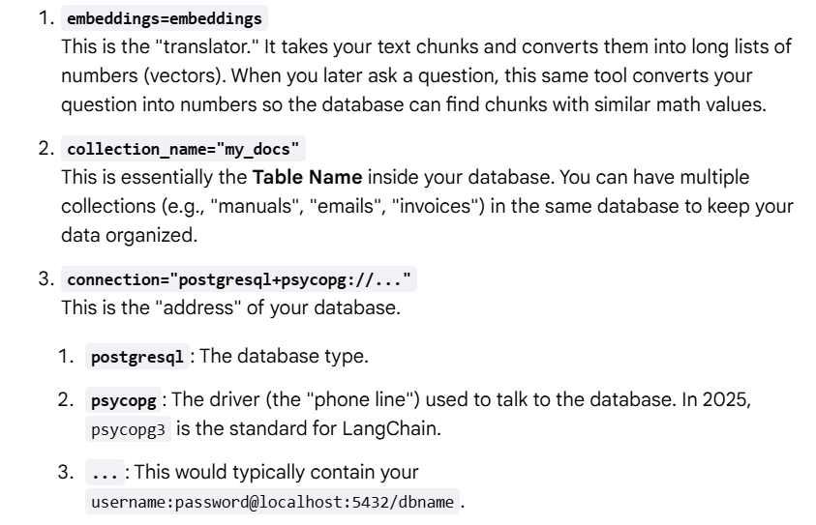
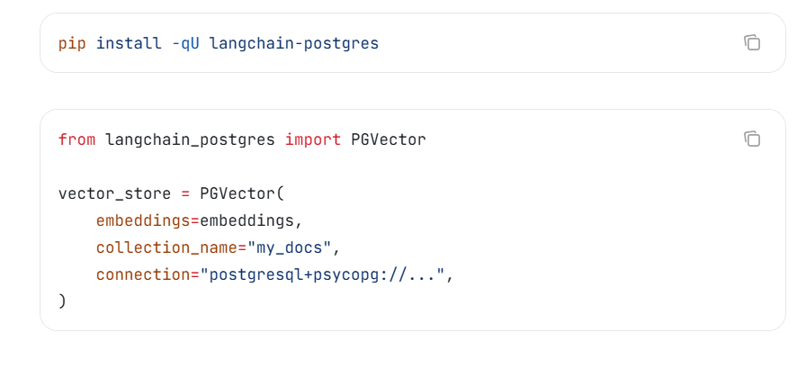
Creating vector store

Slide 6
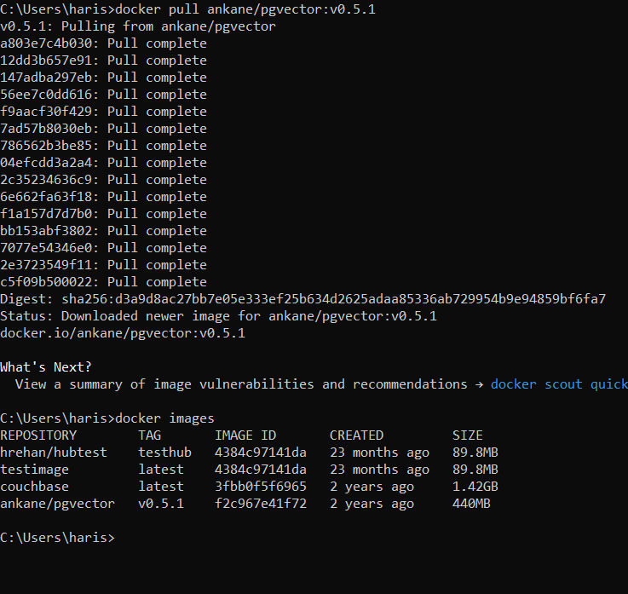
Install pgvec
https://www.postgresql.org/ftp/pgadmin/pgadmin4/v9.11/windows/

Slide 7
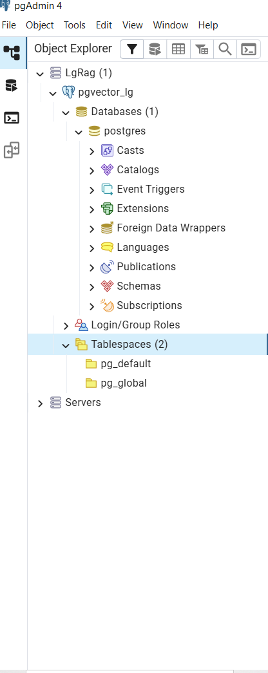
vector_store.similarity_search("climate change", filter={"source": "report.pdf"})

Slide 8
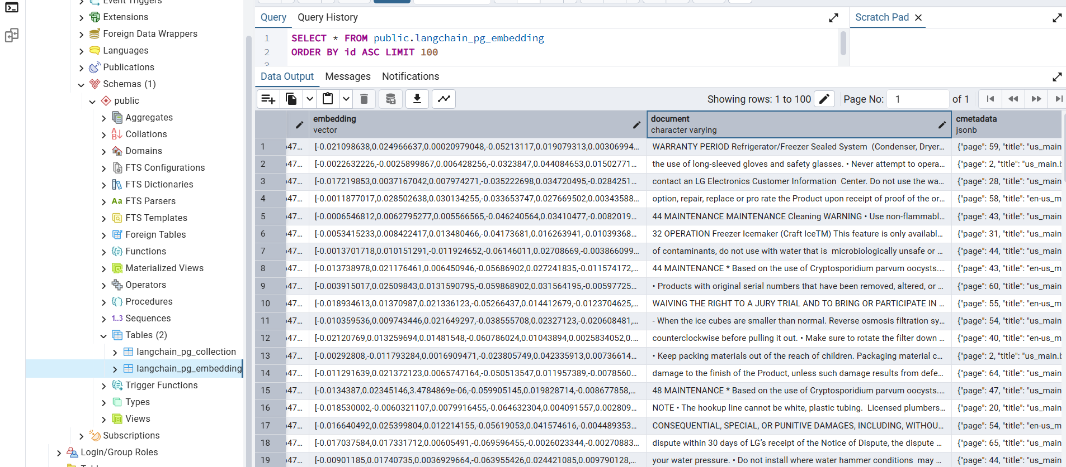
Vector store

Slide 9
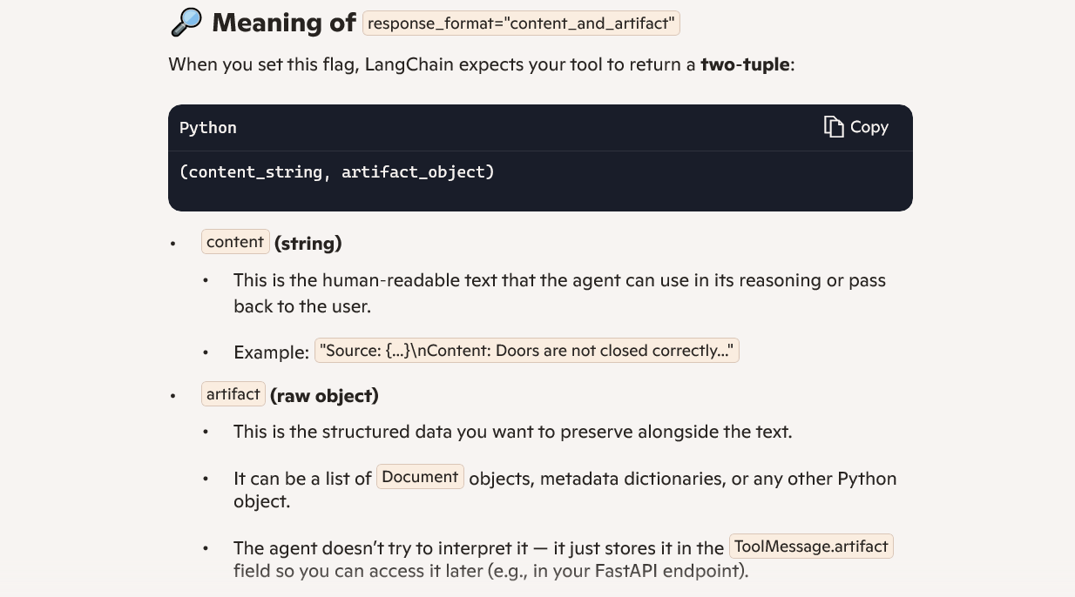

Slide 10
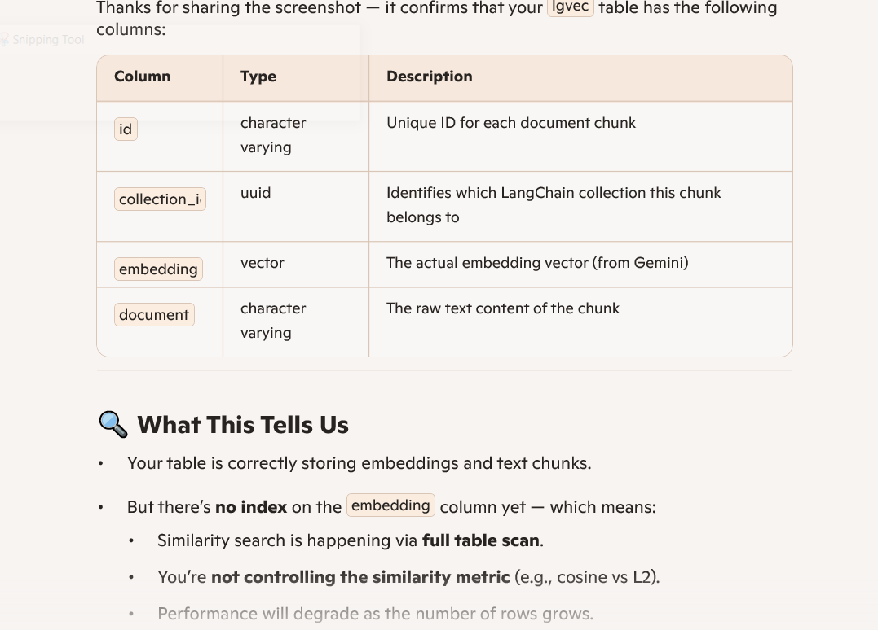
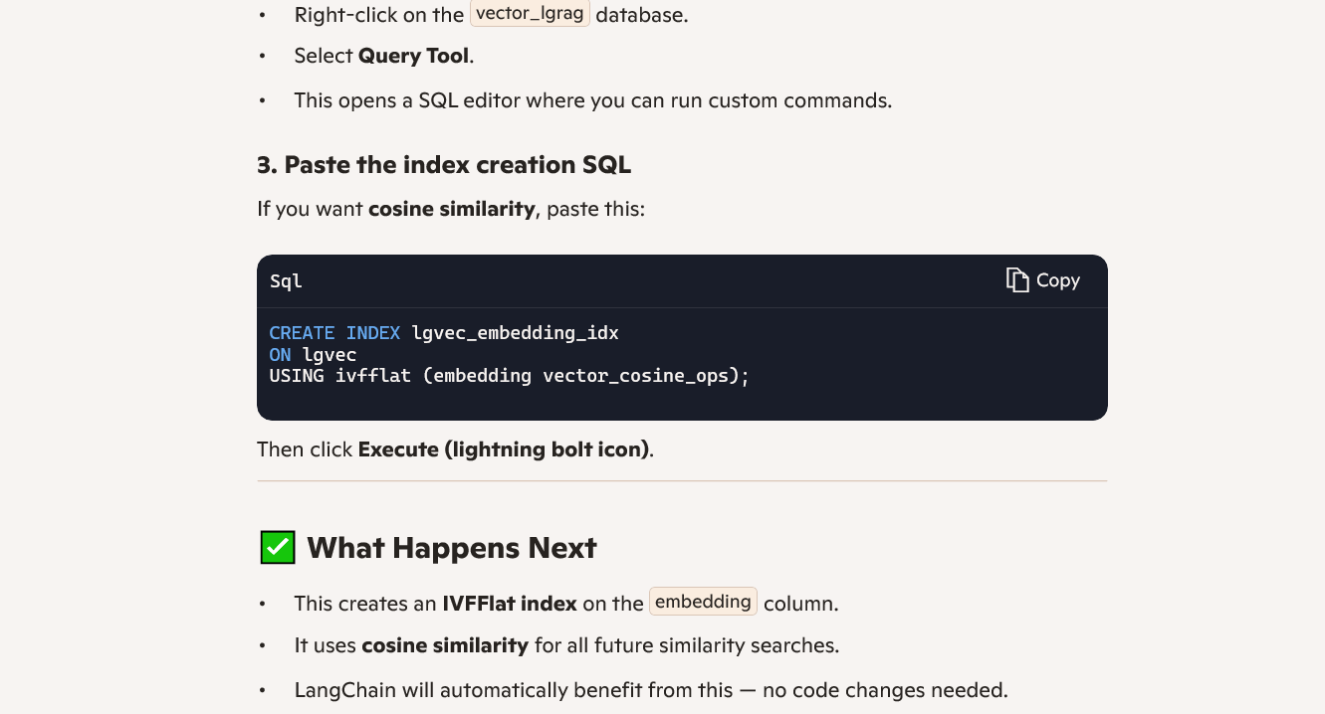

Slide 11
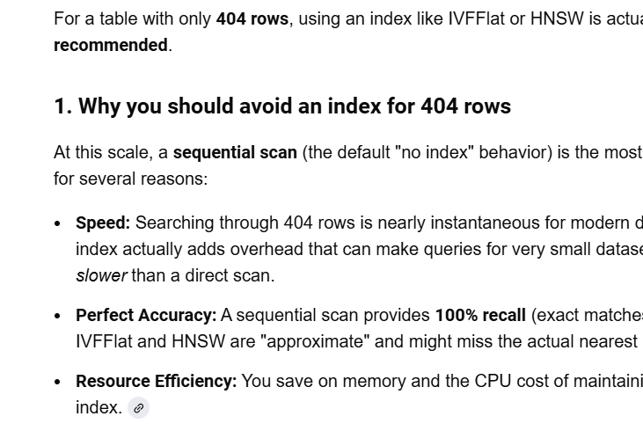
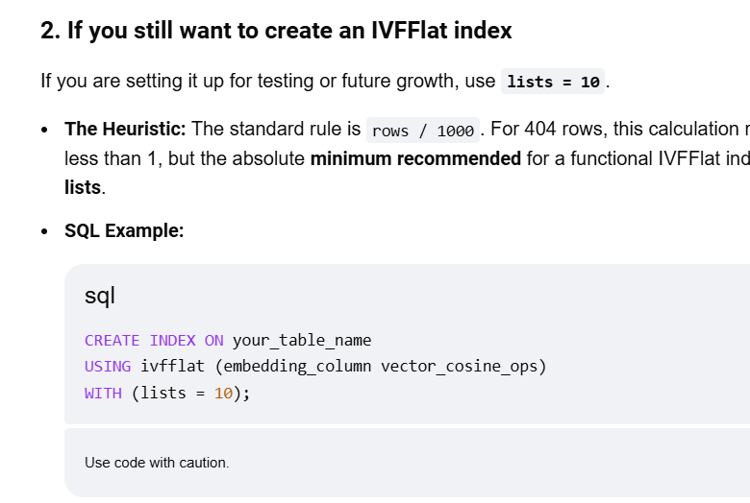

Slide 12
Great question! When you call: Python results = vector_store.similarity_search("How to install french door", k=2) Show more lines LangChain does query the backend PostgreSQL database where your embeddings are stored. Here’s what happens step by step: Convert Query to Embedding Your text query "How to install french door" is converted into an embedding using GoogleGenerativeAIEmbeddings. Send Query to PostgreSQL LangChain’s PGVector uses SQL under the hood to perform a similarity search against the embedding column in your lgvec table. It uses the <=> operator for distance comparison (cosine similarity, because you set vector_cosine_ops when indexing). The query looks like: SQL SELECT * FROM lgvec ORDER BY embedding <=> '[query_vector]' Show more lines Return Results PostgreSQL returns the top k most similar rows based on vector similarity. LangChain wraps them as Document objects with page_content and metadata. ✅ So yes, the similarity search is executed in the database, not in memory. This is why adding the IVFFLAT index improves performance for large datasets.

Slide 13
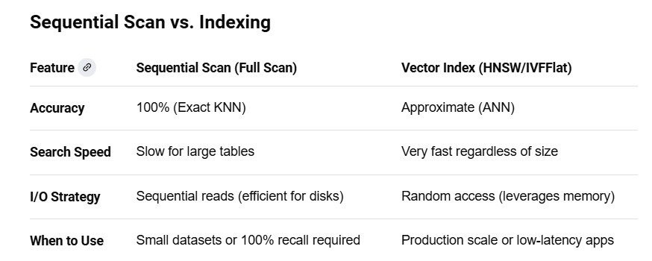
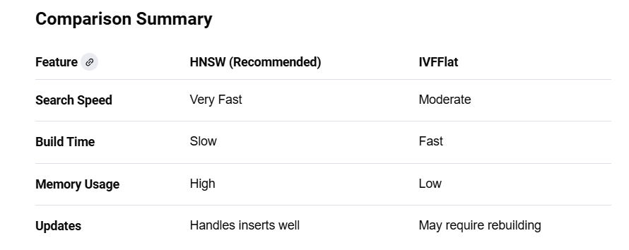

Slide 14
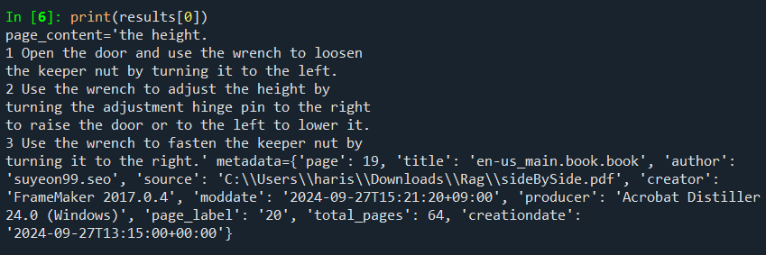
Similarity Search results

Slide 15
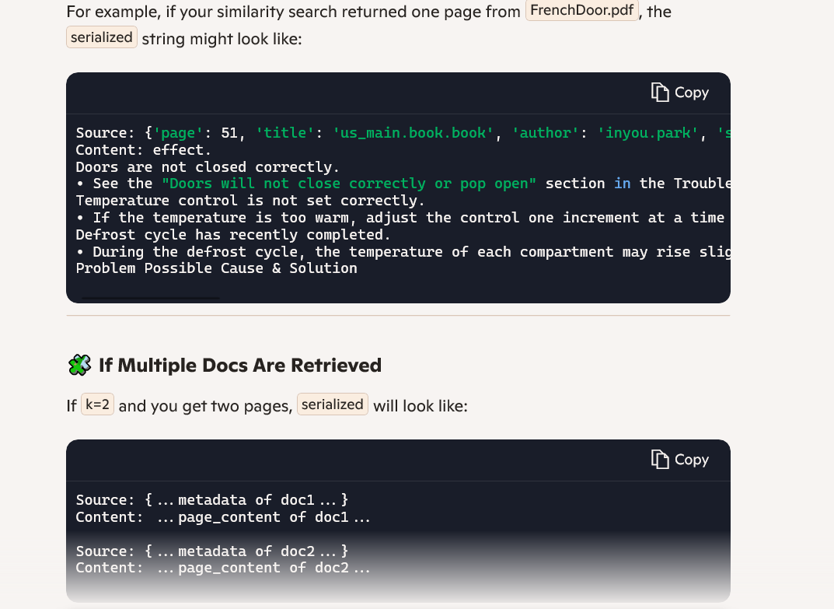

Slide 16
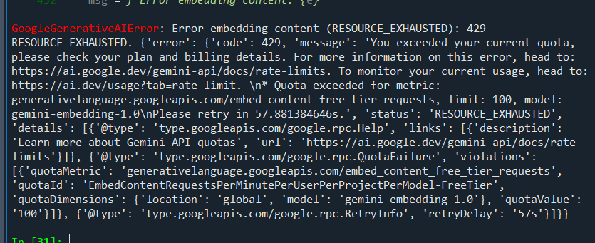
issues

Slide 17
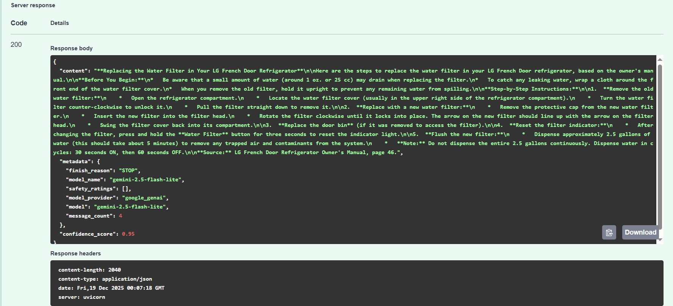
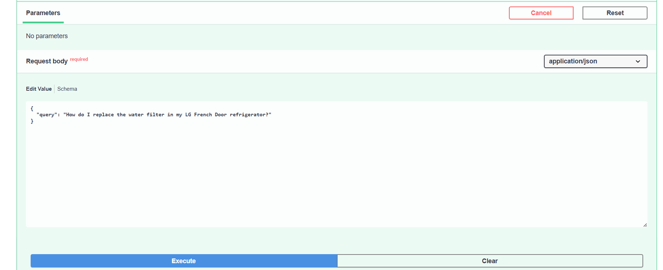

Slide 18
{ "content": "Source: {'page': 51, 'title': 'us_main.book.book', 'author': 'inyou.park', 'source': 'C:\\\\Users\\\\haris\\\\Downloads\\\\Rag\\\\FrenchDoor.pdf', 'creator': 'FrameMaker 2017.0.4', 'moddate': '2021-01-04T10:12:14+09:00', 'producer': 'Acrobat Distiller 20.0 (Windows)', 'page_label': '52', 'total_pages': 68, 'creationdate': '2020-12-28T16:54:51+00:00'}\nContent: effect.\nDoors are not closed correctly.\n• See the \"Doors will not close correctly or pop open\" section in the Troubleshooting.\nTemperature control is not set correctly.\n• If the temperature is too warm, adjust the control one increment at a time and wait for the \ntemperature to stabilize.\nDefrost cycle has recently completed.\n• During the defrost cycle, the temperature of each compartment may rise slightly and \ncondensation may form on the back wall. Wait 30 minutes and confirm the proper \ntemperature has been restored once the defrost cycle has completed.\nProblem Possible Cause & Solution", "metadata": { "retrieved_chunks": [ { "page": 51, "title": "us_main.book.book", "author": "inyou.park", "source": "C:\\Users\\haris\\Downloads\\Rag\\FrenchDoor.pdf", "creator": "FrameMaker 2017.0.4", "moddate": "2021-01-04T10:12:14+09:00", "producer": "Acrobat Distiller 20.0 (Windows)", "page_label": "52", "total_pages": 68, "creationdate": "2020-12-28T16:54:51+00:00" } ] }, "confidence_score": 0.95 }

Slide 19
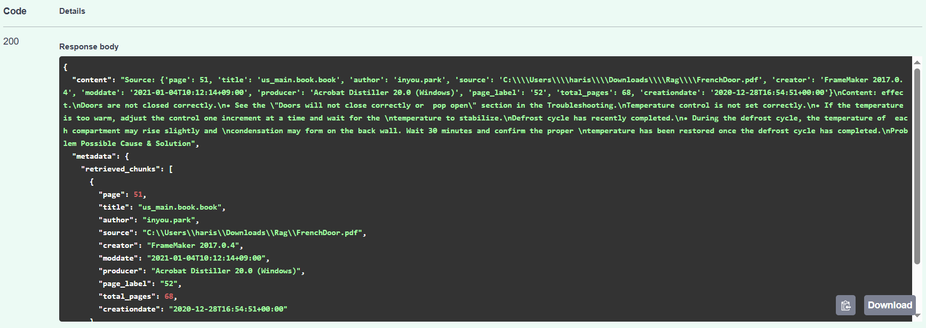

Slide 20
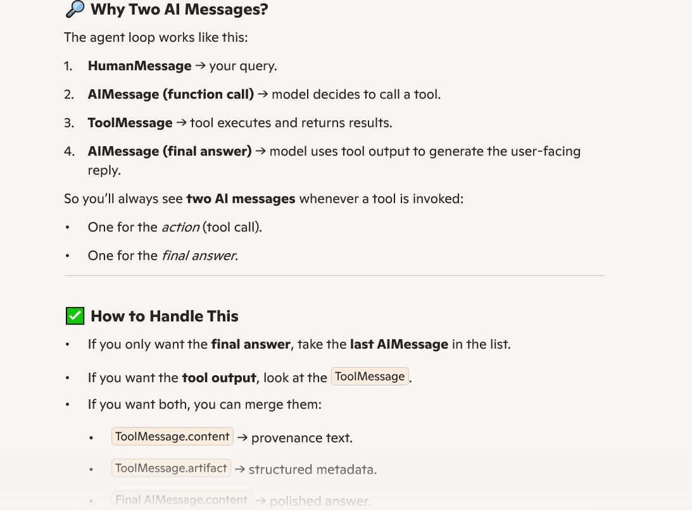
2 Ai Messages

Slide 21
