Slide 1
New York Times Articles Processing and Clustering Using Hadoop and Mahout
Challenge 1 Team Members:
Harish Dara
Maheswara Reddy D

Slide 2
The various steps undergone in Processing and Clustering the data are: 1. Data Acquisition 2. Pre-processing 3. TF-IDF Calculation 4. Clustering 5. Visualization

Slide 3
1. Data Acquisition:
From the New York Times Newswire API we downloaded 39809(aprx 40,000) articles.
We used RESTful web services to download the data. RESTful web service exposes a set of resources that identify the targets of the interaction with its clients.
We handled connection errors, gave appropriate delay time and removed duplicate articles.
The JSON content obtained from the URL is being parsed and the required information(Article’s URL and Abstract) is written to output text file.

Slide 4
2. Pre-Processing
Before calculating the Tf, IDF & TF-IDF we have cleaned the data.
We removed special characters, digits from the abstract content by using regular expressions and converted it into lowercase.
We used the Google Stop Words list to identify the stop words and removed the Stop Words from the abstract content.
We performed Word Stemming by using Snowball Stemmer Java code.
We obtained clean abstract content.

Slide 5
3. TF, IDF & TF-IDF Calculation- Using Hadoop Framework.
We have used 3 Map-Reduce Jobs to calculate the term frequency(TF), Inverse Document Frequency(IDF) and TF-IDF
1St Map-Reduce Job
The output of 1st Reducer is <word@url, word count in article> a Key & Value pair.
Pre-Processed Data
Mapper 1
<word@url,1>
Reducer 1
<word@url, word count in article>

Slide 6
In the second Map Reduce Job we have calculated the Term Frequency
Term Frequency= n/N
n ->No. of times word repeated
N ->Total No. of Words in the abstract.
The output of 2nd Reducer is <word@url, Term frequency> a Key & Value pair.
Reducer 1 Output
Mapper 2
<url, word=count in article>
Reducer 2
<word@url, Term Frequency>

Slide 7
In the third Map Reduce Job we have calculated the Inverse Document Frequency and TF-IDF
IDF= log(N/d)
N-> Total No. of Documents
d-> No. of documents in which the term appears.
TF-IDF = TF * IDF
The output of 3rd Reducer is <word@url, TF-IDF> a Key & Value pair.
Reducer 2 Output
Mapper 3
<word, url=term frequency>
Reducer 3
<word@url, TF-IDF>

Slide 8
4. Clustering
We have performed Clustering using K-Means Algorithm in MAHOUT.
Why K-Means??
We can alter the K value by which we can alter the no. of clusters formed.
We can alter the iteration value so that we can iterate till data is clustered properly.
It consists various functions to find the similarity between vectors such as Euclidean Distance Measure, Cosine Similarity etc.
Implementation of K-Means in Mahout
Taken Output from Hadoop and fed as input for Clustering.
The output from Hadoop needs to be transformed to Sequence files which contains data in(Key, VectorWritable) format.
Initialized the centroid points and wrote them to Sequence files.

Slide 9
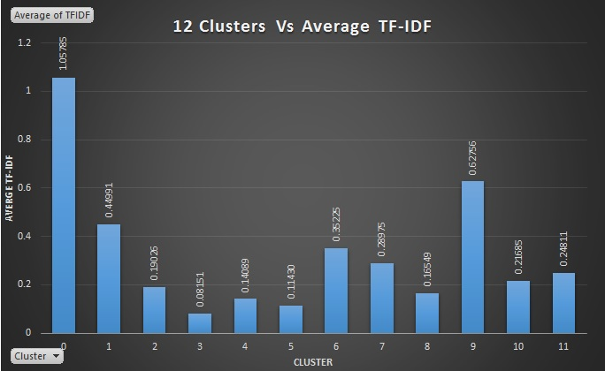
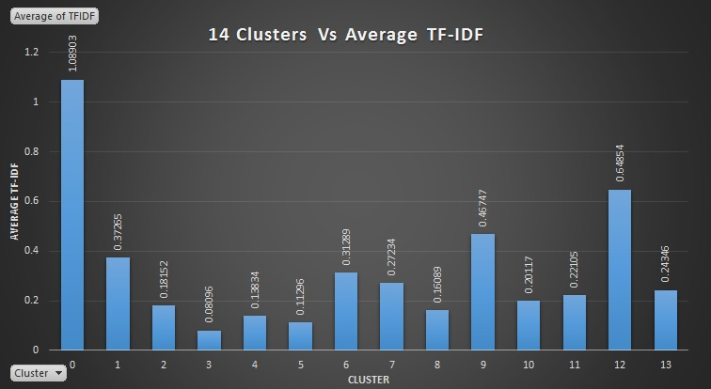
Deciding on the Number of Clusters.
We have performed clustering by passing various values for K (12,14,16,18,20) to decide the best number of clusters.
Performed a graphical analysis by taking the clusters and their corresponding Average TF-IDF for (12,14,16,18,20) clusters formed.

Slide 10
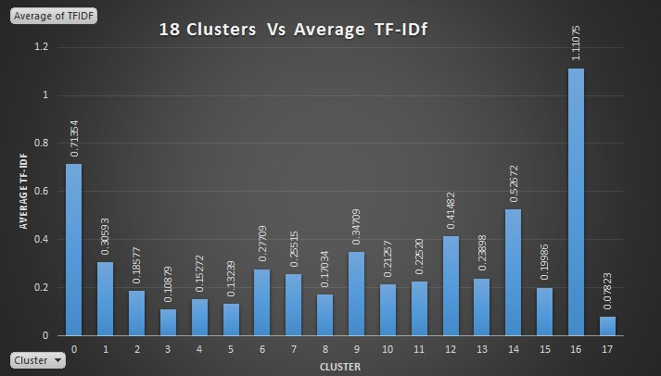

Slide 11
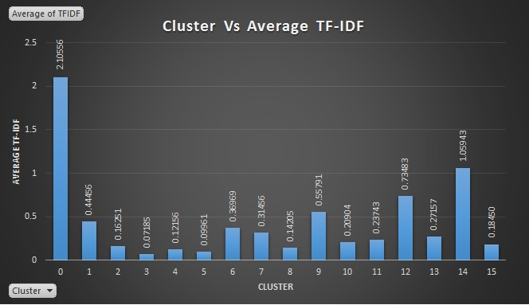
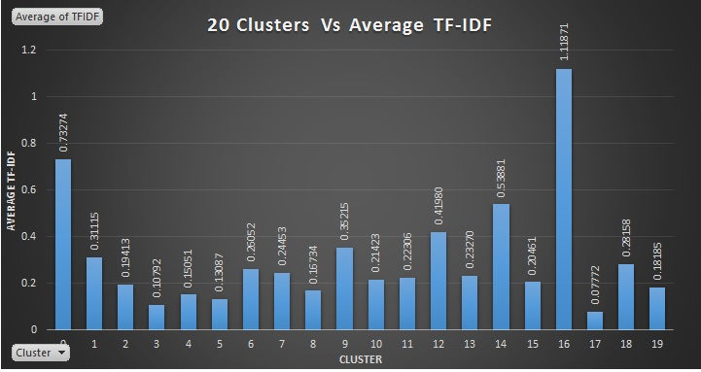

Slide 12
From the above graphs we have observed that in 18 Clusters, the Average TF-IDF per Cluster spans across all the values. So we have taken 18 as the best No. Of. Clusters for the dataset.
For 18 Clusters formed we have drawn various observations.
Number Of Words Per Cluster shown below.
Average TF-IDF Value per Cluster.
Maximum TD-IDF for every Cluster
Minimum TD-IDF for every Cluster.

Slide 13
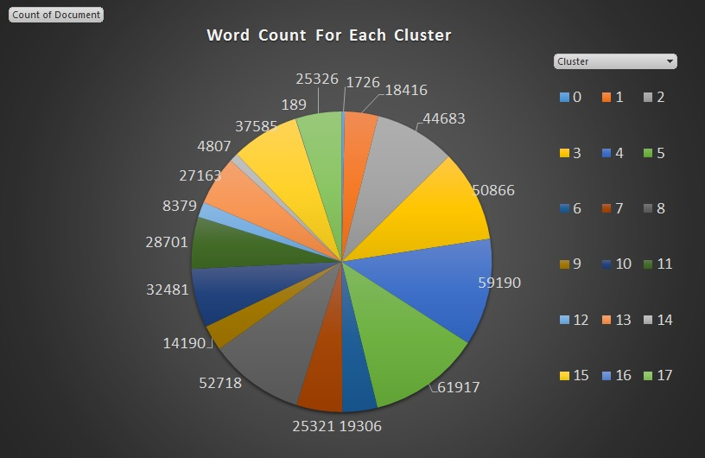
No. Words For every Cluster.

Slide 14
Average TF-IDF per Cluster.

Slide 15
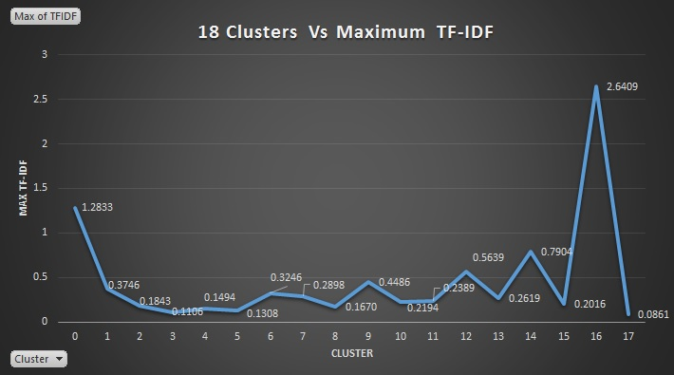
Maximum TF-IDF per Cluster.

Slide 16
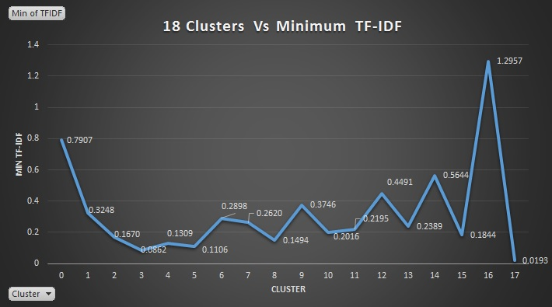
Minimum TF-IDF per Cluster.

Slide 17
Visualization
We have found the 20 most discriminative words in every Cluster and showed them graphically along with TF-IDF value.

Slide 18
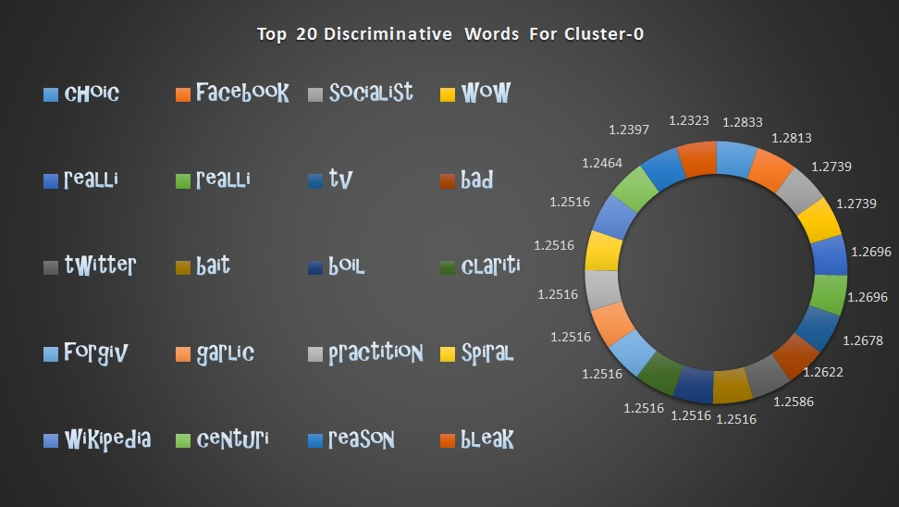

Slide 19
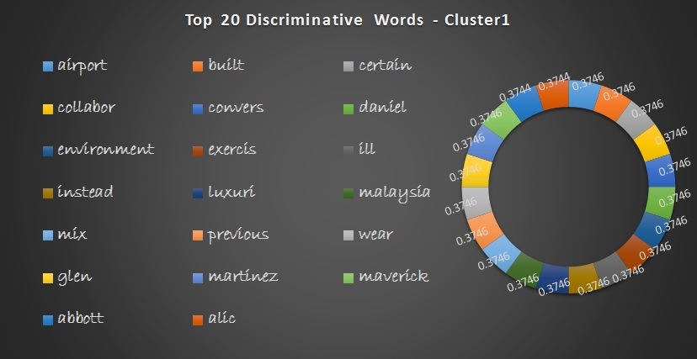

Slide 20
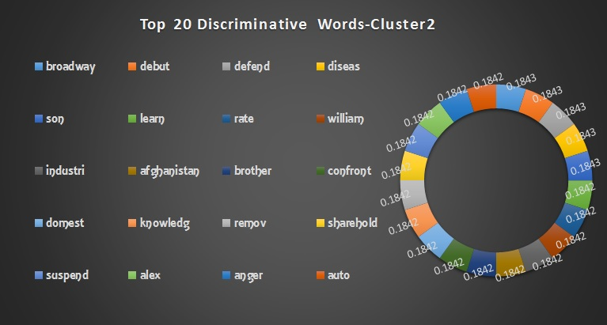

Slide 21
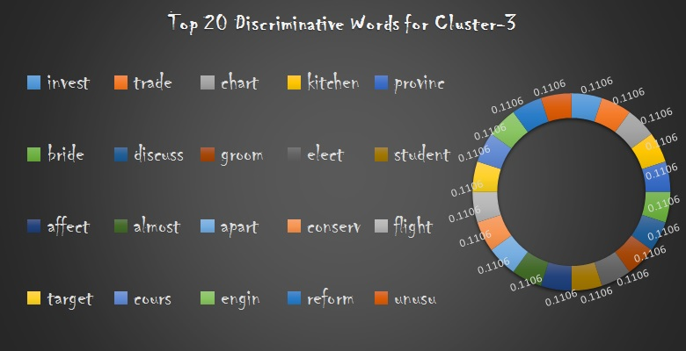

Slide 22
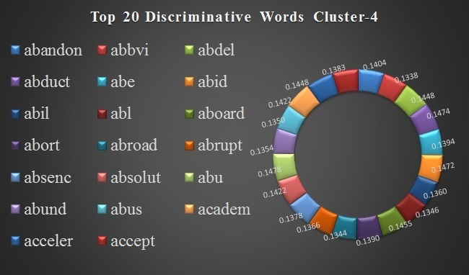

Slide 23
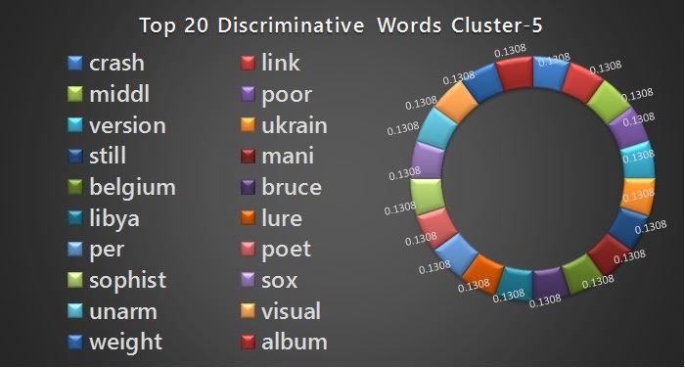

Slide 24
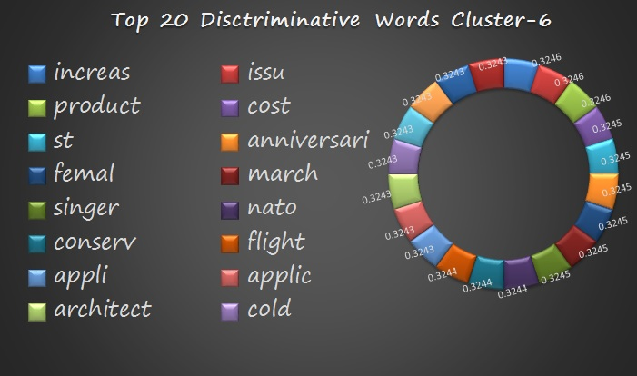

Slide 25
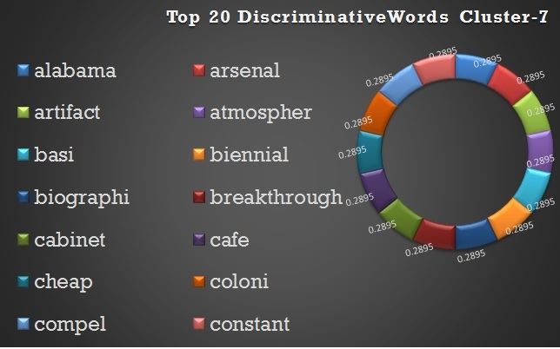

Slide 26
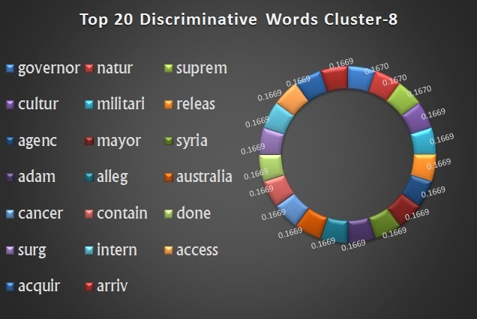

Slide 27
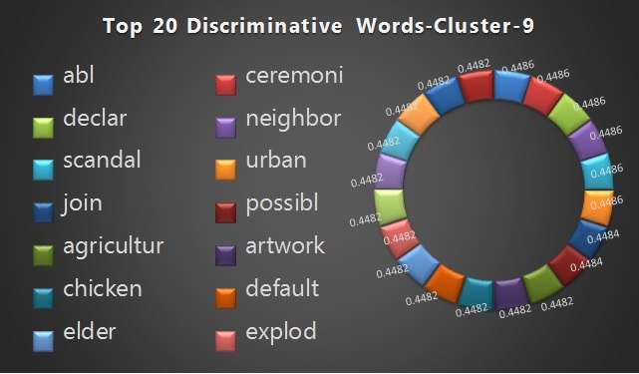

Slide 28
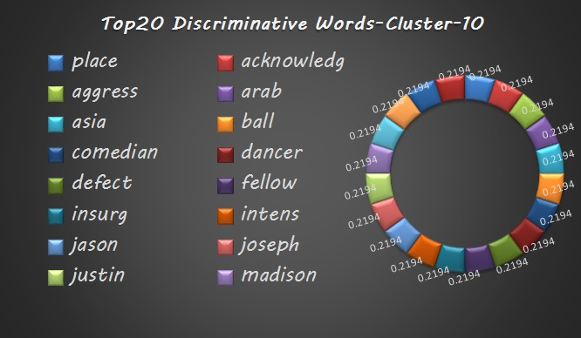

Slide 29
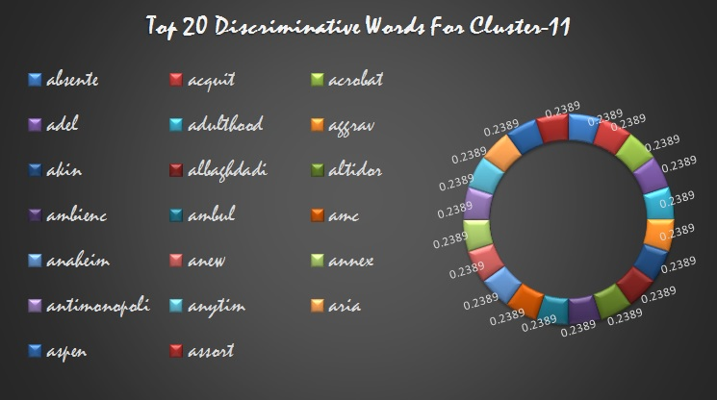

Slide 30
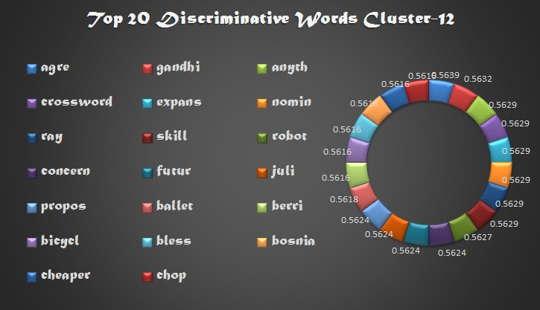

Slide 31
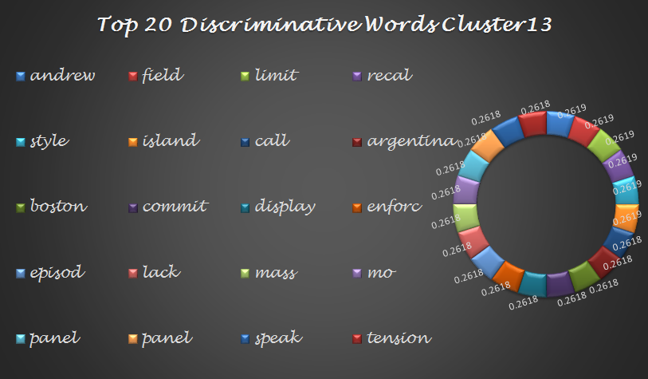

Slide 32
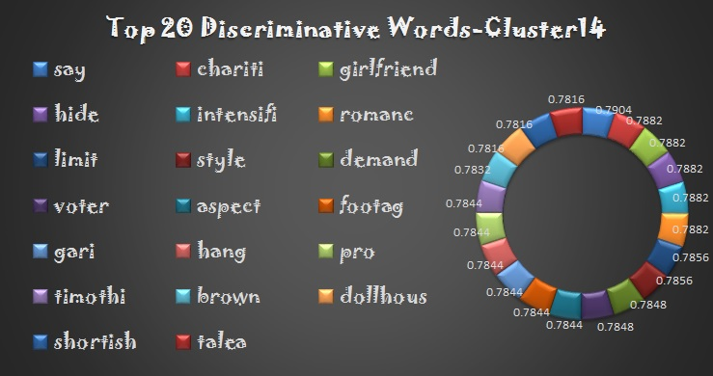

Slide 33
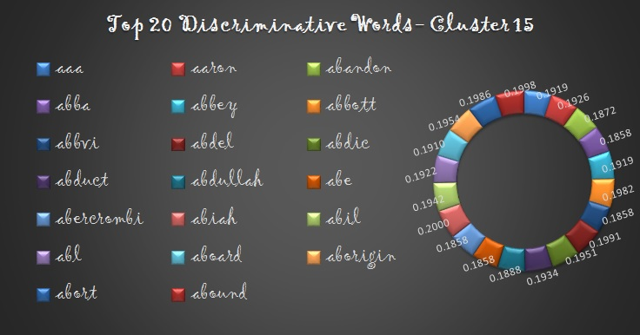

Slide 34
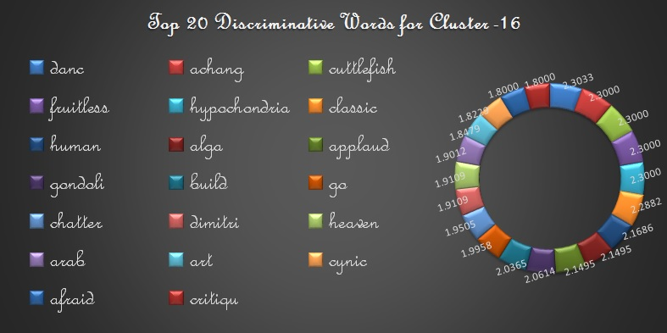

Slide 35
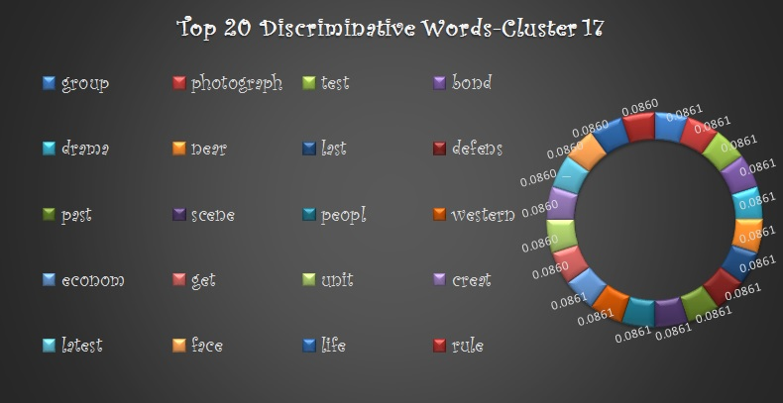

Slide 36
Thank You.

