Slide 1
PROCTOR VISION
AI-POWERED EXAMINATION INTEGRITY AND ATTENTION ANALYTICS
HARISH S · LOGIN360 · 27/10/2026
Notes:
Open with the project title and frame the system as an AI-powered examination integrity and attention analytics workflow. Motion guidance: fade in the title plate, then draw on the camera frame and landmark signal.

Slide 2




END-TO-END PIPELINE
FROM WEBCAM FRAMES TO AN INTEGRITY SIGNAL
CAPTURE
ANALYZE
Live video from the webcam.
Faces, attention, eye state, and nearby objects.
SCORE
DOCUMENT
Sustained anomalies become scored incidents.
Evidence is stored and the session is summarized.
Overall process: observe → interpret → score → document.
Notes:
Walk left to right through the system: observe the webcam stream, interpret the scene, score sustained anomalies, and document the session. Motion guidance: reveal each timeline node in sequence, then draw the connectors.

Slide 3
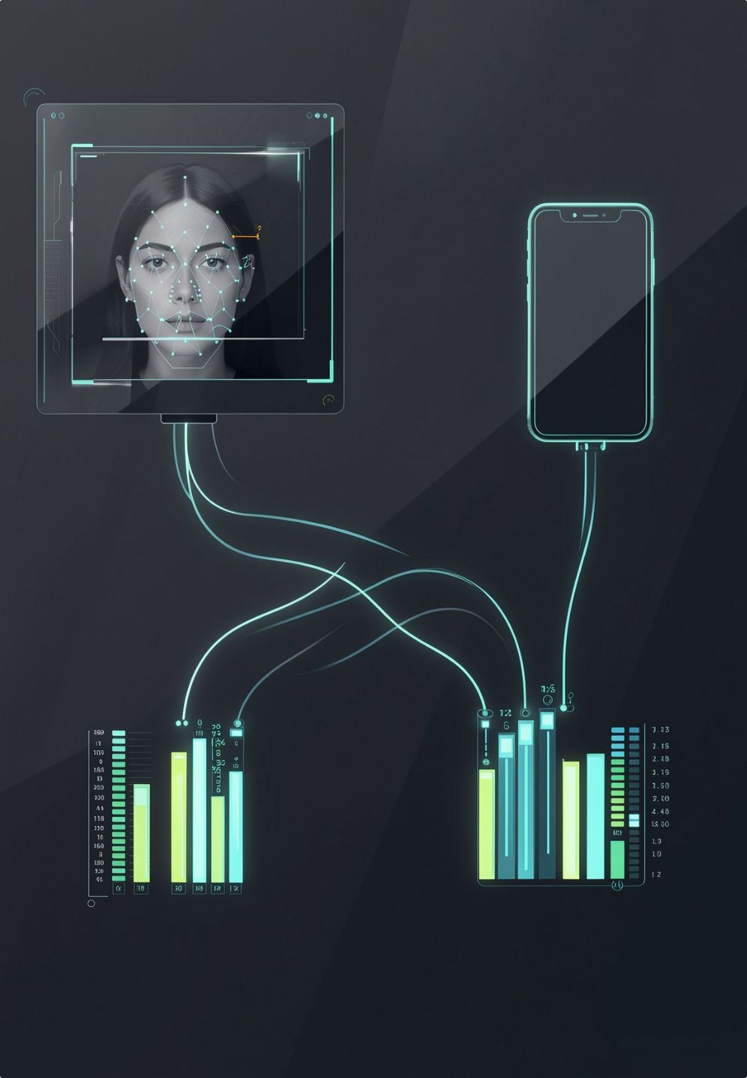



MODEL STACK
TWO AI MODELS READ THE SCENE IN PARALLEL
FACE LANDMARKER
OBJECT DETECTOR
Detects up to five faces and tracks landmarks for face presence, eye closure, and head direction.
Identifies people and mobile phones from the live frame.
SIGNAL FUSION
Combines the detections into a single monitoring state.
Notes:
Emphasize the parallel read of the scene. Face Landmarker supplies facial geometry and state; Object Detector identifies people and mobile phones; signal fusion creates one monitoring state. Motion guidance: appear the two branches together, then draw both into telemetry.

Slide 4



EXPLAINABLE INCIDENT RULES
RULES TURN BEHAVIOR INTO EXPLAINABLE INCIDENTS
HIGH SEVERITY
CRITICAL
Missing face for more than 2.5 seconds
Multiple faces
CRITICAL
MEDIUM SEVERITY
Mobile phone detected
Looking away or prolonged eye closure
RISK WEIGHT
Each event is rate-limited, assigned a risk weight, and added to the running risk score.
Notes:
These rules make behavior reviewable rather than mysterious. Each event has a threshold or condition, a severity, rate limiting, and a risk weight that contributes to the running score. Motion guidance: use restrained emphasis on the amber severity markers.

Slide 5
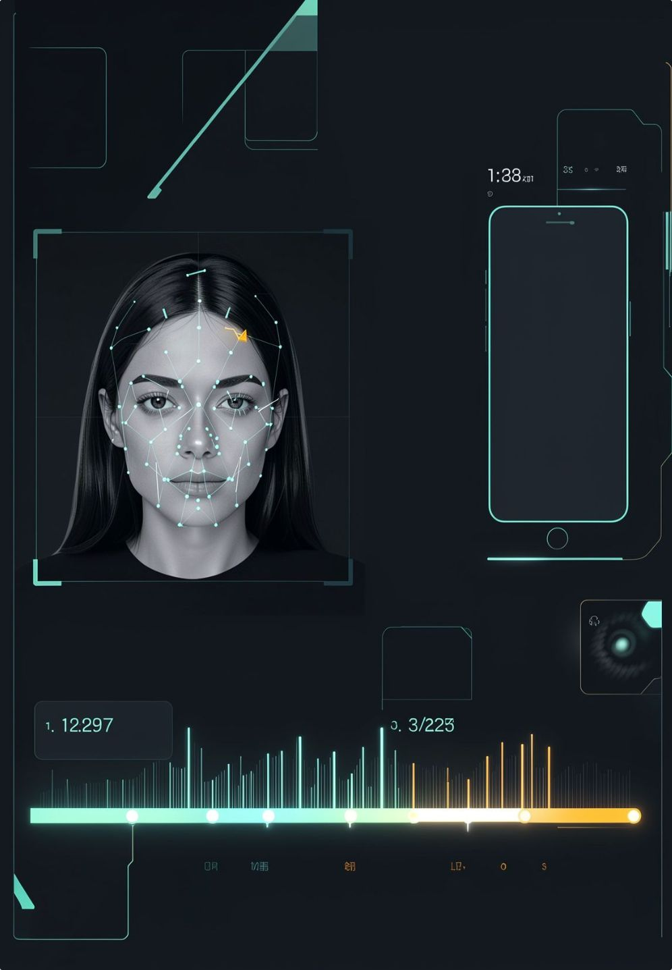
TRACEABLE REVIEW
EVIDENCE IS CAPTURED AT THE MOMENT RISK RISES
01
02
03
04
DETECTION
EVENT LOG
EVIDENCE SNAPSHOT
REVIEWER TIMELINE
Risk rises from a detected event.
Time, event name, severity, risk, details, and snapshot path are recorded.
High- and critical-severity incidents save a frame to the local evidence gallery.
Each decision stays traceable for review.
Notes:
Explain that evidence is created at the moment risk rises, not reconstructed later. The log carries the decision fields, severe events save a local frame, and the timeline connects the event to the evidence. Motion guidance: draw the connector from detection through the snapshot into the reviewer timeline.

Slide 6
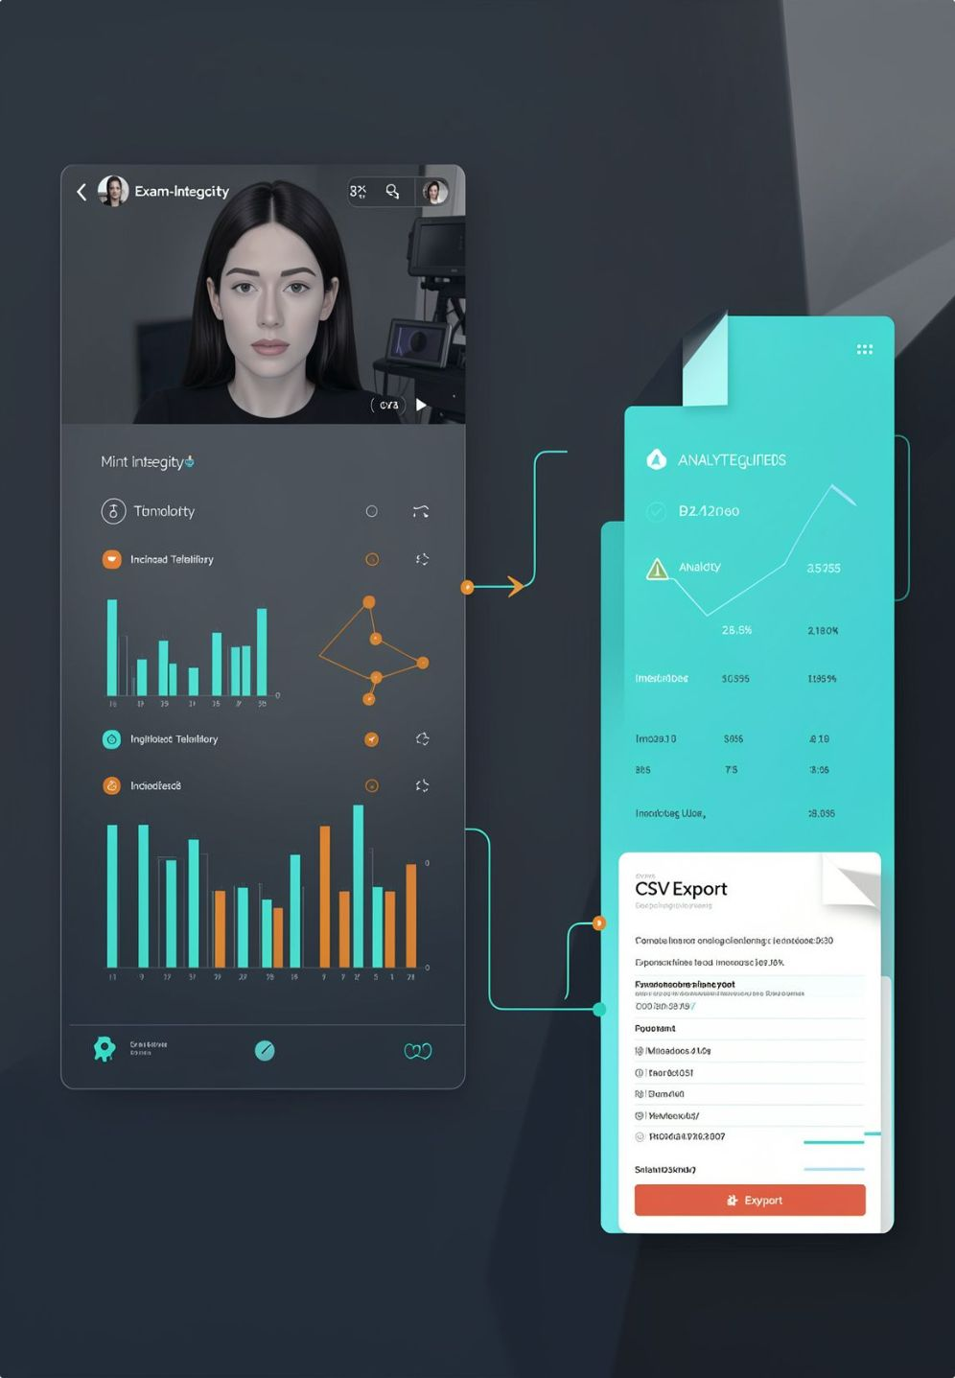



SESSION TO REPORT
ONE SESSION BECOMES A REVIEWABLE EXAM REPORT
LIVE MONITOR
ANALYTICS
EXPORT
Camera feed, integrity score, attention state, eye state, and event count.
Face presence, attention, current integrity, and incident breakdown.
A CSV report preserves the session history for follow-up.
PRODUCT LOOP
Monitor in real time → review evidence → export the record.
Notes:
Close on the product loop. The live monitor supports the session, analytics organize the signals, and CSV export preserves the history for follow-up. Motion guidance: fade in the three destinations, then draw the loop through monitoring, review, and export.

Slide 7
CONCLUSION
REAL-TIME MONITORING TURNS EXAM PROCTORING INTO EXPLAINABLE, EVIDENCE-BACKED REVIEW
1
2
3
4
MONITOR
EXPLAIN
EVIDENCE
REVIEW
Live webcam analysis flags risk as it rises.
Rules turn each behavior into a scored, traceable incident.
Snapshots are captured at the moment risk changes.
Each session becomes a clear, exportable exam report.
Real-time signals, explainable scoring, and reviewable records work together to support fair, accountable integrity decisions.
Notes:
Summarize the end-to-end value: real-time monitoring surfaces risk early, explainable rules make each incident reviewable, evidence is captured at the moment risk rises, and the session report supports follow-up.

Slide 8
PROCTOR VISION
THANK YOU
Questions and discussion
Notes:
Thank the audience and open the floor for questions.

